Slide 1

Cinema delivers return on investment
Evidence for using cinema to help drive response and deliver profit

Slide 2

Driving sales and
ROI with Cinema
It can be easy to think of cinema solely as a brand building channel however, it’s a false dichotomy to label any channel as brand or performance and cinema is no different.
Many brands are already using cinema to great success and delivering brand and sales outcomes.
It is however key to understand how cinema can best unlock this for your brand and the implications for planning.
This deck provides guidance on planning cinema to maximise campaigns for sales and return on investment alongside evidence of the outcomes it can deliver, and the data available to help with measurement.
Notes:
Add title

Slide 3

Cinema paybacks & delivers incremental profit
Data from Ebiquity, GroupM and Lumen highlights how cinema’s high attention environment leads to a significant impact – driving incremental profit and return on investment for brands
For every £1 invested…
Cinema ROI =
£2.56
Long-term incremental profit per 000 impressions
Attentive seconds per 000 impressions
£2.56 stat sourced from Thinkbox, GroupM, Ebiquity – Profit Ability 2 Chart Source: Ebiquity and Lumen – Maximising Profit through Attention 2024
Notes:
Something we’re very confident of is the effectiveness of cinema to be able to deliver cost efficient incremental reach within the AV mix.
Using various tools and models, we’re able to forecast AV campaigns that can deliver significantly greater uplift when compared against AV plans that have excluded cinema.
The chart on the left shows a typical heavyweight AV mix working to a total budget of £2.6m, with the inclusion of only TV, VOD, and OLV.
On the right, you’ll see the addition of cinema into the mix, while keeping the total budget the same, we can deliver an uplift of 6 percentage points vs. 16-34s.
It’s worth noting, if you wanted to achieve these uplifts in linear TV alone, you’d expect to need to increase your budget by millions of pounds, but also worth noting your frequency against heavy TV viewers would exceed diminishing returns.

Slide 4








Cinema has delivered ROI for many brands
Data from Ebiquity, GroupM and Lumen highlights how cinema’s high attention environment leads to a significant impact – driving incremental profit and return on investment for brands
Max Factor
IKEA
Audi
Healthy Skin Harmony saw 3.5% value sales growth & Max Factor was the No.1 selling self-select cosmetics brand in Boots in December
      Cinema is responsible for significant incremental sales and delivered ROI of £18 for every £1 spent
      Cinema was the top performing above-the-line channel during the campaign – with a ROI of £50 for every £1 invested
Just for Men
Ernest Jones
ENO
      Across the ten-day period where only cinema was live sales jumped by 249%
      The stores in locations running cinema saw a 9% YOY increase in attributed sales outperforming other outlets by 3%.
      The cinema campaign helped Madame Butterfly exceed its “lofty sales target” by over 10%
Toni & Guy
eBay
wagamama
      There was a 44.9% uplift in sales during the month that cinema activity was live
      Sales in the test region increased by 2.6% as a result of the cinema activity
      Across the 11 week period that cinema was live UK like-for-like sales increased by 12%

Slide 5
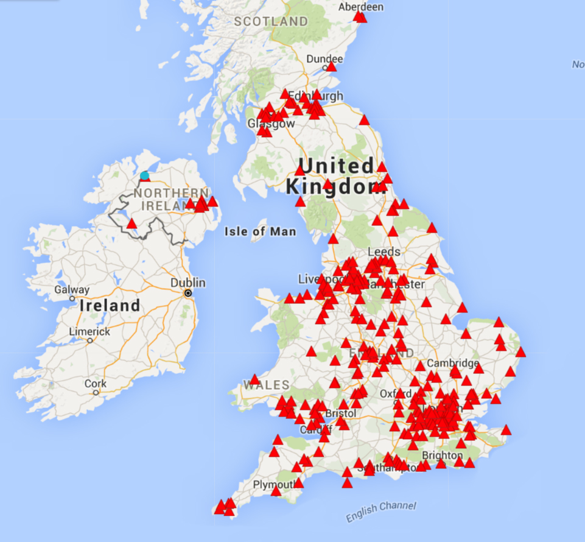
Cinemapper identifies store & DCM cinema matches
DCM can map a brand’s catchment area, stores or local stockists to the nearest cinema sites based on distance in miles, drive time or walk time
Stores/Areas of interest
DCM Cinemas

Slide 6

Creative can be tailored with bespoke end frames
Brands can also add a tailored 5” end frame to its ad running in our feels.
This can promote location of local sites, highlight relevant information, and add a localised touch to national copy brands might be running to drive further audience engagement.
We’ve seen many brands from the automotive, retail and travel sectors take advantage of this addition to their cinema campaigns…
Ernest Jones: Drive footfall to nearest store
Virgin Trains: Locally-relevant routes
Counter Terrorism: Tailored local messaging
BMW: Displaying nearest dealership

Slide 7



Case studies: Cinema driving sales
Plan to proximity
Plan to proximity x Bespoke end frames
wagamama
wagamama
Ernest Jones
IKEA
wagamama used DCM’s Cinemapper tool to locate cinemas in proximity (10-15mins drive) to its restaurants to minimise wastage.
Analysis found that across the 11-week period UK like-for-like turnover increased by 12%, against a backdrop of sector decline.
Ernest Jones highlighted the nearby stores to cinema’s in shopping centres. These selected stores saw a 9% YOY increase in attributed sales outperforming other Ernest Jones’ outlets by 3%.
IKEA ran 20 different executions across the UK highlighting closest locations. The campaign helped drive market share (+1.4pp YOY) and footfall increased +31% YOY
Brands can also add a tailored 5” end frame to its ad running in cinema to help promote local sites and highlight relevant information.
Source DCM Case Study Databank. Full case studies can be found here: https://www.dcm.co.uk/case-studies

Slide 8
Detailed spot by spot report available for all
To ensure your econometric/MMM analysis includes the best quality cinema data, please ask your sales rep to provide a full spot-by-spot spreadsheet breakdown at the end of your campaign.
Date | TV Region | Buying Route | Film | Delivered Admissions | Location | Postcode
23/04/2025 | Yorkshire | Film Pack | Sinners | 38 | Cineworld Sheffield | S9 2EP
23/04/2025 | Meridian | Film Pack | Sinners | 40 | The Light Sittingbourne | ME10 3JY
23/04/2025 | Granada | Film Pack | Sinners | 36 | The Light Brighton | CH45 2HZ
23/04/2025 | Granada | Film Pack | Sinners | 45 | The Light Brighton | CH45 2HZ
23/04/2025 | Anglia | Film Pack | Sinners | 31 | Picturehouse Norwich | NR2 4AD
23/04/2025 | London | Film Pack | Sinners | 56 | Mile End Genesis | E1 4UJ
23/04/2025 | London | Film Pack | Sinners | 35 | Picturehouse West Norwood | SE27 9JU
23/04/2025 | London | Film Pack | Sinners | 63 | BEAM Hertford | SG14 1PS
Notes:
Something we’re very confident of is the effectiveness of cinema to be able to deliver cost efficient incremental reach within the AV mix.
Using various tools and models, we’re able to forecast AV campaigns that can deliver significantly greater uplift when compared against AV plans that have excluded cinema.
The chart on the left shows a typical heavyweight AV mix working to a total budget of £2.6m, with the inclusion of only TV, VOD, and OLV.
On the right, you’ll see the addition of cinema into the mix, while keeping the total budget the same, we can deliver an uplift of 6 percentage points vs. 16-34s.
It’s worth noting, if you wanted to achieve these uplifts in linear TV alone, you’d expect to need to increase your budget by millions of pounds, but also worth noting your frequency against heavy TV viewers would exceed diminishing returns.

