Slide 1
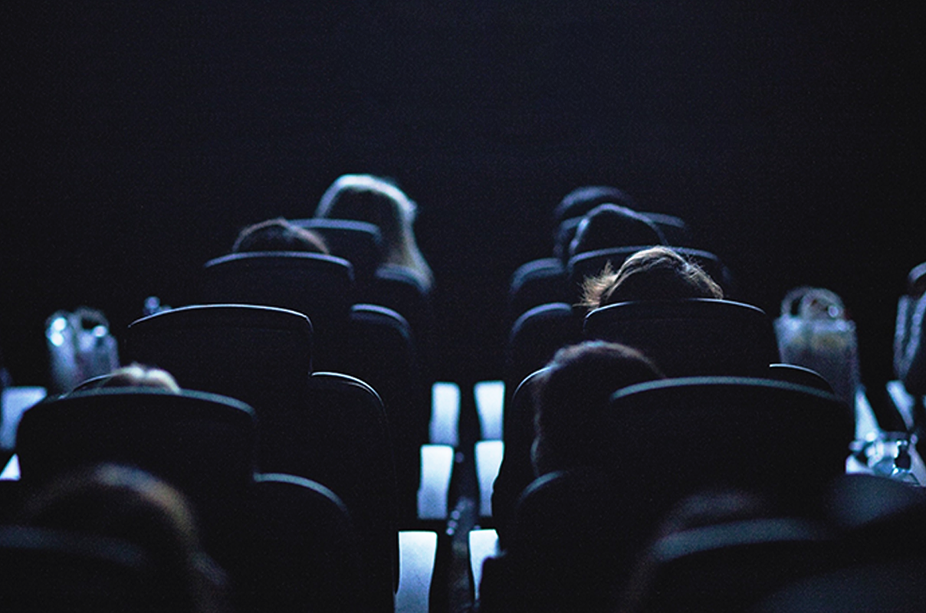
Premium Positions
Why brands should consider premium positions when buying cinema

Slide 2
The cinema play list
Average amount of brand advertising in reel: 11 minutes
1
DCM opening indent
2
Brand ads
3
Bronze spot
4
DCM closing indent
5
Silver spot
6
Film trailers
7
Gold spot
8
Film

Slide 3
The Gold, Silver and Bronze Spots
Take advantage of the most prestigious positions in advertising
1.
2.
3.
4.
5.
6.
7.
8.
DCM opening ident
Brand ads
Bronze spot
DCM closing ident
Silver spot
Film trailers
Gold spot
Film
89%
91%
100%
of cinemagoers seated when Bronze Spot begins
of cinemagoers seated when Silver Spot begins
of cinemagoers seated when Gold Spot begins
+15% rate card
+30% rate card
+60% rate card

Slide 4
The Bronze Spot
Take advantage of the most impactful positions in advertising
3.
Bronze Spot
+15% rate card
1.
DCM
Opening ident
2.
Brand
Ads
4.
DCM
Closing
Ident
5.
Silver
Spot
6.
Film
Trailers
7.
Gold
Spot
8.
FILM
The Bronze Spot is a premium fixed position at the very end of the main ad reel, just before the closing DCM ident – offering the perfect opportunity to achieve standout.
A 60” or longer spot perfect for engaging, powerful content

Slide 5
The Silver Spot
Take advantage of the most impactful positions in advertising
3.
Silver
Spot
+30% rate card
1.
DCM
Opening ident
2.
Brand
Ads
5.
Bronze
Spot
4.
DCM
Closing
Ident
6.
Film
Trailers
7.
Gold
Spot
8.
Film
Positioned after the DCM closing ident and just before the start of the trailers, the Silver Spot offers standout outside the main ad reel when the cinema audience is settled, engaged and ready to see the latest trailers..
A 60” or longer showcase spot perfect for engaging, powerful content

Slide 6
The Gold Spot
The most impactful position in advertising
7.
Gold
Spot
1.
DCM
Opening ident
2.
Brand
Ads
5.
Bronze
Spot
4.
DCM
Closing
Ident
5.
Silver
Spot
6.
Film
Trailers
8.
Film
The Gold Spot is the last commercial message after the trailers and therefore typically sits 8-10 minutes away from any other brand ads.
This 60”+ spot offers real standout in the reel, running when anticipation and attention is at its highest pre-film and is the perfect opportunity to be up close to the main event.
‘The most valuable few seconds in cinema advertising’ – Media Week

Slide 7

Audience attention increases as the reel progresses
Attention levels are high throughout in cinema but there is a correlation with attention increasing the closer it gets to the film
Main block of brand ads
Premium positions
Source: Lumen & DCM – Centre of Attention 2022

Slide 8
Premium positions drive higher brand recall
Placing your ad in the premium position delivers an uplift in brand recall vs. appearing ‘in reel’ - 10% for Bronze Spot, 70% for Silver Spot and 2x for the Gold Spot
Prompted brand recall, based on 4 studies conducted by eworks. Results indexed to ‘in reel’ ad average

Slide 9
The gold spot delivers positive brand impact
Running your ad in the Gold Spot can drive additional cut through and ultimately make the ad work harder in landing message and driving consideration
A travel brand ran the same ad in two films – in one running ‘in reel’ and the other running in the ‘Gold Spot’. Seeing the ad in the Gold Spot delivered even bigger uplifts in ad awareness, brand perception agreement and consideration vs. those delivered by the ‘in reel’ activity:
Gold Spot Uplift vs. In Reel Uplift
+33%
Ad awareness
+18%
Consideration
+260%
Brand Perceptions
ource: DCM & Differentology. Average across a selection of brand perception statements

Slide 10
Impact of the Gold Spot
Running your ad in the Gold Spot can drive additional cut through (+28% on ad recall) and ultimately make the ad work harder in landing message and driving consideration
A travel brand ran the same ad ‘in reel’ and in the Gold Spot of two films.
Seeing the ad in the Gold Spot delivered even bigger uplifts in ad awareness, brand perception agreement and consideration vs. those delivered by the ‘in reel’ activity:
Gold Spot Uplift vs. In Reel Uplift
Implicit agreement to brand statements
+42%
+28%
+77%
% Of statements significantly shifted
+33%
Awareness
+18%
Consideration
+260%
Perceptions
Source: DCM effectiveness studies run by Differentology

Slide 11
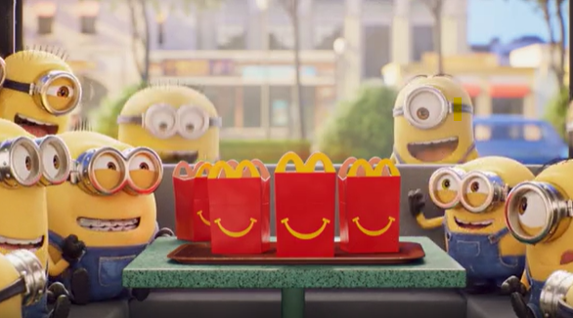

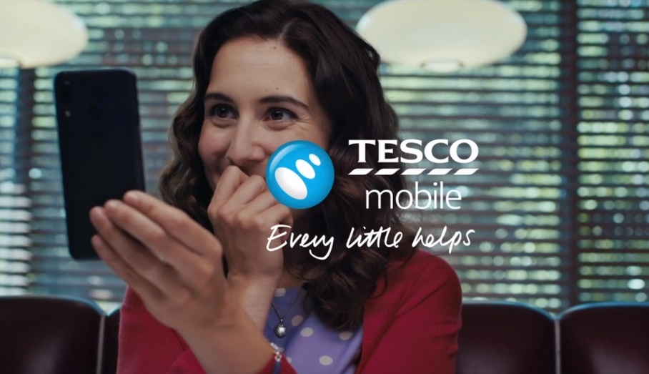
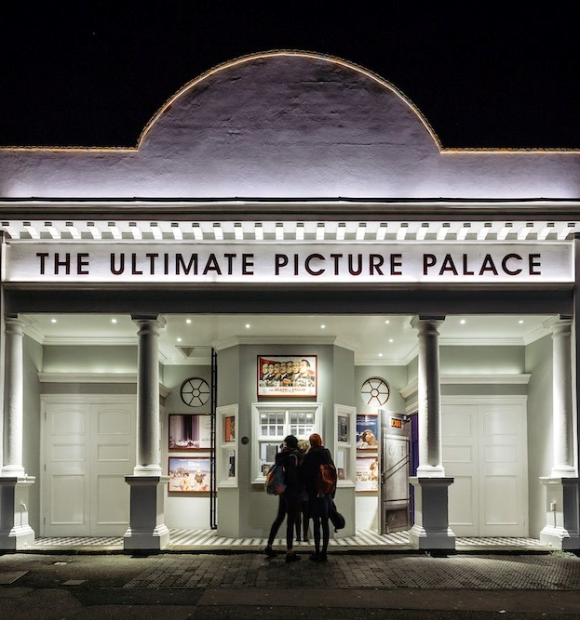
Case studies: Bronze Spot
McDonalds
L'Oréal
Tesco Mobile
Happy Meal
Prada Paradoxe
Every Little Helps
Whilst children’s TV consumption continues to decline, McDonalds wanted to find the best way to reach Parents and Kids aged 4-7 about Happy Meal.
DCM and OMD collaborated to create a long-term Bronze spot partnership that gave McDonald’s access to every family film to reach dual viewing more effectively, helping to reconnect with families to drive nostalgia.
The Bronze Spot laydown worked incredibly well for McDonald’s, delivering significant reach among its key parent + child audience as well as driving key brand metrics involving action intention, whilst 50% of those exposed to the ad reported that they had gone on to visit McDonald’s, and 2 in 3 of those that recalled the Happy Meal Bronze Spot ad went on to purchase a Happy Meal.
L'Oréal wanted to showcase their new feminine fragrance Prada Paradoxe in a big impactful environment to reach as many potential buyers/gifters as possible, ultimately driving awareness and buzz about the fragrance.
Knowing that cinema was a great fit for them, L'Oréal bought the Bronze spot in Don’t Worry Darling to efficiently reach a female audience
The high-impact environment of cinema worked effectively, with exposure to the ad in cinema leading to significant uplifts in awareness (+45%), consideration (+28%) and intention to act, whereby 9 in 10 of those in the market to purchase in the next 3 months said they will take some form of action (e.g., test the Prada fragrance in-store, visit the Prada website).
The aim of the campaign was to land key messages around the range of handsets available through Tesco Mobile and ultimately deliver gains in consideration amongst 25-44s & HP+CH.
Cinema was identified as a great opportunity for Tesco Mobile to engage with parents in an environment that promotes dual viewing (i.e., parents with children), so they bought into the Bronze Spot across a strong slate of family titles.
The cinema campaign was a success in delivering significant uplifts across a range of key metrics including ad awareness (+53%), consideration (+107%) and improved impressions (+18%).
Ultimately, those exposed to the campaign in cinema were 10% more likely to consider Tesco Mobile than those who didn’t see the campaign in cinema.

Slide 12
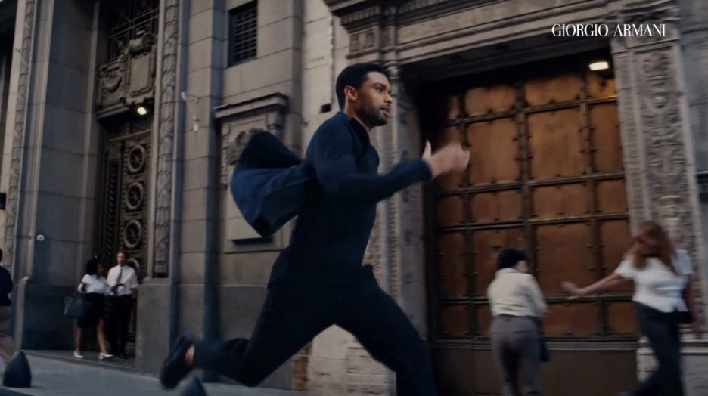
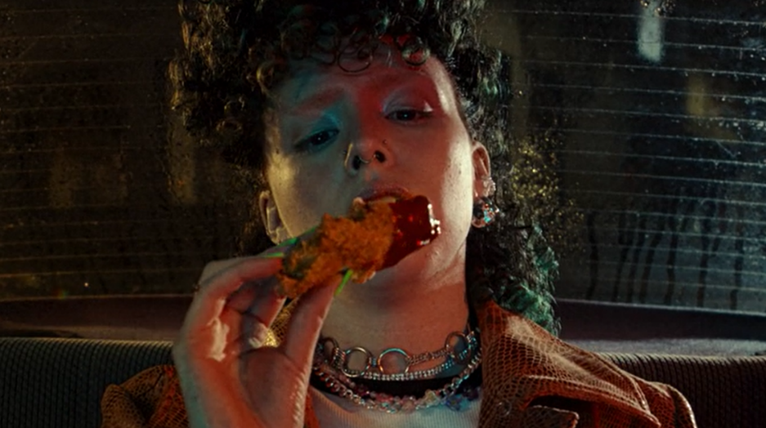
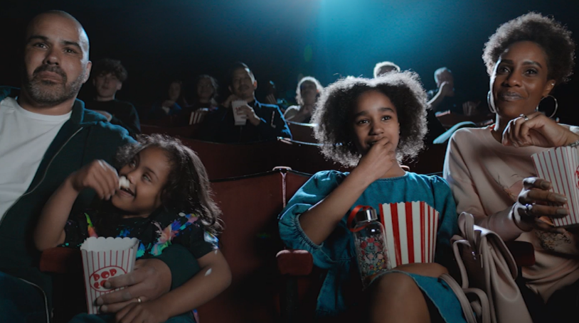
Case studies: Silver Spot
L'Oréal
KFC
BT Broadband
Armani Code
It’s Finger Lickin’ Good
Unbreakable Broadband
In the lead up to the key festive purchasing season, L'Oréal wanted to reach those who were in the market for a male fragrance, whether it be for themselves or as a gift to their family or friends
The new 60” brand asset starring Regé-Jean Page occupied the Silver Spot of The Banshees of Inisherin, knowing it would efficiently deliver against the primary male audience.
Cinema worked effectively as part of the AV mix driving significant uplifts across awareness (+9% uplift), being extremely likely to consider purchasing (+38%) and agreement with the statement ‘I would gift for someone’ (+29%).
KFC wanted to cut through to their target audience of 18-25s and families to drive brand awareness and consideration.
Knowing that cinema is the most effective way to reach their target audience in a highly engaging environment, KFC bought into several film packs in-reel in addition to 3 Silver Spots in Asteroid City, No Hard Feelings & Insidious: The Red Door.
Ultimately, the silver spot laydown helped to increase KFC’s key metrics, including significant uplifts in spontaneous awareness amongst young adults (+60%) and being extremely likely to consider amongst young adults (+159%).
Overall, 91% of respondents had taken some form of action after watching the cinema activity including ordering KFC delivery, mentioned to family and friends and visited the website.
BT aimed to attract new customers with a campaign that communicated unbreakable connection following UK lockdown where Wi-Fi speed went from a ‘nice to have’ to a ‘daily essential’.
DCM Studios & BT collaborated to create two bespoke 60” ads with footage licenced from Paddington 2 and Tomb Raider, securing the Silver Spot in several key titles to showcase the need for unbreakable broadband in a unique and attention-grabbing way,
Exposure to the cinema ad delivered on the campaigns key brand metrics including brand recall, memorability and improved impressions.

Slide 13
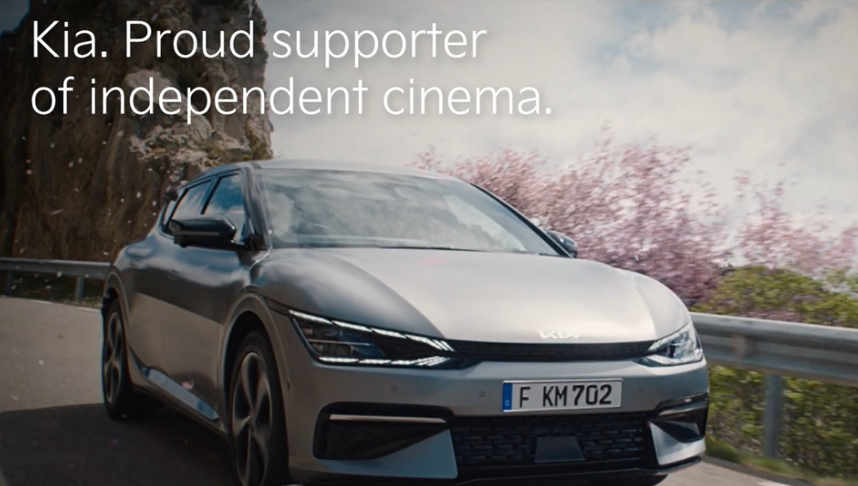
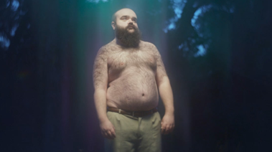
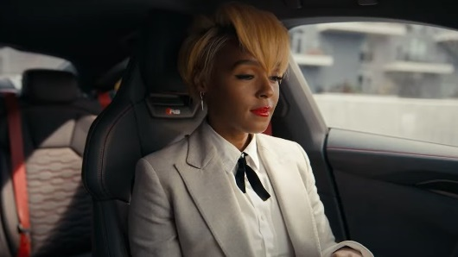
Case studies: Gold Spot
Kia
Trainline
Audi
Movement That Inspires
Great Journey’s Start with Trainline
Q4 e-tron and e-tron GT
Kia looked to showcase the brand’s innovative credentials in a premium environment as part of a new brand identity launch, promoting both the EV6 and Niro EV to help cement itself as a leader in the electrified market.
Running from April 2022 – May 2023, Kia took on an annual residency as the Gold Spot across all independent cinemas on the DCM estate, launching several creatives as part of its ‘Movement that Inspires’ campaign.
Comparing results from those who were exposed to the advert in the cinema in Wave 1 (2022) to Wave 2 (2023), consideration of Kia had increased by 8%, positive impression jumped by 9% and spontaneous awareness of Kia as an ‘electric car brand’ has increased by 14%.
Trainline wanted to stand out by showcasing their 60” creative in the highly attentive environment of cinema, to drive cut through of their ‘Great Journey’s Start with Trainline’ proposition and land the message that customers can save 35%.
Trainline secured the Gold Spot across key titles to ensure the ad was delivered in highly efficient films for their target of young adults.
Exposure to the ad in the cinema helped boost Trainlines key objectives, where almost 50% of cinemagoers associated the key ‘Save 35%’ message with Trainline and 74% associated the new ‘Great journeys start with..’ message with the brand.
Overall, consideration of Trainline was higher for cinemagoers and over 8 in 10 cinemagoers said that they intended to take some form of action.
As the automotive industry begins to prepare for the 2030 ban on the sale of new petrol/diesel cars in the UK, Audi wanted to be on the front foot and establish its credentials as a market leader in the electric vehicles, using this campaign to promote awareness and consideration for both the Q4 e-tron and e-tron GT models.
With the cinema burst starting just days before Christmas, Audi wanted to maximise relevance and so decided to run three pieces of copy across its two Gold Spot selections in The King’s Man and The Matrix: Resurrections.
Using cinema to engage an affluent audience worked successfully for Audi, with cinema delivering significant increases in model awareness (+14%) and consideration (+32%) of its electric vehicles, in addition to an 100% uplift from control to test in agreement with the statement that ‘Audi is a leader in electric vehicles’.

Slide 14
Why you should consider premium positions
Premium positions can further maximise impact delivered by cinema advertising – driving stand out, attention and its impact on brand metrics
Stand out
Attention
Impact

