Slide 1
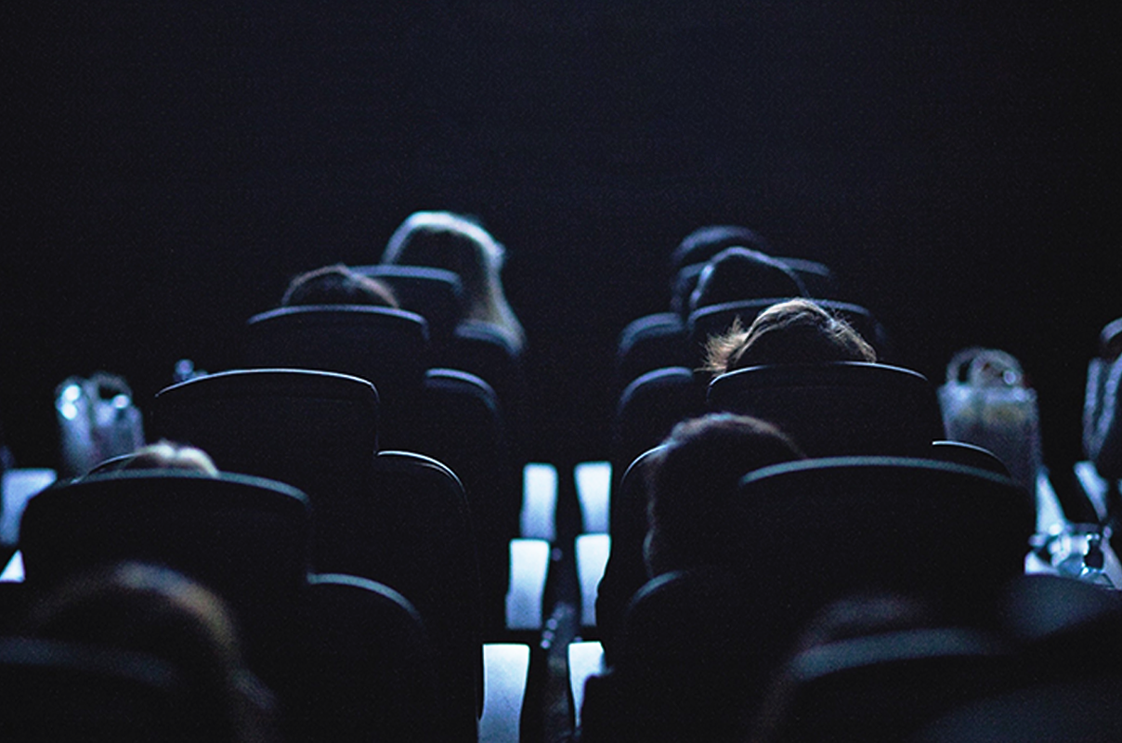
Copy Length
Short or long copy length – what works best in cinema?
Notes:
The role cinema can play within the AV mix to maximise outcomes

Slide 2
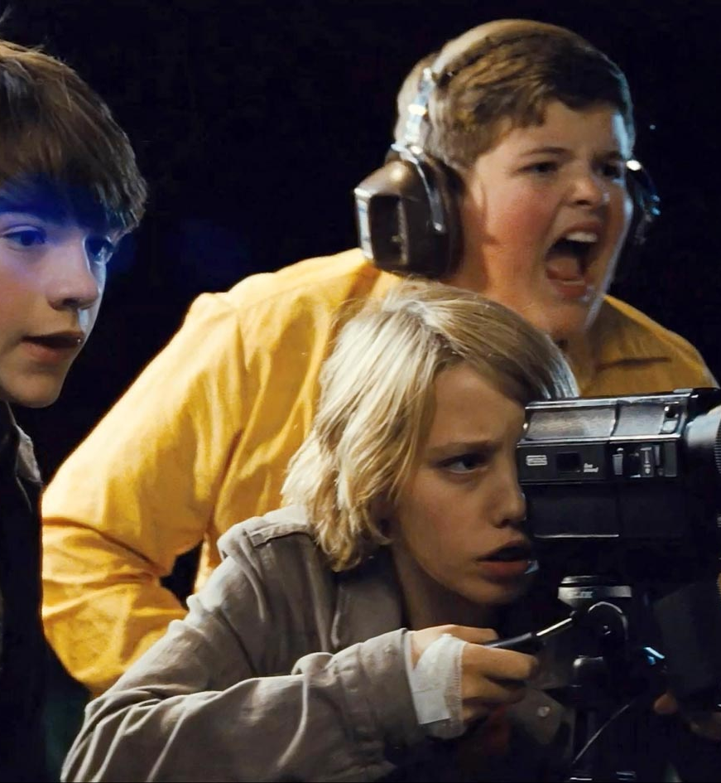
Shorter or longer copy in cinema?
The question of the optimal copy length for any given environment is an important one but a difficult one to answer definitively as there are so many variables beyond the time length of an ad that impact its potential performance.
Research demonstrates that our brains respond and understand best when processing stories and the more comprehensive a story the fewer gaps our own minds have to ‘fill in ‘ themselves. For brands trying to lodge your message and your name in someone’s mind, context and narrative are both key.
Research from Thinkbox demonstrates longer copy (compared to shorter copy often used across online video) can be more effective. With cinema, the benefit is that the baseline for attention is much higher than online channels and so you can run longer copies successfully but it’s not a necessity to cutting through.

Slide 3

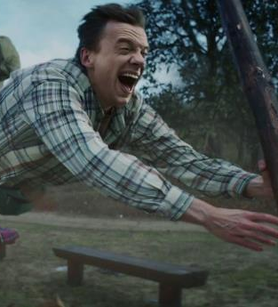
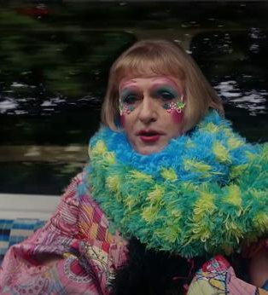
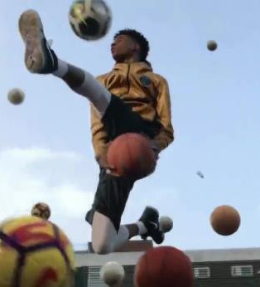
Thinkbox & Work Research found longer ads do have benefits over short ads
In their ‘Matter of Time’ study, longer ads were found to have benefits to recall of brand imagery and agreement with key brand perceptions
Longer ads have benefits over shorter executions
Longer ads act as memory ‘anchors’
Longer ads enhance image memory
Brand awareness decays faster than brand perception
Source: Thinkbox

Slide 4
Longer ads can better shift key brand perceptions
In their ‘Matter of Time’ study, longer ads were found to drive substantial uplifts in implicit and explicit agreement with brand perceptions
Explicit agreement to brand statements
Implicit agreement to brand statements
+42%
+77%
% Of statements significantly shifted
Source: A Matter of Time, 2019, Work/Walnut/Thinkbox. Based on 3 brands (3 x short ad; 3 x long ad)
Notes:
Work research looked at the explicit brand perceptions first – looking to see how many of the statements (about 50 answered) see a significant improvement after people saw either a short ad or a long ad initially.
Nearly 91% of those brand statements significantly increased after people saw the long ad, compared to 64% for the short ad. Highlighting that unsurprisingly the long 60” timelength is better at delivering a greater volume of information than the short 5-10”.

Slide 5



Starting longer & following up with shorter drives brand perceptions
Being exposed to a longer ad first and then a shorter ad later drives bigger uplifts in explicit brand perceptions than just being exposed to short ads
=
+28%
Improvement in explicit brand perception
=
+9%*
Improvement in explicit perception
3-5 days
3-5 days
=
+51%
Improvement in explicit perception
Source: A Matter of Time, 2019, Work/Walnut/Thinkbox. Based on 3 brands (3 x short ad; 3 x long ad). * Based on one test cell for one 10 second ad
Notes:
When a short ad is seen after a long ad, there’s a 51% uplift in explicit memory effects versus just 9% for seeing a short ad in isolation. This is including a gap of several days between viewing the ads and testing.
Much bigger effect when you have that longer ad as the ‘memory anchor’ that’s primed you for everything else you see after that points. Your mind is aware of the original, so it’s easy to recognise and fill in the gaps when they see the shorter ads, and this makes the latter work harder.

Slide 6
How does the cinema environment impact this?
Regardless of your ad length, the big screen is going to naturally amplify your ad – larger screens produce better focus, stronger emotional and improve recall
Larger Screens produce stronger emotional responses
Larger Screens Improve Recall
Significantly more focus that watch the same on smaller screens
Source: Lombard et al., 1997; Reeves et al., 1999; Heo, 2003; Maniar et al., 2008; Devlin et al., 2020

Slide 7

Maximise attention with cinema
80% of your ad will be watched by cinemagoers – regardless if it’s 30” or 60”
Lumen norms
Source: Lumen Attention Research Channel Benchmarks
Notes:
As you can see Cinema is really the stand out media when it comes to driving engagement – on average 24 seconds of a 30” ad are watched, and 48 seconds of a 60”. The level of attention provided by exposure to the ad in cinema far surpasses what is achievable in other formats and really allows for deep engagement with the brand and the message.
By comparison TV on average delivers a solid 15.5 seconds attention to a 30” ad, and there’s a decreasing tail of attention available across other formats e.g. 4 seconds of a 15-20” bumper on YouTube and 1-1..5 seconds attention paid to Facebook and Instagram Infeed advertising.

Slide 8
Longer views = higher brand recall
Cinema already has an impressive baseline thanks to most impressions generating high levels of attention
% prompted brand recall
86% of cinema ad impressions reach >15s
vs. 24% for a 30s TV ad
Significantly lower vs viewed
Source: Lumen Attention Research Project April 2022 Question Base: Not Viewed = 82, 0 to 15s = 66, 15 to 30s = 428, 30 to 50s = 152, 50s+ = 266. Q. Prompted Recall: “Which of the following brands, if any, do you remember advertising on screen before the film? Select all that apply.”

Slide 9
Most brands brands run TV copy (30”) on the big screen too
Copy length
70% of all copy that ran in DCM cinemas was 30” or shorter
Source: DCM Production
Notes:
As you can see Cinema is really the stand out media when it comes to driving engagement – on average 24 seconds of a 30” ad are watched, and 48 seconds of a 60”. The level of attention provided by exposure to the ad in cinema far surpasses what is achievable in other formats and really allows for deep engagement with the brand and the message.
By comparison TV on average delivers a solid 15.5 seconds attention to a 30” ad, and there’s a decreasing tail of attention available across other formats e.g. 4 seconds of a 15-20” bumper on YouTube and 1-1..5 seconds attention paid to Facebook and Instagram Infeed advertising.

Slide 10

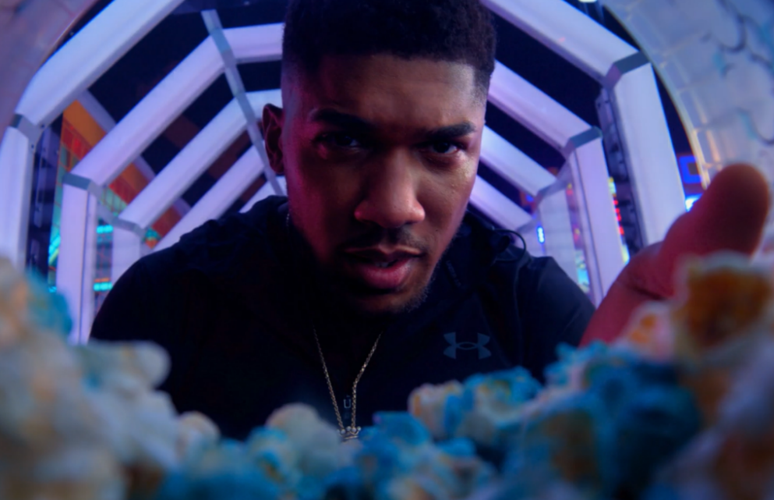
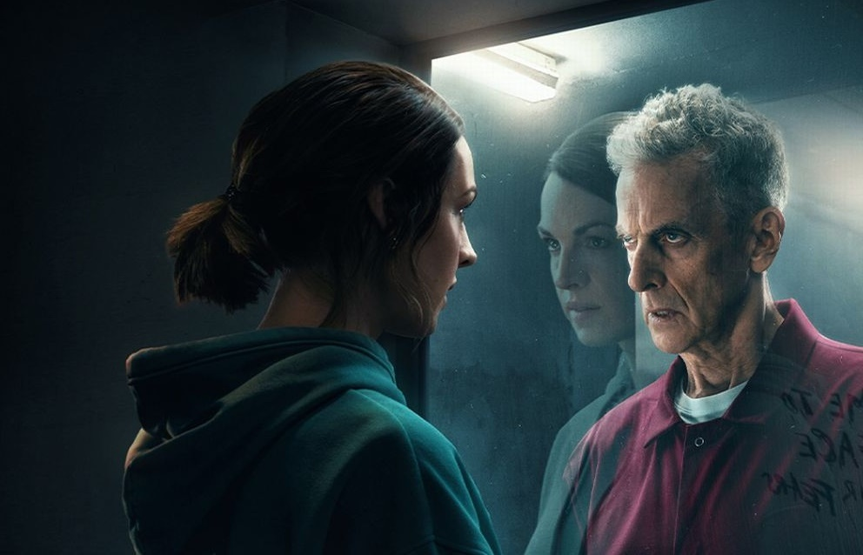
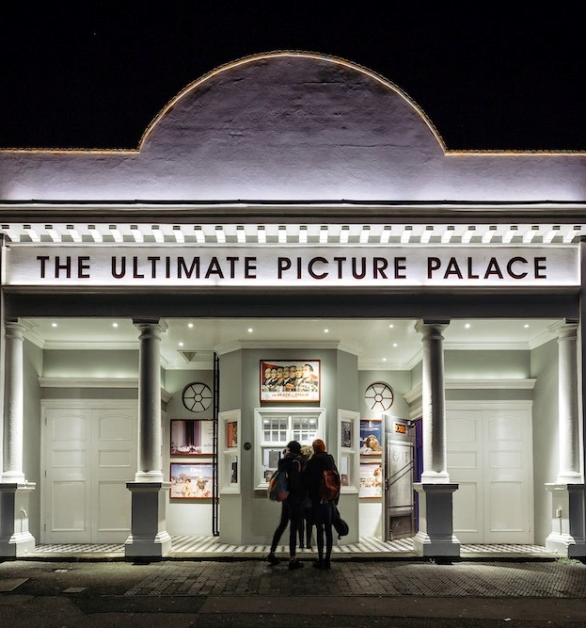
Success with short, long and multiple copies
Using short copy in cinema
Using longer copy in cinema
Using multiple copies in reel
Ferrero Rocher – Celebrate The Moment
JD Sports – Christmas
Prime Video – The Devil’s Hour
Ferrero Rocher wanted to showcase its 20” ad in a high quality environment to reflect its own premium brand positioning and drive incremental reach as part of a wider AV mix.
Exposure to the ad in cinema delivered significant uplifts including awareness (+114%), ad recall (+60% uplift vs. DCM benchmark), key brand perceptions (+12% average uplift) and consideration - not only for seasonal occasions but for all year round treats and celebrations too.
JD Sports wanted to really cut through and make an impact at a key time of year for the business.
JD Sports decided to run its full hero 120” ad in cinema during the opening week of the film. After the opening week, all cinemas would revert to showing the 30” ad to keep cover building in the run up to Christmas alongside the wider AV mix.
The 120” ad was found to drive gains (from an already very high baseline) key brand perceptions, consideration and intention to act among the target 16-24 audience
Prime Video worked with DCM Studios to create a high impact, disruptive launch campaign for its new psychological thriller series The Devil’s Hour.
Disrupting the cinema reel by running 3 bespoke 10” blipverts, the main 30” ad, and a ‘takeover’ of the DCM closing ident delivered prominence for the show in an already high attention environment.
This high frequency approach to cinema worked very well for the show, driving awareness by +56%, recall of the in-reel advertising was +25% vs. DCM benchmark and consideration to watch the show increased by +5%.
Source: DCM Case studies

Slide 11


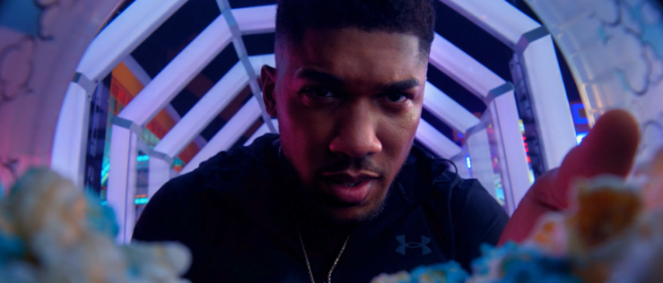
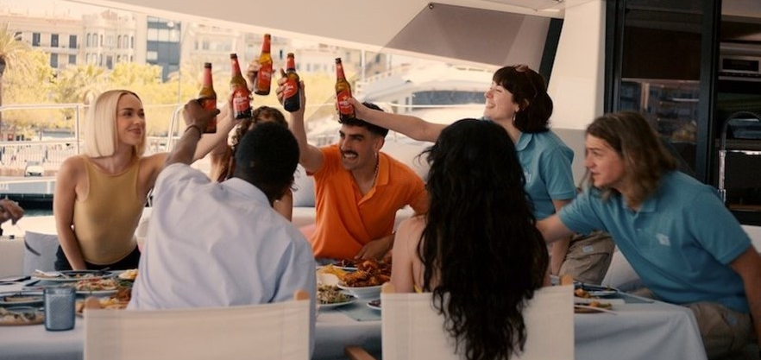

Virgin Media 90”
Boots 180”
JD Sports 120”
Estrella Dam 6.5 minutes
Samsung 120”

Slide 12
Summary
Things to consider
1
2
3
People remember stories – so use whichever copy length that enables you to tell that story in the most effective and engaging way possible.
Cinema’s naturally higher attention environment is a benefit for brands – whether it’s 30” or 60” (and longer) using cinema as part of the AV mix maximises the chances of your ad being watched. If you have made a longer piece of copy, it should be running in cinema while the shorter edits can be used elsewhere.
If budget is a concern, consider starting your cinema campaign with the longer ad running to drive initial impact and then switch to the shorter ad for later weeks to make your admissions go further and scale up reach.

