Slide 1

Cinema: an accountable medium
Why brands can trust cinema

Slide 2
Why you can trust cinema
Since becoming a fully digital operation in 2012 DCM offer an accountable and transparent process
Informed
forecasts
Daily
updates
Ticket sales
reported
We forecast admissions for each film, forming the basis of our buying routes. Over 5 years’ worth of admissions data is used to inform average footfall by site and screen predictions
Cinemas update us daily on what movies they
plan to show over the 7-14 days, by site, date and time so we can schedule adverts against them
Box office ticket sales are delivered directly
from the cinema’s in house POS system or
web portal to our Data Warehouse
Accountable reporting
Independent corroboration
If a film starts outside of its allocated time band,
is cancelled, or is shown without our prior knowledge, these admissions are automatically detected and discarded. We only report admissions for films that have a live and accountable playlist and then allocate these to campaigns.
Each week, ComScore who independently measure 95% of worldwide box office data,
collect admissions and report these to our campaign management team. This data is
used to corroborate our own admissions,
ensuring transparency

Slide 3
Forecasting admissions
Various factors are considered when making informed decisions about how many admissions a film could deliver
When is the film being released?
Time of year is often a good indicator to
the likely performance of the film during the time of the market
Is the film getting a ‘Saturation’ release (in 250+ screens)?
If a film has a Saturation release it has a good chance of delivering in excess of 150k admissions.
Which studio is distributing the movie in the UK?
This can be a good indicator of whether film is likely to have big marketing power behind it and the ability to cross the £10m box office mark (c.1m DCM admissions).
What have similar films and other works of the featured directors / lead actors achieved at the UK box office?
What are DCM’s major exhibitor partners (Cineworld, Odeon and Vue) predicting?
Liaising with each exhibitor’s expert film booking teams allows DCM to sense-check forecasts
Once a total admissions forecast has been set DCM’s system will then use historic admissions data to automatically calculate likely site by site share of the admissions across the DCM estate.

Slide 4
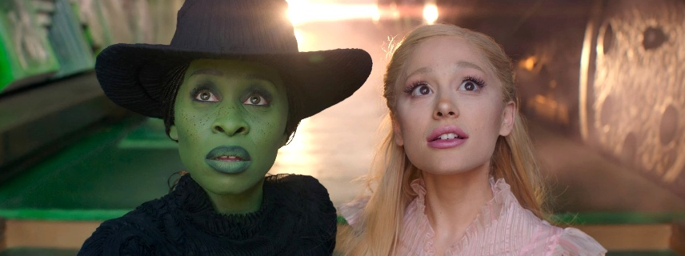

Audience profile of new theatrical releases
Using audience profile data from the CAA Film Monitor survey, DCM can help you identify which films are the best fit for the campaign’s target audience
Film Monitor
Comparatives for upcoming release
Example: 16-34 Women
Film Monitor is an online face-to-face survey independently run by Differentology on behalf of the Cinema Advertising Association
Bi-weekly survey will amass a nationally representative sample of c.24,000 respondents (aged 7+) across a calendar year
Film Monitor will collect audience profiles for c.100 theatrical releases that account for c.90% of all UK admissions
Every new major theatrical release is given a ‘comparative title’. This will be a film released in the last couple of years (that has a robust Film Monitor audience profile) that is a good proxy for the upcoming release’s likely audience demo.
For films that are sequels/in a franchise selecting a comparative is straightforward (e.g. Wicked is the comparative for Wicked: For Good). For others, the selection of a comparative will be based on the BBFC certificate and influenced by genre, director, lead actor/actress etc.
Using comparatives helps inform which buying routes a film will be sold within.
Wicked: For Good Comparative: Wicked
23% 16-34 Female | 16-34 Female Index: 170
16-34 TVRs: 20
The Housemaid. Comparative: Anyone But You
40% 16-34 Female | 16-34 Female Index: 300
16-34 TVRs: 7

Slide 5
Predicting reach & frequency for upcoming films
DCM’s planning system collates together admissions forecasts by film/buying routes, comparative film demographic profiles and this is fused with RSMB’s gold standard coverage and frequency model.
Admissions forecast
Comparative
film demo. profile
Campaign
length
RSMB gold standard reach
& frequency model
Coverage and frequency calculations are based on:
  The predicted audience demo profile (based on Film Monitor profile of the allocated comparative title)
  Admissions forecast for the upcoming release(s)
  Campaign length
The gold standard RSMB model used by DCM to calculate C&F is based on 52 weeks of recency and frequency data from the CAA’s Film Monitor survey – and allows DCM to provide accurate C&F/TVR estimates for every campaign

Slide 6
How we collect, verify & report admissions
Daily updates
POS data
Data matching
Reporting
Weekly performance
In the detail

Slide 7
How we collect, verify & report admissions
Daily updates
POS data
Cinemas update us daily on what movies they plan to show over the next week (with specific showing dates and times) and we schedule ads against these showings
Point of sale ticket information gets sent to
our ‘data warehouse’ by cinema, screen, showing and ticket type.
DCM corroborates this with Comscore to
ensure accuracy and transparency

Slide 8
How we collect, verify & report admissions
Data matching
Reporting
Admissions are only reported for films that have a live and accountable playlist and these are then allocated to the campaigns featured.*
*Any film showings we can not match (e.g. a showing we didn’t have prior knowledge of) or where any issues have occurred (e.g. cancelled) has its admissions automatically detected and discarded.
Data is then matched to campaign playlists
in our scheduling system, Accord

Slide 9
How we collect, verify & report admissions
Weekly performance
In the
detail
Weekly campaign performance report sent by DCM sales team to agencies & clients
Detailed spot by spot breakdown can be supplied if required by clients or econometric agencies

Slide 10
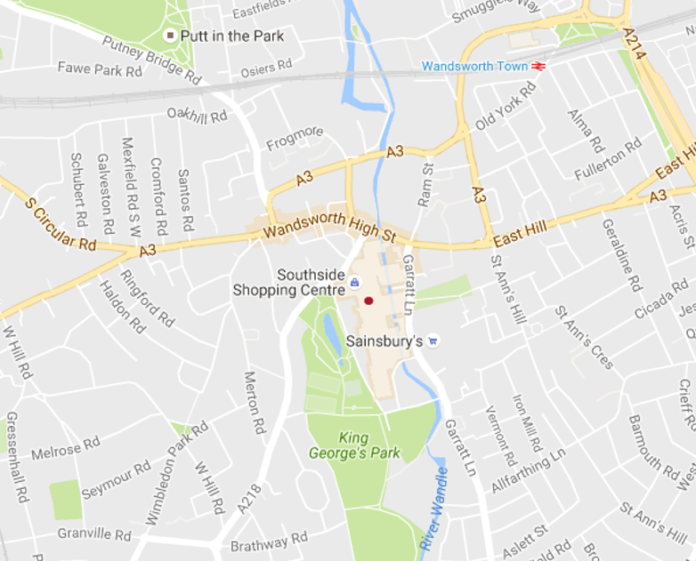
Detailed spot by spot breakdown spreadsheets can be supplied for every campaign
Cineworld Wandsworth
Date | TV Region | Film | Delivered Admissions | Location | Postcode
06/09/2024 | LONDON | Beetlejuice Beetlejuice | 38 | Cineworld Wandsworth | SW18 4TF
06/09/2024 | LONDON | Beetlejuice Beetlejuice | 40 | Cineworld Wandsworth | SW18 4TF
06/09/2024 | LONDON | Beetlejuice Beetlejuice | 36 | Cineworld Wandsworth | SW18 4TF
06/09/2024 | LONDON | Beetlejuice Beetlejuice | 45 | Cineworld Wandsworth | SW18 4TF
06/09/2024 | LONDON | Beetlejuice Beetlejuice | 31 | Cineworld Wandsworth | SW18 4TF
06/09/2024 | LONDON | Beetlejuice Beetlejuice | 56 | Cineworld Wandsworth | SW18 4TF
06/09/2024 | LONDON | Beetlejuice Beetlejuice | 35 | Cineworld Wandsworth | SW18 4TF
06/09/2024 | LONDON | Beetlejuice Beetlejuice | 63 | Cineworld Wandsworth | SW18 4TF

Slide 11
Calculating C&F & TVRs for cinema (post-release)
Final Admissions
CAA film monitor profile
Kantar GB
universes
Example:
Deadpool & Wolverine
Industry Admissions (28 days):
5,190,749
Film Monitor Profile (16-34%): 52%
= 2,699.189 16-34 admissions
16-34 Universe: 15,262,000
(16-34 Admissions / 16-34 Universe
* 100)
= 17.7 16-34 TVRs
A film’s final admissions figure (DCM or Industry):
7 days
28 days
60 days
A film’s final
CAA Film Monitor profile that provides demographic breakdown of the cinema audience
Cinema C&F and TVRs are calculated
based on Kantar’s
GB universes

Slide 12
Independent preshow audits
Background
Methodology
Assosia, a trusted retail research and quality assurance specialist, has been engaged to undertake regular audits that would capture presence during various intervals of the preshow experience.
Assosia act as a third-party independent agency on behalf of clients to provide unprejudiced and impartial auditing information.
Assosia auditors visit selected cinemas monthly across the UK over a weekend (Friday, Saturday and Sunday) to review the pre-reel experience and collate presence throughout the reel data.
Auditors arrive to sit in the auditorium at least 15 minutes prior to the film start time. They are briefed to collect the following information for each screening:
Number of cinemagoers present during the bronze spot
Number of cinemagoers present during the silver spot
Number of cinemagoers present during the gold spot
The auditor will leave the showing once the film has begun.
Audit data has been collated with results published highlighting the latest averages
(% of total audience present) for the different stages of the ad reel.
Sources: DCM 2025

Slide 13
Audience presence throughout cinema preshow
Findings are based on over 2,250 audits conducted by independent auditors Assosia
Average amount of brand advertising in reel: 11 minutes
1.
DCM Opening ident
2.
Brand ads
3.
Bronze spot
4.
DCM Closing ident
5.
Silver spot
6.
Film trailers
7.
Gold spot
8.
Film
89%
91%
100%
of cinemagoers seated when Bronze Spot begins
of cinemagoers seated when Silver Spot begins
of cinemagoers seated when Gold Spot begins

Slide 14
Summary: Why cinema provides the best AV experience for brands
Full
(big) screen
Sound
(always) on
Viewed by humans
Shared
viewing
Brand safe films
& pre-cleared advertising
Robust processes & reporting

