Slide 1
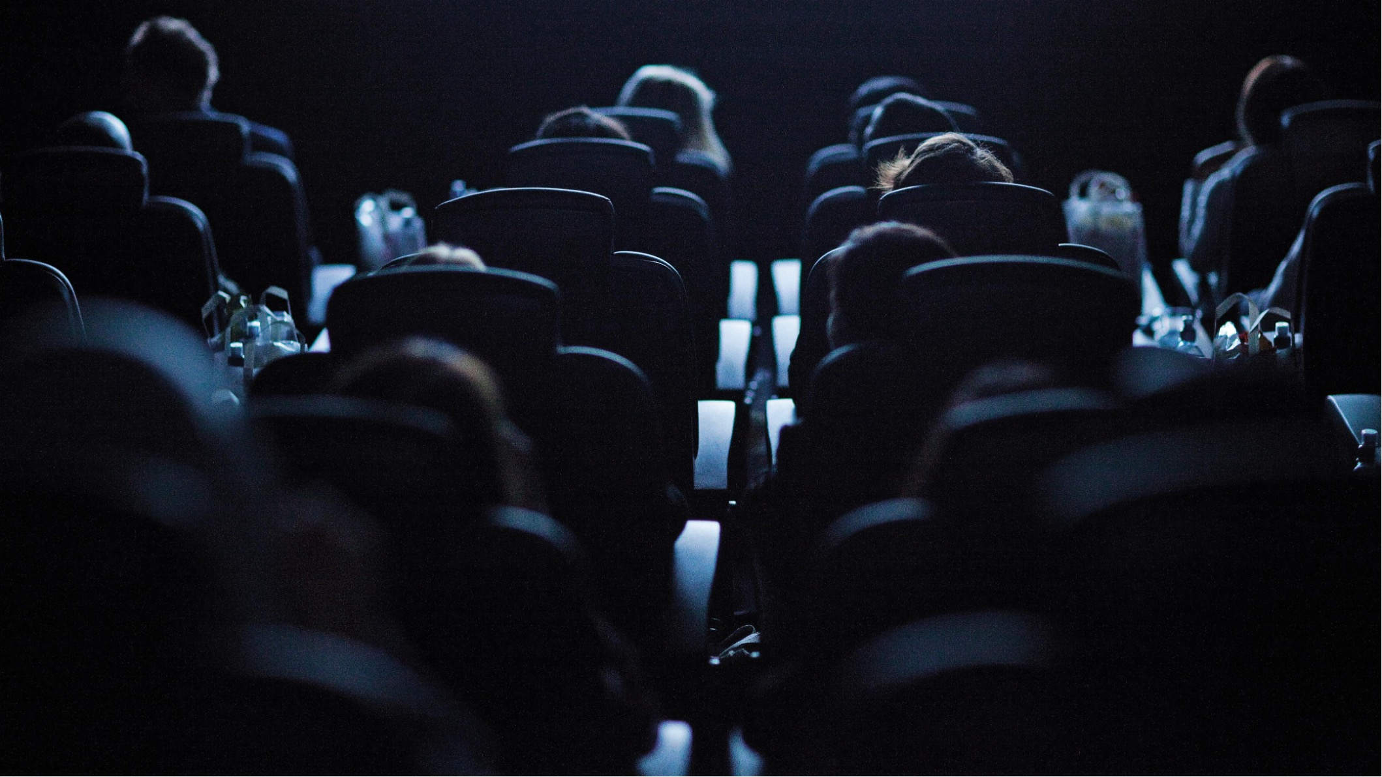
Cinemapper:
Proximity planning
DCM’s proximity planning tool allows brand to geo-target
and run smart, efficient cinema campaigns

Slide 2
Cinemapper can help you target your audience more efficiently
DCM can map a client’s catchment area, branches, stores or local stockists.
We map the location
of the nearest
cinema sites based
on distance in miles,
drive or walk time.
Brands can add
a tailored 5” end frame to their main
ad, delivering a national message
with a local touch.

Slide 3
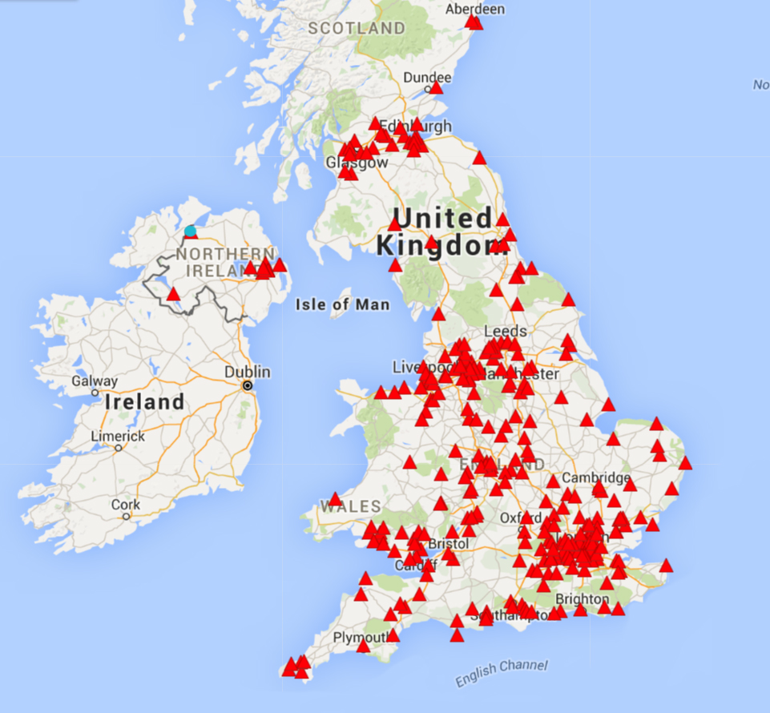
Cinemapper identifies store & DCM cinema matches
Stores/Areas of interest
DCM Cinemas

Slide 4
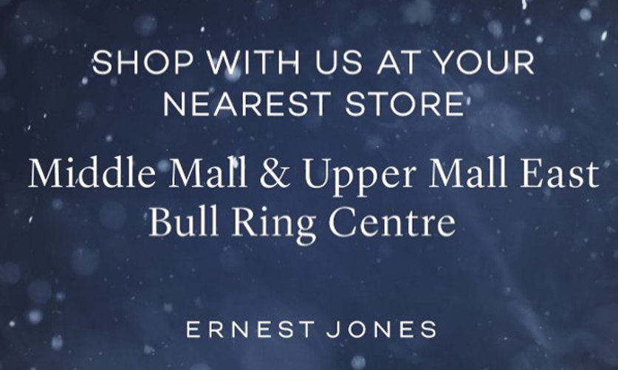
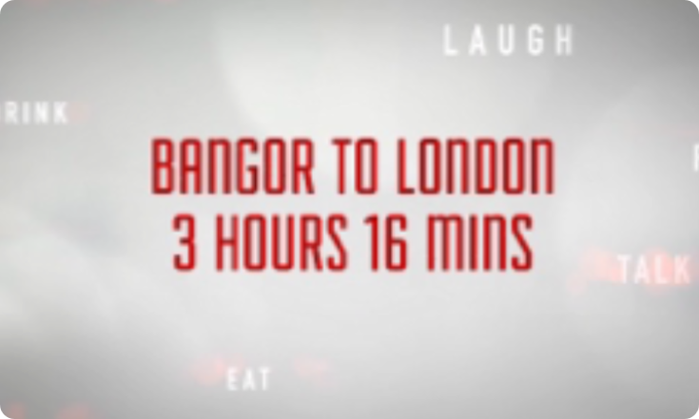
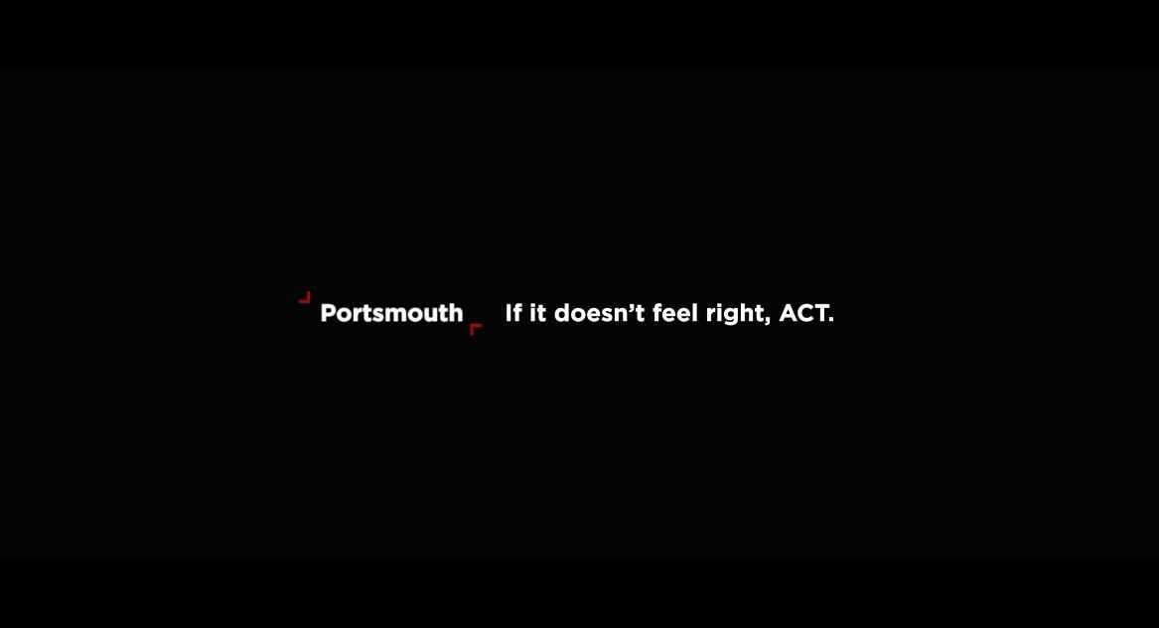
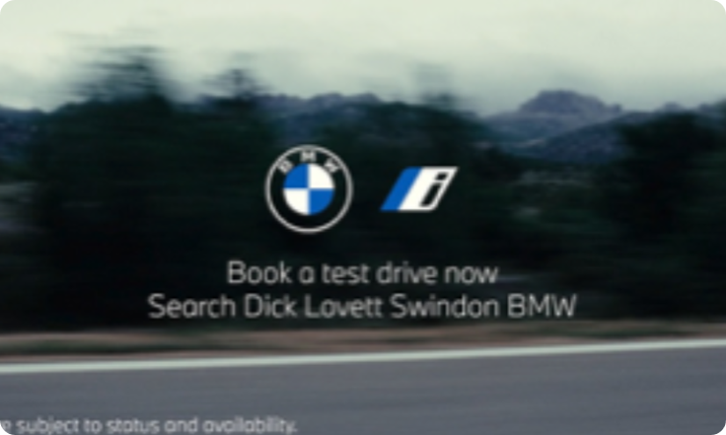
Creative can be tailored with bespoke end frames
Ernest Jones:
Drive footfall to nearest store
Virgin Trains:
Locally-relevant routes
Counter Terrorism:
Tailored local messaging
BMW:
Displaying nearest dealership

Slide 5
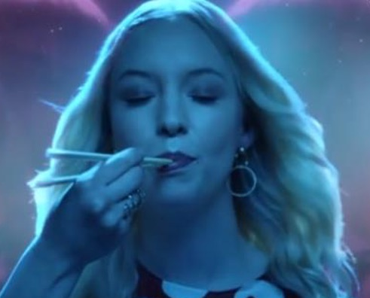

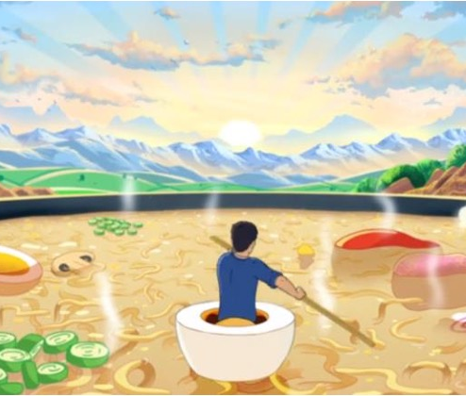
Cinemapper case studies
Wagamama
Wagamama used Cinemapper to locate 97 cinemas in proximity to its restaurants in eight key cities – buying selected sites that were within 10-15 minute drive of its restaurants.
Launching the ‘Bowl To Soul’ campaign in DCM cinemas was a huge success for Wagamama – driving awareness, landing key brand perceptions and ultimately sales.
Across an eleven-week period UK like-for-like turnover increased by 12%, outperforming the category which declined across the same time. A set of results so impressive the campaign won a prestigious Effie Award!
JD Sports
Using Cinemapper, JD Sports were able to run its hero 120” ad in cinemas closest to the brand’s
top-performing stores in the run up to the key Christmas period.
Exposure to the targeted 120” ad helped increase awareness by 7% and recall by 17%.
Consideration also increased by 3% and intention to act also increased with higher claimed visits to the JD Sports website, word of mouth and claimed purchase.
Source DCM Case Study Databank. Full case studies can be found here: https://www.dcm.co.uk/case-studies

Slide 6


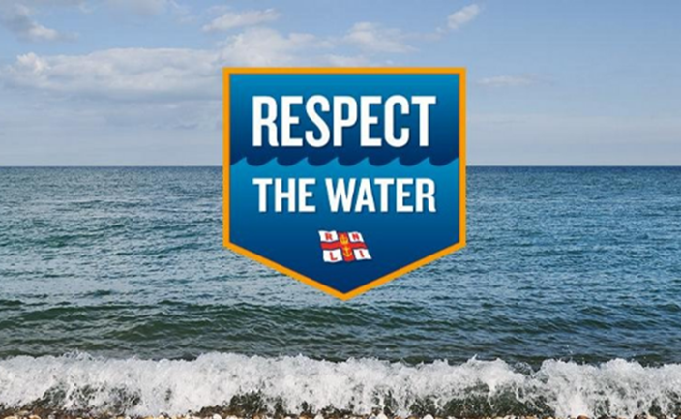
Cinemapper case studies
Ernest Jones
Mini
The RNLI
Ernest Jones wanted prioritise targeting in a premium environment in proximity to its stores.
The campaign ran in sites within a 20-minute drive time of an Ernest Jones store. Where stores and cinemas within shopping centres overlapped the brand added a bespoke 5” end frame that highlighted the store location to drive direct footfall.
The selected stores saw a 9% increase in attributed sales YOY, outperforming other Ernest Jones’ outlets by 3%.
Mini wanted to drive footfall into its local retail centres to get car buyers behind the wheel of a Mini.
Cinemas were matched to their nearest Mini retail centre, with bespoke 3” end frames - directing cinemagoers to their nearest Mini dealership – added to the Mini ad. This resulted in 147 pieces of locally-relevant copy playing out across 439 screens.
Mini trumped its lead target, with cinema providing dealerships with 2,940 incremental and directly attributable test drives.
RNLI utilised Cinemapper to pinpoint cinemas near rivers and seas to upweight activity in these sites and ensure the ‘Respect the Water’ message was being driven home in the right place, to the right people.
The campaign, with cinema as an integral contributor, was hailed as a significant success, delivering an uplift of 36% in campaign awareness and a 33% uplift in correct message takeout amongst the targeted young male audience.
Source DCM Case Study Databank. Full case studies can be found here: https://www.dcm.co.uk/case-studies

Slide 7
Cinemapper: the process
Planning a geo-targeted campaign is easy with Cinemapper – just supply us with a list of correct postcodes and the proximity you’d like us to plan against, and DCM will do the rest. Let your DCM rep know if you’d like to factor in bespoke end frames to the costing too.
Supply a list
of correct postcodes for stores
Tell us your
desired proximity
to your target cinema
(Miles, drive or walk time)
DCM will
supply maps, matched cinema list & tailored costing

