Slide 1

Cinema:
How To Buy

Slide 2









The Cinema advertising landscape
Digital Cinema Media – 85% of UK cinema admissions
+ over 160 independent cinemas
Pearl & Dean – 15% of UK cinema admissions
+ over 200 independent exhibitors
Source: DCM/P&D share of industry admissions = Comscore

Slide 3
Planning a cinema campaign is easy and flexible
Campaigns can be run broadly or incredibly targeted down to individual showings if so desired
Plan by audience
Plan by film
Plan by genre
Plan by
cinema
Plan by week
Plan by day
Plan by time
Plan by
showing

Slide 4
The Cinema Playlist
Take advantage of the most prestigious positions in advertising
Average amount of brand advertising in reel: 11 minutes
1.
DCM OPENING
IDENT
1.
DCM Opening ident
2.
Brand ads
3.
Bronze spot
4.
DCM Closing ident
5.
Silver spot
6.
Film trailers
7.
Gold spot
8.
Film

Slide 5
The Gold, Silver & Bronze spots
Take advantage of the most prestigious positions in advertising
Average amount of brand advertising in reel: 11 minutes
1.
DCM Opening ident
2.
Brand ads
3.
Bronze spot
4.
DCM Closing ident
5.
Silver spot
6.
Film trailers
7.
Gold spot
8.
Film
89%
of cinemagoers seated when Bronze Spot begins
91%
of cinemagoers seated when Silver Spot begins
100%
of cinemagoers seated when Gold Spot begins
+15% rate card
+30% rate card
+60% rate card
Audience presence numbers from audits conducted by Assosia

Slide 6
The Gold Spot
The most impactful position in advertising
Average amount of brand advertising in reel: 11 minutes
The Gold Spot is the premium position, helping brands to
become an integral part of the cinema experience.
The Gold Spot is the last commercial message after the trailers and sits, on average, six minutes away from any other advertising.
To book into any premium spots, or find out more, contact your DCM rep.
7.
GOLD SPOT
1.
DCM OPENING
IDENT
7.
GOLD SPOT
This 60” or longer spot offers standout outside the main ad reel and offers the perfect opportunity to be up close to the main event.
1.
DCM Opening ident
2.
BRAND ADS
3.
BRONZE SPOT
4.
DCM CLOSING IDENT
5.
SILVER SPOT
6.
FILM TRAILERS
7.
Gold spot
8.
Film
  100% of cinemagoers are seated when the Gold Spot begins*
‘The most valuable few seconds in cinema advertising’ – Media Week
  Guaranteed admissions
of cinemagoers seated when Gold Spot begins
+60% rate card
*Source: Assosia

Slide 7
Cinema offers a range of buying route options for brands
Audience Guarantee Pack
(£65 CPT)
Premium / 16-34 Adults /
16-34 Men / 16-34 Women / ABC1 Adults AGP
(£75 - £80 CPT)
HP+CH
(£36 CPT)
Alcohol
(£75 CPT)
Source: DCM. CPT costs: Q1-Q3, +10% for Q4
Independents
(£105 CPT)
Geo Targeting
(£105 CPT)
Film Package
(£85 - £128 CPT)
Regional /
Site By
Site
Source: DCM. CPT costs: Q1-Q3, +10% for Q4

Slide 8

Audience Guarantee Pack (AGP)
Cinema’s most popular buying route.
Guaranteed industry admissions
The broadest and most cost-effective way of reaching the whole cinema audience in any given campaign period - offering the best opportunity to achieve mass reach
Runs across the variety of films showing over your selected dates
Can be bought on a national or regional basis
There are Adult, 1634, Male/Female and Premium AGP options available if campaign requires a more targeted audience approach.
30” Ratecard CPT: £65
(+10% in Q4)
Notes:
Add title

Slide 9

16-34 / 16-34 Men /
16-34 Women / Premium AGP
These four audience guarantee packages are more targeted than our AGP – selecting films that are forecast to skew towards a specific audience.
For example, our Premium AGP is more targeted towards an upmarket audience, predominantly incorporating films profiling 68%+ ABC1.
Similarly, a 16-34 Women / 16-34 Men AGP predominantly incorporate films that respectively profile 58%+ female/male.
Minimises unwanted wastage and allows for closer audience targeting
Guaranteed industry admissions p/w
16-34 Adult, 16-34 Men & 16-34 Women AGP - £75 ratecard CPT
Premium AGP - £80 ratecard CPT
(Ratecard costs are +10% in Q4)
Notes:
Add title

Slide 10

Alcohol / Gambling AGP
The Alcohol/Gambling AGP allows you to be confident you are only advertising in films that profile over 75% 18+, with all films approved by the Cinema Advertising Association (CAA).
Comic book/superhero releases are not typically included in this AGP
CAA panel reviews and votes on any ‘borderline’ films based on the forecast audience profile of each title (based on recent comparative title)
Can be bought on a national or regional basis
Bar sponsorships and sampling are available, with 30% of our sites featuring a bar on the premises
30” Ratecard CPT: £75
(+10% in Q4)
Notes:
Add title

Slide 11

HP+CH AGP
The HP+CH AGP allows an advertiser to have presence with all family releases over a given period and utilise the rare opportunity to hit a captive family when they’re all together.
As family films are predominantly released across school holiday periods, admissions will be much more buoyant across these periods.
Family admissions are available on a national or regional basis
Creative must be ‘U’ certification
HFSS regulations apply
30” Ratecard CPT: £36
Notes:
Add title

Slide 12

HFSS AGP
Responsibly advertise your food or drink products on the big screen.
In the UK, an HFSS product may only be advertised with feature films achieving a national audience profile of <25% under-16s
The category of a film does not necessarily determine the profile of the audience it may attract. The CAA uses comparative film profiles to review and then vote on the suitability of titles for carrying HFSS advertising.
This package will only include films that are forecast to profile 75%+ 16+.
It is an advertiser's responsibility to inform the Cinema Advertising Association (CAA) if the product or brand they wish to advertise is HFSS.
£75 Ratecard CPT
(Ratecard costs are +10% in Q4)
Notes:
Add title

Slide 13

Film Pack
Choose which specific films you’d like to buy to reach cinemagoers.
Film packages allow you to select individual films that profile well against your target audience.
Booking a film pack is the only way to ensure exhibition with a specific film
You can choose national or regional targeting
Film packages offer estimated admissions
30" Ratecard CPT: £85/£106/£122
(major release / blockbuster / super-blockbuster)
(Ratecard costs are +10% in Q4)
Notes:
Add title

Slide 14

DCM Independents
This package only includes DCM’s Independent cinema portfolio, representing c.12m admissions annually.
The venues are spectacular community hubs, often with private members clubs and bars, underpinned by diverse and immersive programming.
The core independent audience is older and more affluent than the average cinemagoer: 61% ABC1 and 53% over 45
22% of the core independent audience are heavy cinemagoers
27% of the core independent audience is based in London
£105 Ratecard CPT
(Ratecard costs are +10% in Q4)
Notes:
Add title

Slide 15

Regional and site by site targeting
Opportunity to buy cinema nationally or regionally
Also offer cinema on a site-by-site basis
Regions split same as ISBA TV regions
Ratecard price on application
Notes:
Add title

Slide 16

Geo-targeting pack
Using Cinemapper, DCM’s cinema proximity planning tool, you can run national campaigns with a local spin for every region, city, town or cinema across the UK.
All DCM sites can be bought on an individual basis if required
Pricing will be subject to location and size of venue
Talk to DCM about mapping your locations to our sites
Multiple end frame messaging directs consumers to their local store, dealership, location or franchise.
Notes:
Add title

Slide 17

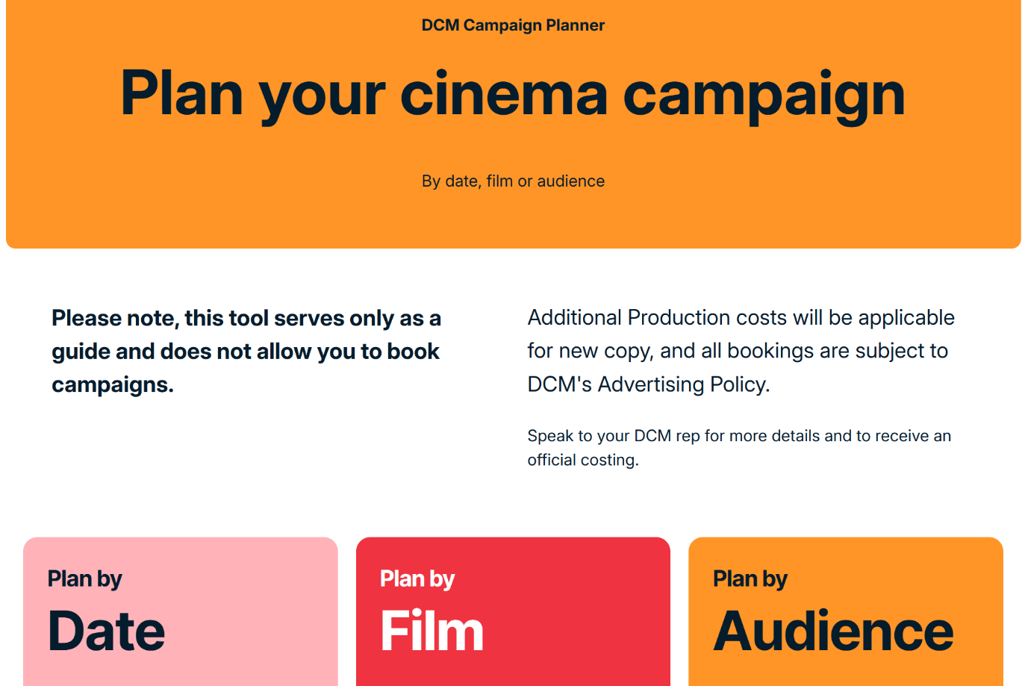
Latest forecast admissions are available on DCM’s website

