Slide 1
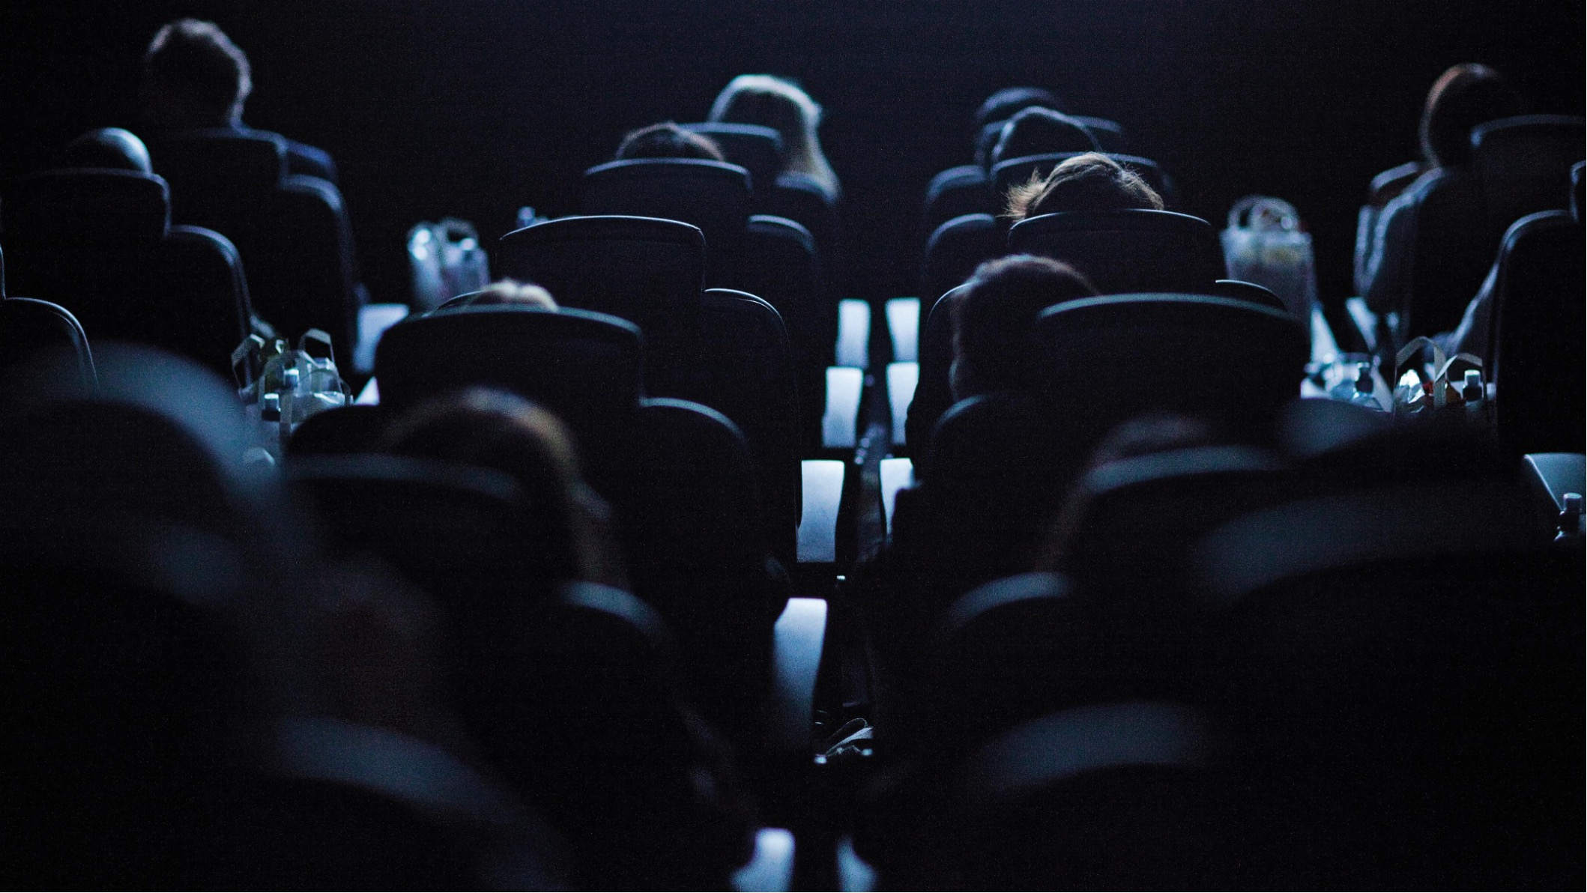
Our Cinemas
Digital Cinema Media (DCM) represents
85% of the UK cinema marketplace

Slide 2
The numbers
UK Cinema
DCM (85%)
Pearl & Dean (15%)
4602
screens
3,757
screens
485
screens
837
sites
551
sites
286
sites

Slide 3







Our cinema partners
160+
INDEPENDENT EXHIBITORS
= 85% of all cinema admissions
Source: DCM/P&D share of industry admissions is verified by Comscore, Q4 2025

Slide 4





The DCM Estate
INDIES
Sites
87
104
90
25
14
23
208
Screens
945
877
887
98
105
224
621

Slide 5
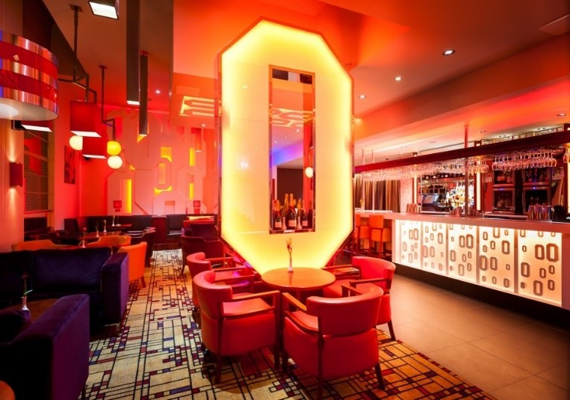
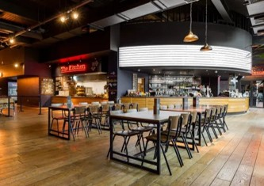

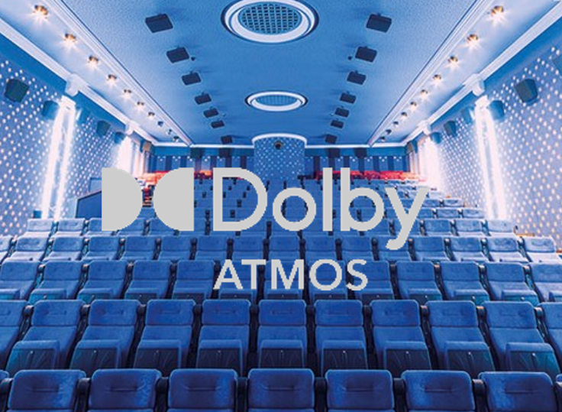
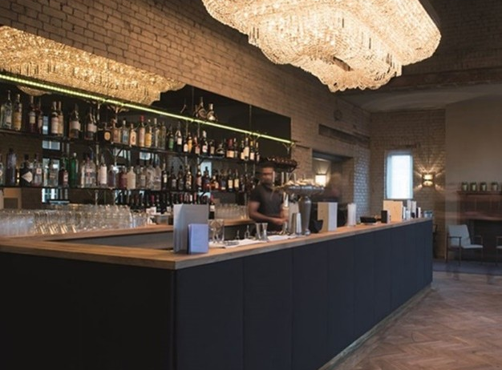
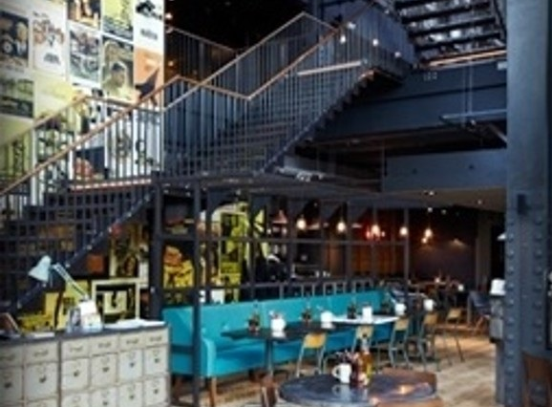
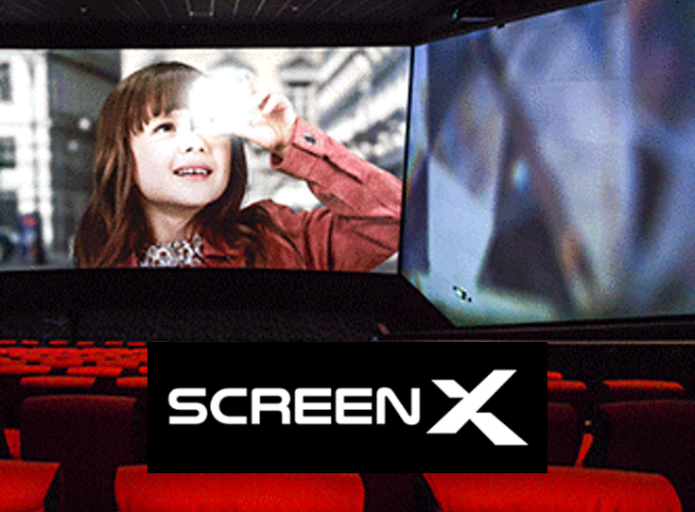
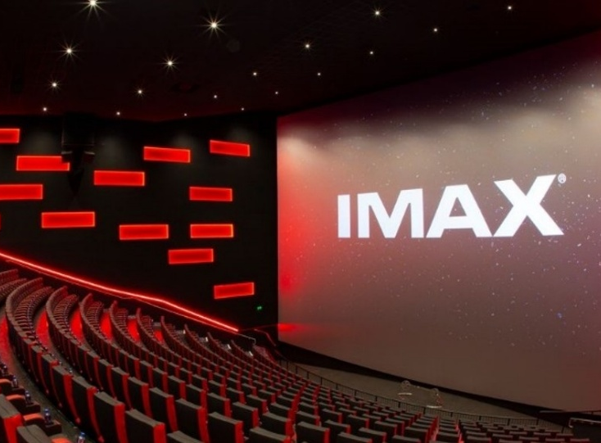

The Cinema experience is more than just the film
Our exhibitors are world leaders in ensuring their cinemas provide a luxurious and innovative experience for audiences.

Slide 6
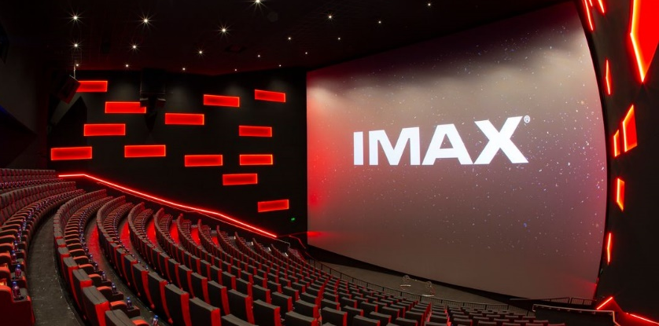
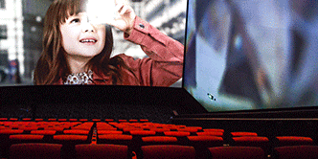
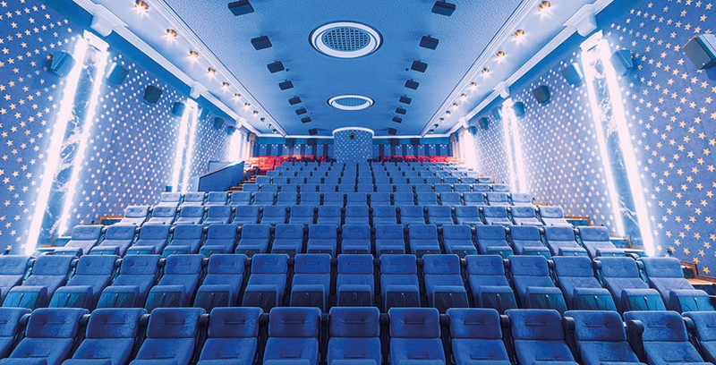




Our cinemas are always looking to invest in new tech to enhance the experience
IMAX screens stretch from floor to ceiling and from wall to wall, creating a picture so big it feels like you’re inside the film but yet still being able to see every detail in stunning high-resolution.
Available for brands to upgrade their ads to IMAX and showcase in over 54 cinemas.
Screen X is a state-of-the-art atmospheric experience that uses twelve additional projectors to extend the film out onto the side walls of the screening room and surround the audience in their seats with 270° projection. Extending the film beyond the audience’s peripheral vision brings them closer to the action than ever before.
Screen X can be found in 23 Cineworld sites across the UK with plans to increase this further. Brands can showcase their own ads in Screen X format – see a case study from Halifax on dcm.co.uk
Dolby Atmos expands on existing surround sound systems by adding height channels, allowing sounds to be interpreted as three-dimensional objects – fully enveloping audiences in the soundscape of the film. Installed in over 110 screens so far, brands can upgrade their ad to take advantage of this stunning audio in cinema.
4DX is extreme sensory cinema. With stimulating effects like water, wind, scent and strobe lighting, that thrill you in your moving seat 4DX is the most exhilarating way to watch a film.
4DX screens can be found in 34 Cineworld sites across the UK with plans to continue rolling out more in future.
Brands can ‘4DX’ their own ads to fully immerse the audience in the ad and maximise the impact of creative amongst a young thrill-seeking audience.
Case study from the British Army available on dcm.co.uk

Slide 7

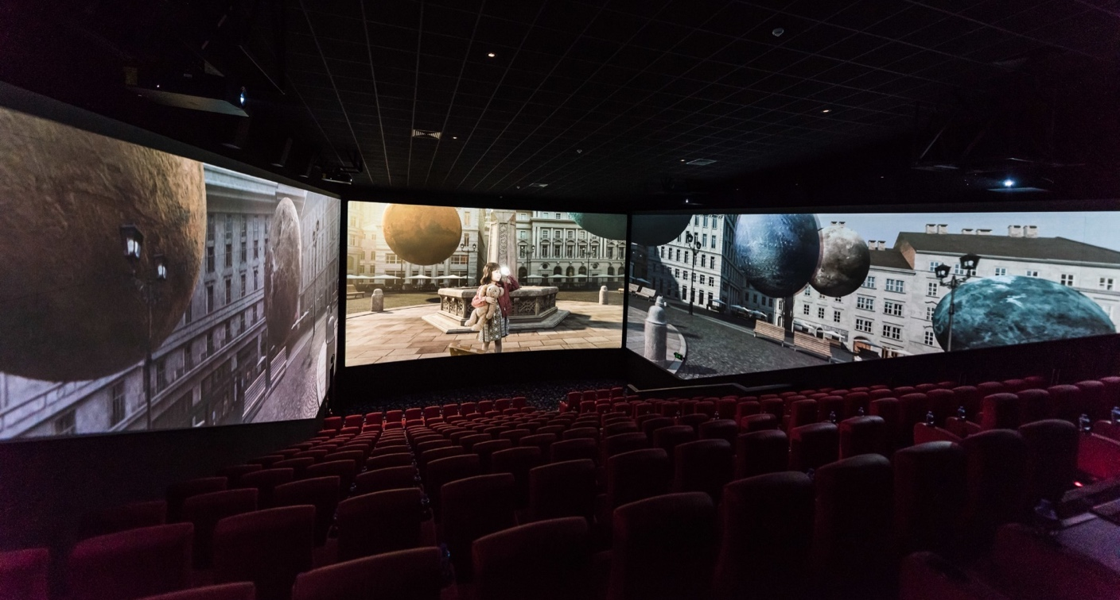

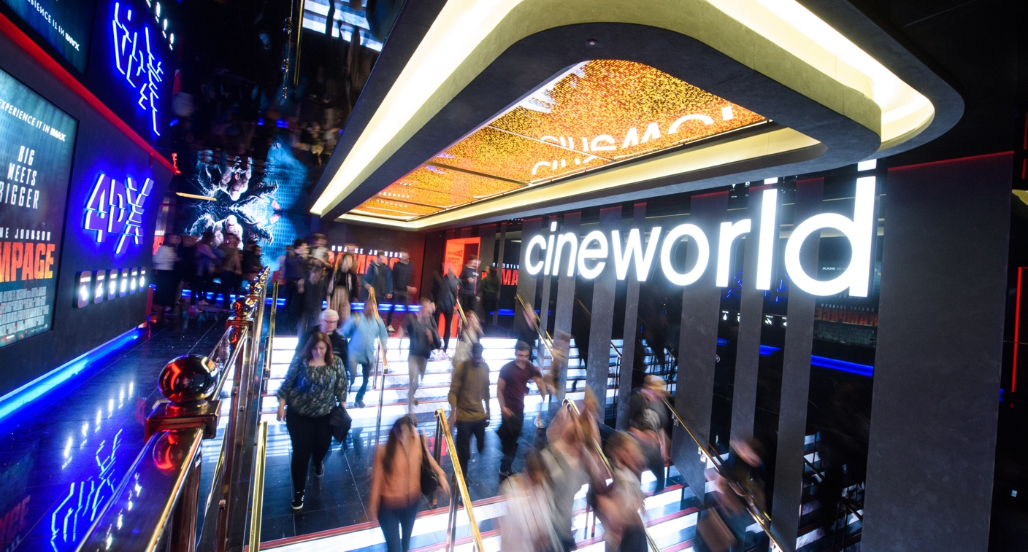
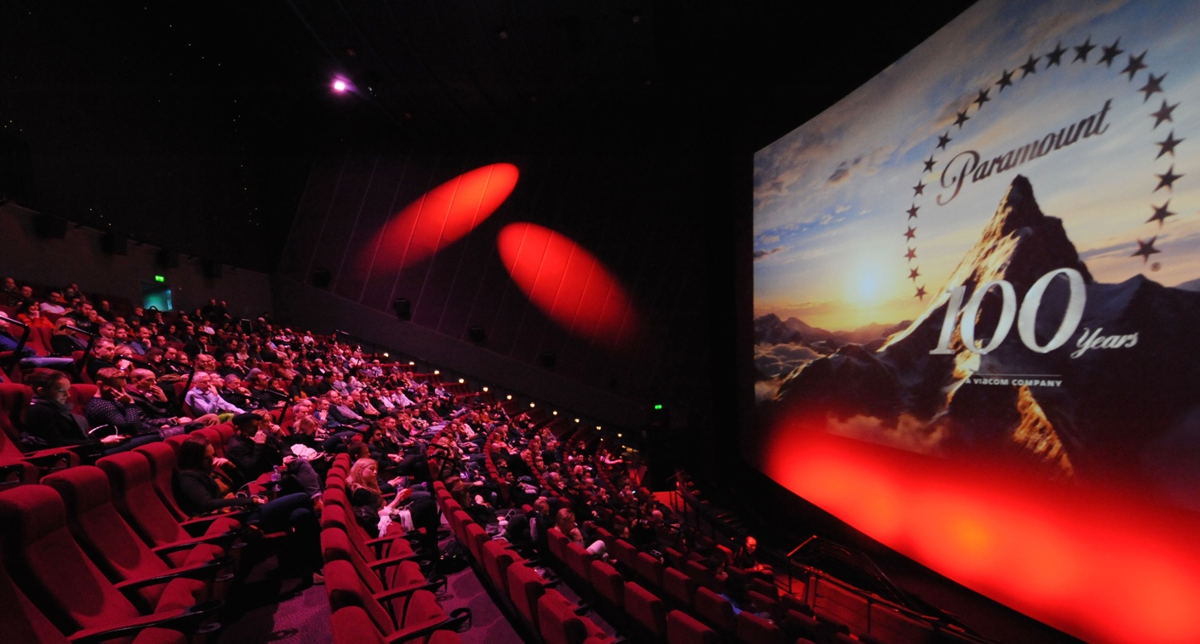

Slide 8
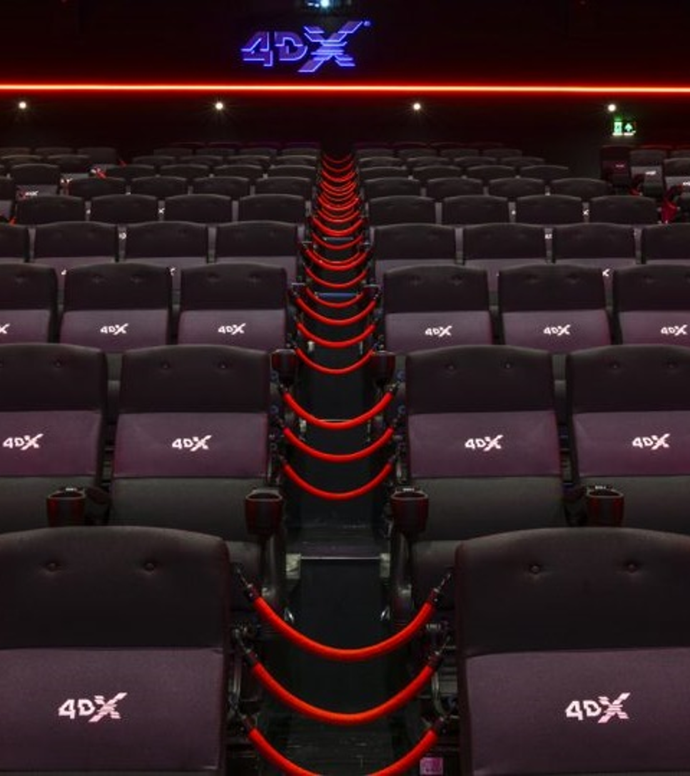
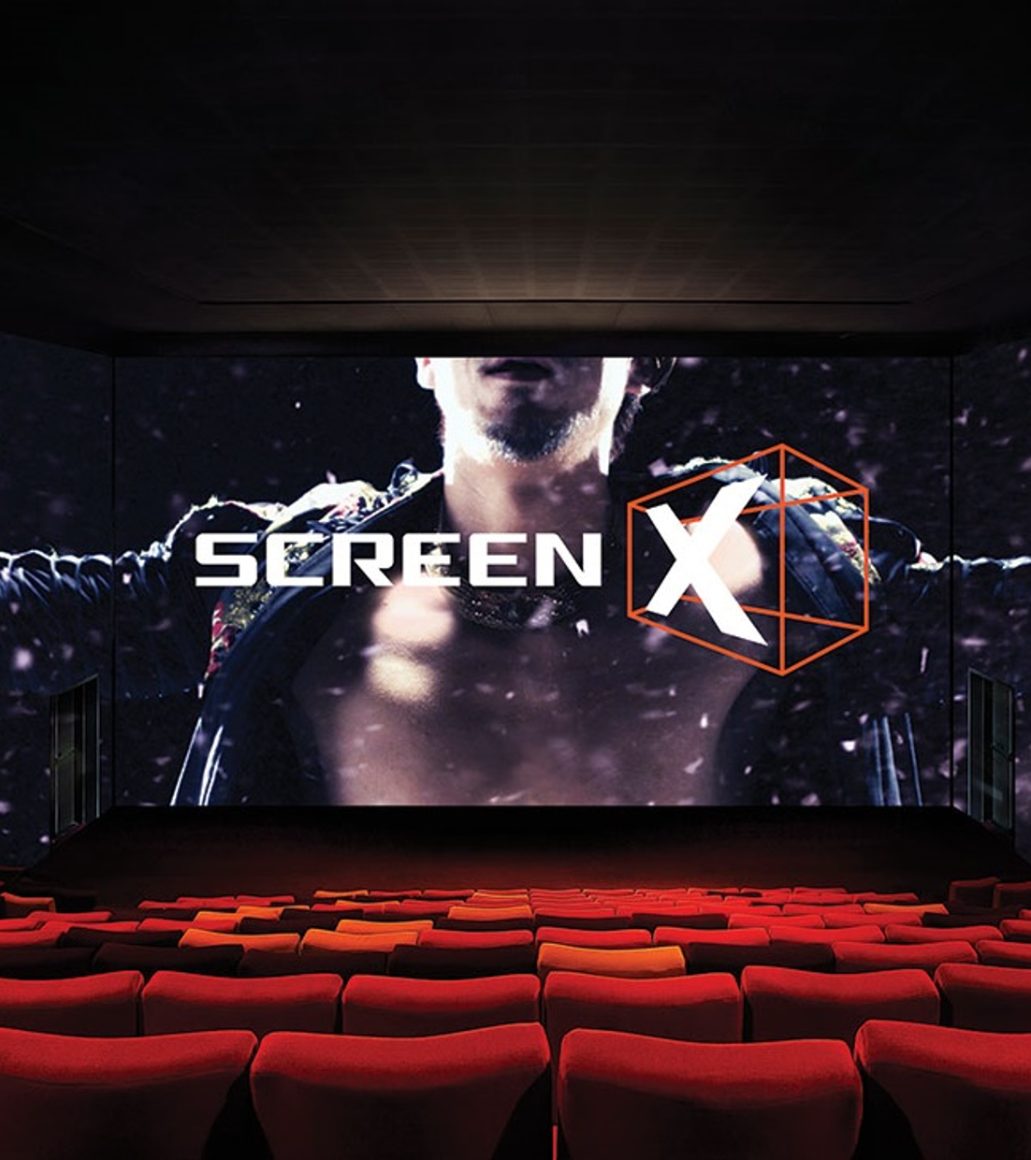

Slide 9
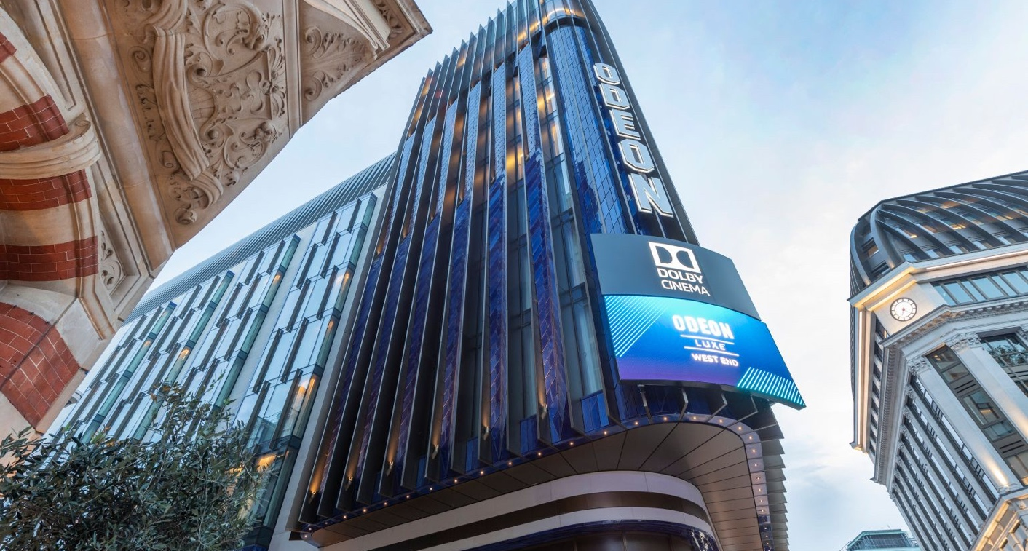
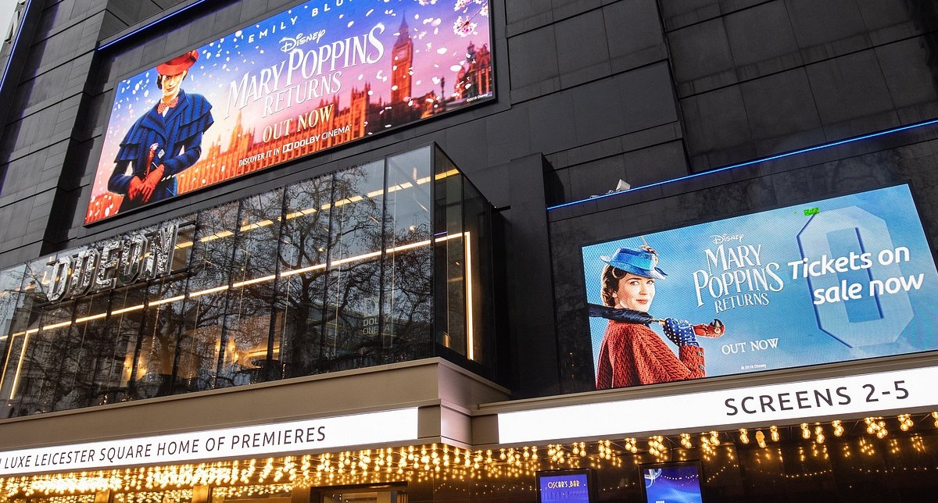
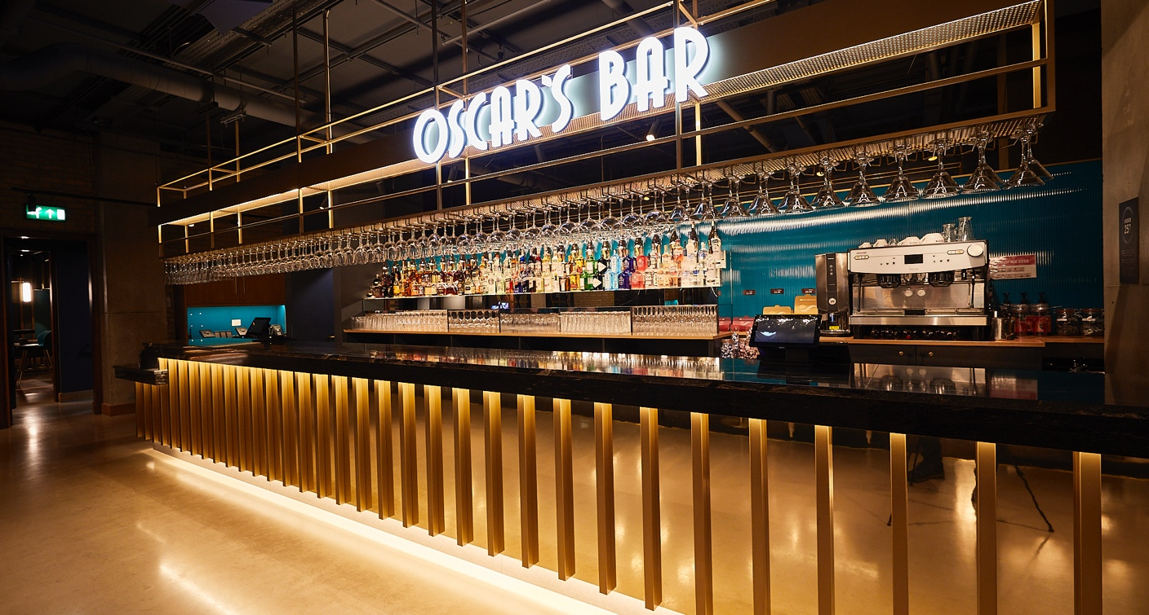
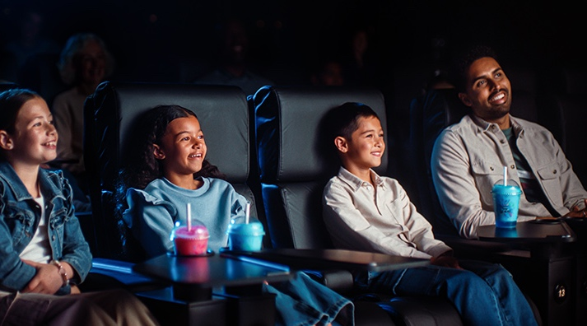

Slide 10
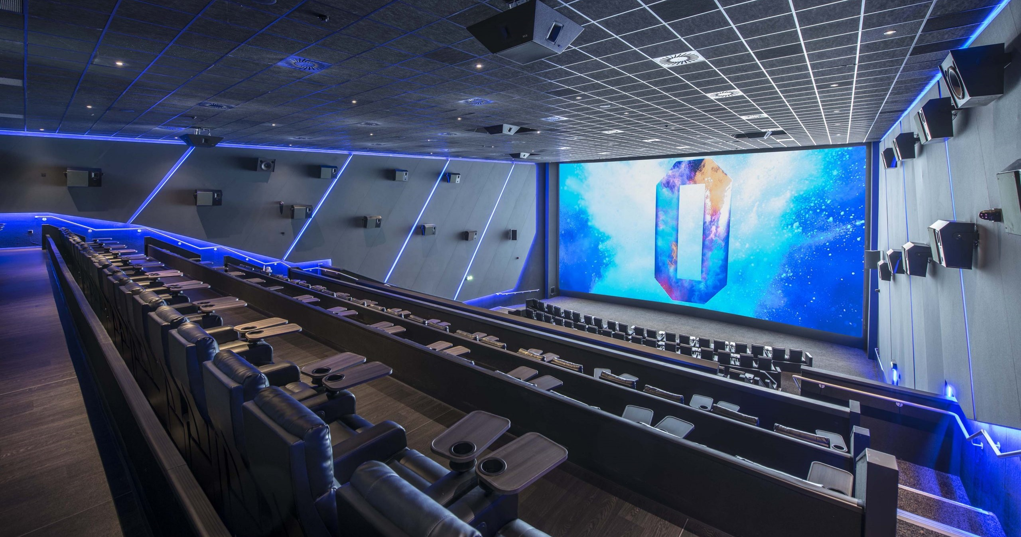

Slide 11
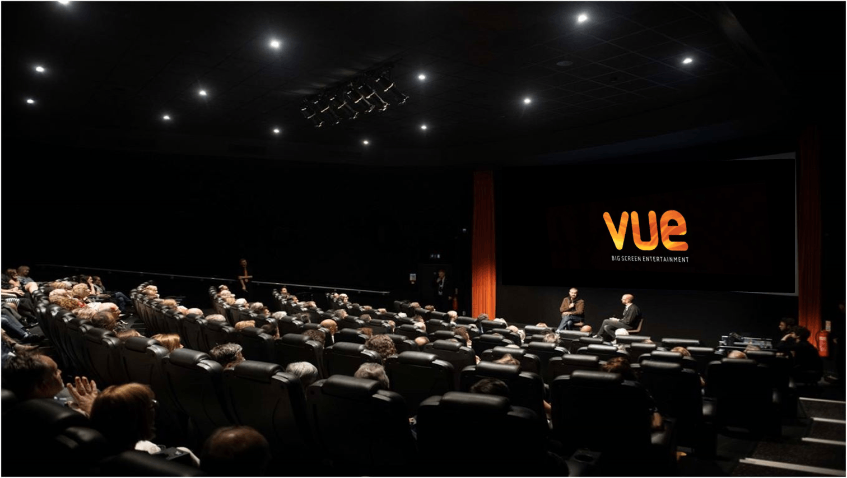
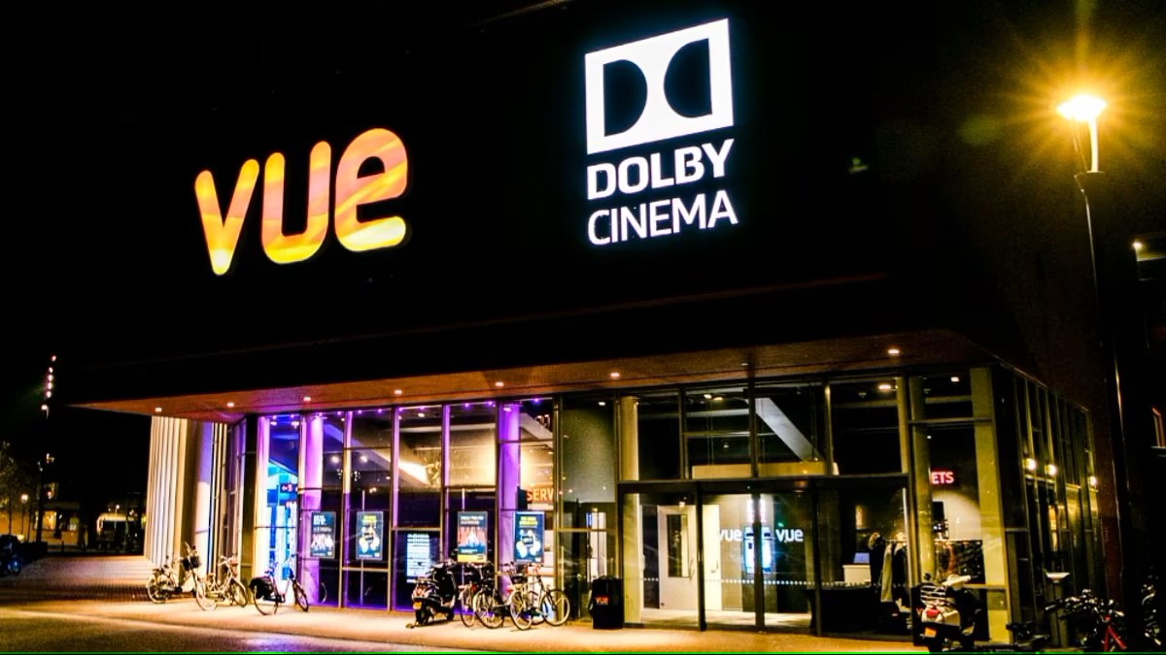
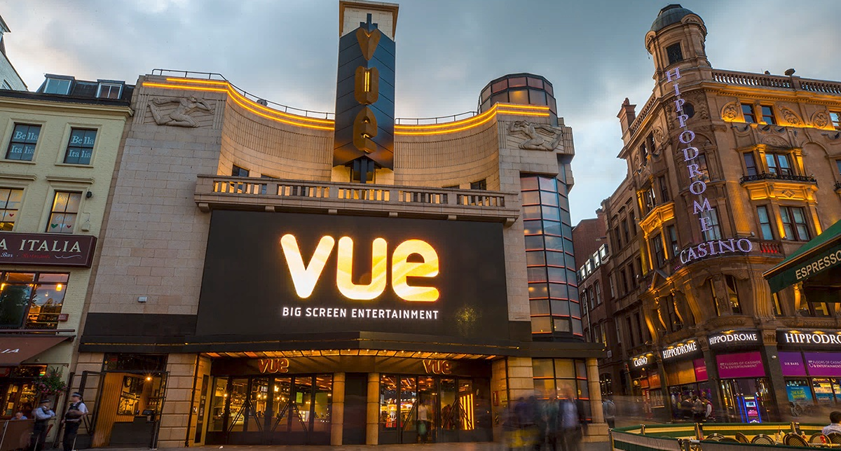


Slide 12
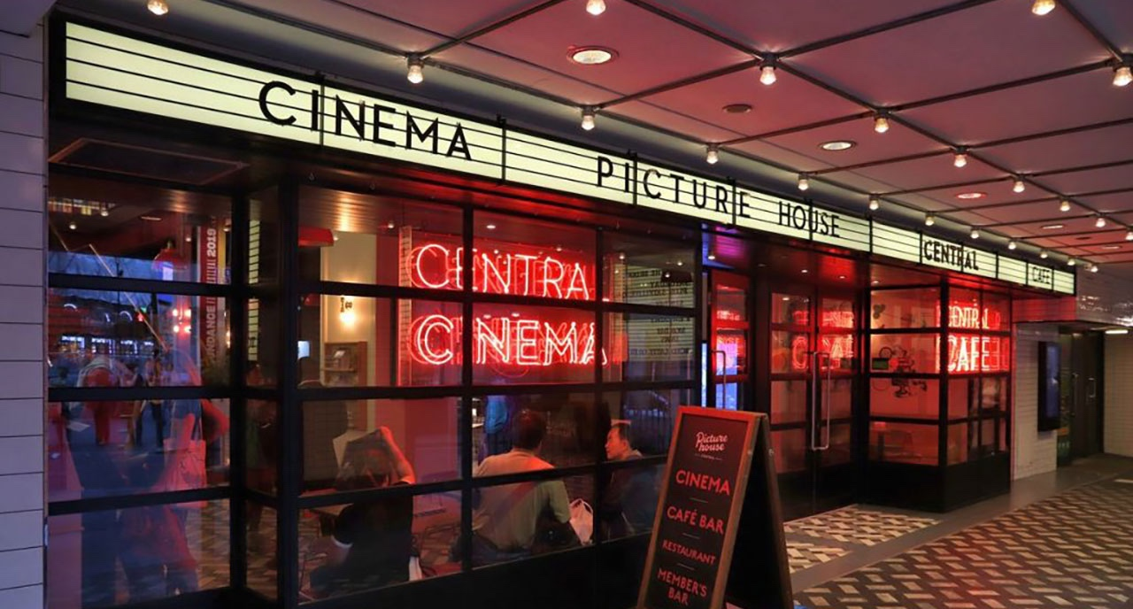
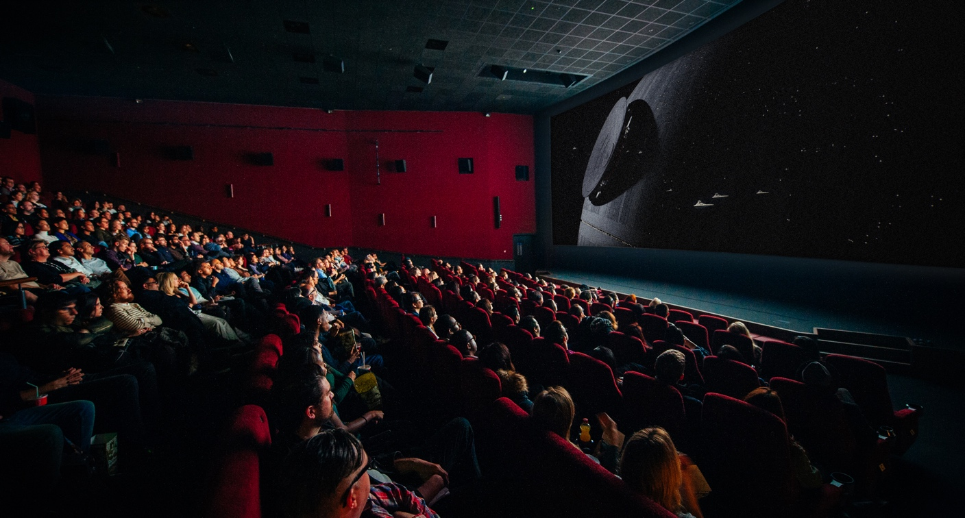

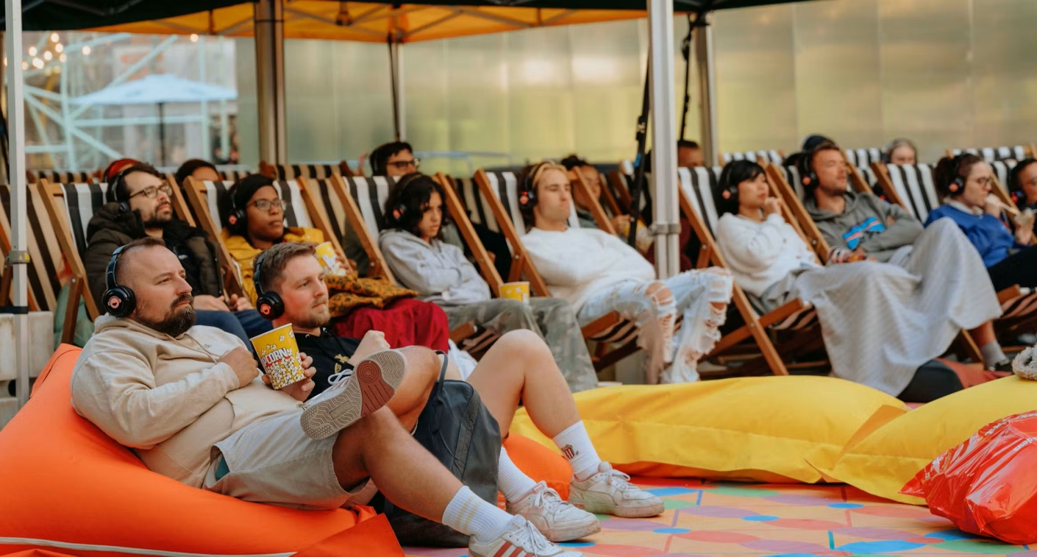
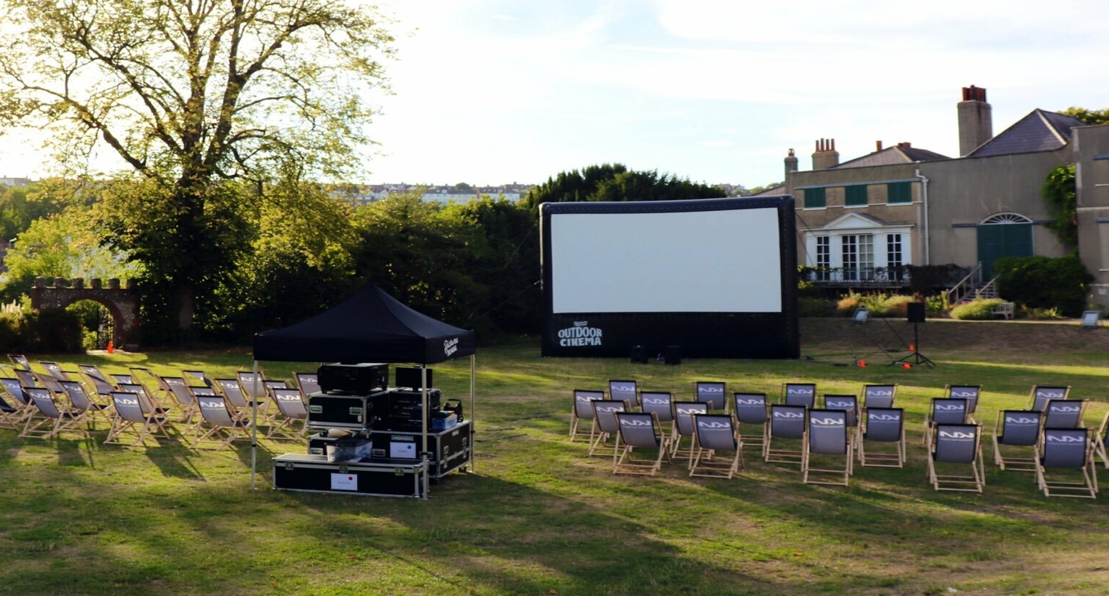

Slide 13
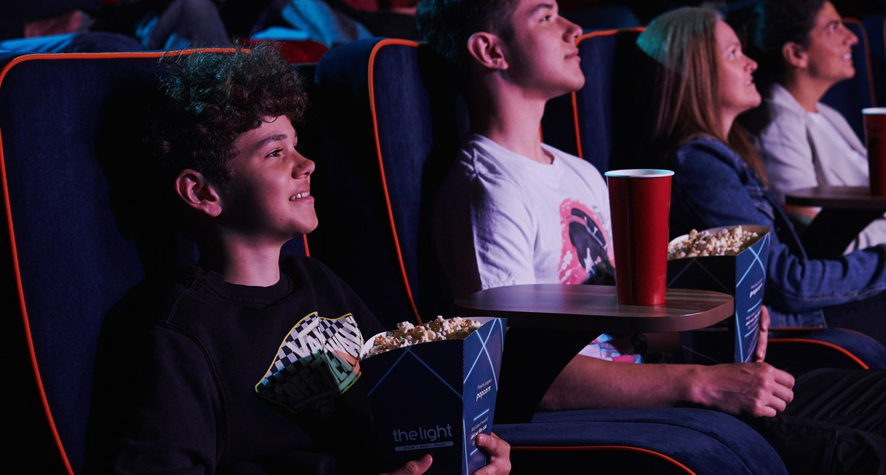
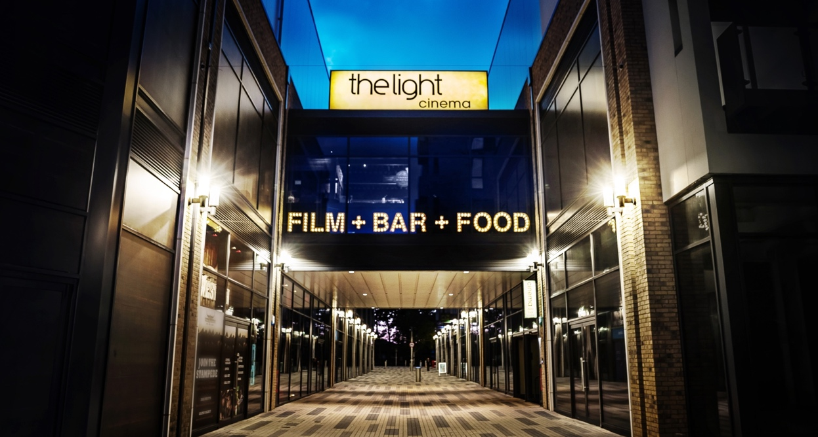

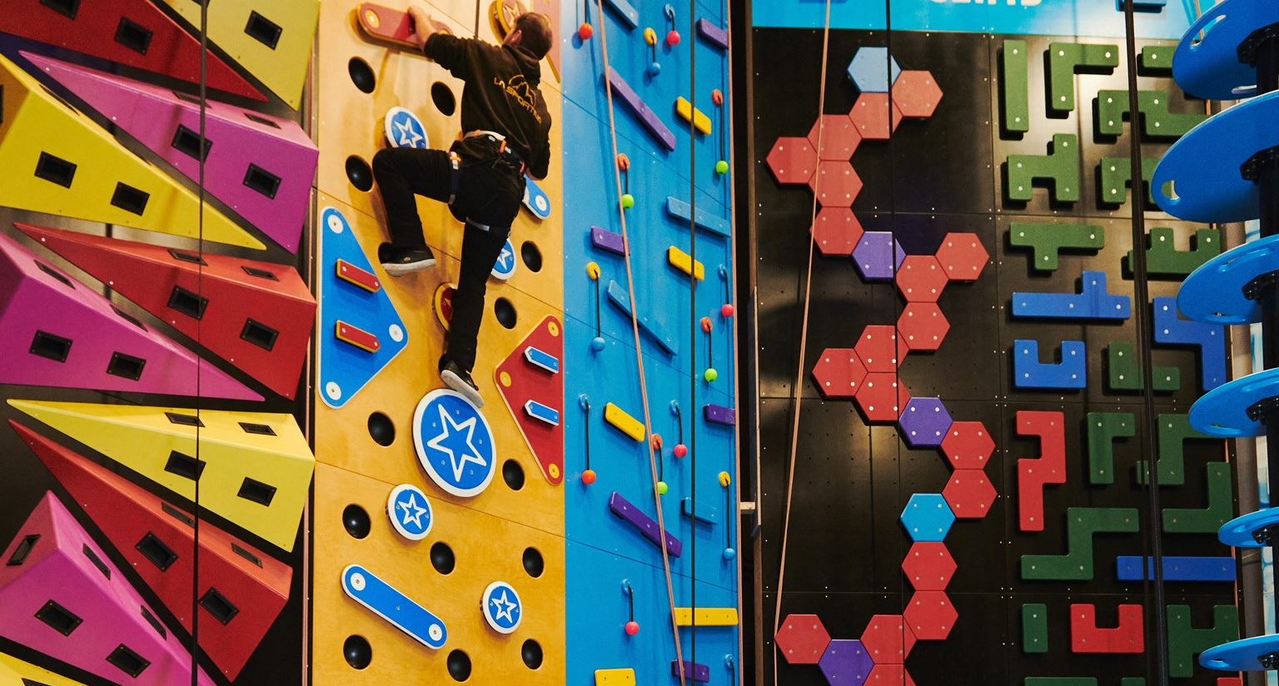
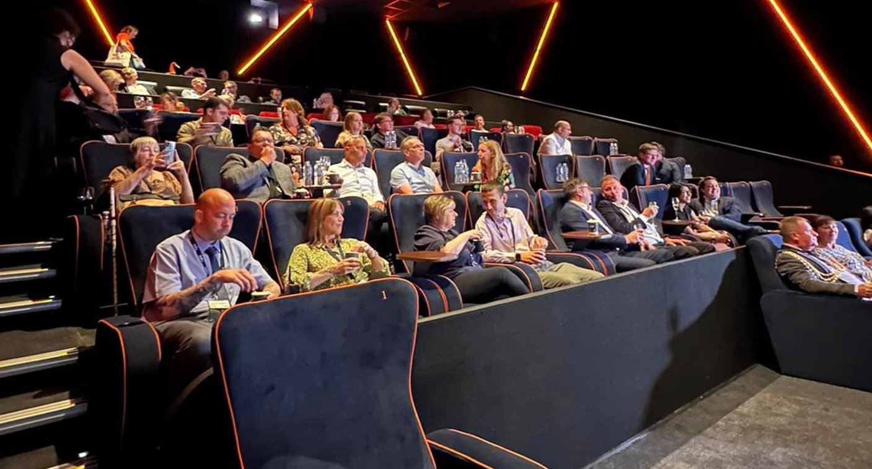

Slide 14
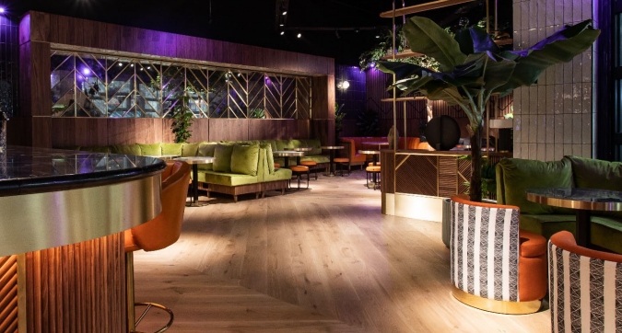
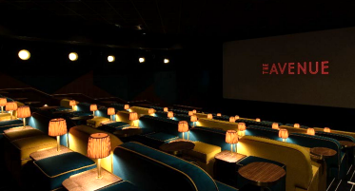
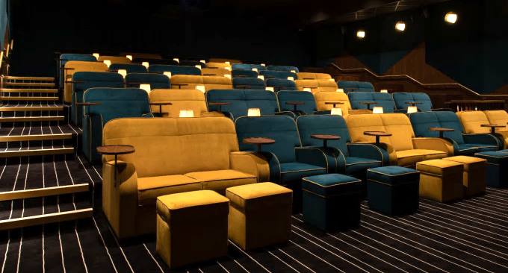
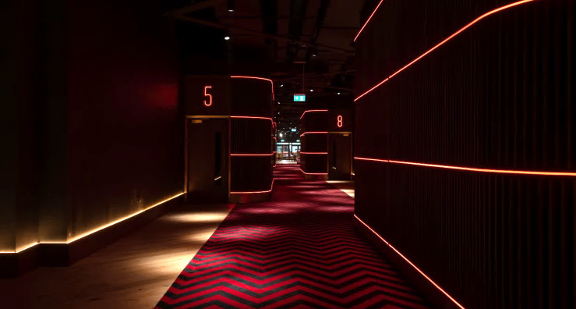

Slide 15




















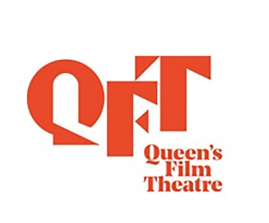



DCM: Our independent cinema partners
Graves
Cumbernauld

Slide 16
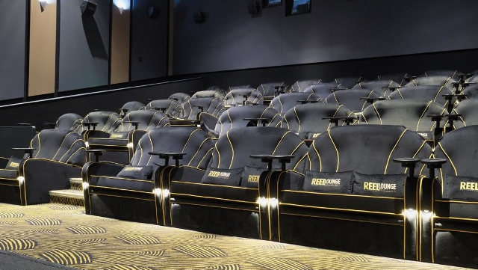
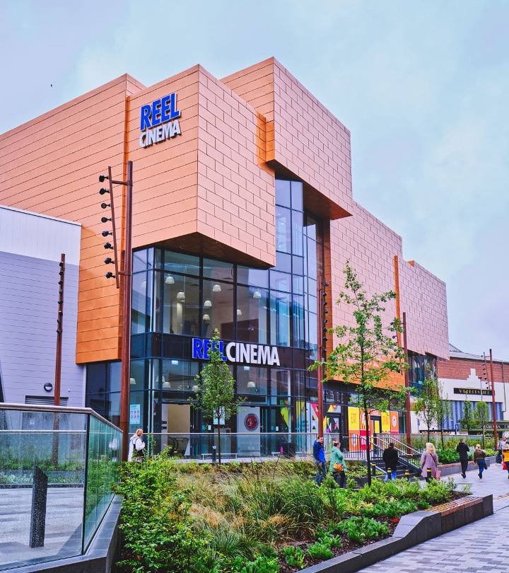

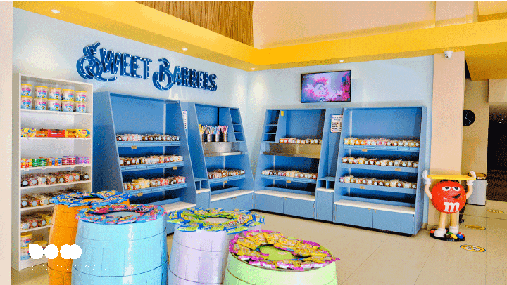

Slide 17
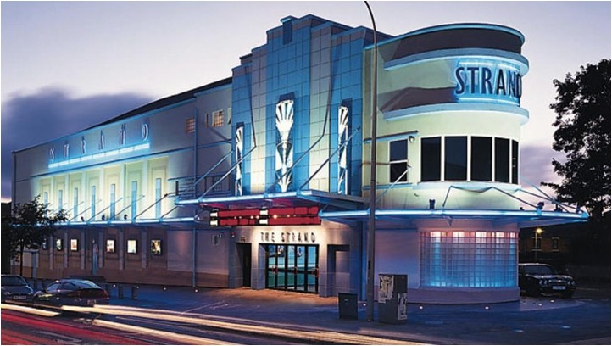
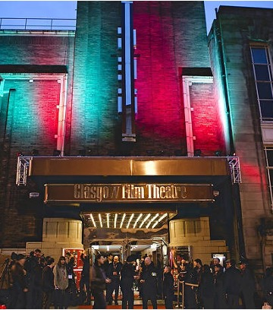
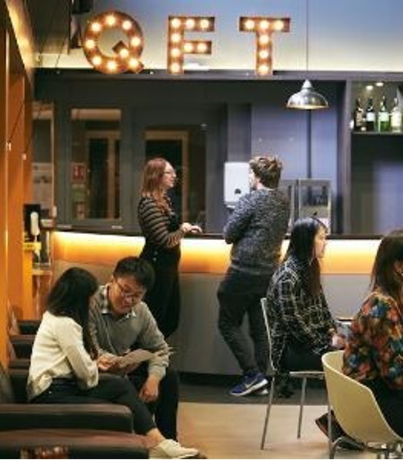
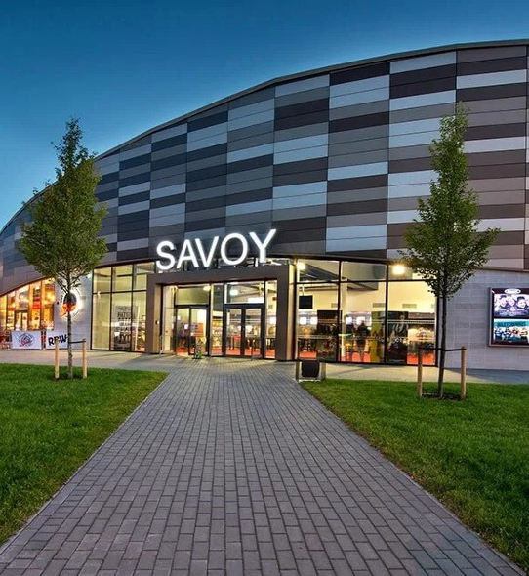
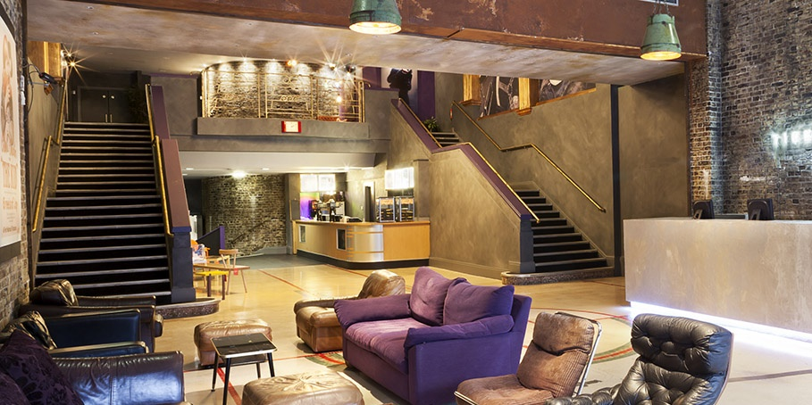
DCM
Independent cinemas

Slide 18
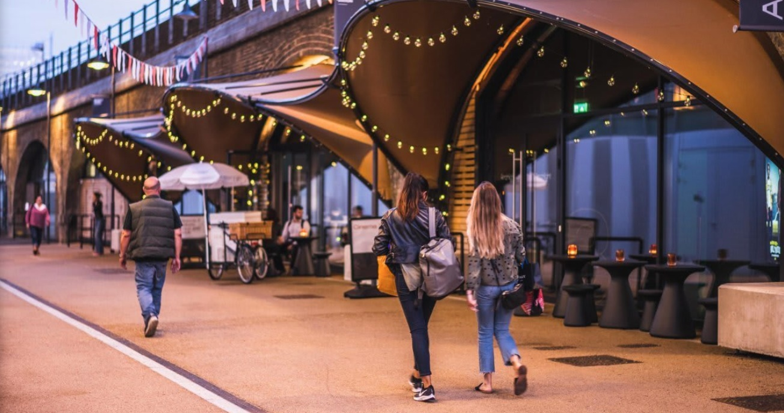
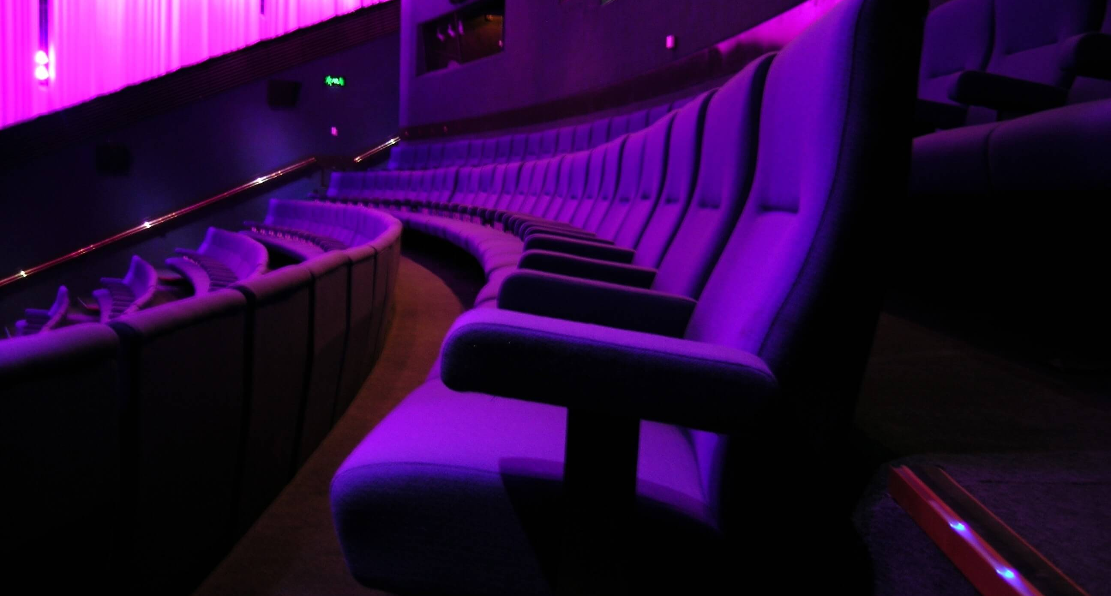
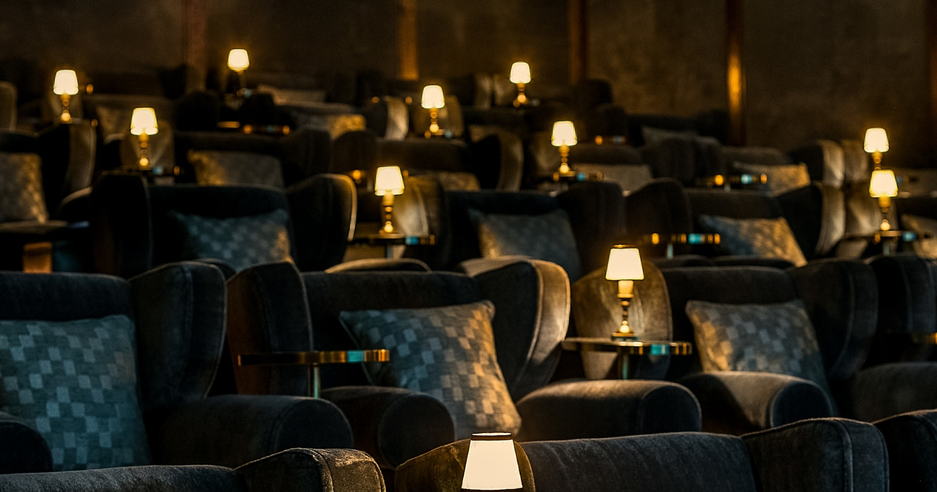
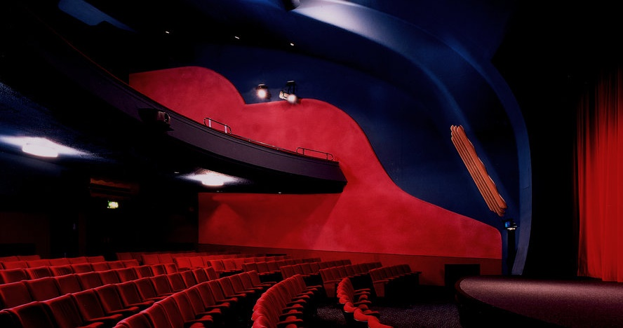
Electric, White City
Recent additions London
Archlight, Battersea
Rio, Dalston
Barbican

