Slide 1

Maximise with cinema
Notes:
The role cinema can play within the AV mix to maximise outcomes

Slide 2
Cinema’s popularity continues to endure
Cinema’s appeal, particularly among younger adults, has sustained making it one of the most
popular out-of-home leisure activities enjoyed.
Source: GB TGI October 2024

Slide 3
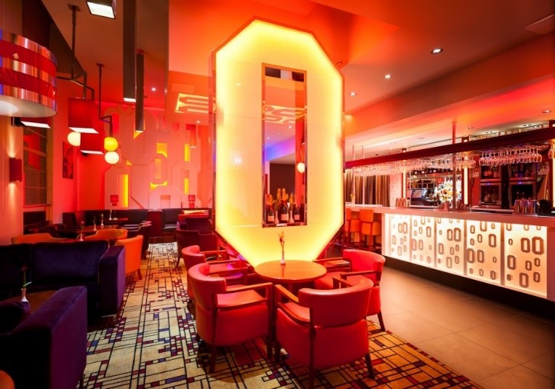


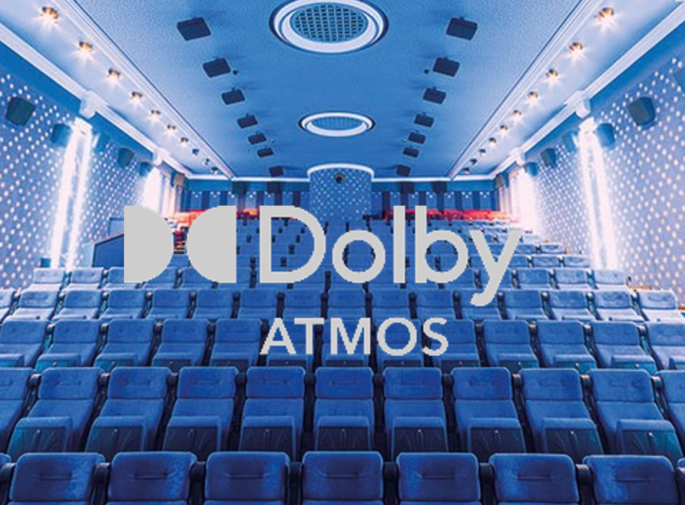



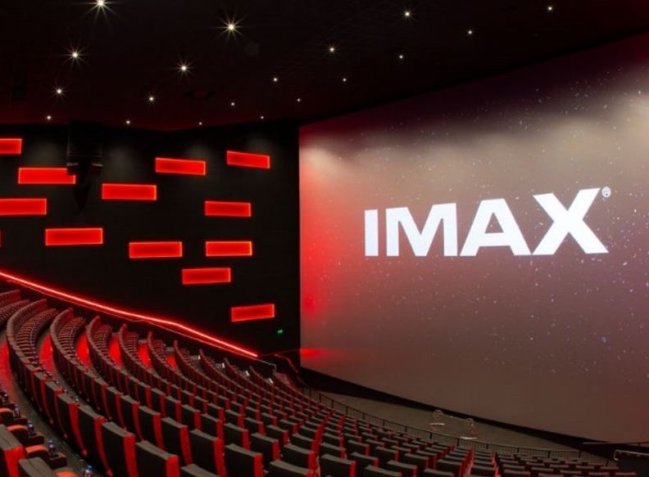

The cinemagoing experience: bigger and better than ever
Notes:
Cinemas have been investing heavily to ensure cinema provides a luxurious and innovative experience for audiences.

Slide 4
Cinema: resilient & offering affordable entertainment
The UK cinema sector remains in a strong place
+10% increase in number of cinemas across the last 10 years
£7.92
Average ticket
price
+10% increase in
admissions since
2022
Sources: Cinema UK / Comscore. UK figures.
Notes:
The UK cinema sector remains in a strong place – an affordable entertainment option will always attract an audience, and we continue to see YOY growth in admissions since 2021.

Slide 5






Cinema continues to create huge cultural moments
Half of the films in the Top 10 All-Time UK Box-Office list have been released in last 5 years…
Source: Comscore Movies
Notes:
No Time To Die / Spider-Man: No Way Home / Barbie / Avengers: Endgame / Top Gun: Maverick

Slide 6
The Maximiser: the role of cinema for brands
Cinema’s strengths allow it to play a multitude of role for brands
Maximise awareness
Maximise consideration
Maximise sales

Slide 7
Cinema profiles younger and more upmarket
Cinema is a great complement to TV & online video campaigns providing a more affluent, younger skewing audience
Source: GB TGI Jan 2024 (Dec 2022 – Nov 2023)- ‘Been to the cinema in the last week’ / Channels watched in the last week’ / Instagram, Facebook, TikTok & YouTube = Used in last 7 days

Slide 8
Maximise 16-34 reach with cinema
Redistributing weight from linear TV into cinema can increase total campaign weight for key audiences – as seen below with this £2.5m AV budget example.
Cinema maximises
16-34 reach
by +6pts
Source: DCM AV Reach Maximiser, powered by IPA Touchpoints 2024 Channel Planner Data
Notes:
Something we’re very confident of is the effectiveness of cinema to be able to deliver cost efficient incremental reach within the AV mix.
Using various tools and models, we’re able to forecast AV campaigns that can deliver significantly greater uplift when compared against AV plans that have excluded cinema.
The chart on the left shows a typical heavyweight AV mix working to a total budget of £2.6m, with the inclusion of only TV, VOD, and OLV.
On the right, you’ll see the addition of cinema into the mix, while keeping the total budget the same, we can deliver an uplift of 3 percentage points vs. Housepersons with Children, and 11 percentage points vs. 16-34s.
It’s worth noting, if you wanted to achieve these uplifts in linear TV alone, you’d expect to need to increase your budget by millions of pounds, but also worth noting your frequency against heavy TV viewers would exceed diminishing returns.

Slide 9

Maximise attention with Cinema
A far greater proportion of your ad – 24 seconds of a 30” and 48 seconds of a 60” - will be watched in cinema
Lumen norms
Source: Lumen Attention Research Channel Benchmarks
Notes:
As you can see Cinema is really the stand out media when it comes to driving engagement – on average 24 seconds of a 30” ad are watched, and 48 seconds of a 60”. The level of attention provided by exposure to the ad in cinema far surpasses what is achievable in other formats and really allows for deep engagement with the brand and the message.
By comparison TV on average delivers a solid 15.5 seconds attention to a 30” ad, and there’s a decreasing tail of attention available across other formats e.g. 4 seconds of a 15-20” bumper on YouTube and 1-1..5 seconds attention paid to Facebook and Instagram Infeed advertising.

Slide 10
If you want to maximise cost-effective attention, start with cinema in your AV mix
Cinema’s unbeatable level of attention to ads means when you adjust CPMs for attention it’s significantly more cost-effective than paid social
Source: Ebiquity and Lumen – Maximising Profit through Attention 2024. Cinema based on AGP buy. TV: estimated Brand TV Adult CPT 2024. OOH: average Ad CPT based on discounted panel rates across range of standard & broadcast formats
Notes:
Cinema’s unbeatable level of attention to ads means when you adjust CPMs for attention it’s significantly more cost-effective than paid social
Underlying CPTs:
TV- £8
Online Video - £4.62
Social - £3.02
OOH - £4
Cinema - £40
Online Display - £1.27
One challenge we hear from agencies and clients is that cinema is too expensive, and if you look at it purely through a lens of CPTs, you can understand where that challenge stems from.
But we know that not all impacts are made equal. Although some channels can offer cheaper impacts, a lot of that delivery can often go unnoticed.
We know the importance and effectiveness of attention to deliver uplift against key brand metrics.
And we have applied Lumen Attention data to estimated industry 16-34 CPMs to calculate an Attentive CPM, and again, cinema outperforms linear TV, OOH, digital display, and Facebook, whilst being comparable to YouTube and Instagram, so really impressive numbers.
We can therefore quite confidently counter the premium price challenge, and demonstrate that if you want cost-efficient attention, you need to start with cinema.

Slide 11
Maximise shared viewing with cinema
Cinema is THE shared experience – almost all showings of your ad will be in a collective environment compared to YouTube and TV often being solus views.

Slide 12
Cinema maximises social and fitness signals
Research from everyday people and EssenceMediacom shows how cinema advertising excels when it comes to deliver strong ‘social’ and ‘fitness’ signals for brands for the 16-34 audience
Social Signal
Fitness Signal
Source: Everyday People / EssenceMediacom, January 2024
Notes:
Research from Everyday People and EssenceMediacom shows how cinema advertising excels when it comes to deliver strong ‘social’ and ‘fitness’ signals for brands for the 16-34 audience.

Slide 13
Maximise positive brand impact with cinema
Independently run campaign effectiveness studies have shown that cinema delivers significant uplifts on key brand metrics
Ad awareness
+19%
Recall
+44%
‘Everyone knows this brand’ (Agree)
+12%
‘Everyone likes this brand’ (Agree)
+26%
Brand perception statements
+23%
Awareness, Recall & Brand Perceptions (Top3) Source: Differentology, databank of 100+ cinema campaign effectiveness studies. Brand Fame Metrics Source: Everyday People, based on six campaigns. Relative uplifts between those exposed to the ad in cinema vs. those not exposed to ad in cinema (Demographically matched groups)
Notes:
Since 2015 DCM have been working with Differentology to measure the effectiveness of cinema advertising for brands, and they have now built up a databank of 60+ campaigns from across 18 different product categories that we can tap into to understand the impact cinema can have as part of the media mix.
Comparing the results of those exposed to the cinema ad vs. those not exposed to the ad in cinema we can see that a highly attentive view of your ad in cinema delivers significant uplifts across important metrics including recall, awareness, brand perceptions, consideration and intention to act.

Slide 14
Maximising trust & premium perceptions
‘The advertising is premium…’ top 3 scores indexed vs cinema
‘I trust the advertising in…’ scores indexed vs cinema
Premium Source: FAME, All Cinemagoers 15+. Trust Source: IPA Touchpoints 2023 Superhub. Base: All Adults 15+. ‘I trust the advertising in…’ - % agree
Notes:
Cinemagoers are significantly more likely to perceive the advertising they see on the big screen as premium and trusted vs. other AV channels – specifically over twice as likely vs. online / online video advertising.

Slide 15

Cinema maximises perceived brand value
Price sensitivity meter output Laundry detergent brand
Cinema delivers price premium +14% above the average
Average optimal price point:
£6.71
Source: DCM/everyday people 2025. Base: 150 UK adults per media cell
*Statistically significant difference vs. all media except for TV and Video Sharing at 95% confidence interval
Notes:
The study found that when people are told a new brand is launching, price premium can be influenced simply by changing the media channel the brand is said to be advertising on.

Slide 16



Cinema maximises positive brand impact
Better brand impression
+28%
Cinema contributed 7% to ‘brand desire’ – 4x more effective than the next best channel - despite only accounting for c.1% of the overall media spend
Consideration
+32%
Consideration of purchasing a Kia electric car increased by 8% across the first year of the campaign.
Intention to act
+16%
Cinema delivered an uplift in ‘Aspirational’ perceptions (+36%) and consideration of Prada Paradoxe (+28%).
Source: Differentology, databank of 90+ cinema campaign effectiveness studies. Relative uplifts between those exposed to the ad in cinema vs. those not exposed to ad in cinema (Demographically matched groups). Top 2 agree scores reported for consideration and brand impression
Notes:
Cinema can help drive brand affinity and impression, and ultimately unlock significant increases in key mid-funnel metrics including consideration and purchase intent
Since 2015 DCM have been working with Differentology to measure the effectiveness of cinema advertising for brands, and they have now built up a databank of 60+ campaigns from across 18 different product categories that we can tap into to understand the impact cinema can have as part of the media mix.
Comparing the results of those exposed to the cinema ad vs. those not exposed to the ad in cinema we can see that a highly attentive view of your ad in cinema delivers significant uplifts across important metrics including recall, awareness, brand perceptions, consideration and intention to act.

Slide 17
Maximise incremental profit with cinema
Data from Ebiquity, GroupM and Lumen highlights how cinema’s high attention environment leads to a significant impact – driving incremental profit and return on investment for brands
For every £1 invested…
Cinema ROI = £2.56
Long-term incremental profit per 000 impressions
Attentive seconds per 000 impressions
£2.56 stat sourced from Thinkbox, GroupM, Ebiquity – Profit Ability 2. Chart Source: Ebiquity and Lumen – Maximising Profit through Attention 2024

Slide 18


Geo-targeting to drive efficient response
Using Cinemapper, DCM’s cinema proximity planning tool, you can run a targeted cinema campaign or add a localised spin to your national campaigns.
Map postcodes of your stores, key catchment areas etc. to the nearest cinemas based on distance in miles, drive time or walk time
Add end frame messaging to direct the audience to their nearest location
Notes:
1. All DCM sites can be bought on an individual basis
2. Regions split same as ISBA TV regions
3. Pricing will be subject to location and size of venue
4. Multiple end frame messaging offers a way of
directing consumers direct to their local store,
dealership, location or franchise

Slide 19







Cinema delivers ROI
      “Cinema is responsible for significant incremental sales and delivered ROI of £18 for every £1 spent”
      Cinema was the top performing above-the-line channel during the campaign – with a ROI of £50 for every £1 invested
      The stores in locations running cinema saw a 9% YOY increase in attributed sales outperforming other outlets by 3%.
      Sales in the test region increased by 2.6% as a result of the cinema activity
Healthy Skin Harmony saw 3.5% value sales growth & Max Factor was the No.1 selling self-select cosmetics brand in Boots in December
Like-for-like sales increased by 12% (against sector decline) with Cinema delivering 60% of the incremental sales.
Source: DCM case studies

Slide 20
Maximise impact with cinema
The strengths of cinema are particularly influential for campaigns where you may be starting something new – e.g. new campaigns, new products & new messages
Cinema delivers unrivalled attention
Cinema delivers exclusive reach
Cinema: the place for co-viewing
Cinema delivers impact
A necessity for storytelling
Particularly for 16-24, 16-34 and houseperson with children audiences
Increasingly key as this declines in some linear AV environments
An immersive, trusted & premium environment that can deliver brand and response outcomes

