Slide 1
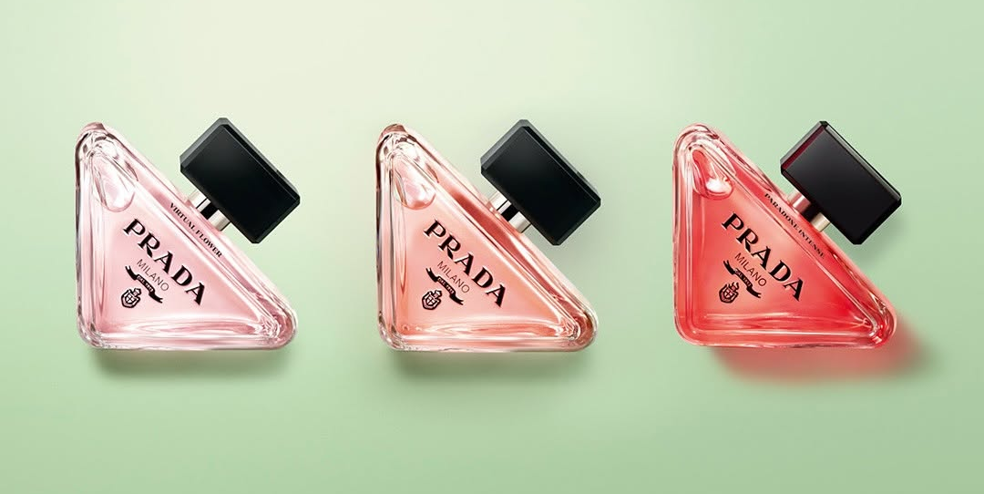
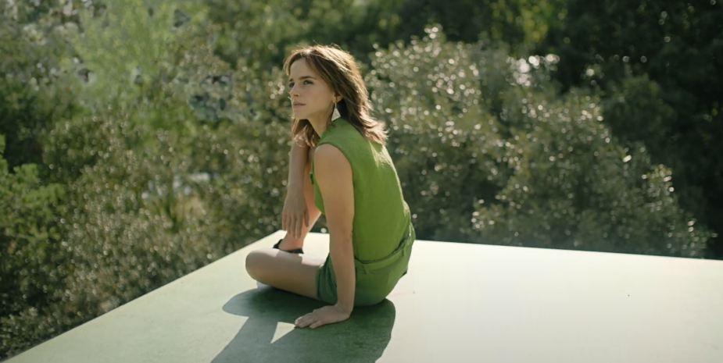

L’Oreal
Background
As part of the launch of the new Prada Paradoxe fragrance, L’Oreal wanted to maximise reach to potential buyers, as well as generally driving awareness and buzz around the brand. It was also vitally important for the campaign to reflect the quality and prestige of the product.
Plan
To effectively reach a predominantly female audience, the ad ran in the Bronze Spot in Don’t Worry Darling and in-reel across 16-34 Women AGP titles including Elvis, Where the Crawdads Sing, Ticket to Paradise and The Woman King.
Results
Awareness of the Prada Paradoxe fragrance was up +45% vs. control sample, consideration similarly up +28%
Perception that Prada Paradoxe is ‘sophisticated and aspirational’ up +36% amongst those exposed via cinema.
Source: DCM / L'Oréal Prada Paradoxe. Conducted by; Differentology, September 2022.
Notes:
Source: DCM / L'Oréal Prada Paradoxe. Conducted by; Differentology, September 2022.
Results base: Females 16-34. Uplifts are test (exposed to ad in cinema) vs control (not exposed to ad in cinema)

Slide 2
L’Oreal
Prada Paradoxe
Media agency | Target | Buying route | Copy length
EssenceMediacom | Women | Bronze spot 16-34 Women AGP | 60”
Background
As part of the launch of the new Prada Paradoxe fragrance, L’Oreal wanted to maximise reach to potential buyers, as well as generally driving awareness and buzz around the brand. It was also vitally important for the campaign to reflect the quality and prestige of the product.
Plan
With their creative copy - capturing “the essence of the undefinable and ever-evolving Prada woman” - fronted by actress Emma Watson, L'Oréal wanted to showcase this in big impactful environments and chose cinema as the perfect partner for this.
To effectively reach a predominantly female audience, the ad ran in the Bronze Spot in Don’t Worry Darling as well as a 16-34 women AGP, with titles including Elvis, Where the Crawdads Sing, Ticket to Paradise and The Woman King.
Results
The high-impact environment of cinema worked effectively, driving significant uplifts across key metrics:
Driving product awareness
Awareness of Prada Paradoxe was up +45% vs. control sample.
Heightened consideration
Likelihood to consider Prada Paradoxe was +28% amongst those exposed via cinema.
Improving brand perceptions
Perception that Prada Paradoxe is ‘sophisticated and aspirational’ was up +36% amongst those exposed via cinema.
Source: DCM / L'Oréal Prada Paradoxe. Conducted by; Differentology, September 2022.
Notes:
Source: DCM / L'Oréal Prada Paradoxe. Conducted by; Differentology, September 2022.
Results base: Females 16-34. Uplifts are test (exposed to ad in cinema) vs control (not exposed to ad in cinema)

