Slide 1

Blipverts

Slide 2
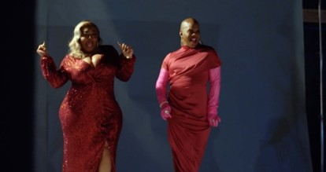

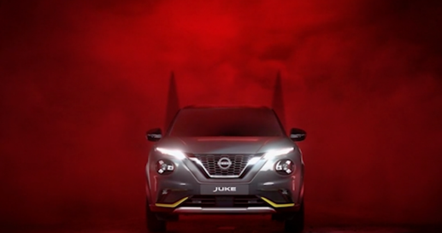




Blipverts
Summary
Blipverts are typically 10 seconds long and most likely there will be three of them throughout the ad reel to make the equivalent of one 30 second spot. Blipverts are often used to create excitement or intrigue about a new launch. They can be used to generate curiosity about what is to come and then are followed up by a 30-60” ad later on that provides more information.
Key benefits - Brand objectives - awareness
Disrupt the reel entirely and take cinema audiences on an unexpected
journey with your brand
Dominate the DCM ad reel and give brands full ownership
Build awareness, deliver cut through and generate higher frequency
Click here for case studies
Clients
Production
6-8 weeks (est)
Length
5” – 10”
No. blipverts
2-5
Source: DCM Planner, based on industry admissions

Slide 3
Blipverts
Although they are usually the shortest ads in the pre-show, blipverts are designed to dominate the DCM ad reel prior to the brand ad in either reel or premium spot.
1.
10”
DCM
opening ident
2.
10”
Blipvert
3.
Brand ads
4.
10”
Blipvert
5.
Brand ads
6.
10”
Blipvert
7.
Brand ads
8.
30”
hero ad
9.
Bronze Spot
10.
15”
DCM
closing ident
11.
Silver spot
12.
Film trailers
13.
Gold spot
14.
Film
Blipvert #1
Blipvert #2
Blipvert #3

Slide 4
The power of blipverts
Audience reaction to blipverts are very positive with cinemagoers rating them as more memorable and something they’re even more likely to pay attention to and act on.
Blipverts Statements - Top 3 ‘Strongly agree’ scores
68%
73%
67%
62%
Advertising in this format is more memorable than a typical cinema ad
Advertising in this format is more engaging than a typical cinema ad
I pay more attention to cinema advertising in this format
Advertising in this format would make me more likely to consider the brand or product being advertised than
typical cinema ads
Source: DCM Conducted by; Differentology, October 2022.
Results base: 18-54s. To what extent do you agree or disagree with these statements about ads shown in the blipvert format? (10-point scale).

Slide 5






Contextually relevant content enhances these shifts in brand metrics
Meta-analysis of 22 recent cinema campaigns & 7 contextual / bespoke campaigns
+55%
+20%
+33%
+38%

