Slide 1

Activations

Slide 2
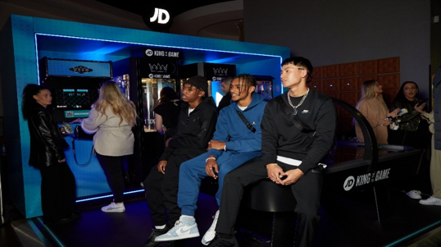
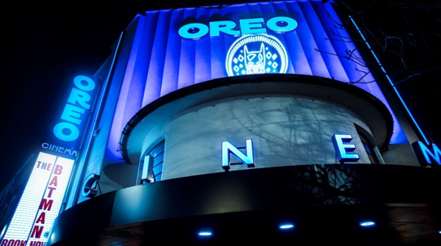
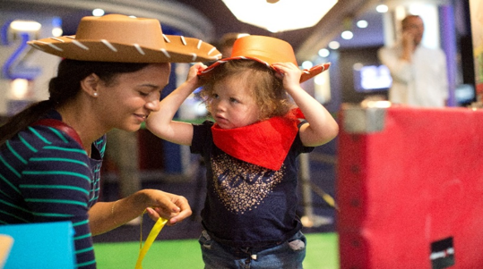
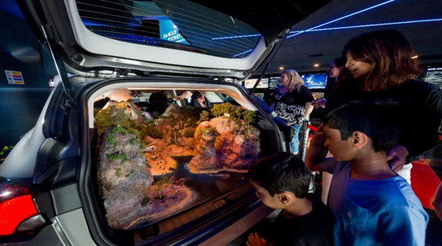







Activations
Immersive activations will create a truly impactful and unforgettable cinema trip.
Summary
DCM Studios partner with cinemas across the country to enhance a typical cinema trip into an immersive journey with your brand. By utilising the cinema space more effectively, we have opened up new touch points for brands to explore with their customers being at the forefront of it all.
Key benefits - brand objectives – action
Brand activation provides a unique, memorable experience to increase brand awareness and brand loyalty.
Through a multi-touch brand experience with several interactive and engaging elements, cinema has proven to be a unique medium for brands to immerse their audience and bring their brand to life.
Click here for case studies
Case studies
Audience
Activation Dependent
Min Spend
£100k (£50k Media & £50k Activation)

Slide 3
