Slide 1

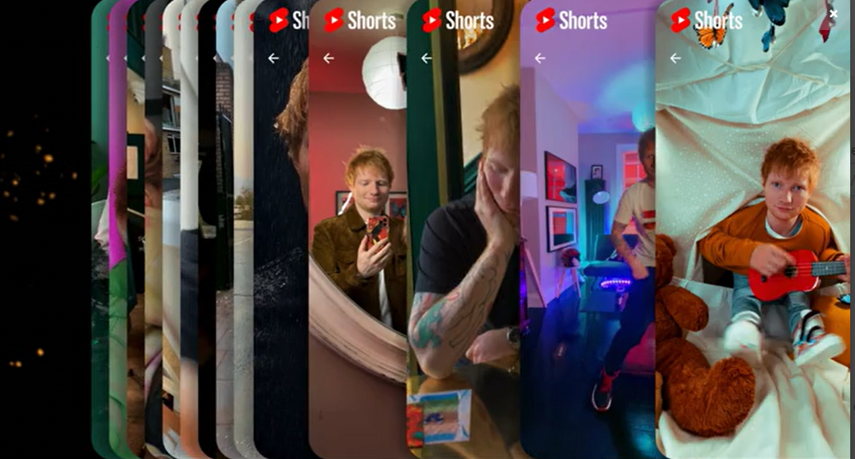
YouTube
Background
YouTube launched its new snackable media platform - YouTube Shorts which needed a big, bold launch campaign to break through the competition, drive attention and maximise awareness.
Plan
In partnership with DCM Studios, YouTube created a Blipvert campaign, running as a sequence of 2 x 6” blips and a hero 20” AV creative, mimicking the reel-like content on the Shorts platform. Buying a 16-34 AGP ensured the campaign reached the target audience and YouTube also showcased the ad on OOH foyer screens within cinemas.
Results
Cinema performed brilliantly with the campaign over-delivering by 200k admissions, and with a total of 600k cinemagoers seeing the OOH panels within the foyer.

Slide 2

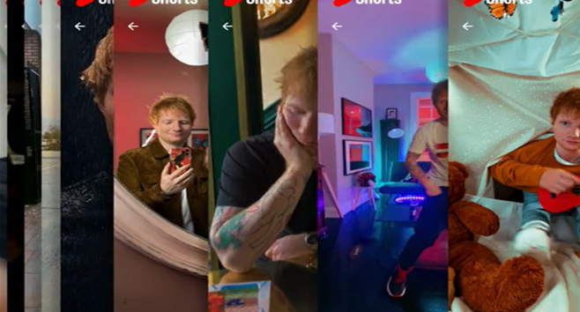

YouTube
Media Agency | Target | Buying Route | Copy length
OMD UK | 16-34S | 16-34 AGP | 6” Blips + 20”
YouTube Shorts Launch
Background
YouTube launched its new snackable media platform - YouTube Shorts. The next generation of mobile-first creators would be able to create short, snappy and easily digestible content. YouTube then needed a big, bold launch campaign to break through the competition, drive attention and maximise awareness.
Plan
In partnership with DCM Studios, YouTube created a Blipvert campaign, running as a sequence of 2 x 6” blips and a hero 20” AV creative, mimicking the reel-like content on the Shorts platform. Buying a 16-34 AGP ensured the campaign reached the target audience. The ad ran in some of the biggest films of the year: No Time to Die, Shang-Chi and the Legend of the Ten Rings, and Venom: Let There Be Carnage.
Alongside the on-screen activity, YouTube also bought into the foyer with cinema OOH panels reaching people in the foyers before the film. This not only allowed created multiple touchpoints across the cinema journey to drive frequency, but also extended reach to other cinemagoers who weren’t going to see one of the titles the campaign was running in.
Results
Cinema’s role in the campaign was a success with YouTube able to deliver on key brand metrics through cinema exposure.
Exceeding Impression Targets
Cinema performed brilliantly with the on-screen campaign over-delivering by 200k admissions, and with a total of 600k cinemagoers seeing the OOH panels within the foyer.
“We were very pleased to see the collaborative work with DCM to create unique blipvert formats to reflect our assets and overall new platform content. Overall, it was great launch of Shorts across cinema with stellar admissions and footfall over-delivery!” Adam Burrows (Head of User & Subscriptions Marketing UK, YouTube)

