Slide 1
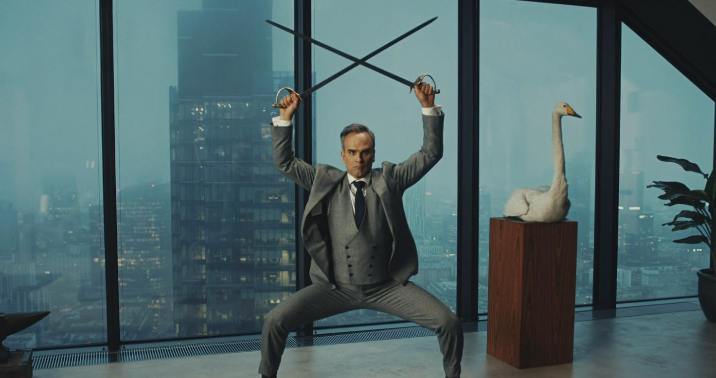
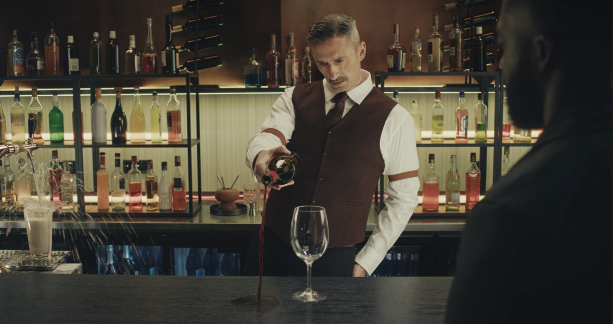

Wilkinson Sword
Background
Struggling to stand out against competitors in the market, Wilkinson Sword wanted to find a way to impactfully reach 18-34 men.
Plan
Wanting to maximise reach in an attentive and engaging environment, Wilkinson Sword introduced cinema to the wider media plan for the first time. The ‘Blade Masters’ 30” copy ran in-reel as part of a wider campaign, efficiently reaching young men via the release of Deadpool & Wolverine.
Results
Recall amongst exposed was up +34% vs control
Consideration increased by +17% vs control, with just under 50% ‘Very Likely’ to consider Wilkinson Sword
Intent to buy among those exposed to the ad in cinema also increased by 35%.
Source: DCM / Wilkinson Sword. Conducted by; Differentology July 2024.
Notes:
Source: DCM / Wilkinson Sword. Conducted by; Differentology July 2024.
Uplifts are control (not exposed to ad in cinema) vs test (exposed to ad in cinema)

Slide 2
Wilkinson Sword
‘Blade Masters’
Media agency | Target | Buying route | Copy length
VCCP | 18-34 Men | Film pack | 30”
Background
Struggling to stand out against competitors in the market, Wilkinson Sword knew they had to find a way to impactfully reach its target audience of 18-34 males. Looking to launch a new creative that would promote the quality of its products and good value credentials Wilkinson Sword ultimately wanted to re-assert the brand as high-quality and drive awareness & consideration.
Plan
Wanting to maximise reach in an attentive and engaging environment, Wilkinson Sword introduced cinema to the wider media plan for the first time, running the ‘Blade Masters’ 30” copy in-reel as part of their wider campaign that included BVOD, Social, YouTube & Outdoor.
With the release of Deadpool & Wolverine, Wilkinson Sword knew cinema would be an efficient way of reaching the target demo of young men.
Results
Recall amongst exposed was up +34% vs control with over half of cinemagoers recalling the ad.
Amongst those exposed just under half claimed to be ‘Very Likely to consider Wilkinson Sword, up +17% vs control.
Those exposed to the ad in cinema were also significantly more likely to ‘intend to buy Wilkinson Sword next time’ – up +35% vs. control
Source: DCM / Wilkinson Sword. Conducted by; Differentology July 2024.
Notes:
Source: DCM / Wilkinson Sword. Conducted by; Differentology July 2024.
Uplifts are control (not exposed to ad in cinema) vs test (exposed to ad in cinema)

