Slide 1
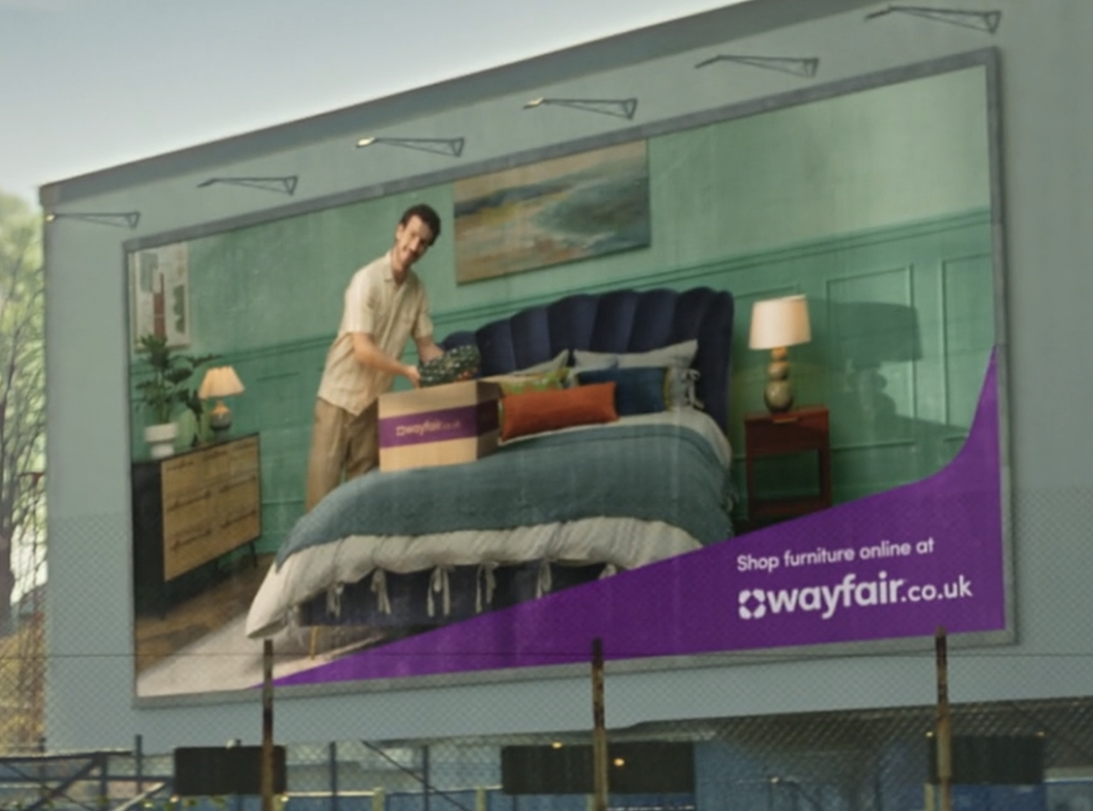
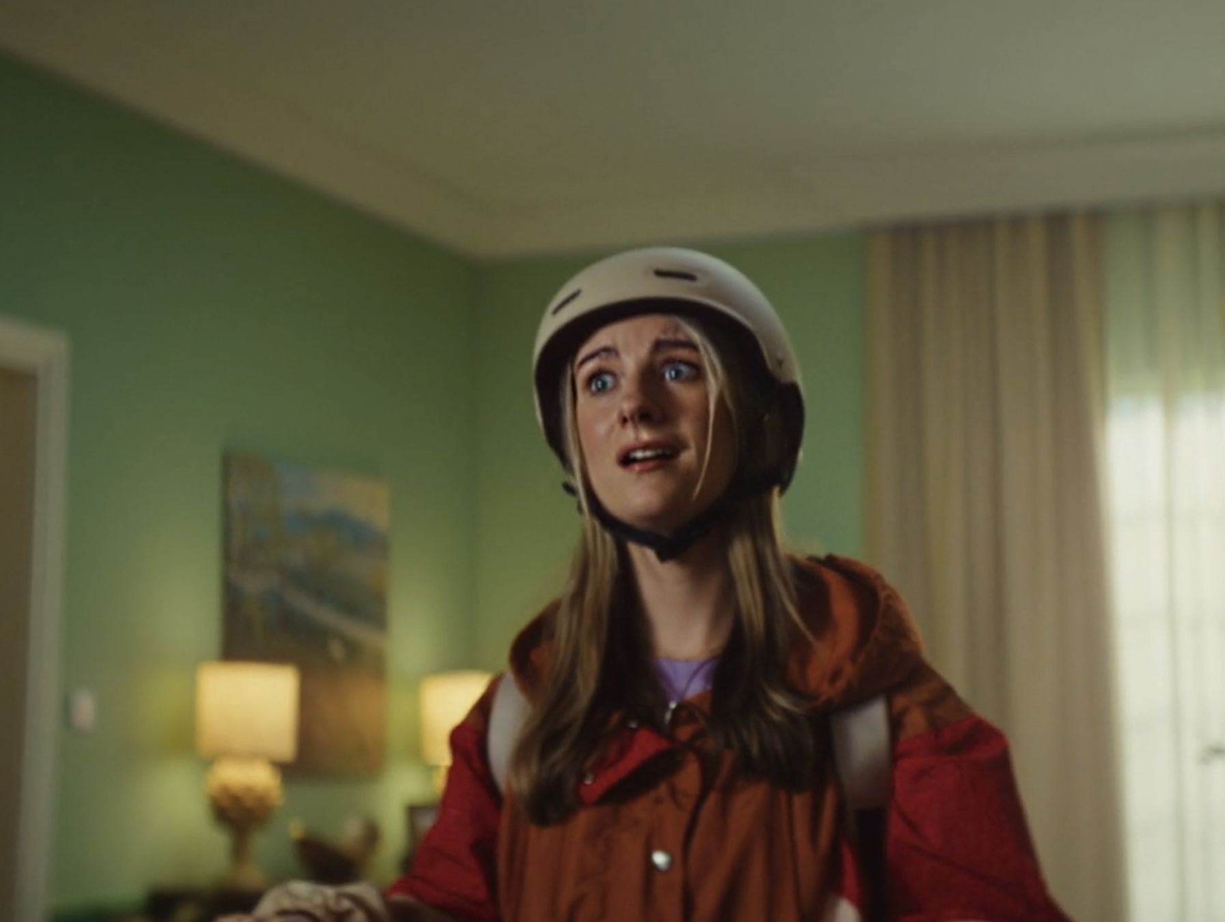

Wayfair
Background
While prominent in the US, Wayfair has yet to break the UK with main competitor, IKEA, holding the advantage of heritage and physical retail locations. The goal of this campaign was to grow brand familiarity amongst key ABC1 Ads audience.
Plan
Wayfair ran in an ABC1 Adults AGP across April-May 2025 accessing films such as The Penguin Lessons, Sinners & Thunderbolts*. DCM’s Cinemapper was also used to ensure specific areas were targeted with the cinema campaign.
Results
Amongst those exposed via cinema, there was a +111% uplift in those who knew Wayfair ‘very well’.
+62% significant uplift in those intending to purchase homeware from Wayfair vs. those not exposed in cinema.

Slide 2
Wayfair
Media agency | Target | Buying route | Copy length
Wavemaker ,Manchester | ABC1 25-54 | ABC1 Adults AGP | 30”
‘Get it out of your head, and into
your home’
Results
The cinema campaign was impactful at driving KPIs across Wayfair’s core campaign objectives.
Increased familiarity
Amongst those exposed via cinema, there was a +111% uplift in those who knew Wayfair ‘very well’.
Boosting intent to purchase
+62% significant uplift in those intending to purchase homeware from Wayfair vs. those not exposed via cinema.
Background
While prominent in the US, Wayfair has yet to break the UK, with main competitor, IKEA, holding the advantage of heritage and physical retail locations. The latest creative showcased the ease of making purchases on Wayfair, not letting life’s busy nature get in the way. The campaign’s aims were to grow familiarity amongst a key ABC1 Adult audience and to ultimately drive intent to purchase.
Plan
Ensuring effective reach amongst the target audience, Wayfair ran in an ABC1 Adults AGP across April-May 2025 accessing films such as The Penguin Lessons, Sinner & Thunderbolts*.
Cinema’s premium environment provided high levels of attention, helping Wayfair to successfully land key messaging and prompt action amongst those exposed. DCM’s Cinemapper was also used in order to pinpoint specific the key areas that would run the cinema campaign.

