Slide 1
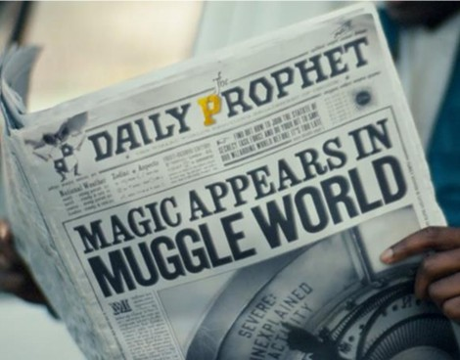
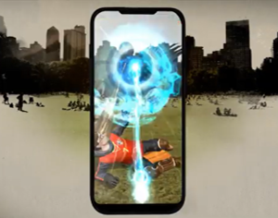

Warner Bros. Games
Harry Potter: Wizards Unite
Background
Warner Bros. Games wanted to create buzz and drive pre-registrations for the upcoming Harry Potter: Wizards Unite augmented reality mobile game.
Plan
Warner Bros. Games committed to two bursts of the campaign, with the first launching the first teaser trailer in the ad reel ahead of Fantastic Beasts: The Crimes of Grindelwald and the second launching in the Gold Spot ahead of Pokémon: Detective Pikachu targeting fans of the Pokémon Go game.
Results
Making cinema the home of the exclusive teaser propelled Harry Potter: Wizards Unite into a zeitgeist moment that drove conversation, word-of-mouth and ultimately made it one of the most pre-registered apps ever on Google Play Store.

Slide 2

Warner Bros. Games
Media Agency | Target | Buying Route | Copy length
PHD | 16-34 Adults | Film Packs | 60”
Harry Potter: Wizards Unite
Background
Warner Bros. Games wanted to create buzz and drive pre-registrations for the upcoming Harry Potter: Wizards Unite augmented reality mobile game.
Plan
Early in the planning process it was identified that cinema would be a key channel for teasing the game given the cinematic heritage of the franchise. Warner Bros. wanted to reveal more about the game in two strategic bursts and capitalised on the theatrical slate to achieve this. The first burst launching the first teaser trailer in the ad reel ahead of Fantastic Beasts: The Crimes of Grindelwald and the second launching in the Gold Spot ahead of Pokémon: Detective Pikachu targeting fans of the Pokémon Go game.
The contextually relevance meant Warner Bros. could create a real ‘moment’ in the reel, reigniting the fandom and building anticipation and excitement that could then be amplified by a wider digital content strategy ahead of release.
Results
Cinema helped Warner Bros. Games drive buzz and excitement, social sentiment tracking also showed that cinema helped drive huge amounts of online conversation.
Making cinema the home of the exclusive teaser propelled Harry Potter: Wizards Unite into a zeitgeist moment that drove conversation, word-of-mouth and ultimately made it one of the most pre-registered apps ever on Google Play Store.

