Slide 1

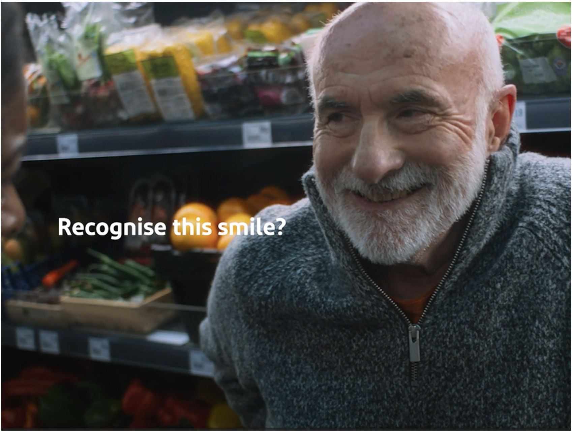

Voltarol
Background
GSK aimed to transform Voltarol’s existing awareness into increased consideration and boost perceptions surrounding quality of product with the target 35+ adult demographic.
Plan
GSK bought into an ABC1 Adults AGP to access demographically relevant films such as Wicked Little Letters, Back to Black, Civil War, and Monkey Man.
Results
61% of exposed cinemagoers very likely to consider Voltarol, a +7% uplift from those not exposed to the ad in cinema.
Over 30% exposed claimed they are intending to use or purchase a Voltarol pain relief product.
Source: DCM / Voltarol Conducted by; Differentology,Apr 2024.
Notes:
Source: DCM / Voltarol Conducted by; Differentology,Apr 2024.
Uplifts are control (unexposed to ad) vs test (exposed to ad)

Slide 2
Voltarol
‘The Joy of Movement’
Media agency | Target | Buying route | Copy length
Publicis | 35+ | Partnership & Idents | 30”
Background
Whilst Voltarol was already a renowned brand for being the best in relieving back and joint pain, GSK aimed to transform that awareness into increased consideration, as well as wanting to boost existing perceptions surrounding quality of product amongst a target demographic of 35+ adults.
Voltarol launched their new 'Smile' creative, which claims that 1 in 3 people hide their pain behind a smile, encouraging them to use targeted anti-inflammatory muscle and joint pain relief - the message promoted Voltarol as embodying the ‘joy of movement’.
Plan
GSK bought into an ABC1 Adults AGP to access demographically relevant films such as Wicked Little Letters, Back to Black, Civil War, and Monkey Man. Alongside this campaign ran across multiple media channels, including Meta, YouTube, and OOH.
Results
Exposure to the Voltarol ad in the attentive and engaging environment of cinema helped improve Voltarol's core metrics.
Brand awareness
Prompted awareness of Voltarol amongst those exposed was almost 90%.
Consideration and intent to act
61% were very or extremely likely to consider Voltarol, +7% uplift vs. control. Over 30% claimed they were intending to use or purchase a Voltarol pain relief product.
Source: DCM / Voltarol Conducted by; Differentology,Apr 2024.
Notes:
Source: DCM / Voltarol Conducted by; Differentology,Apr 2024.
Uplifts are control (unexposed to ad) vs test (exposed to ad)

