Slide 1
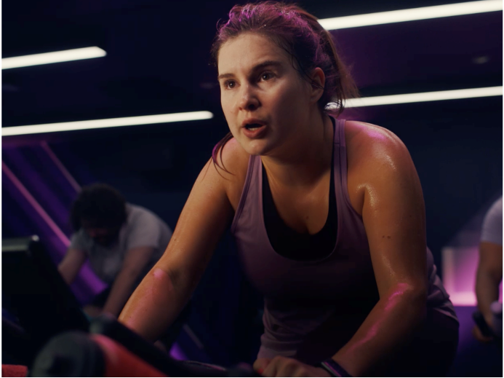
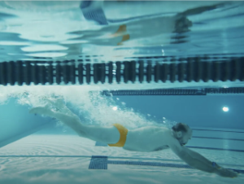

Virgin Active
DCM Awards nominee:
Best use of cinema (small)
Background
Amidst increased competition from both high-end and low-end gyms and against a backdrop of the cost-of-living crisis, Virgin Active wanted to promote an offer led campaign to build excitement around its gyms and stimulate growth in member sign-ups.
Plan
Virgin Active and Mindshare used DCM’s Cinemapper tool to plan efficiently, running in an ABC1 Adults AGP exclusively across cinemas that were within a 30-minute drivetime radius of Virgin Active’s 34 clubs.
Results
Starting with cinema as part of its plan proved successful for Virgin Active with the campaign driving +14% lift in sales vs. budgeted target.
Source: Virgin Active 2023 DCM Awards Entry
Notes:
Source: Virgin Active 2023 DCM Awards Entry

Slide 2
Virgin Active
DCM Awards nominee:
Best use of cinema (small)
Whatever gets you moving, it all counts
Media agency | Target | Buying route | Copy length
Mindshare | ABC1 Adults | ABC1 Adult AGP | 30”
Background
Virgin Active Clubs was facing an increase in competition from both high-end and low-end gyms and against a backdrop of the cost-of-living crisis decreasing disposable income for many, membership numbers had not yet returned to pre-pandemic levels. To counteract this, Virgin Active wanted to promote an offer led campaign to build excitement around its gyms and stimulate growth in member sign-ups.
Plan
Virgin Active and Mindshare used DCM’s Cinemapper tool to plan efficiently, targeting cinemas that were within a 30-minute drivetime radius of Virgin Active’s 34 clubs. This minimised wastage, ensuring they were targeting people most likely to join the gyms. The campaign period, ran from December to February when people were most likely to consider joining a gym. Running in an ABC1 Adults AGP gave Virgin Active broad reach across demos appearing in reels ahead of titles including M3gan, Babylon, Triangle of Sadness, I Wanna Dance With Somebody and Empire of Light.
Results
Cinema was highly effective, specifically the geo-target efficiencies allowed by planning through Cinemapper.
Success driving sales
The campaign drove a 14% lift sales vs. budgeted target.
Impact of geo-targeting
“Cinema activity was vital for Virgin Active to achieve impact and engagement with a captured audience. We focused on an audience buy that was layered with geotargeting cinema venues that had proximity to the clubs to drive efficiencies. Our overall cross media campaign drove a significant uplift in footfall to our clubs which we were delighted with.”
Caroline Macklin, Head of Brand, Virgin Active
Source: Virgin Active 2023 DCM Awards Entry
Notes:
Source: Virgin Active 2023 DCM Awards Entry

