Slide 1
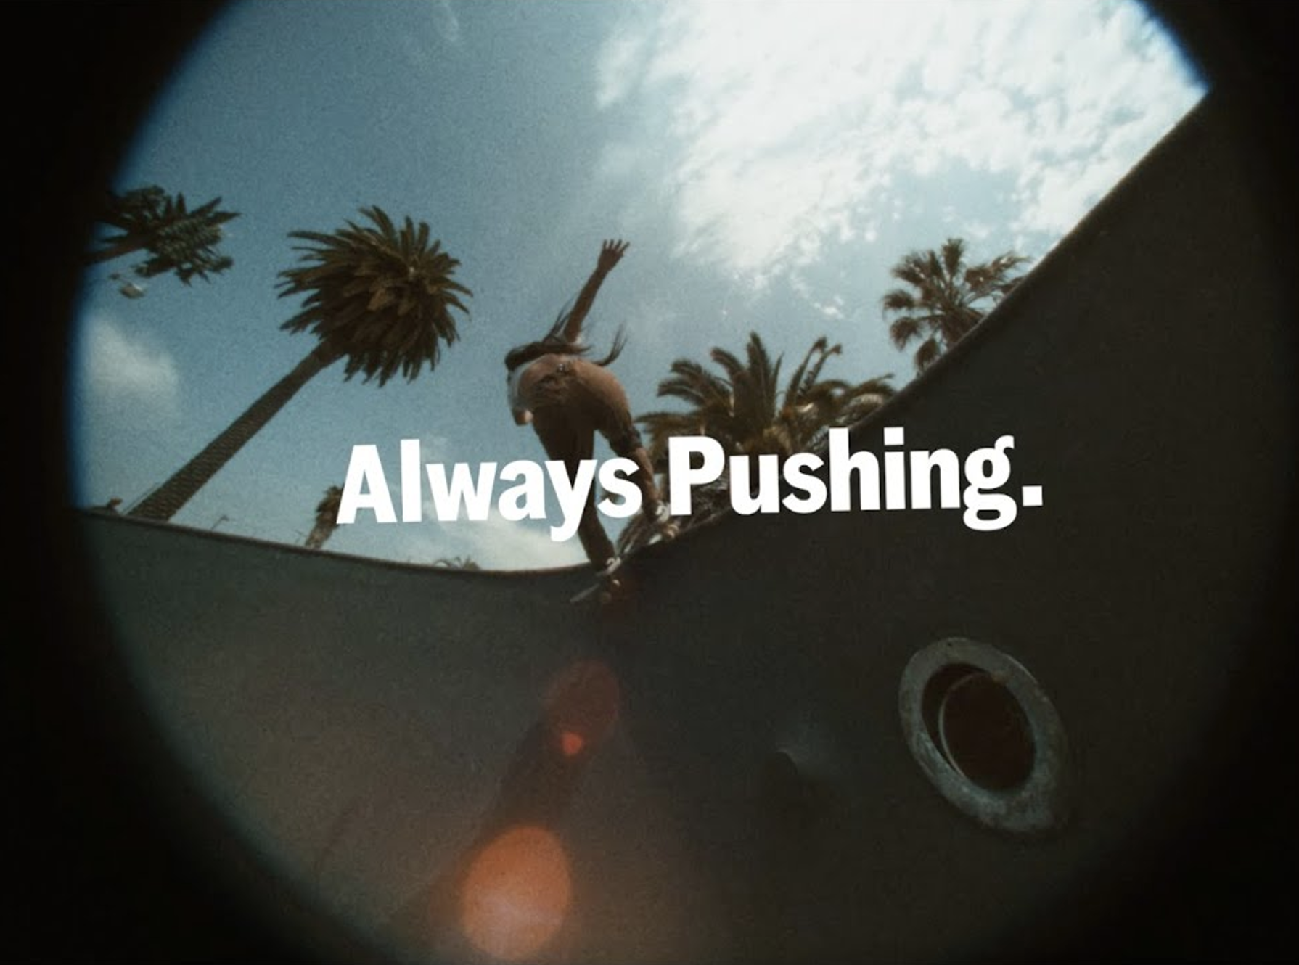
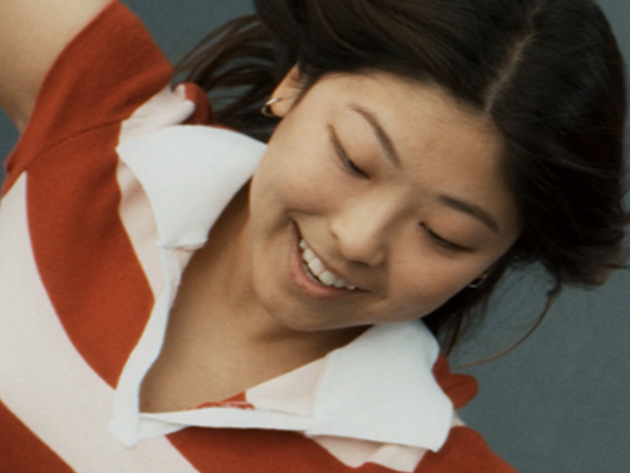

Vans
Background
Vans felt the brand was no longer top of mind, with no clarity on what the brand stood for. Knowing that young audiences look to associate themselves with brands that matter to them and reflect their values, Vans realised that they needed to enhance their relevancy through elevated storytelling.
Plan
Vans showcased a hero 60” copy in cinema – buying into 16-34 skewing films - to build an emotional connection with this audience.
Results
Around half of exposed cinemagoers agreed they were very likely to consider Vans, a significant +48% uplift from those not exposed to the ad in cinema.
The campaign saw a +88% significant uplift in agreeing that Vans is ‘for people like me’.
Notes:
No source

Slide 2
Vans
‘Always Pushing’
Media agency | Target | Buying route | Copy length
MGOMD | 16-34 | 16-34 AGP & Film Pack | 60”
Background
While recognising consistent success with existing consumers,
it was evident that potential new customers had lost clarity on what Vans stands for and the brand was no longer top of mind. Knowing that young audiences increasingly look to associate themselves with authentic brands that matter to them and
reflect their values, Vans realised that they needed to enhance their relevancy.
Plan
Vans showcased the hero 60” copy in cinema, to ensure their creative was seen in the premium, high attention cinema environment that would help build an emotional connection. The Vans campaign ran in films including Deadpool & Wolverine, A Quiet Place: Day One, Longlegs and Twisters and across other channels including Social, YouTube & Online.
Results
Cinema helped to significantly improve several of Vans core brand KPIs.
Perceptions
Uplifts across various perceptions… ‘is for people like me’ (+88%), ‘is a brand I want to be seen wearing’ (+41%) and ‘is well-known for what it does’ (+34%).
Consideration
Around half of exposed cinemagoers agreed they were very likely to consider Vans, a significant +48% uplift from those not exposed to the ad in cinema.
Notes:
No source

