Slide 1
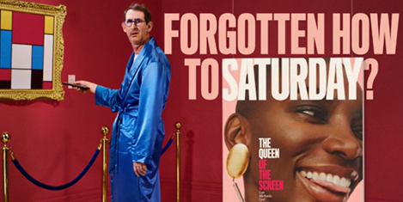
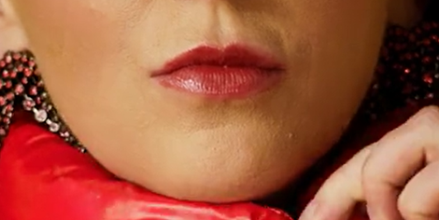

The Guardian
Background
The Guardian wanted to reach an ABC1 adult audience to relaunch its Saturday Magazine. The goal was to increase consideration of subscribing and ultimately drive market share.
Plan
The Guardian ran its 30” copy in showings of The French Dispatch – a story of a fictional Kansas newspaper supplement produced in the late 60’s by American expatriates. The 30” cinema spot became the hero piece of the relaunch, with wider activity on other AV, Print and OOH medias.
Results
In its launch week, the Saturday Guardian saw its highest market share for 19 months at 18.2%.
The campaign drove 1,080 subscriptions, 52% higher than the previous period and 44% higher than the target.
Source: The Guardian, DCM Awards entry

Slide 2
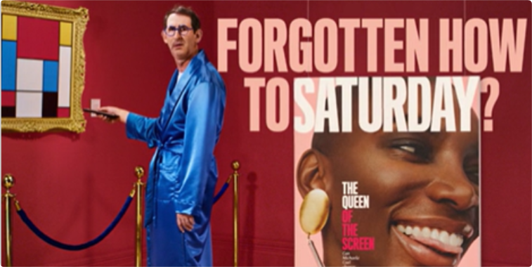


The Guardian
Media Agency | Target | Buying Route | Copy length
PHD Media | ABC1 Adults | Film Pack, AGP | 30”
Saturday Magazine Relaunch “Forgotten how to Saturday?”
Background
The Guardian wanted to create an impact using cinema’s high-attention, premium environment to reach an ABC1 adult audience to relaunch its Saturday Magazine, as a super-sized 100+ page format which would sit inside the day’s paper.
Plan
The Guardian specifically chose to run its 30” copy in showings of The French Dispatch – a movie which itself focused on the story of a fictional Kansas newspaper supplement produced in the late 60’s by American expatriates. The 30” cinema spot became the hero piece of the relaunch, with its creative then being re-purposed in shorter formats in paid digital, social, and online video to increase awareness amongst both a current and prospective audience.
This was also planned alongside non-video formats including physically sampling copies of the magazine, using OOH and using the full suite of the Guardian's own channels.
Results
The campaign was hugely successful at hitting key ROI targets, with cinema playing a crucial part at engaging audiences in a premium environment.
Increased Market Share
In its launch week, the Saturday Guardian saw its highest market share for 19 months (since March 2020) at 18.2%.
Exceeding Subscription Targets
The campaign drove 1,080 subscriptions, 52% higher than the previous period and 44% higher than the target.
Source: The Guardian, DCM Awards entry

