Slide 1
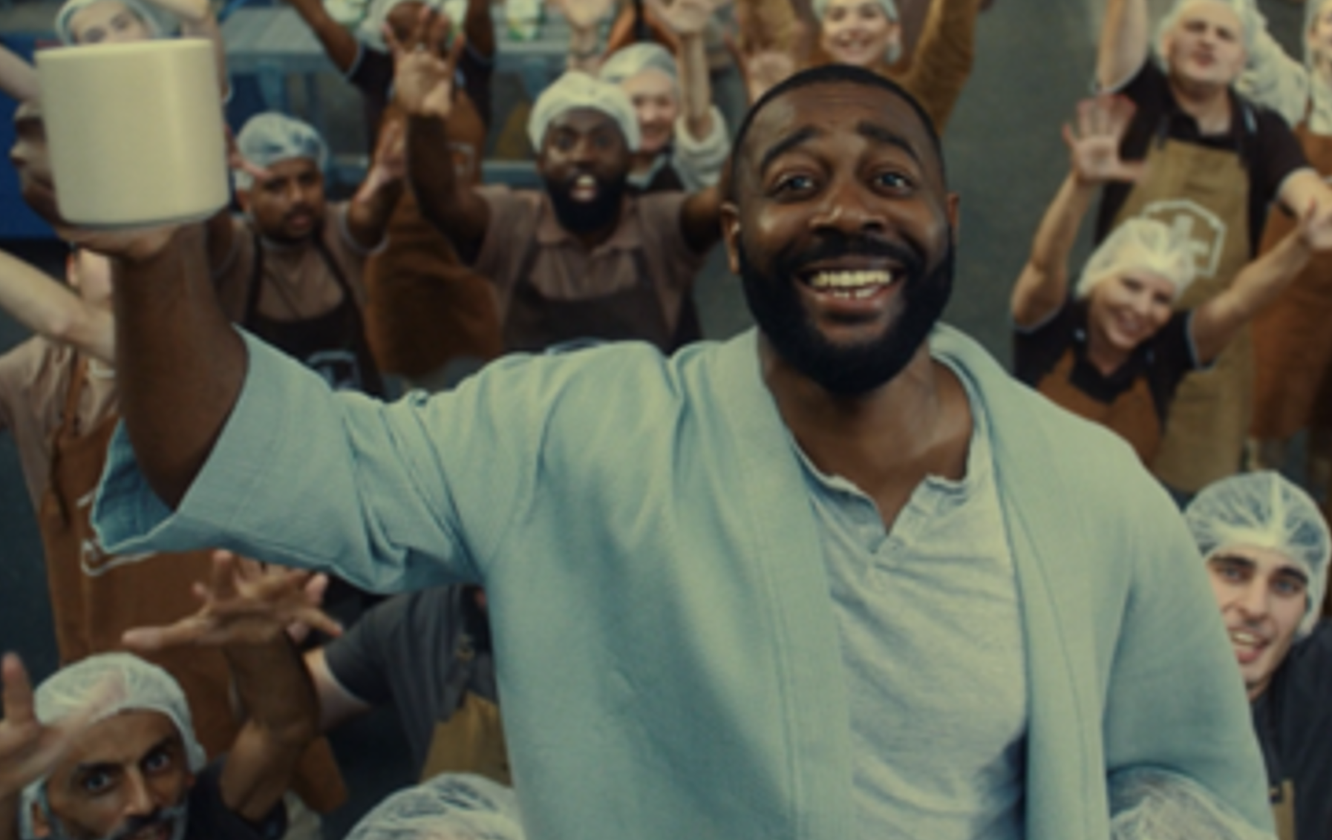
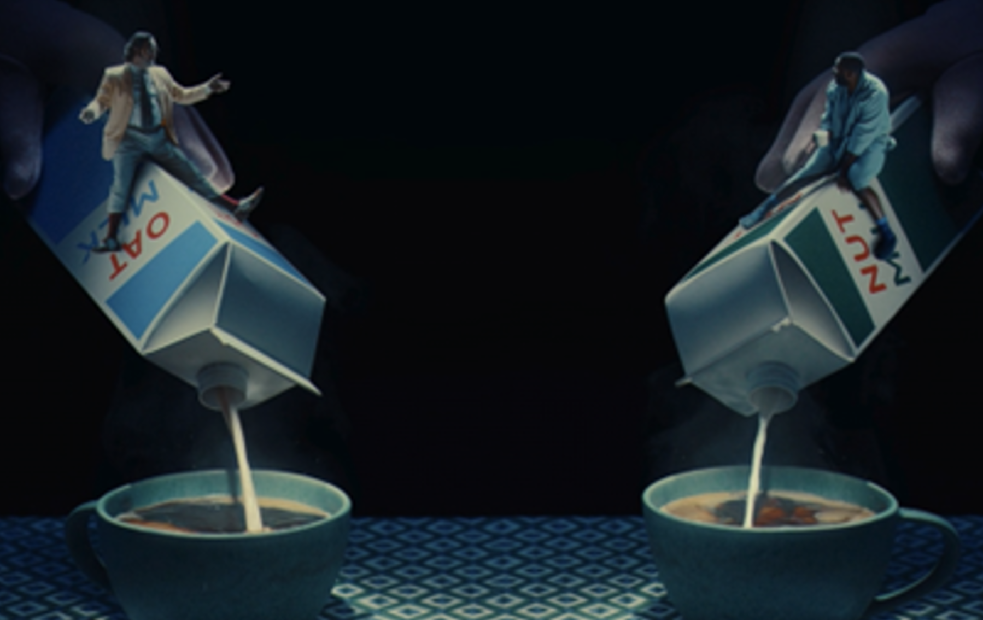

Taylors of Harrogate
Background
Taylors of Harrogate wanted to reintroduce the brand with a creative re-launch, focusing on the brand narrative rather than product specific advertising.
Plan
Taylors of Harrogate bought into an AGP in addition to several film packs running across the autumn including Napoleon, Killers Of The Flower Moon, and The Hunger Games: Ballad of Songbirds and Snakes.
Results
Consideration increased with a significant uplift of +17% for those who were exposed to the ad in cinema.
Cinema also delivered significant uplifts across key perceptions including ‘are a brand with family values’ (+47%) and ‘are a brand for people like me’ (+57%).
Source: DCM / Taylors of Harrogate. Conducted by; Differentology, Oct 2023.
Notes:
Source: DCM / Taylors of Harrogate. Conducted by; Differentology, Oct 2023.
Results base: 16+. % agree (top 3 out of 10). Uplifts are test (exposed to ad) vs control (unexposed to ad)

Slide 2
Taylors of Harrogate
‘It takes a big family to make a great coffee’
Media agency | Target | Buying route | Copy length
Goodstuff | ABC1 Adults | AGP + Film Packs | 60”
Background
Without a video asset for nearly a year, Taylors of Harrogate wanted to reintroduce the brand with a creative re-launch, focusing on the brand narrative rather than product specific advertising. To stand out from competitors amongst their target audience of ABC1s and 35+ adults, Taylors of Harrogate knew that cinema would be an ideal channel to showcase the new master brand 60” creative in a premium visual environment to an engaged and attentive audience.
Plan
Taylors of Harrogate bought into an AGP in addition to several film packs running across the autumn including Napoleon, Killers Of The Flower Moon, The Hunger Games: Ballad of Songbirds and Snakes and The Marvels. Cinema ran as part of a wider campaign alongside TV, BVOD, Social and Online where the brand showcased shorter length copy (30”, 20” & 10”).
Results
Exposure to the ad in cinema helped deliver on key objectives.
Consideration
Increased (+17%) for those who were exposed to the ad in cinema.
Improved perceptions
Uplifts across key perceptions such as ‘are a brand with family values’ (+47%) and ‘are a brand for people like me’ (+57%).
Claimed action
Almost a third of test respondents claimed to have bought Taylors of Harrogate coffee since seeing the ad.
Source: DCM / Taylors of Harrogate. Conducted by; Differentology, Oct 2023.
Notes:
Source: DCM / Taylors of Harrogate. Conducted by; Differentology, Oct 2023.
Results base: 16+. % agree (top 3 out of 10). Uplifts are test (exposed to ad) vs control (unexposed to ad)

