Slide 1
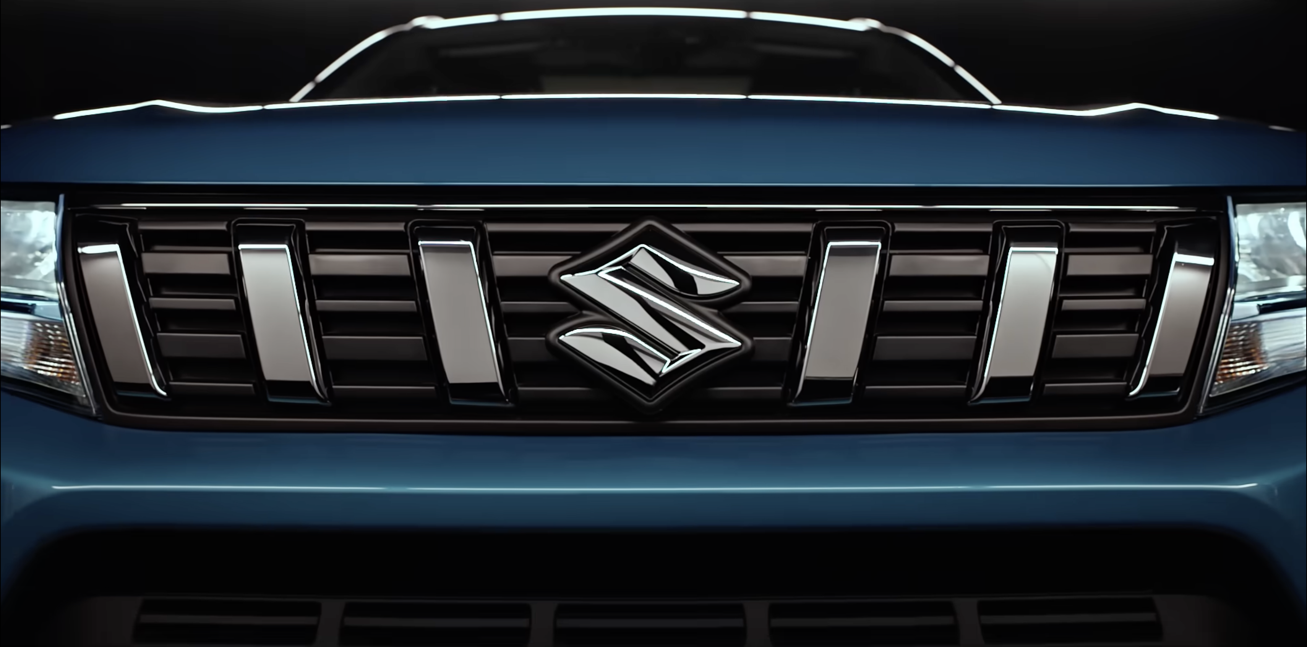
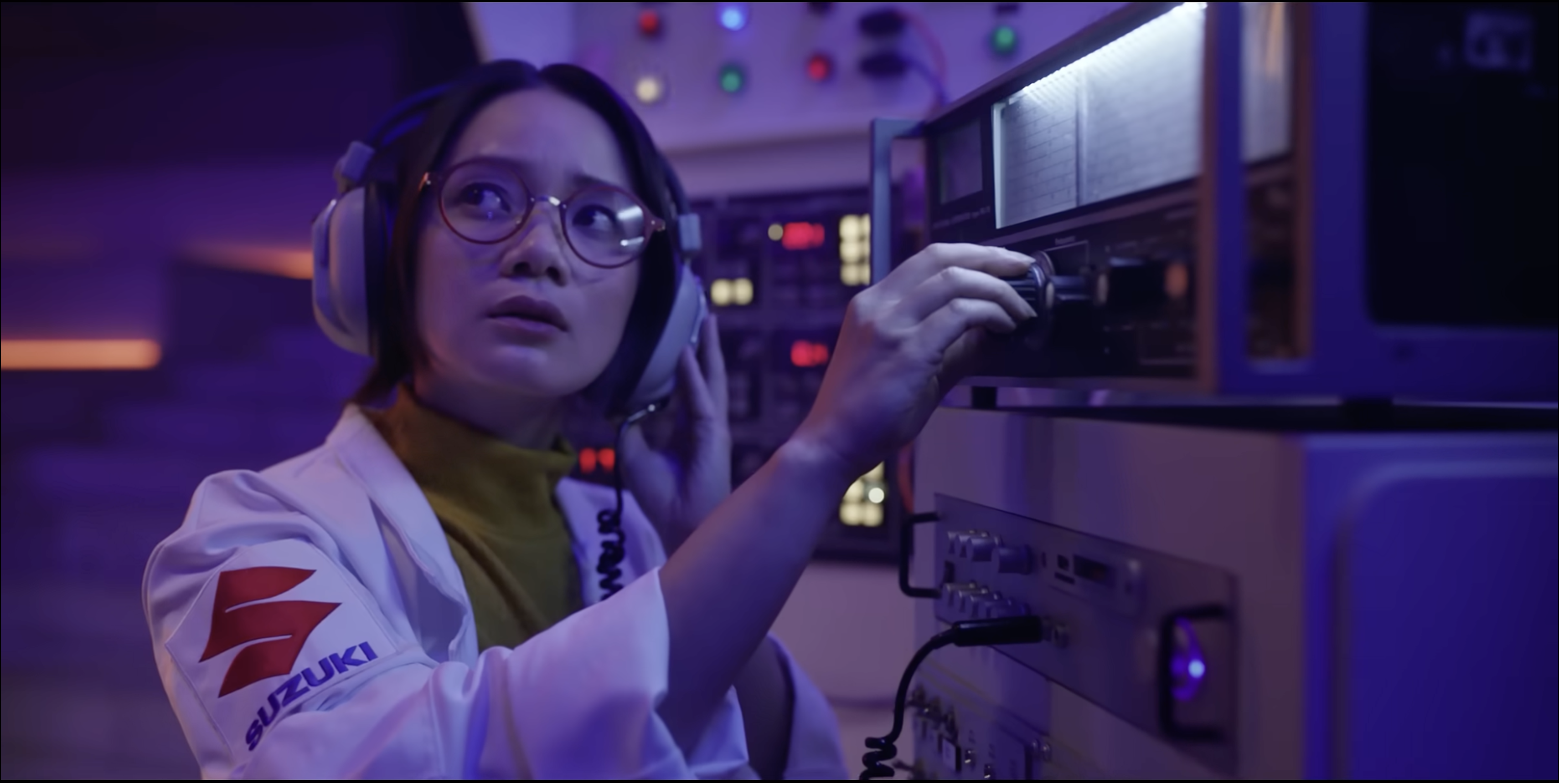

Suzuki
Background
Launching its new 'Good Different' brand campaign, Suzuki wanted to celebrate its cars’ uniqueness. The campaigns message was aiming to drive cut through and consideration with an ABC1 Adult audience.
Plan
Suzuki bought into a ABC1 and Family AGP to target an upmarket audience giving the campaign access to films including Elvis, Thor: Love & Thunder, Minions: The Rise of Gru, Where The Crawdads Sing, Bullet Train and Nope.
Results
Likelihood to consider Suzuki was up +88% amongst those exposed via cinema
Perception that Suzuki ‘is distinctive’ saw a +106% uplift vs. control sample
Source: DCM / Suzuki. Conducted by; Differentology, August 2022.
Notes:
Source: DCM / Suzuki. Conducted by; Differentology, August 2022.
Results base: ABC1s. Uplifts are test (exposed to ad in cinema) vs control (not exposed to ad in cinema)

Slide 2
Suzuki
Media agency | Target | Buying route | Copy length
the7stars | 25-54 ABC1 Adults | ABC1 & Family AGP | 60”
Good Different
Background
With the launch of its new 'Good Different' brand campaign, Suzuki wanted to celebrate how its cars are different from everything else on the market, and importantly give customers everything they need – hybrid and new tech features - as standard. Simplifying what is often over-complicated by other brands, Suzuki’s playful ad communicating this message was aiming to drive cut through and consideration with an ABC1 Adult audience.
Plan
Knowing that cinema can add valuable incremental reach in a highly attentive environment, Suzuki ran its campaign nationally on the big screen alongside a wider campaign including TV, BVOD, Social & Online.
Suzuki bought into a ABC1 and Family AGP to target an upmarket audience giving the campaign access to films including Elvis, The Black Phone, Thor: Love & Thunder, Minions: The Rise of Gru, Where The Crawdads Sing, Bullet Train and Nope.
Results
The campaign was successful in driving significant uplifts across Suzuki’s brand metrics including awareness, key perceptions and consideration.
Successful cut-through
Unprompted awareness of the ad was up +69%, significantly higher than DCM benchmarks.
Increased consideration
Likelihood to consider Suzuki was up +88% amongst those exposed via cinema.
Brand perception
Perception that Suzuki ‘is distinctive’ saw a +106% uplift vs. control sample.
Source: DCM / Suzuki. Conducted by; Differentology, August 2022.
Notes:
Source: DCM / Suzuki. Conducted by; Differentology, August 2022.
Results base: ABC1s. Uplifts are test (exposed to ad in cinema) vs control (not exposed to ad in cinema)

