Slide 1
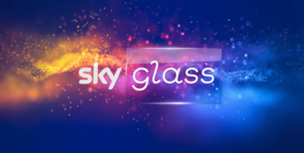
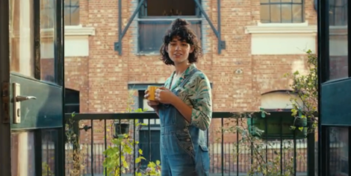

Sky Glass
DCM Awards nominee:
Best Use of Cinema (Large)
Background
After a successful product launch in 2022 that drove mass awareness of Sky Glass, Sky wanted to shift its focus to driving consideration to purchase - showcasing its key ‘Smarter than a Smart TV’ message.
Plan
Sky strategically used two copy lengths, launching the campaign with the new 60” copy in bespoke film packs across Q4, and continued momentum by accessing both the ABC1 Adult & Family AGPs. The campaign then ended with a cut-down 30” copy to maximise admissions from the budget.
Results
Cinema achieved a consideration cost-per-point that was more efficient than TV (+14%) and BVOD (+57%)
The whole campaign was a huge success driving 30% incremental sales volume immediately after launch.

Slide 2

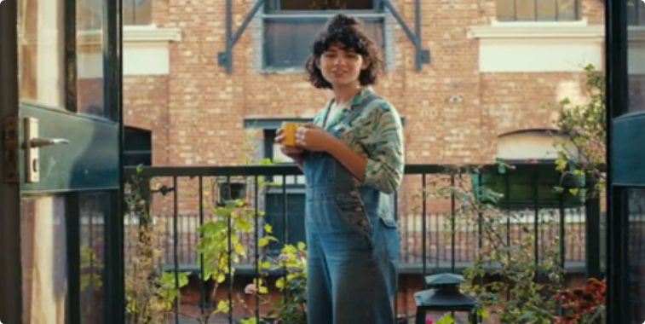

Sky Glass
DCM Awards nominee:
Best Use of Cinema (Large)
Media Agency | Target | Buying Route | Copy length
EssenceMediacom | ABC1 Adults | ABC1 Ads / Family AGP & Film Packs | 60” , 30”
Smarter Than A Smart TV
Background
After a successful product launch in 2022 that drove mass awareness to Sky Glass and its credentials as an industry leading premium viewing experience product, Sky wanted to shift its focus this time to driving consideration to purchase. With its highly attentive, premium environment, and strong sound and visual quality, Sky ran across cinema knowing that it was the perfect reflection of the key features that Sky Glass can offer, showcasing the key ‘Smarter than a Smart TV’ message.
Plan
Sky strategically used two copy lengths, launching the campaign with the new 60” copy in bespoke film packs across Q4, and continued momentum by accessing both the ABC1 Adult & Family AGPs. The 60” spot that afforded the time to communicate multiple key features including the 4K screen & sound bar, delivered in an immersive and engaging environment. The campaign then ended with a cut-down 30” copy to maximise admissions from the budget.
Results
Cinema helped deliver an impressive cost-efficient consideration as part of the AV mix:
Cost-Efficient Consideration Uplifts
Cinema achieved a consideration cost-per-point that was more efficient than TV (+14%) and than BVOD (+57%).
Improvement Across Sales
The whole campaign was a huge success driving 30%
incremental sales volume immediately after launch.

