Slide 1


Sky
DCM Awards nominee:
Best Use of Cinema (Small)
Media Agency | Target | Buying Route | Copy length
EssenceMediacom | ABC1 Adults | Bronzer, Silver and Gold Spots | 60”
Gangs of London
Background
In October 2022, audiences were treated to the much-awaited comeback of Sky's highly acclaimed original crime-drama: Gangs of London. The first season earned recognition as the "most-binged premier box set" of 2020 and set a challenging benchmark for the eagerly expected second instalment.
Sky needed to cement Series 2 as an unmissable cultural moment and cinema was identified as the crucial AV environment to effectively communicate the show's grandeur and intensity and reach the right audience at the right time.
Plan
The focus point for this campaign was to access films based on age-appropriate (the creative was restricted to 15+) contextual content, using a blend of placements throughout the campaign period.
The campaign utilised Bronze, Silver and Gold spots and in-reel ad placements, accessing 18 films across 10 weeks - including Don’t Worry Darling and Halloween Ends - to ensure cut through.
Results
Not only was cinema more effective than paid social and TV in driving key Sky brand metrics (“Content worth paying for”); cinema aided the success of the series, which was the top British based drama for Q4 2022.
Using cinema to help launch the new series resulted in Gangs of London having:
The highest awareness of any Sky Original in 2022.
The best Talkability score for a Sky Original in 2022.
The best returning series viewing numbers since 2020.
Source: Sky 2023 DCM Awards Entry

Slide 2

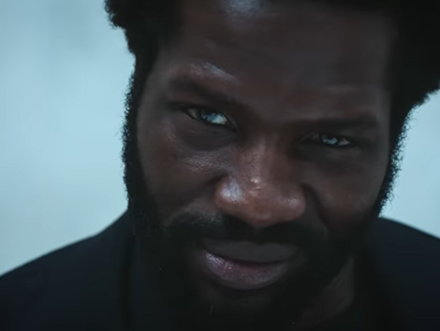

Sky
DCM Awards nominee:
Best Use of Cinema (Small)
Background
Ahead of the much-anticipated second series of Gangs of London, Sky knew the importance of building excitement and cementing the show’s return as a significant cultural moment.
Plan
The focus was to access films based on age-appropriate content, with the campaign utilising Bronze, Silver and Gold spots and in-reel ad placements, accessing 18 films across 10 weeks to ensure cut through.
Results
The highest awareness of any Sky Original in 2022.
The best Talkability score for a Sky Original in 2022.
The best returning series viewing numbers since 2020.

Slide 3


Sky
DCM Awards nominee:
Best Use of Cinema (Small)
Media Agency | Target | Buying Route | Copy length
EssenceMediacom | ABC1 Adults | Bronzer, Silver and Gold Spots | 60”
Gangs of London
Background
Ahead of the much-anticipated second series of Gangs of London, Sky knew the importance of building excitement and cementing the shows return as a significant cultural moment. The first season earned recognition as the "most-binged premier box set" of 2020 and set a challenging benchmark for the eagerly expected second instalment. Cinema was identified as the crucial AV environment to effectively communicate the show's grandeur and intensity and reach the right audience at the right time.
Plan
The focus was to access films based on age-appropriate content (the creative was restricted to 15+), with the campaign utilising Bronze, Silver and Gold spots and in-reel ad placements, accessing 18 films across 10 weeks - including Don’t Worry Darling and Halloween Ends - to ensure cut through.
Results
Cinema aided the success of the series’ return, which was the top British based drama for Q4 2022.
Improving Associations at Sky
Cinema more effective than paid social and TV in driving key Sky brand metrics such as ‘Content worth paying for’.
Success of Series Launch
The series returned with the highest awareness and best talkability score of any Sky Original in 2022. It also had the best returning series viewing numbers since 2020.

