Slide 1
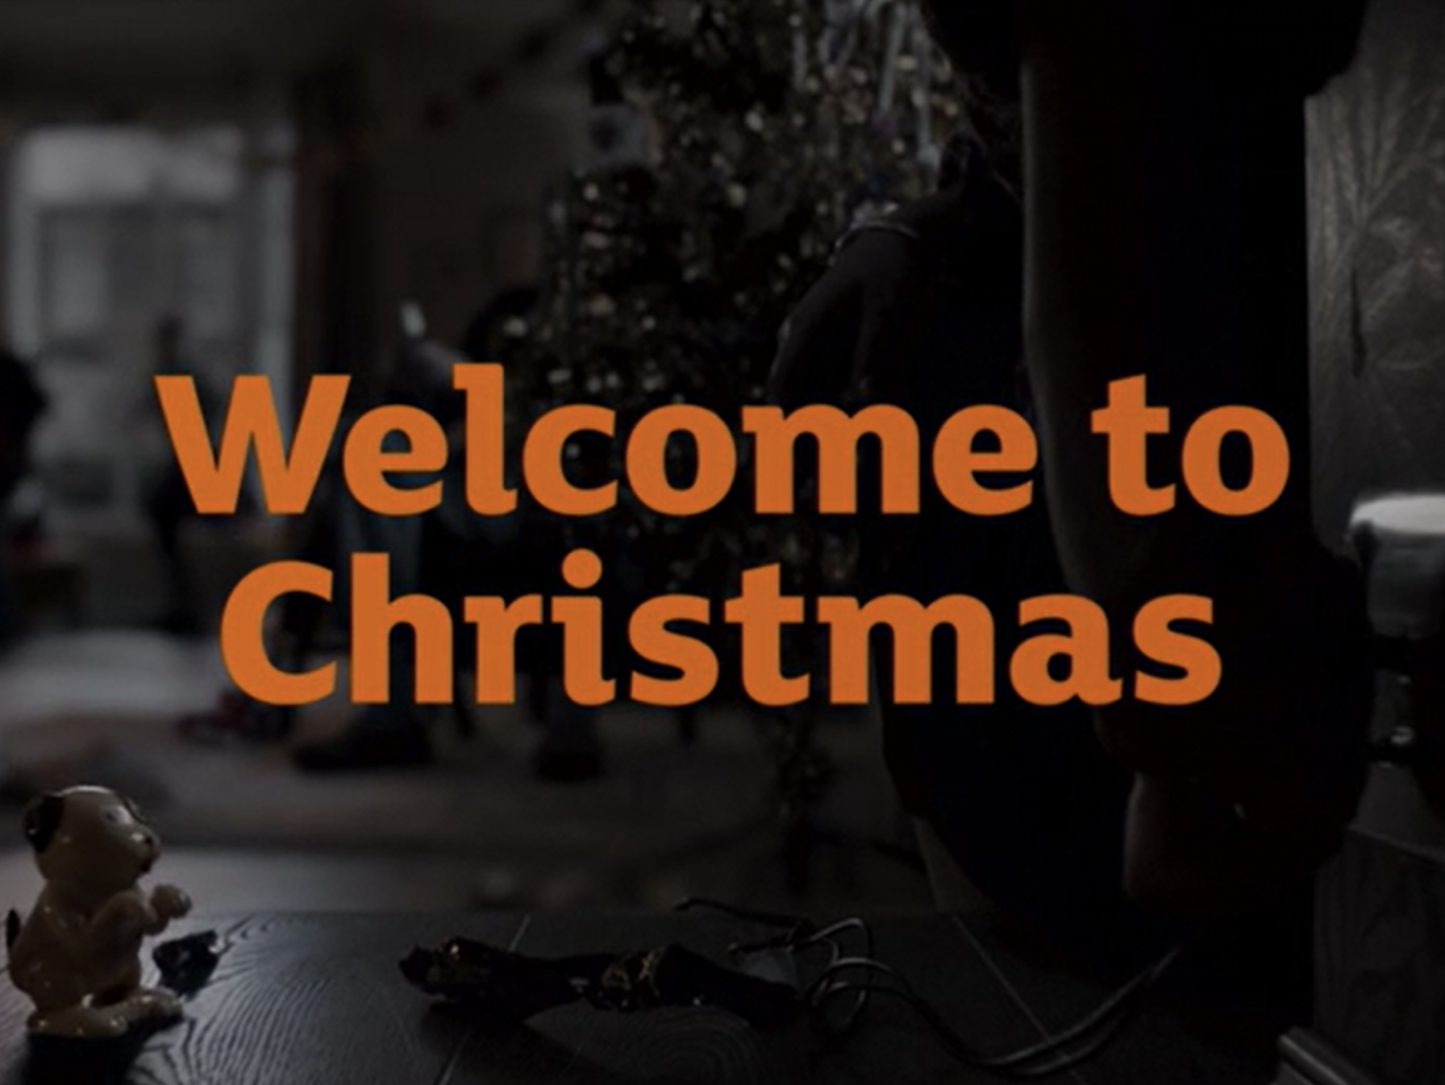
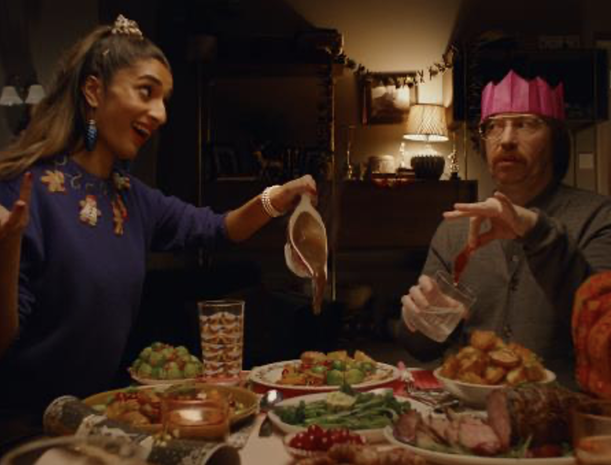

Sainsbury’s
Background
The campaign intended to show people the excitement of Christmas, placing food at the centre of the messaging and highlighting Sainsbury’s as the destination with a delicious Christmas offering. Sainsbury’s wanted to dial up “togetherness” and “indulgence”, with cinema the perfect fit.
Plan
Running from mid-November to Christmas Eve in cinemas, Sainsbury’s bought a HFSS AGP running in reel across a range of films including Ghostbusters: Afterlife, King Richard, House of Gucci and West Side Story.
Results
Uplifts across key perceptions, Sainsbury’s “have everything you need for Christmas” (+36%) and “makes me look forward to Christmas” (+58%) amongst test sample.
65% of those exposed in cinema agree the campaign had a positive impact on their opinion of Sainsbury’s.
Source: DCM / Sainsbury’s. Conducted by: Differentology, Dec 2021
Notes:
Source: DCM / Sainsbury’s
Conducted by: Differentology, Dec 2021
Base: 18+ adults

Slide 2
Sainsbury’s
Media agency | Target | Buying route | Copy length
PHD | Main Shoppers | HFSS AGP | 60”
A Christmas To Savour
Background
After many missed out on a full Christmas experience in 2020, Sainsbury’s wanted to embrace the excitement for the upcoming festive period. The campaign intended to place food at the centre of the festive messaging and highlighted Sainsbury’s as the supermarket destination with a delicious Christmas offering. Sainsbury’s wanted to dial up “togetherness” and “indulgence”, with cinema the perfect fit due to its heightened shared experience.
Plan
Alongside TV, BVOD/Online video, Social, Outdoor, Press, Radio and an Acast partnership cinema was added to the mix to help drive reach, impact, memorability and showcase the 60” ad in its fullest glory. Running from mid-November to Christmas Eve in cinemas, Sainsbury’s bought a HFSS AGP running in reel across a range of films including Ghostbusters: Afterlife, King Richard, House of Gucci and West Side Story.
Results
Cinema successfully allowed Sainsbury’s to showcase its 60” TVC in an environment where it successfully improved key metrics.
Increasing advertising recall
Recall of recent advertising up +23% amongst those exposed in cinema.
Driving key perceptions
Uplifts across perceptions, “have everything you need for Christmas” (+36%) and “makes me look forward to Christmas” (+58%) amongst test sample.
Boosting positive impressions
65% of those exposed in cinema agree the campaign had a positive impact on their opinion of Sainsbury’s.
Source: DCM / Sainsbury’s. Conducted by: Differentology, Dec 2021
Notes:
Source: DCM / Sainsbury’s
Conducted by: Differentology, Dec 2021
Base: 18+ adults

