Slide 1

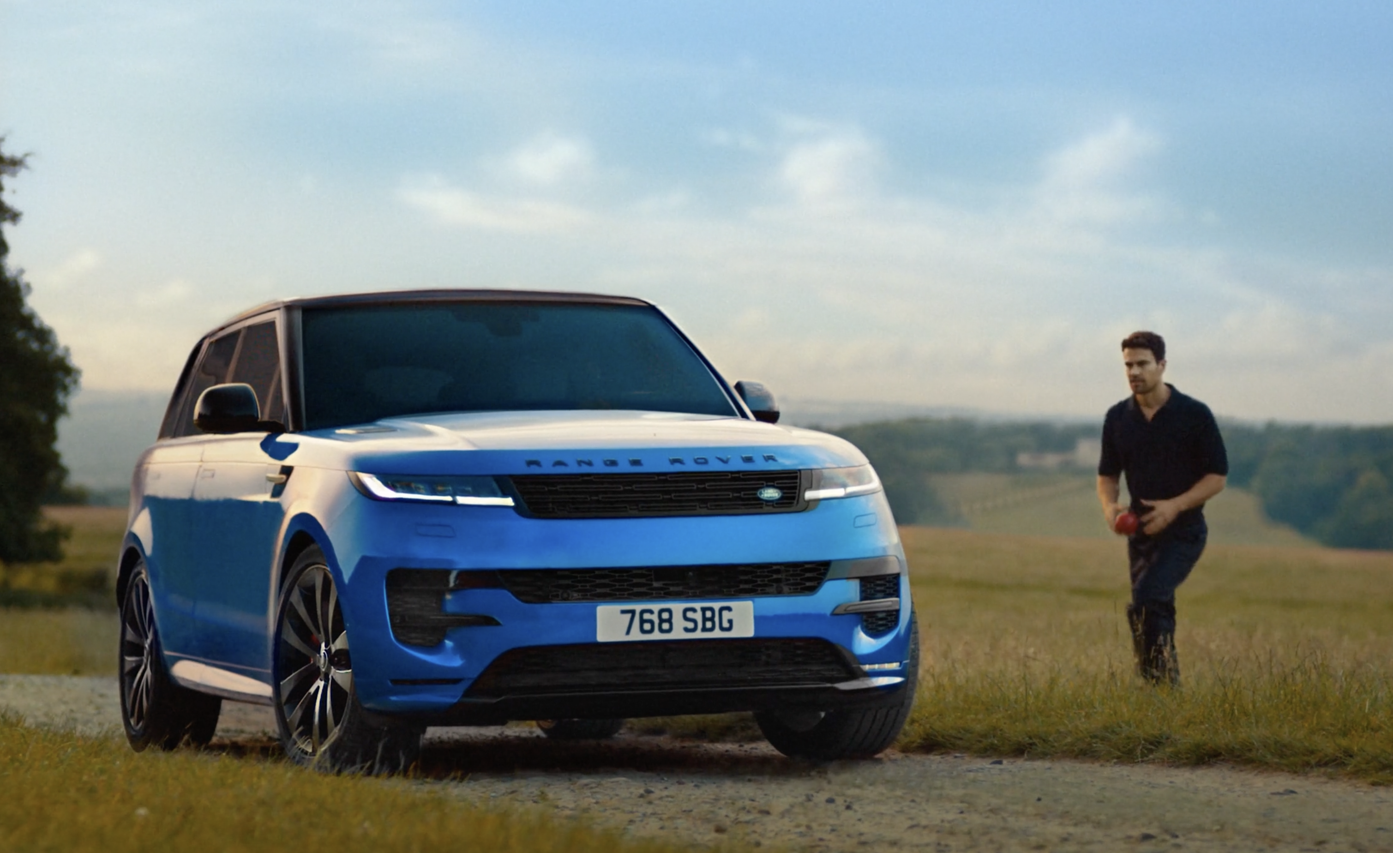

Range Rover
Velocity Blue
Background
Range Rover used cinema to reach affluent 35+ adults in a high impact and premium environment, with the intention of increasing brand awareness and affinity.
Plan
Range Rover cherry-picked Gold & Silver Spots in multiple films that would index strongly for ABC1 Adults.
Results
Cinema played a vital role in driving significant uplifts across improved impressions (+25%) and perceptions surrounding ‘uniqueness’, ‘desirability’ and ‘luxury’, and just under 1 in 5 Test respondents agreed they are intending on purchasing a Range Rover Sport.
Source: DCM / Range Rover. Conducted by: Differentology May 2025
Notes:
Source: DCM / Range Rover. Conducted by: Differentology May 2025. Results base 35+. Uplifts seen from Control (unexposed to cinema ad) vs Test (exposed to cinema ad)

Slide 2
Range Rover
Media agency | Target | Buying route | Copy length
Hearts & Science | ABC1 35+ Adults | Gold & Silver Spot | 60”
Velocity Blue
Background
Range Rover aimed to reach affluent 35+ adults in a high impact and premium environment with the intention to increase brand awareness and affinity.
Plan
Range Rover cherry-picked multiple films that would index strongly towards ABC1 adults, buying a range of Gold & Silver positions in: Thunderbolts*, The Phoenician Scheme, The Accountant 2, The Ballad of Wallis Island and Sinners. Cinema ran alongside a wider campaign that included TV, BVOD, Social, YouTube, Online & Press.
Results
Cinema played a vital role in driving significant uplifts, with those exposed to the cinema seeing a +25% uplift in improved impressions and +28% uplift in consideration. Additionally, cinema helped to boost perceptions surrounding ‘uniqueness’, ‘desirability’ and ‘luxury’, and just under 1 in 5 Test respondents agreed they are intending on purchasing a Range Rover Sport.
Source: DCM / Range Rover. Conducted by: Differentology May 2025
Notes:
Source: DCM / Range Rover. Conducted by: Differentology May 2025. Results base 35+. Uplifts seen from Control (unexposed to cinema ad) vs Test (exposed to cinema ad)

