Slide 1
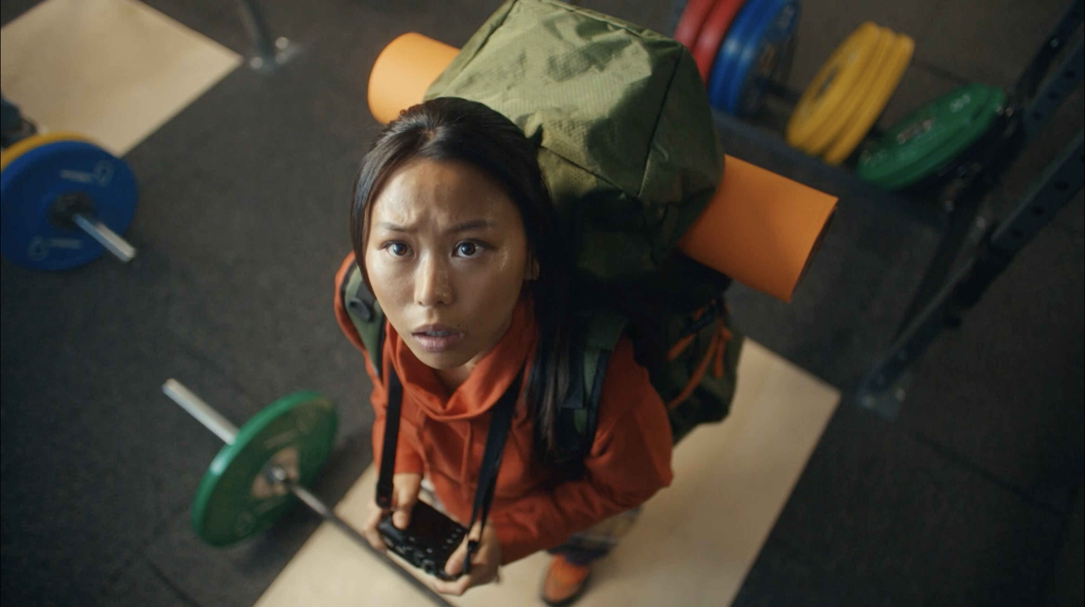
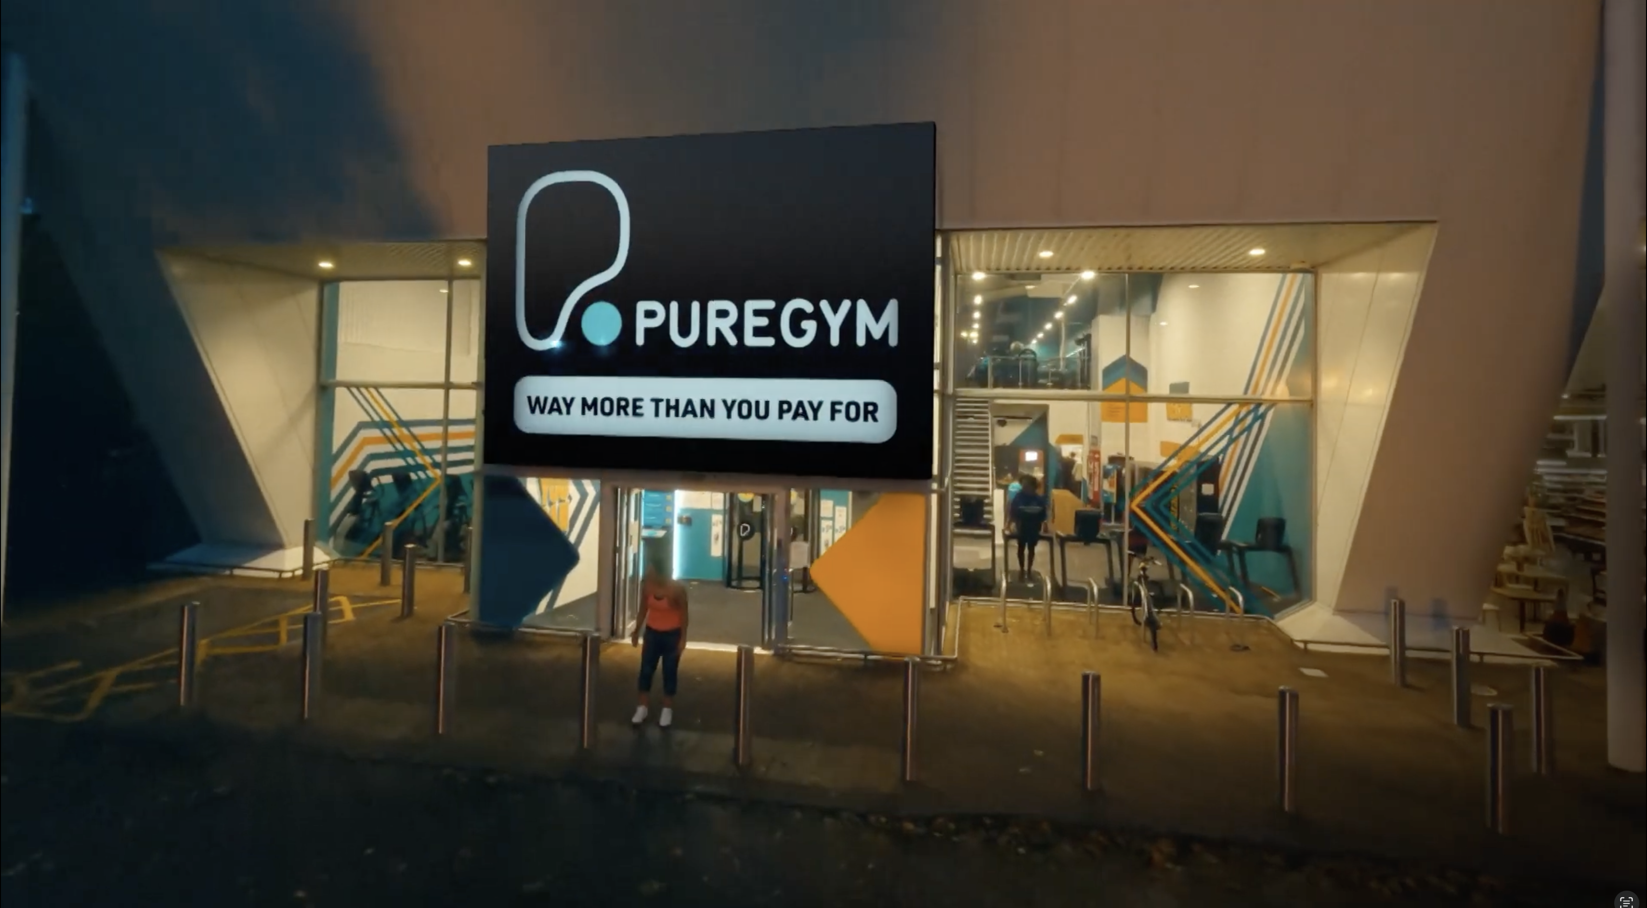

PureGym
Background
PureGym wanted to solidify its position as the top choice for budget-conscious fitness enthusiasts. The campaign looked to drive KPIs across the brand funnel and strengthen perceptions around value and overall quality.
Plan
On top of an existing AV plan, PureGym placed its new ‘Way More Than You Pay For’ 30” creative into blockbuster & major release film packs (including Wonka, Aquaman & The Lost Kingdom) targeting the key 18-34 demo.
Results
Exposure to the ad in cinema delivered a +19% uplift in Consideration and a +29% uplift in intention to visit a PureGym.
Association with being ‘good value for money’ up +10% among those exposed to the ad in cinema.
Source: DCM / Puregym Conducted by; Differentology, Dec 2023.
Notes:
Source: DCM / Puregym Conducted by; Differentology, Dec 2023.
Uplifts are control (unexposed to ad) vs test (exposed to ad)

Slide 2
PureGym
Media agency | Target | Buying route | Copy length
Carat Leeds | 18-34 | Film Packs | 30”
‘Way More Than You Pay For’
Background
Whilst an already established brand, PureGym wanted to solidify its position as the top choice for budget-conscious fitness enthusiasts. Through this campaign, PureGym aimed to expand reach to potential customers, drive awareness, boost consideration to sign up and strengthen perceptions surrounding value for money and overall quality.
Plan
The launch of a new creative, ‘Way More Than You Pay For’ focused on the value and benefits each member gets, particularly during times of increased living costs. PureGym ran cinema nationally with 30” copy running in blockbuster and major release film packs (including Wonka, Aquaman & The Lost Kingdom). These films were selected to target the brand’s key 18-34 demo and deliver incremental reach as part of a wider AV plan including TV, BVOD, Radio & Digital Audio.
Results
The campaign was successful in driving key funnel metrics and boosting key perceptions around relevancy and trust.
Awareness
Prompted awareness of 90% amongst those exposed via cinema.
Associations and perceptions
Improvements across associations and perceptions, with uplifts seen for ‘is for people like me’ (+46%), ‘is a brand I trust’ (+28%), ‘is good value for money’ (+10%) vs. control sample.
Consideration and intent to act
Exposure to the ad in cinema saw a +19% uplift in ‘Very Likely’ to consider and a +29% uplift in intention to visit a PureGym.
Source: DCM / Puregym Conducted by; Differentology, Dec 2023.
Notes:
Source: DCM / Puregym Conducted by; Differentology, Dec 2023.
Uplifts are control (unexposed to ad) vs test (exposed to ad)

