Slide 1
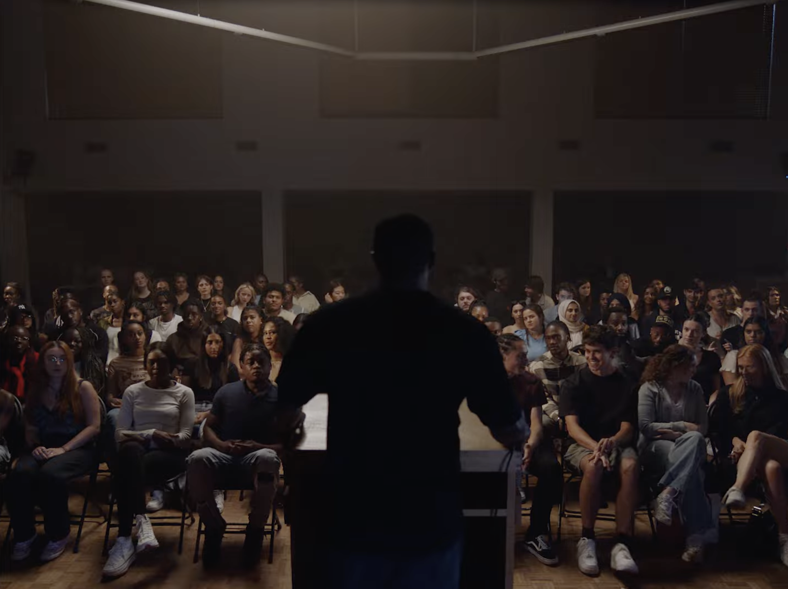
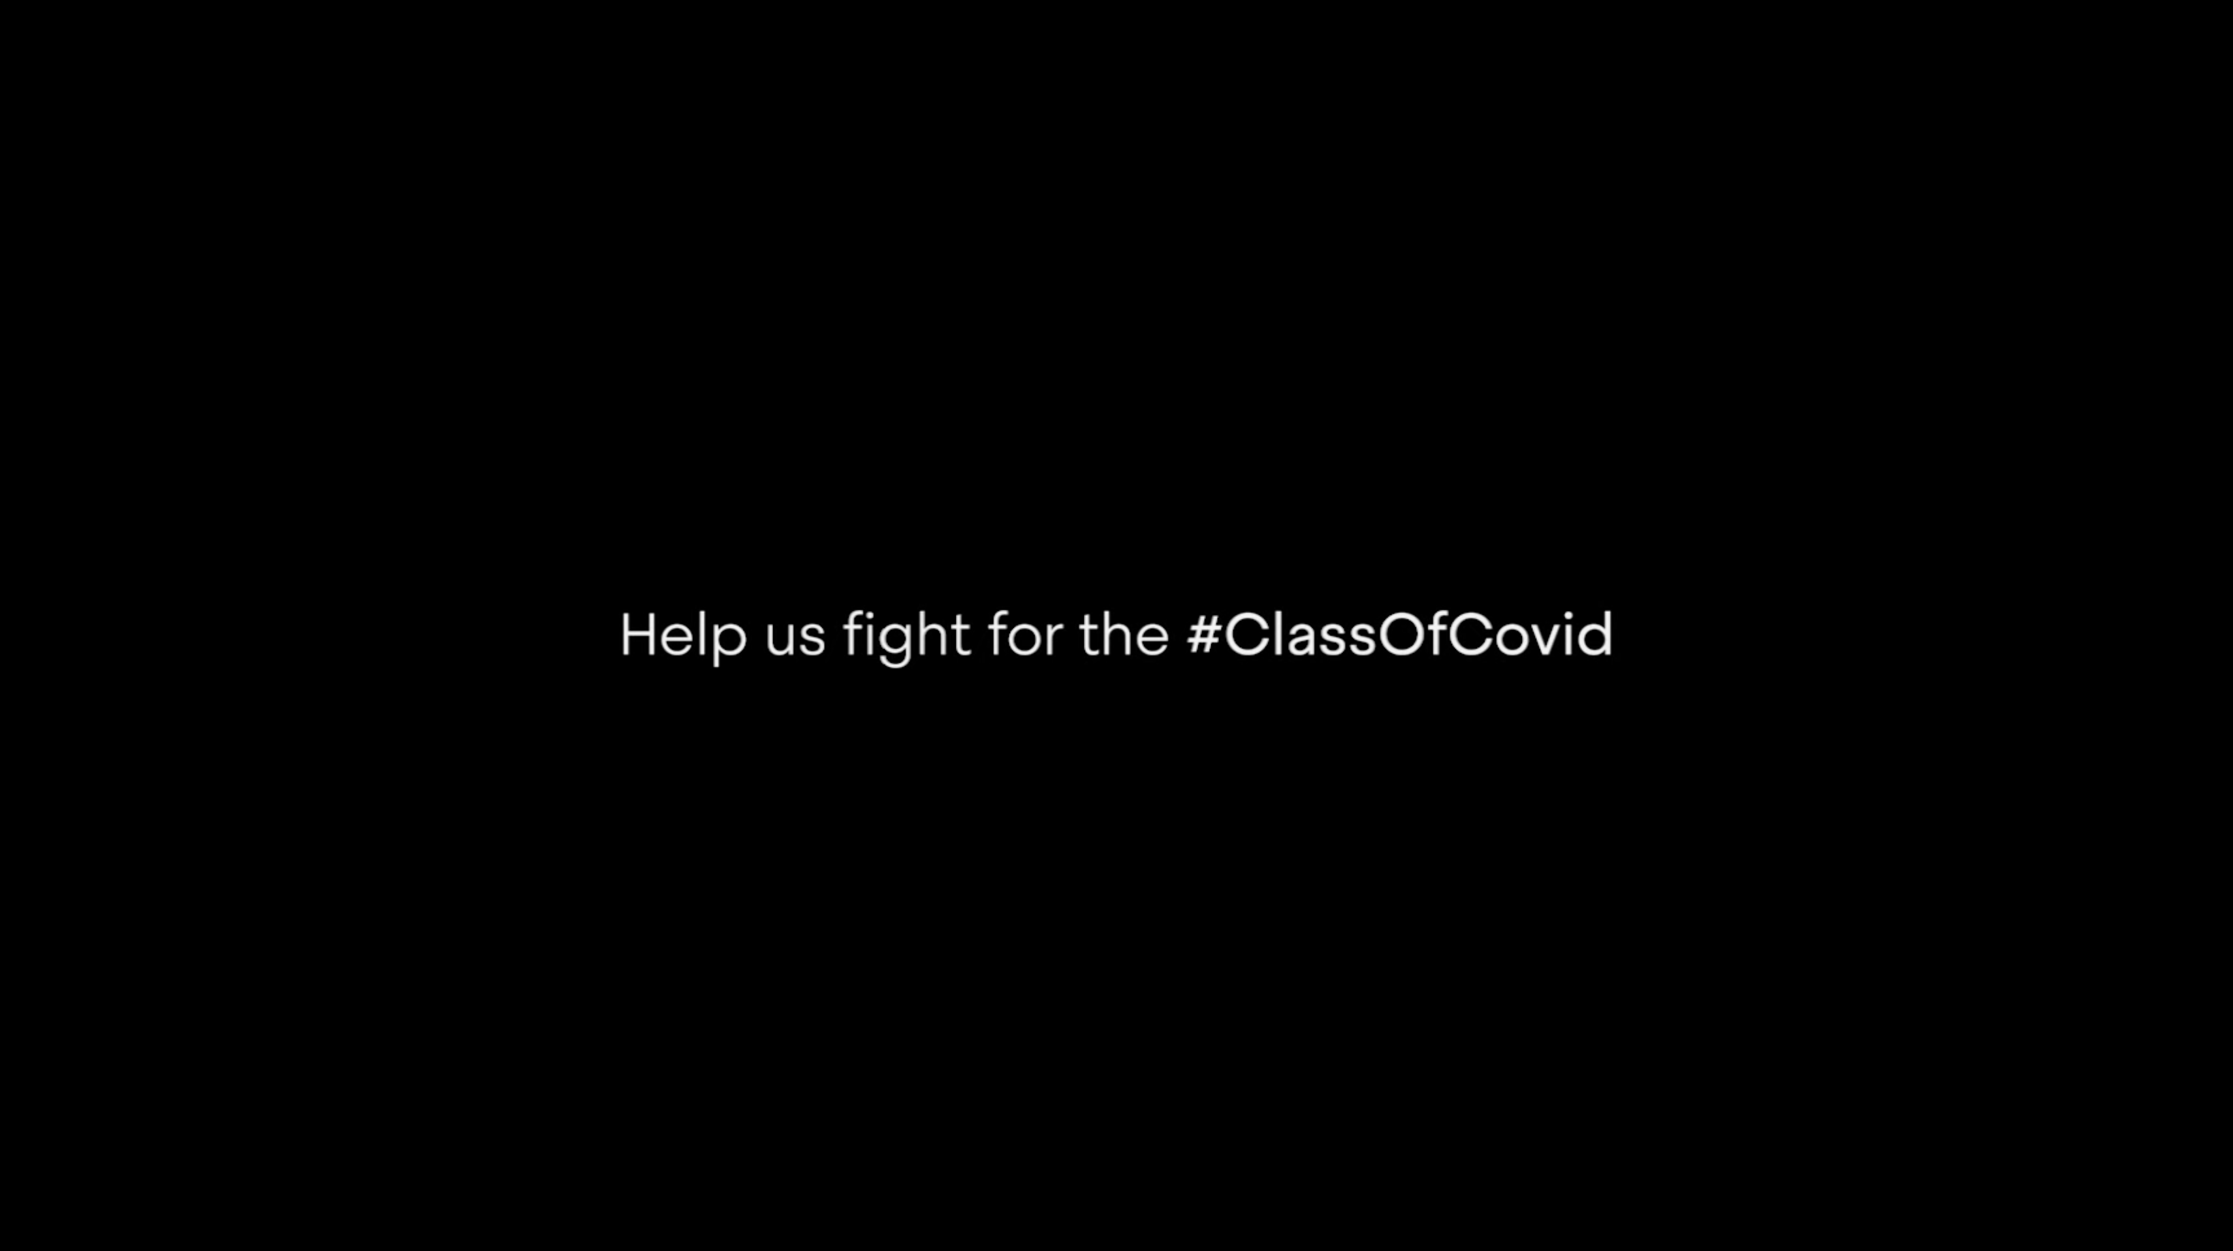

The Prince’s Trust
DCM Awards winner:
Best ‘Marketing for Good’ Cinema Campaign
Background
The Prince’s Trust launched a new campaign to drive awareness amongst young people across the UK who were struggling with the repercussions of the pandemic and those hit hard by the cost-of-living crisis.
Plan
Cinema accompanied a wider channel mix that included BVOD, Addressable TV, Paid Social, OOH, and PR to maximise coverage.
Results
Cinema delivered an impressive 4.2pp. incremental reach to BVOD and Addressable TV
Research revealed that 47% felt compelled to act after being exposed to the AV creative.
Source: The Prince’s Trust DCM Awards Entry
Notes:
Source: The Prince’s Trust DCM Awards Entry

Slide 2
The Prince’s Trust
DCM Awards winner:
Best ‘Marketing for Good’ Cinema Campaign
Media agency | Target | Buying route | Copy length
T&P | ABC1 Adults | Film Packs | 30”
‘Class of Covid’
Background
In the autumn 2022, research had found that 2.8 million 16 to 25-year-olds didn’t think their job prospects would ever recover from the Covid-19 pandemic. Youth charity The Prince’s Trust decided to launch a new campaign to drive awareness amongst young people across the UK who were struggling with the repercussions of the pandemic and those hit hard by the cost-of-living crisis.
The campaign asks the public to recognise the ‘Class of Covid’ – a generation of young people whose confidence, education and opportunities were stolen by COVID-19 and its resultant lockdown.
Plan
Recognising the complexities of launching a campaign in today's fragmented media landscape, the charity identified cinema as a pivotal channel. Cinema providing unparalleled attention from an affluent audience, making it indispensable for the campaign's aims and could deliver cost-efficient incremental audience reach, while importantly immersing viewers in an environment of heighted emotional engagement. Alongside cinema the wider channel mix included BVOD, Addressable TV, Paid Social, OOH, and PR to maximize coverage.
Results
Through cinema The Prince’s Trust successfully engaged its target audience, raised awareness and importantly inspired action.
Reach
Cinema delivered an impressive 4.2pp. incremental reach to BVOD and Addressable TV.
Intent to act
Research revealed that 47% felt compelled to act after being exposed to the AV creative.
Website traffic
The Prince's Trust website, experienced a remarkable +63% uplift in homepage visits compared to the same period YOY.
Source: The Prince’s Trust DCM Awards Entry
Notes:
Source: The Prince’s Trust DCM Awards Entry

