Slide 1
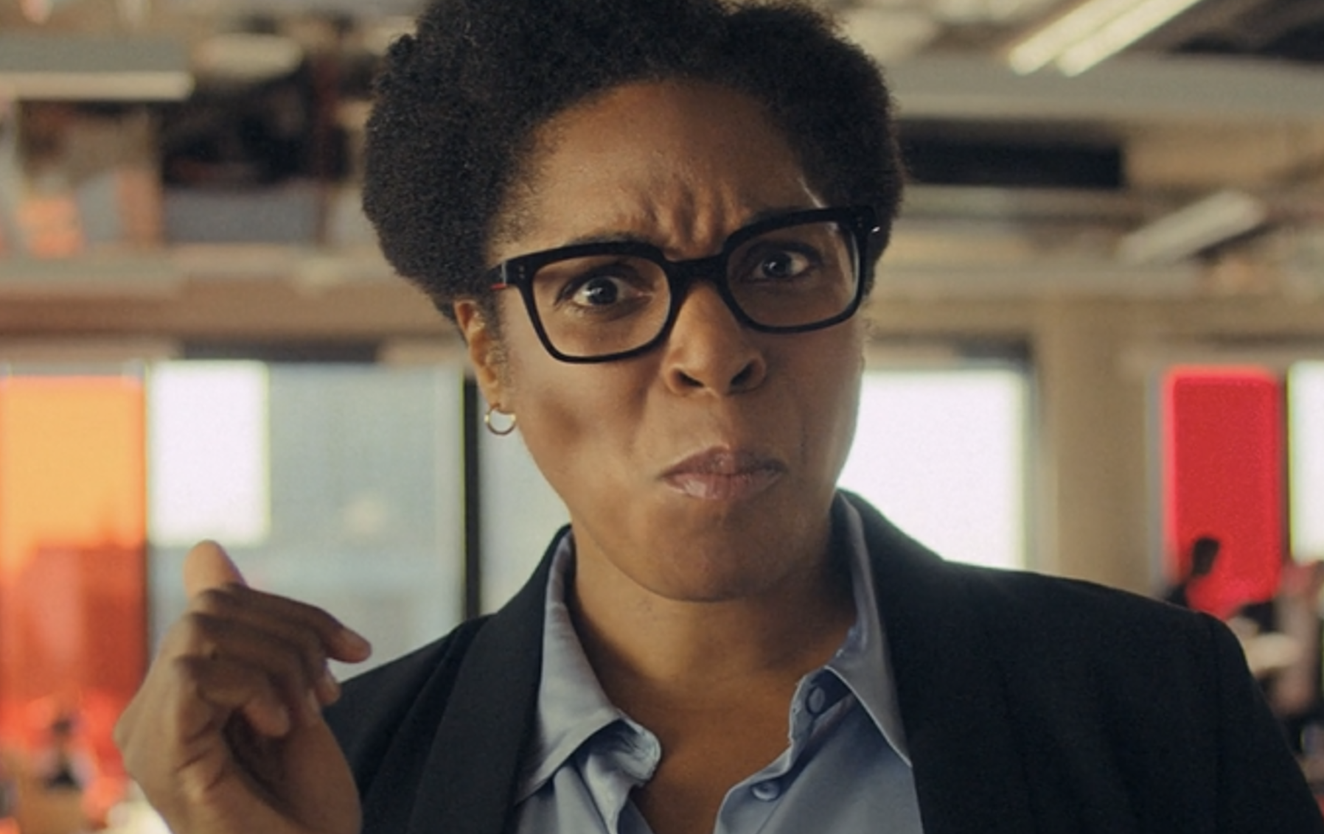
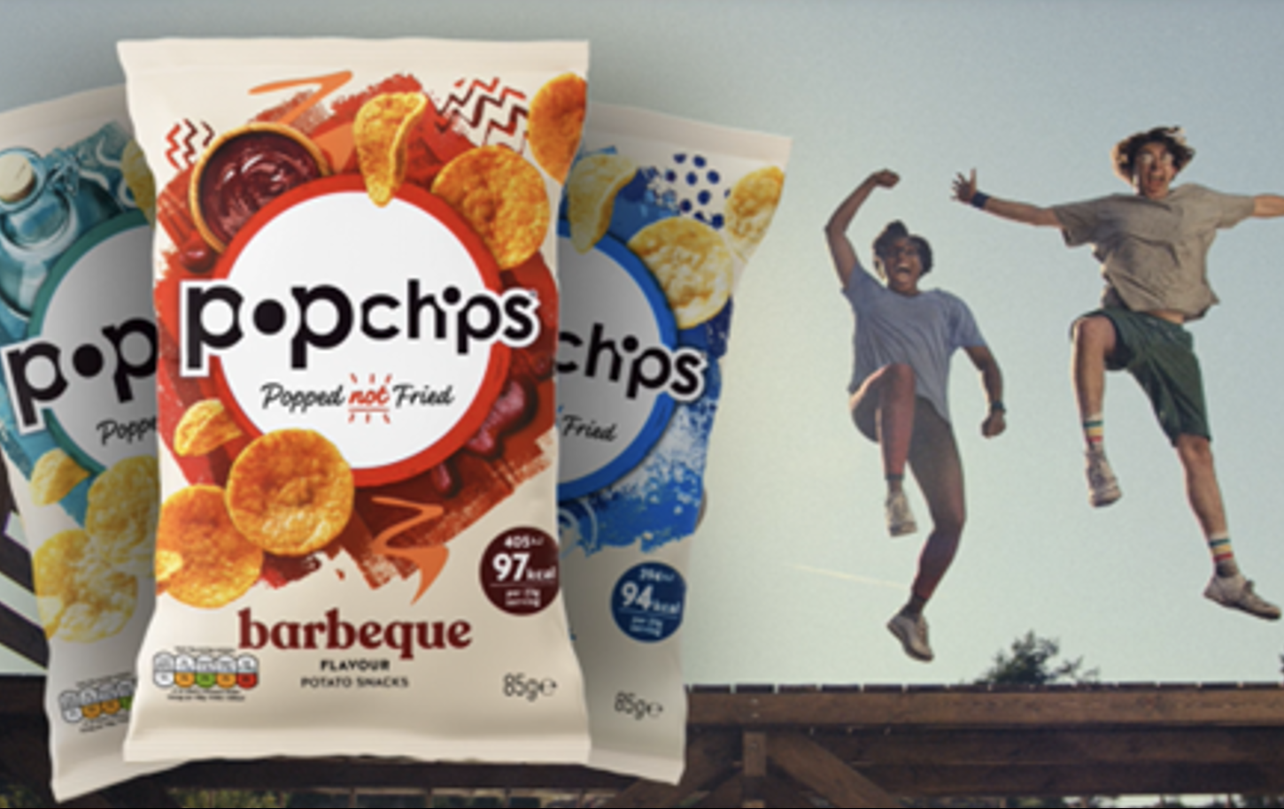

Popchips
Background
Popchips saw cinema as the perfect medium for boosting salience in a co-viewing environment, to drive impact and recommendation vs its already established competitors.
Plan
Using its ‘Start Something New’ 20” copy, Popchips bought film packs for titles running across the key Q4 period, including The Hunger Games: Ballad of Songbirds and Snakes, Killers of the Flower Moon, and Aquaman and the Lost Kingdom.
Results
Consideration of Popchips significantly increased by +27% when exposed to the ad in cinema.
Around 60% of Test cinemagoers claimed to intend to buy Popchips as result of this campaign.

Slide 2
Popchips
Media agency | Target | Buying route | Copy length
Starcom | Adults | Film Packs | 20”
‘Start Something Good’
Background
Popchips saw cinema as the perfect medium for boosting salience in a shared environment, to drive impact and recommendation vs the brand’s already established competitors. Popchip’s key objective for this campaign involved driving purchase intent across its target audience of adults who buy crisps, testing cinema's ability in driving conversion metrics.
Idea
Being new to cinema, Popchips wanted to launch the brand and message across an attentive space to showcase its existing 20” TVC across a wide range of films in Q4 2023.
Plan
Using its ‘Start Something New’ copy, Popchips started with cinema, accessing several popular films running across the end of the year, including The Hunger Games: Ballad of Songbirds and Snakes, Killers of the Flower Moon, The Marvels and Aquaman and the Lost Kingdom.
Results
Cinema exposure significantly improved key metrics for Popchips.
Consideration
Significantly increased by +27% when exposed to the ad in cinema.
Intent to purchase
Around 60% of Test cinemagoers claimed to intend to buy Popchips as result of this campaign.
Improved impressions
Cinema delivered a +32% uplift in positive impressions of the Popchips brand.

