Slide 1


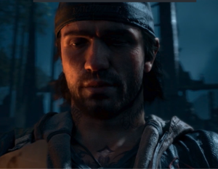

PlayStation
‘Only on PlayStation’ Launch
Background
PlayStation identified that exclusivity is the most important driver for console purchase so wanted to promote the breadth and quality of its exclusive titles, including the impending launch of Days Gone.
Plan
PlayStation decided to split the creative into three 20-second ads punctuating the reel showcasing their exclusive games. The release of Captain Marvel and Avengers: Endgame presented PlayStation with the perfect fit to release their copy, with Marvel’s Spiderman one of their leading exclusive titles.
Results
Over 60% of respondents said they were more likely to purchase each of the games after seeing the ads
Day’s Gone reached top of the UK physical game charts.

Slide 2

PlayStation
Media Agency | Target | Buying Route | Copy length
EssenceMediacom | 16-34 Men | Film packs | 2 x 20”
‘Only on PlayStation’ Launch
Background
PlayStation identified that exclusivity is the most important driver for console purchase amongst its core audience and to maintain its position within a highly competitive gaming market it needed to continue promoting the breadth and quality of its exclusive titles.
Plan
The release of Captain Marvel and Avengers: Endgame presented PlayStation with the perfect fit to release their copy, with Marvel’s Spiderman one of their leading exclusive titles. The core creative centred around a ‘supercut’ trailer, which featured Days Gone alongside a range of current and upcoming exclusives, re-enforcing the ‘Only on PlayStation’ messaging as a seal of quality. PlayStation decided to split the trailer into three 20-second ads punctuating the reel with its games and landing its existing titles alongside the new release.
Cinema was the launch channel for the campaign and critical to delivering impact and awareness amongst its core gaming audience, with online video and DOOH coming in later.
Results
The campaign was successful at promoting the new Days Gone game as well as driving interest to purchase across other exclusive titles.
Driving Intent to Purchase
Over 60% of respondents said they were more likely to purchase each of the games after seeing the ads.
Commercial success of new launch
The investment in the ‘Only On PlayStation’ messaging prior to the launch of Days Gone helped drive the game’s commercial success upon release, with the game entering the UK physical games charts at number one.

