Slide 1
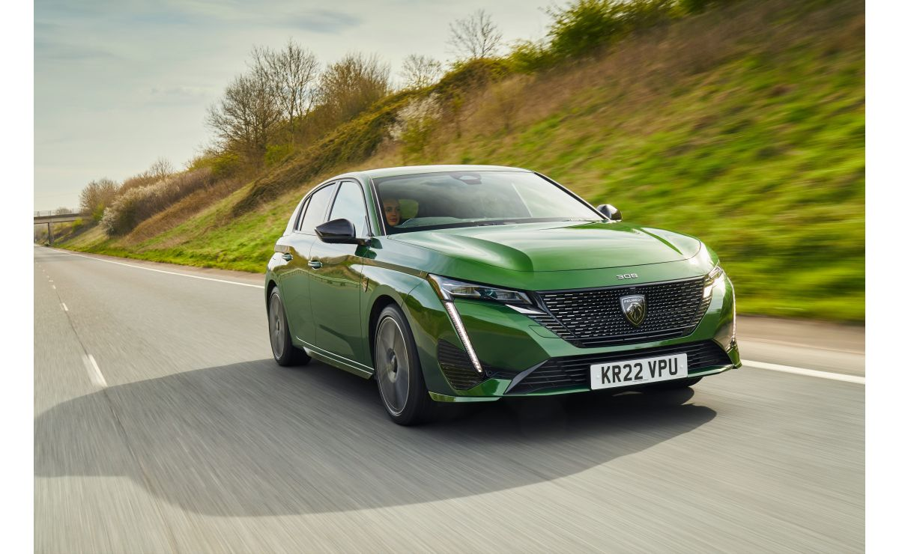
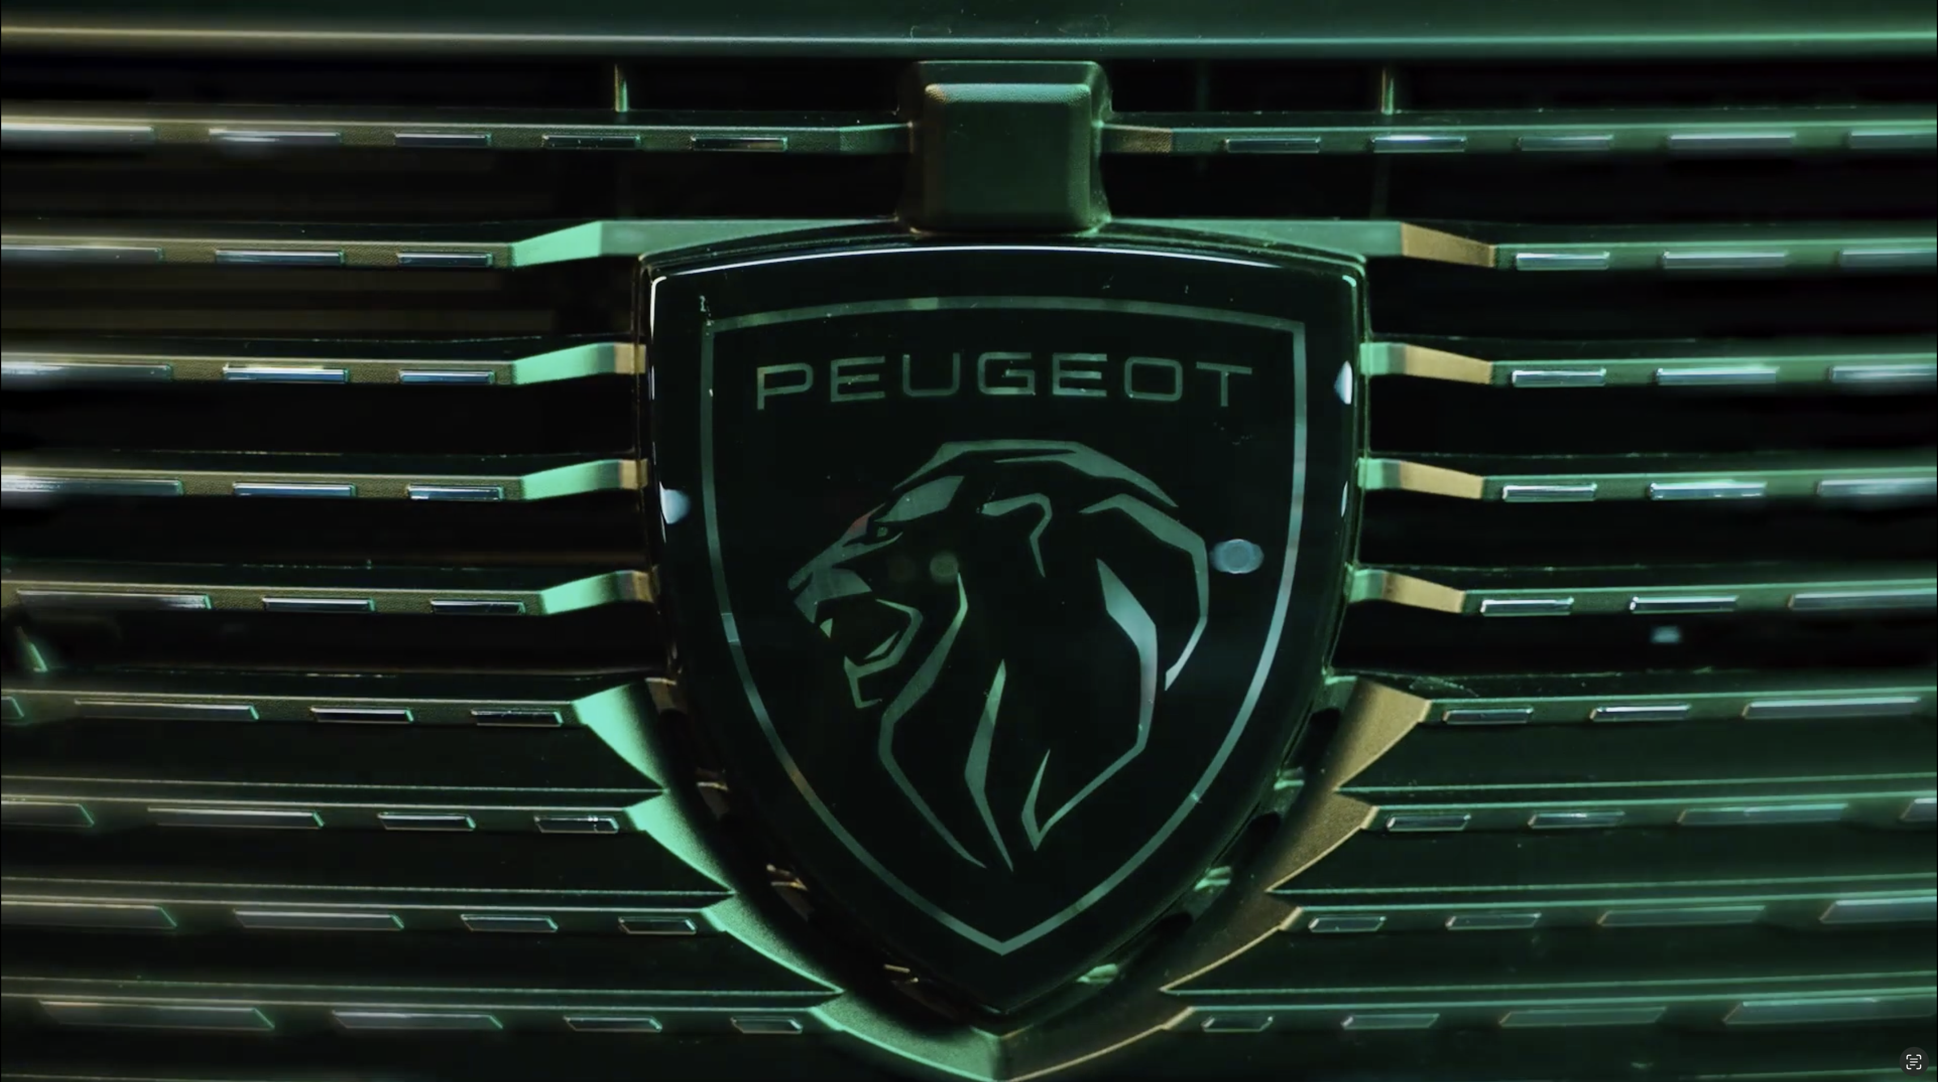

Peugeot
Background
Peugeot wanted to dispel perceptions that the brand was outdated. With the launch of the new Peugeot 308 Hybrid, they wanted to convey the allure of the model in an impactful and creative way and ultimately drive consideration and leads.
Plan
Peugeot bought into a Film Pack for Top Gun: Maverick due to the film’s mass appeal across different audiences. To further the impact of cinema, Peugeot also took over the ‘Turn Your Phone Off’ messaging spot in Odeon cinemas.
Results
Peugeot saw a +17% uplift in leads from May to June ‘22, with cinema the only media live during this period
Search results were 10x higher during the period cinema activity was live compared to levels prior to the campaign
Source: DCM / Peugeot
Notes:
Source: DCM / Peugeot

Slide 2
Peugeot
Media agency | Target | Buying route | Copy length
Starcom | ABC1 Adults | Film Pack + Exhibitor Spot | 30”
Peugeot 308
Background
Peugeot wanted to dispel perceptions that the brand was outdated, following customer insights indicating this was the case. With the launch of the new Peugeot 308 Hybrid, they wanted to convey the allure of the model in an impactful and creative way. Peugeot’s media objectives were to land the new 308 model as upmarket and the embodiment of the new brand vision, and ultimately driving consideration and leads.
Plan
Peugeot bought into a Film Pack for Top Gun: Maverick due to the film’s mass appeal across different audiences. The film’s release date also meant the campaign was live in cinema before any other media isolating the impact cinema had. To drive further cut through and resonance as part of the ad reel in Odeon cinemas, Peugeot also ‘took over’ one of the core exhibitor spots - taking it’s escapist AV copy and weaving this in with the cinema’s ‘Turn Your Phone Off’ messaging.
Results
The isolated activity clearly demonstrated the value of adding cinema to an AV mix in helping to drive key campaign objectives.
Increased leads
Peugeot saw a +17% uplift in leads from May to June ’22 (Peugeot 308 specific leads up +45%), with cinema the only media live during this period.
Higher search traffic
Search results were 10x higher during the period cinema activity was live compared to levels prior to the campaign.
Source: DCM / Peugeot
Notes:
Source: DCM / Peugeot

