Slide 1
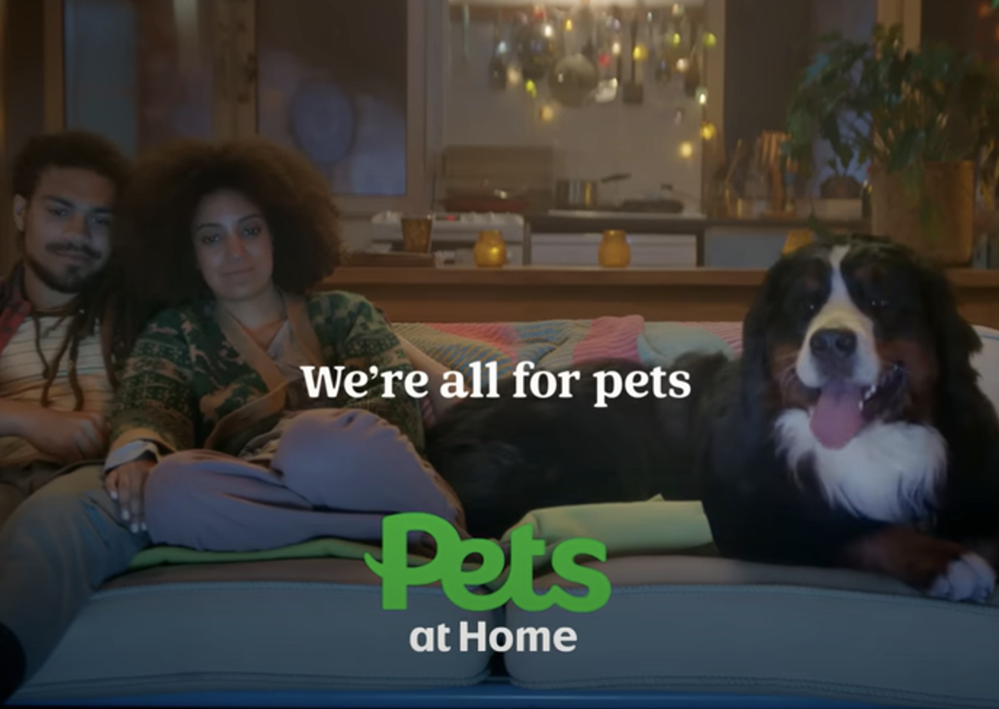
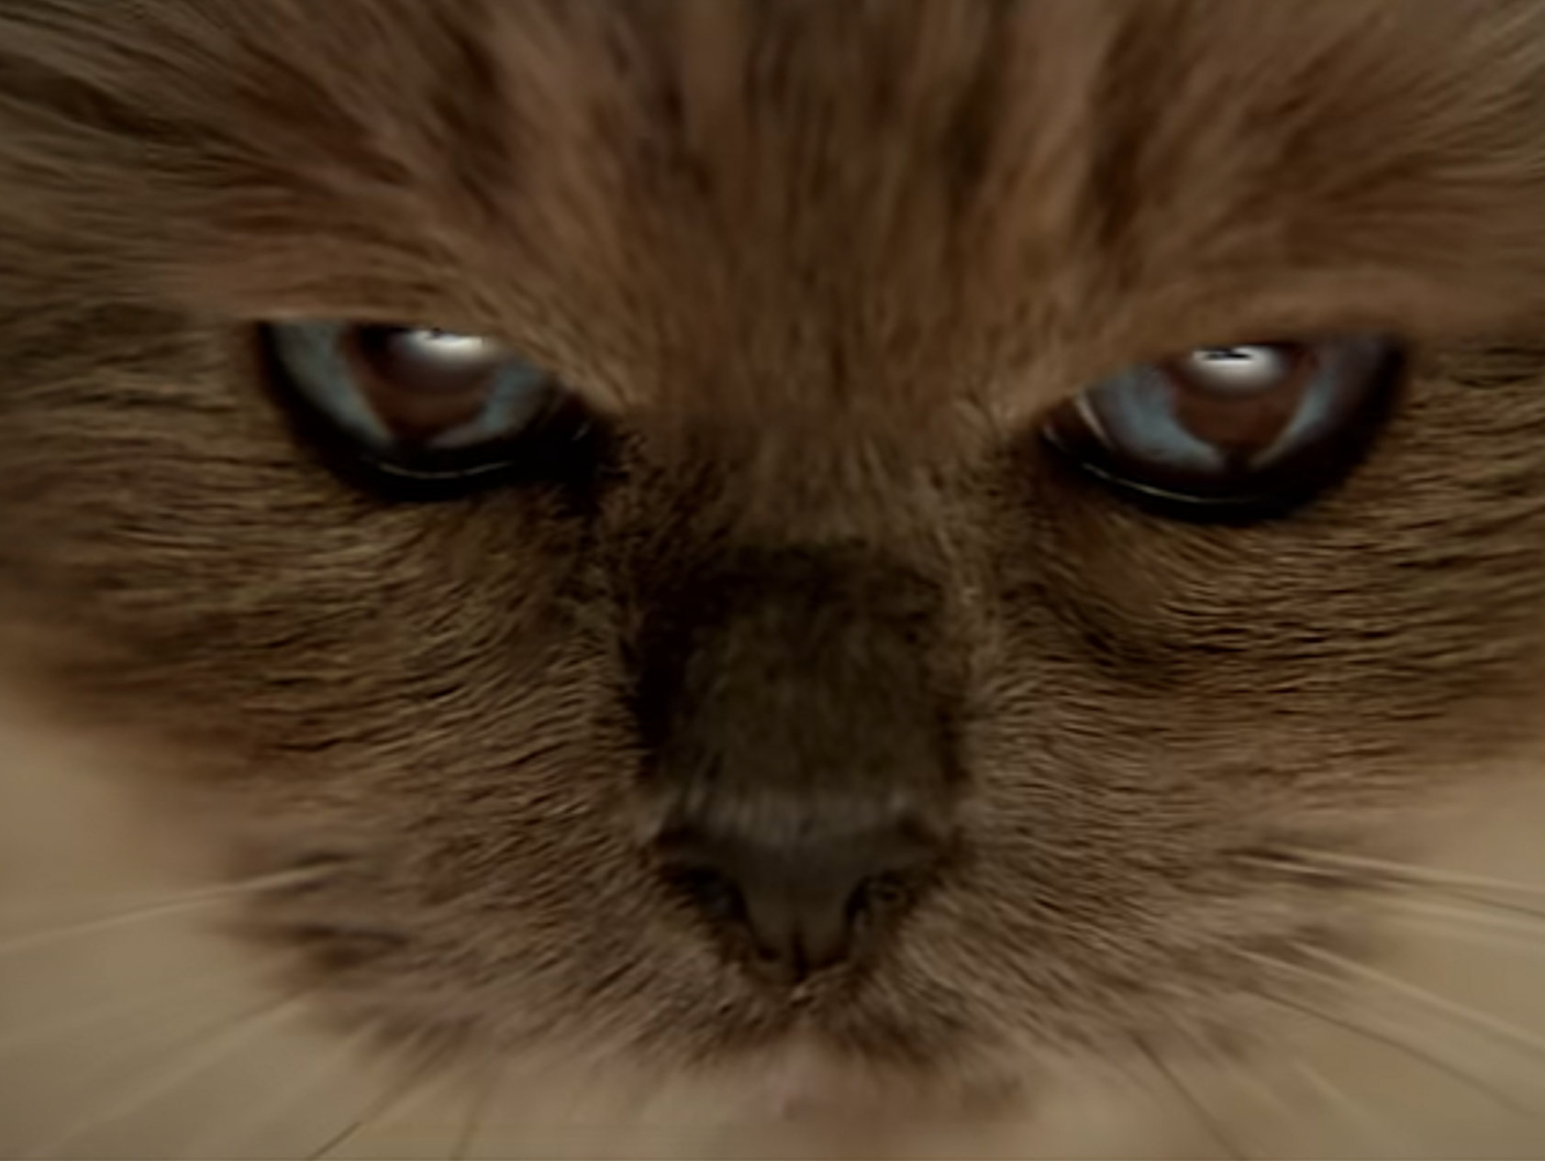

Pets at Home
DCM Awards Nominee:
Best Use of Cinema (Large)
Background
With increased competition in the pet care industry, Pets at Home wanted to enhance its position and drive consideration. The brand underwent a refresh, adopting a cohesive and softer brand identity under the positioning "We’re All for Pets”.
Plan
With a new 60” creative, Pets at Home ran in cinema for 6 weeks over the spring, accessing a number of titles effective in reaching its target family audience including: Spiderman: Across The Spider-Verse and The Little Mermaid, ensuring maximum visibility and reach.
Results
The perception of the company as an authoritative and industry-leading pet care brand grew significantly.
85% felt the brand ‘understood them and their pet’s needs’ (+9% uplift vs. control).

Slide 2
Pets at Home
DCM Awards Nominee:
Best Use of Cinema (Large)
We’re All For Pets
Media agency | Target | Buying route | Copy length
Carat | Families | AGP | 60”
Background
Pets at Home is known as the nation’s largest pet retailer but felt faced with the challenge of being perceived as a disconnected collection of brands rather than a unified and expert pet care company. With increased competition in the pet care industry, the company wanted to enhance its position and drive consideration. To achieve this, Pets at Home underwent a brand refresh, adopting a cohesive and softer brand identity under the positioning "We’re All
for Pets”.
Plan
Pets at Home created a 60” copy with the aim of connecting with pet owners emotionally, using the iconic Meat Loaf song “I’d Do Anything For Love” as a nod to the bond between pets and their owners. Running for 6 weeks across the spring, through an AGP Pets at Home accessed a number of highly efficient titles for its target audience of families including Spiderman: Across The Spider-Verse and The Little Mermaid to ensure maximum visibility and reach.
Results
Overall, the results were impressive and demonstrated the effectiveness of starting with cinema.
Improved associations
The perception of the company as an authoritative and industry-leading pet care brand grew significantly. 85% also felt the brand ‘understood them and their pet’s needs’ (+9% uplift vs. control).
Better brand comprehension
Of those exposed, 74% recognised Pets at Home’s brands as part of one united group.

