Slide 1
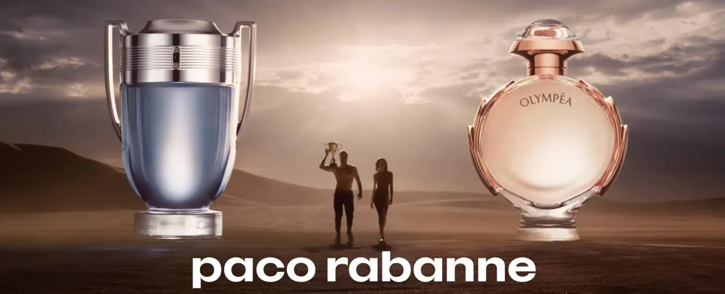
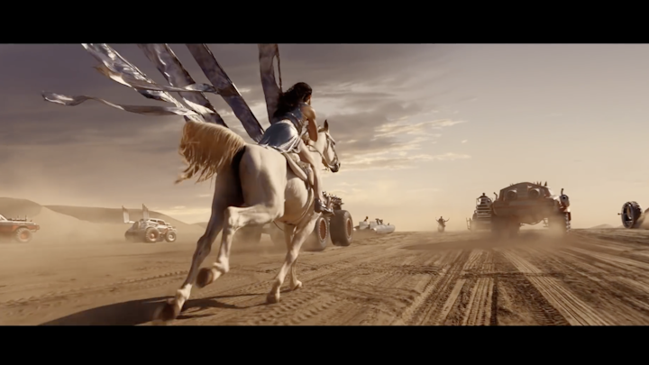

Paco Rabanne
Background
Sales of the Invictus/Olympéa had begun to plateau, and the brand was losing share of voice in a growing market. With the upcoming launch of two ‘Legend’ edition fragrances, Paco Rabanne wanted to make a big splash and reinvigorate the Invictus/Olympéa brands.
Plan
Paco Rabanne bought into a Film Pack for the highly anticipated Avengers: Endgame and worked with DCM Studios to produce a contextually relevant Avengers-themed ident featuring Marvel legends including Iron Man, Hulk and Thor to run alongside their hero 45” creative.
Results
During the period cinema was on air both the Invictus and Olympéa fragrances saw significant sales growth with the Legend fragrances entering the Top 10 masculine and feminine fragrances respectively.
Notes:
No source featured on previous presentation

Slide 2
Paco Rabanne
‘Invictus & Olympéa’
Media agency | Target | Buying route | Copy length
Starcom | 16-34 | Film pack | 45”
Background
By 2015, sales of the Invictus/Olympéa had begun to plateau. The category was in growth, but the brand was losing share of voice to its competitors. With the upcoming launch of two ‘Legend’ edition fragrances, Paco Rabanne wanted to make a big splash and reinvigorate the Invictus/Olympéa brands.
Plan
Paco Rabanne wanted to recruit a younger consumer into the brand. The new Invictus and Olympéa fragrances were due for release on the same date as Avengers: Endgame providing a perfect fit.
Working with DCM Studios, a contextually relevant Avengers-themed ident was created that featured the Invictus and Olympéa brand ambassadors alongside famous Marvel legends including Iron Man, Hulk and Thor. This ran alongside the main ad to help connect the campaign to the film and drive stand out in the reel. A 4DX version of the campaign also ran in Cineworld to further immerse the target 16-34 audience in ad with synchronised movements, smells and special effects.
Results
During the period cinema was on air both the Invictus and Olympéa fragrances saw significant sales growth.
The Legend fragrances entered the Top 10 masculine and feminine fragrances respectively.
Notes:
No source featured on previous presentation

