Slide 1
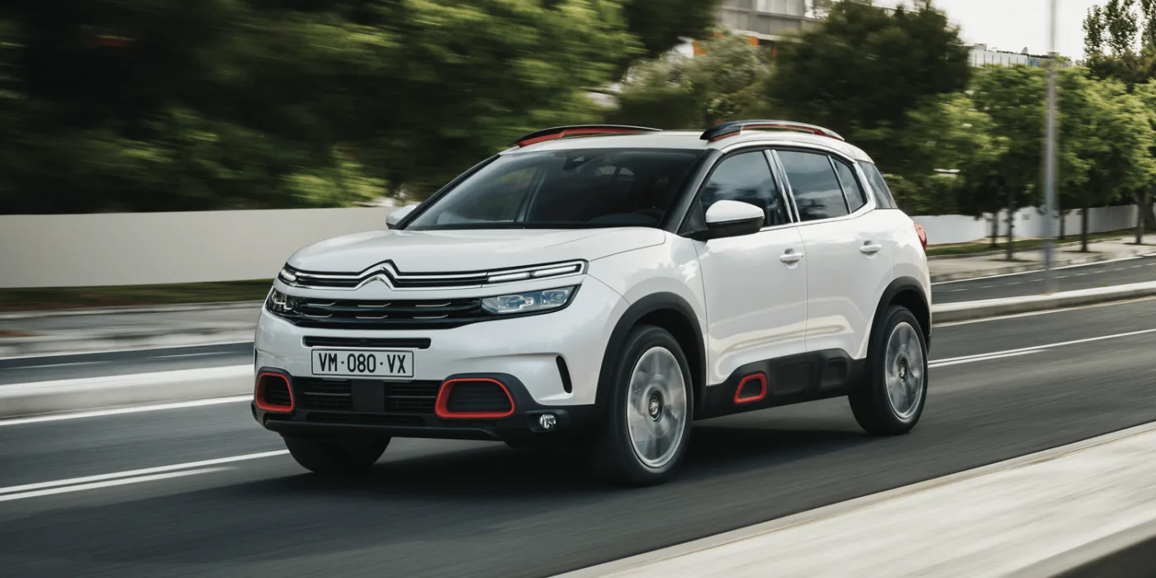
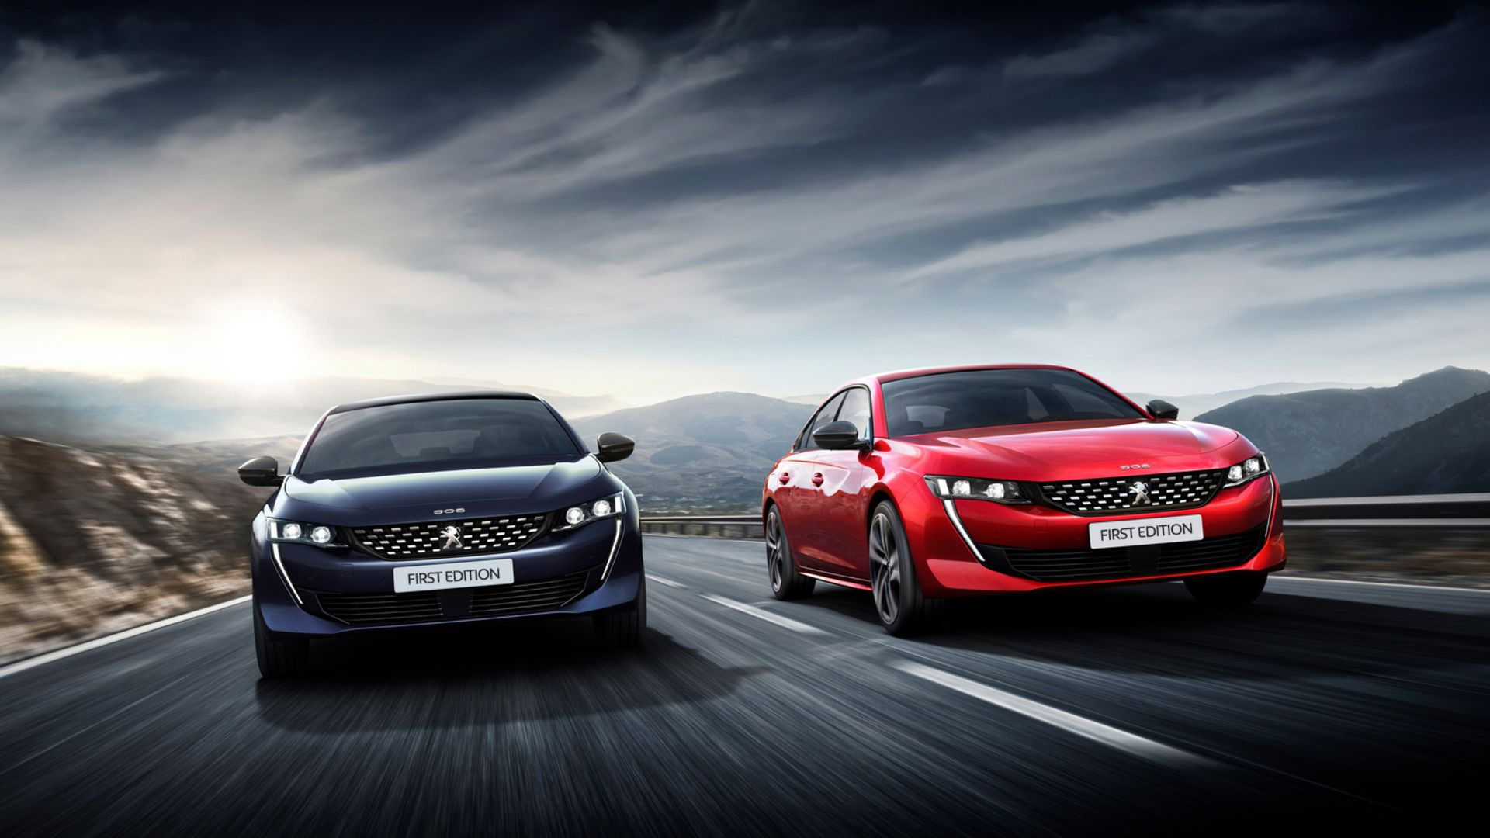

PSA Group
Background
PSA Group wanted to use cinema as an opportunity for longer brand storytelling compared to other AV channels – with the ultimate aim of increasing model awareness and consideration.
Plan
‘Awards Season’ provided the opportunity for PSA to engage with upmarket audiences and align with premium programming. PSA Group bought the Gold Spot in Oscar and BAFTA contenders including Stan & Ollie, Green Book, and The Favourite.
Results
The cinema campaign helped increase perceptions of reliability for both Citroen (+33%) and Peugeot (+42%) brands
Exposure via cinema led to increases in consideration for all three PSA Group brands – Citroen (+68%), DS (+72%) and Peugeot (+25%)
Source: DCM / PSA Group. Conducted by: Differentology, January 2019.
Base: ABC1 35+.
Notes:
Source: DCM / PSA Group. Conducted by: Differentology, January 2019.
Base: ABC1 35+.

Slide 2
PSA Group
Media agency | Target | Buying route | Copy length
EssenceMediaCom | ABC1 35+ | Awards Season Gold Spot | 60”
Awards Season Sponsorship
Background
Historically, the first quarter of the year is very important and competitive for brands in the motor sector with the majority running advertising and looking to capitalise during this key sales period. PSA Group (Citroen, DS and Peugeot) was looking for opportunities that would deliver positive impact amongst its target audience of affluent adults and provide the opportunity for longer brand storytelling compared to other AV channels – with the ultimate aim of increasing model awareness and consideration.
Plan
‘Awards Season’ was the perfect fit for PSA, running from January to March it provided the opportunity for PSA to engage with upmarket audiences and align its three key brands with the highest quality content on the big screen in the lead up to the Oscars and BAFTAs. PSA Group bought the Gold Spot (the most prestigious spot in the reel) in a selection of Oscar and BAFTA contenders including Stan & Ollie, Green Book, The Favourite and Vice.
Utilising the full selection of films bought across the period PSA Group decided to rotate copy and advertise a series of different models.
Results
Aligning its brands with the high-quality content of ‘Awards Season’ helped PSA Group deliver significant additional impact at a key time of year across its three major brands.
Promoting reliability
The cinema campaign helped increase perceptions of reliability for both Citroen (+33%) and Peugeot (+42%).
Driving consideration
Exposure via cinema led to increases in consideration for all three PSA Group brands – Citroen (+68%), DS (+72%) and Peugeot (+25%).
Source: DCM / PSA Group. Conducted by: Differentology, January 2019.
Base: ABC1 35+.
Notes:
Source: DCM / PSA Group. Conducted by: Differentology, January 2019.
Base: ABC1 35+.

