Slide 1
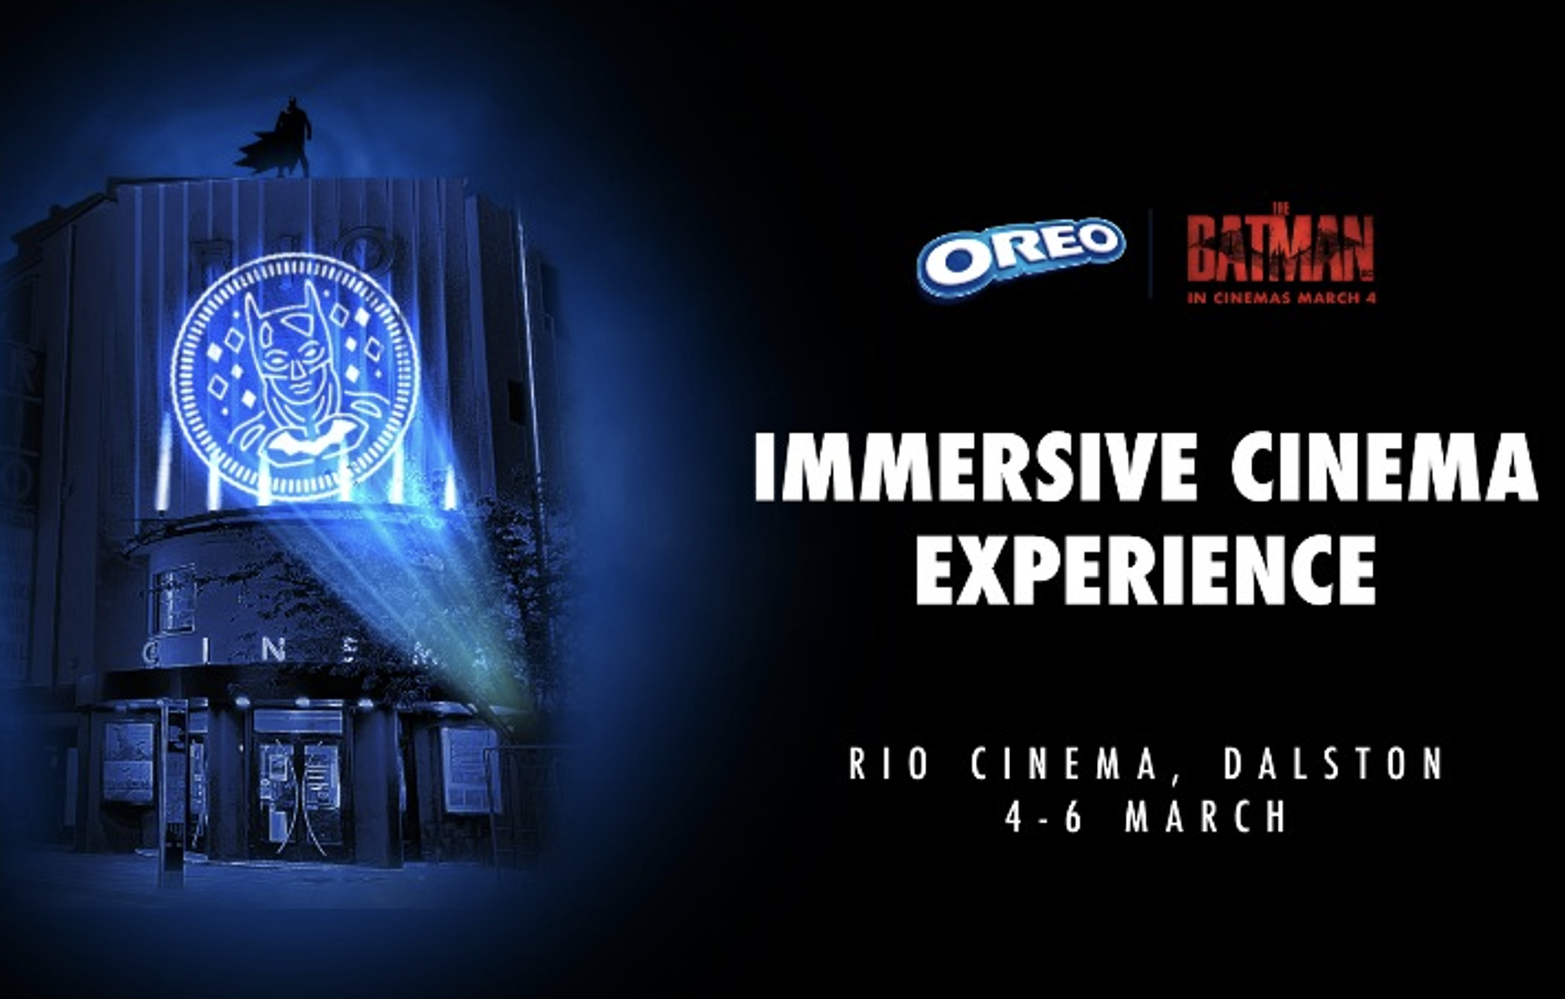
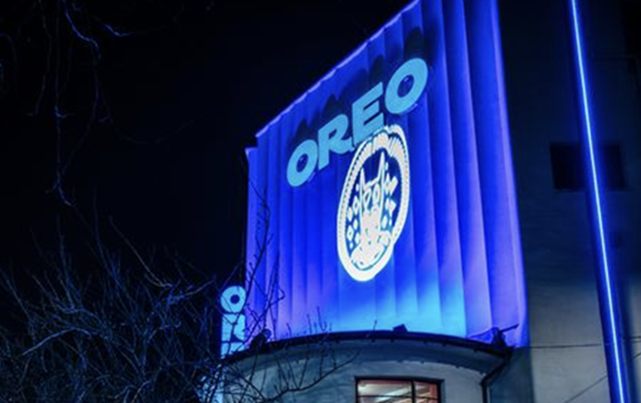

Oreo
Background
Oreo wanted to reach a young audience and elevate its campaign with an immersive experience that would delight the audience whilst also driving fame & talkability.
Plan
Collaborating with DCM Studios & ElevenFiftyFive, Oreo captivated cinemagoers with a Gotham-City inspired Oreo experience to coincide with The Batman’s opening weekend. The three-day experience hosted by East London’s Rio Cinema formed part of a broader partnership that included a 30” ident running across HFSS AGP titles.
Results
Avg. number of people per showing at the Rio Cinema was double that of the rest of the DCM’s estate that weekend.
60% of cinemagoers said it made them more likely to consider Oreo.

Slide 2
Oreo
Oreo x The Batman
Media agency | Target | Buying route | Copy length
Carat | 18-34s | DCM Studios x HFSS AGP | 30”
Background
Oreo wanted to reach a young audience and elevate its campaign with an immersive experience that would delight the audience while also driving fame & talkability.
Plan
Collaborating with DCM Studios & ElevenFiftyFive, Oreo wanted to captivate cinemagoers with a Gotham-City inspired Oreo experience to coincide with the release of The Batman over its opening weekend. The three-day experience hosted by East London’s Rio Cinema formed part of a broader partnership that included a 30” ident running in HFSS AGP titles.
At the Rio Cinema the opening weekend takeover saw the venue taped off as a crime scene in which everyone in the audience was a suspect. To complete the picture all signage was given an Oreo-themed makeover including the ticket kiosk, branded vinyl wall coverings and as many ‘Oreo x The Batman’ embossed cookies as you could eat.
Results
Cinema delivered on Oreo’s key objectives of connecting meaningfully with its target audience while also driving fame and talkability.
Driving interest
The opening weekend takeover drove over 1,300 attendees and the avg. number of people per showing at the Rio Cinema was double that of the rest of DCM’s estate. Recall of the Oreo x Batman partnership was 166% higher for cinemagoers vs. control.
Impact on brand consideration
60% of cinemagoers said it made them more likely to consider Oreo having experienced the opening weekend takeover.

