Slide 1
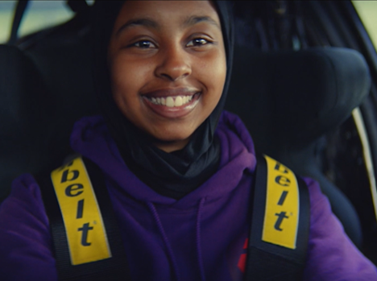
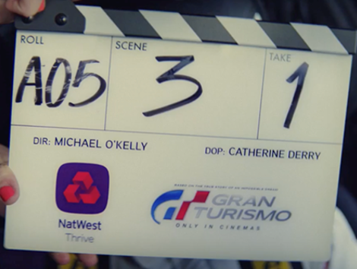

NatWest
Background
NatWest wanted to raise awareness of NatWest Thrive, a money-confidence program designed to help young people develop the self-belief, confidence and money skills to achieve their aspirations.
Idea and Plan
In collaboration with DCM Studios and Sony Pictures, NatWest partnered with Gran Turismo, producing a 60” copy that ran in the Silver Spot of the film, as well as across the 16-34 Adults AGP in the months leading up to the film’s release date.
Results
Prompted awareness of NatWest Thrive increased by +233%
Two thirds of those exposed to the cinema ad are likely to consider NatWest, +46% uplift vs. control.
Source: DCM / Natwest Conducted by; Differentology, September 2023.
Results base: 16+. Uplifts are test (exposed to ad) vs control (unexposed to ad)

Slide 2
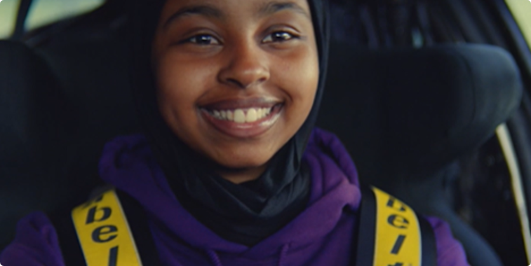
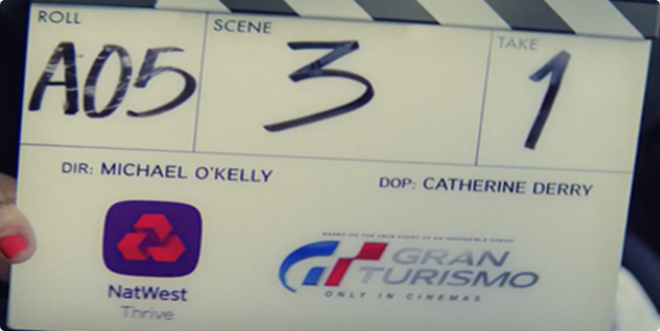

NatWest
Media Agency | Target | Buying Route | Copy length
Initiative | 16-24s | Film Partnership | 60”
Thrive & Gran Turismo Partnership
Background
NatWest wanted to raise awareness of NatWest Thrive, a money-confidence program designed to help young people develop the self-belief, confidence and money skills to achieve their aspirations.
Idea
Knowing that contextualisation of the ads will help boost engagement and cut-through, the bank collaborated with DCM Studios and Sony Pictures to create a film partnership with Gran Turismo – with the film’s themes of dedication/commitment leading to a dream becoming reality, making it the perfect fit. DCM Studios produced a 60” copy showcasing 9 aspiring film makers on site recreating a shot from the film, with Sony providing the car that was used in the filming of Gran Turismo.​
Plan
Before running in a Silver Spot in Gran Turismo, NatWest also ran the ad across 16-34 Adults AGP titles across July – August to build up awareness of the campaign.
Results
Exposure to the contextual NatWest Thrive ad in cinema helped improved NatWest’s key campaign objectives.
Improved Awareness
Prompted awareness of NatWest Thrive increased by +233%.
Increased Consideration
Two thirds of those exposed to the cinema ad are likely to consider NatWest, +46% uplift vs. control.
Driving Key Associations
+29% uplift for key statement - ‘NatWest gives people the confidence to kickstart their future’.
Source: DCM / Natwest Conducted by; Differentology, September 2023.
Results base: 16+. Uplifts are test (exposed to ad) vs control (unexposed to ad)

