Slide 1
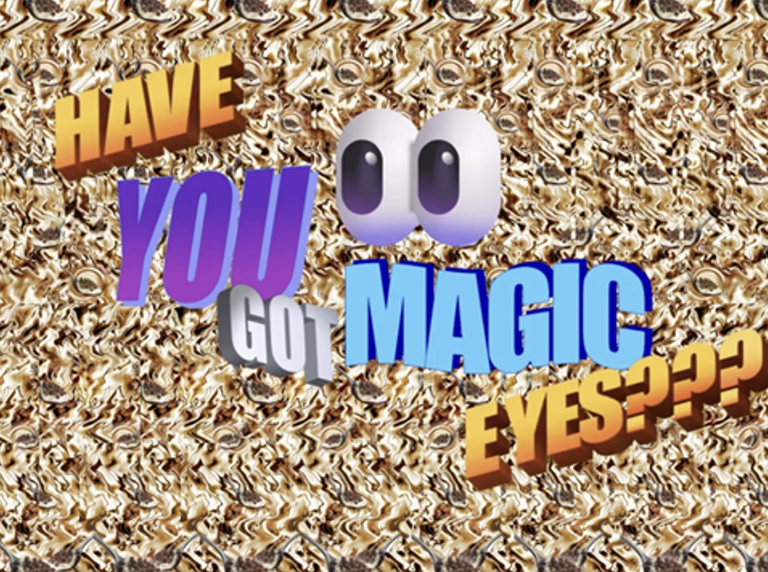
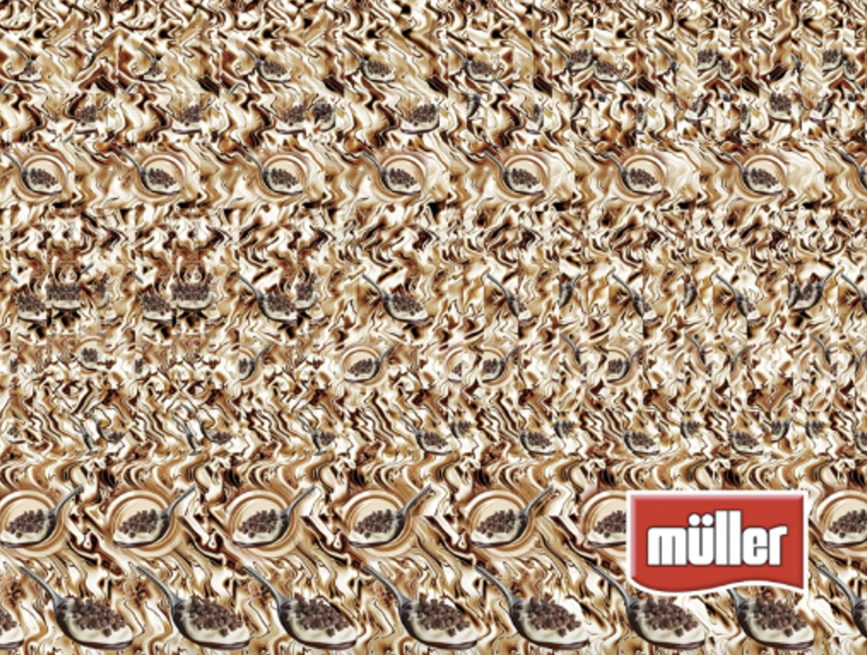

Müller Corner
Background
While already the market leader, Müller Corner wanted to expand sales and drive perceptions of being an ‘everyday treat’ by launching a nostalgia-driven ad campaign.
Plan
The creative copy used the Magic Eye technique, with a 2D kaleidoscope-style image of a Müller Corner yoghurt concealing a hidden 3D Mud Pie. Utilising cinema’s big screen high-attention environment, audiences are encouraged to engage and decipher the hidden word.
Results
Awareness and product trial rate were both up +16% vs. pre-campaign levels.

Slide 2
Müller Corner
Have You Got Magic Eyes?
Media agency | Target | Buying route | Copy length
EssenceMediacom | ABC1 Adults | ABC1 Adult AGP | 10”, 20”
Background
Despite being the current market leader, Müller Corner wanted to expand sales and drive perceptions of being an ‘everyday treat’ by launching a nostalgia driven ad campaign.
Plan
Wanting to grab the attention of its audience, the creative copy used the Magic Eye technique, with a 2D kaleidoscope-style image of a Müller Corner yoghurt concealing a hidden 3D Mud Pie. Here, the audience is encouraged to engage with the ad to decipher the hidden word, utilising cinema’s distraction-free offering.
Müller Corner bought into an ABC1 Adult AGP giving them access to films such as Kingdom of the Planet of Apes, Ghostbusters - Frozen Empire, Back to Black, and Godzilla x Kong - The New Empire. These films aligned with the campaign’s core themes by tapping into nostalgia during the 80s, 90s and 2000s.
Results
This campaign was a remarkable success, with the strategic integration of cinema instrumental in achieving Muller Corner’s key campaign KPIs.
Awareness
Increased +16% vs. pre-campaign.
Trial rate
Product trial rate was also up +16% vs. pre-campaign showing the success in driving direction action.

