Slide 1
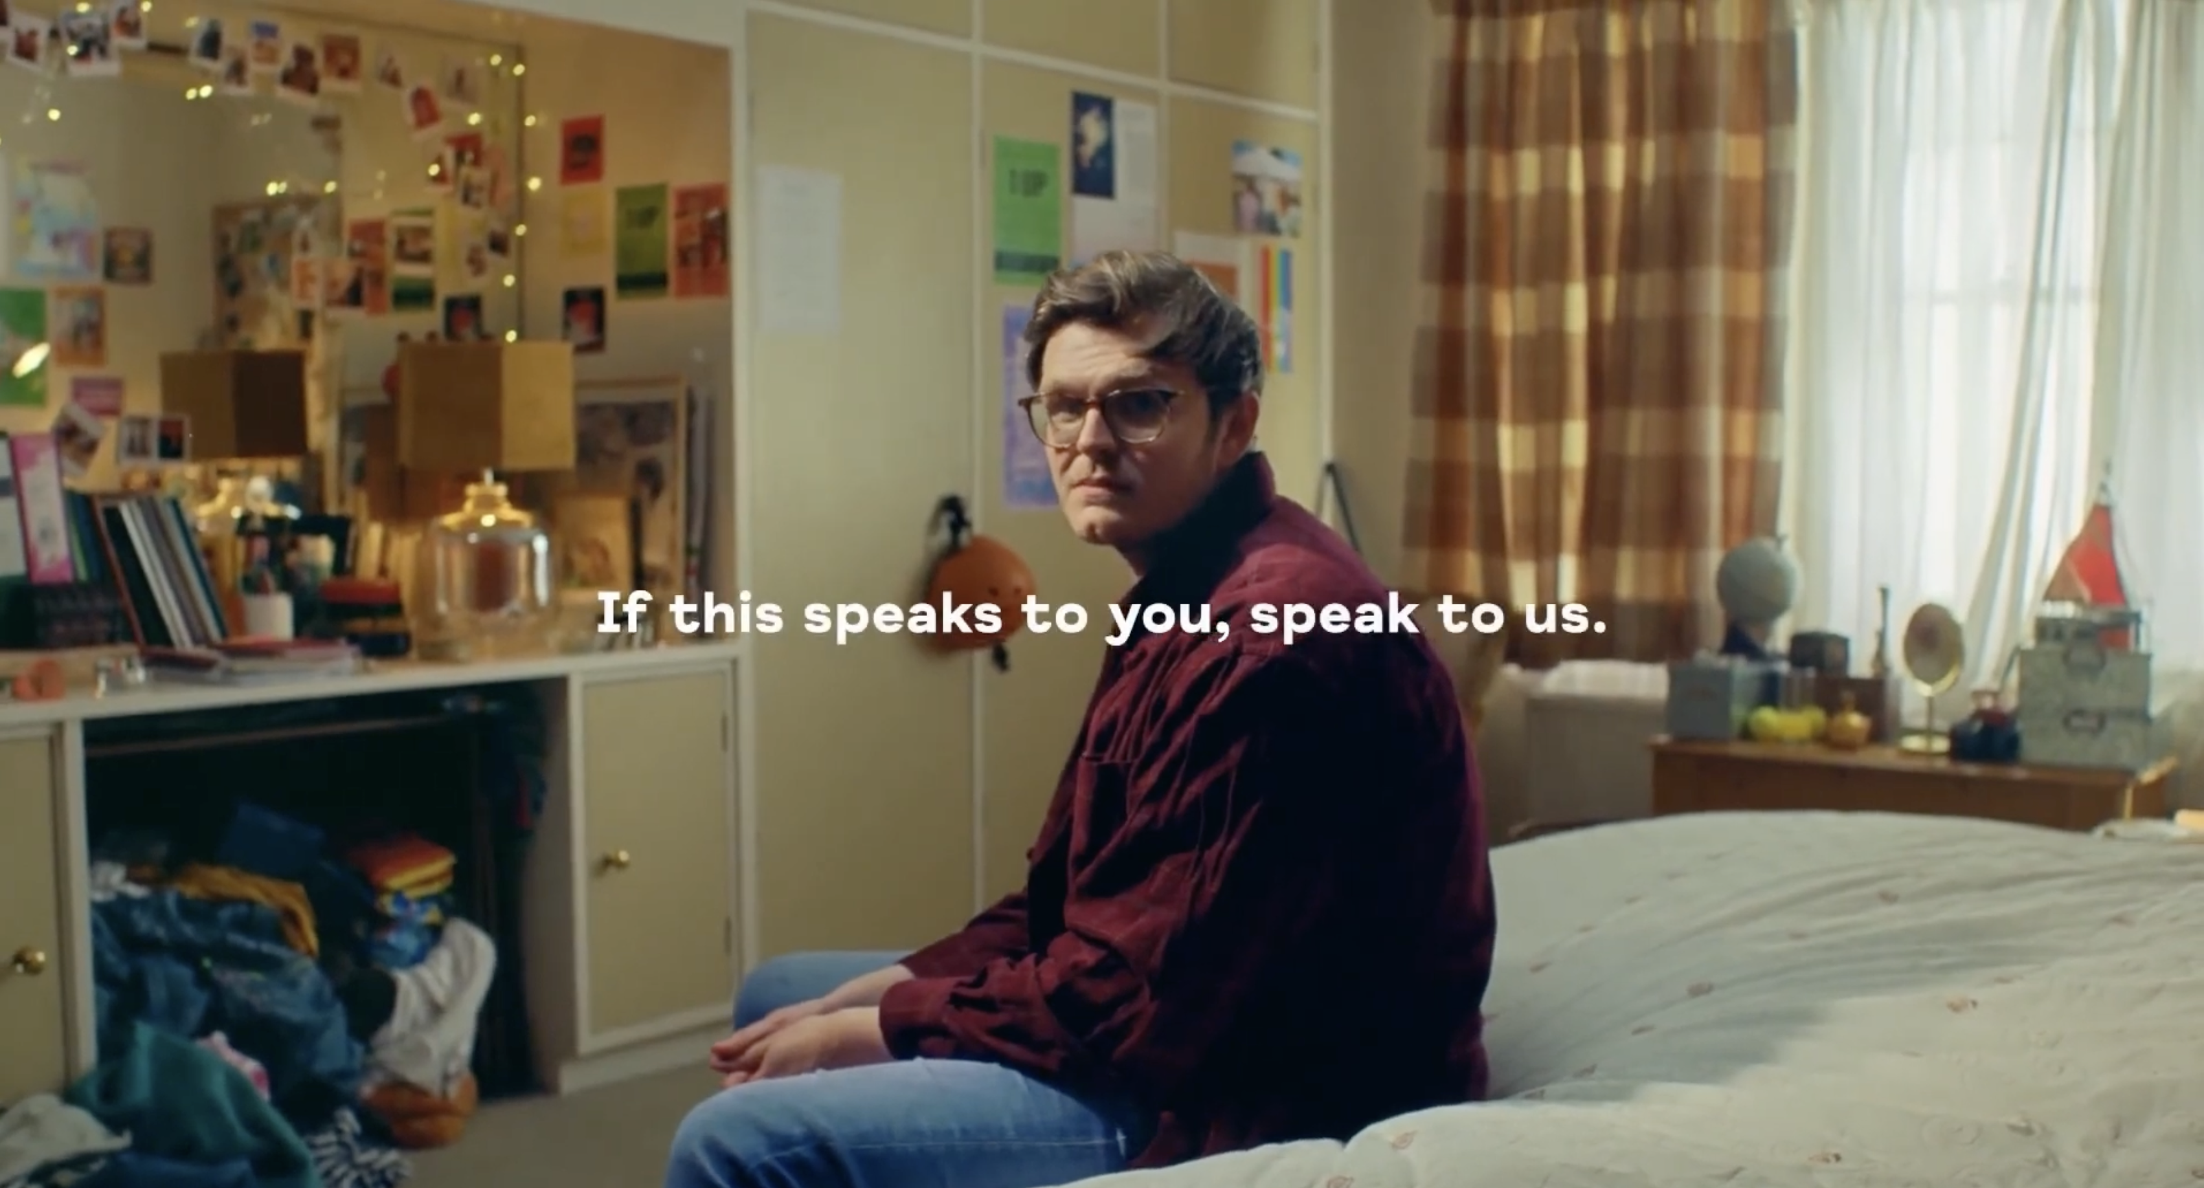
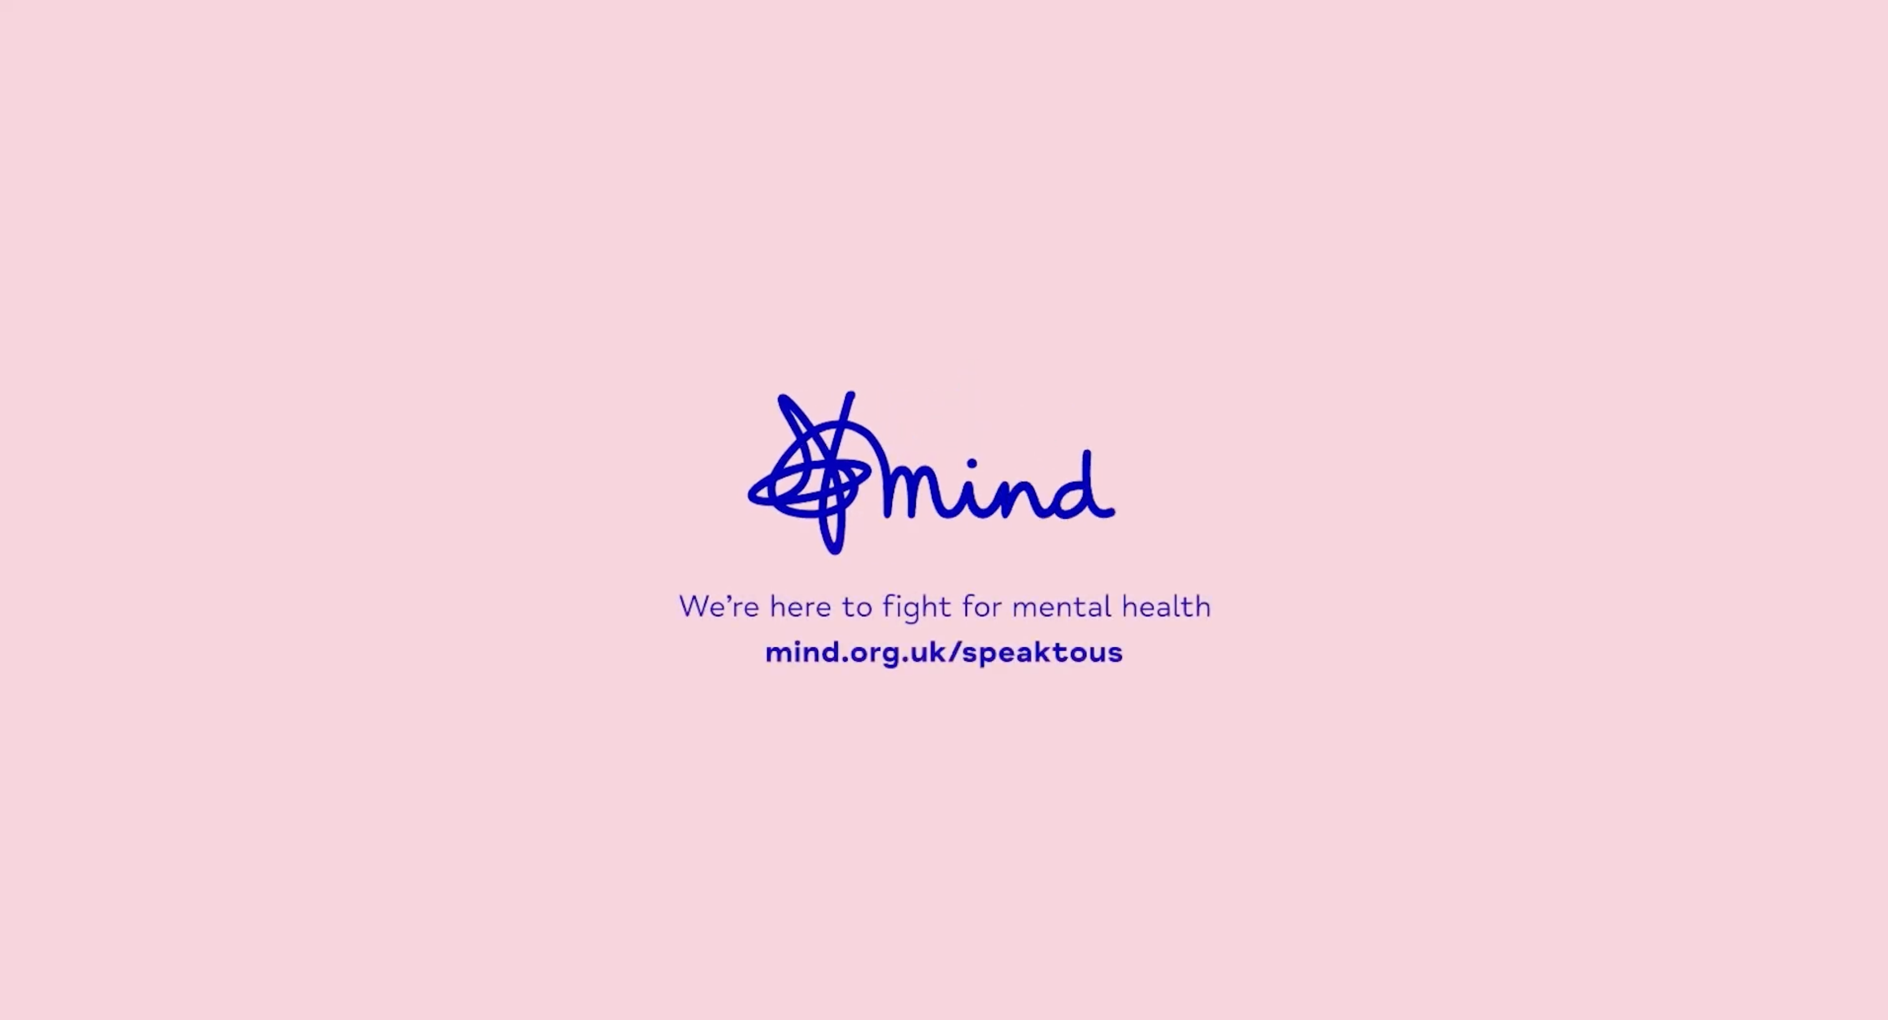

Mind
DCM Awards winner:
Best ‘Marketing for Good’ Campaign
Background
Mind wanted to drive take up of its mental health services, particularly amongst young men who are one of the most vulnerable groups.
Plan
The release of Doctor Strange in the Multiverse of Madness coincided with Mental Health Awareness Week, so was the perfect moment to showcase two emotively powerful creatives. The ads also ran in Ambulance, The Unbearable Weight Of Massive Talent and The Northman and used regional targeting to target London cinemas.
Results
+7% uplift in understanding of Mind’s mental health support offering amongst men 20-40 in London vs. pre-campaign
Mind’s ‘belief in cause’ score for the key audience increased by 13% following the campaign
Notes:
No source featured in previous presentation

Slide 2
Mind
DCM Awards winner:
Best ‘Marketing for Good’ Campaign
Media agency | Target | Buying route | Copy length
Medialab | 16-34 Men | Film Pack | 60”
Connecting Mind and its services with those who need it most
Background
Whilst Mind has been gaining visibility and relevancy in recent years, there is still a gap in take up of mental health support services in certain groups. One of the most vulnerable groups is young men and so, Mind set out to increase both ‘belief in cause’ and association with mental health resources among men aged 20-40 in London.
Plan
With the release of Doctor Strange in the Multiverse of Madness coinciding with Mental Health Awareness Week, Mind saw it as an ideal time to engage young men. Mind created two powerful films, featuring spoken word artists showing the different ways people talk about their mental health experiences.
These copies ran in films including Doctor Strange The Multiverse Of Madness, Ambulance, The Unbearable Weight Of Massive Talent and The Northman.
Using regional targeting, the ad played out in all London cinemas in the DCM portfolio, with OOH support in and around local tube stations.
Results
The cinema campaign was a resounding success with Mind seeing a marked increase in the metrics they set to target in the campaign.
Higher comprehension of support offering
+7% uplift in the understanding of Mind’s mental health support offering amongst men 20-40 in London vs. pre-campaign.
Improvement for ‘belief in cause’ score
Mind’s ‘belief in cause’ score amongst key audience increased by +13% following the campaign.
Increased website traffic
In London, Mind also experienced a significantly higher YOY increase in monthly website traffic (8x that of the rest of the UK).
Notes:
No source featured in previous presentation

