Slide 1
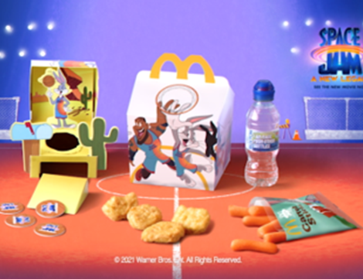
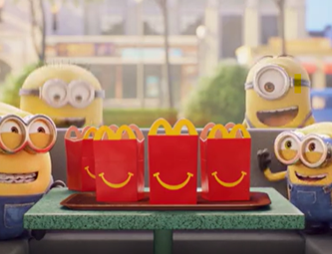

McDonald’s
Background
McDonald’s needed to find a new solution that provided an environment with family ‘co-viewing’ that would enable the brand to reconnect with families, drive nostalgia around the Happy Meal, and ultimately improve ROI.
Plan
A long-term Bronze spot partnership was struck that gave McDonald’s access to every family film across the DCM estate. McDonald’s ran various 30” creatives across the year to reflect the current in-store Happy Meal promotions.
Results
Half of cinemagoers exposed to the ad reported that they had gone on to visit McDonald’s
61% of those that recalled the Bronze Spot ad went on to purchase a Happy Meal.

Slide 2
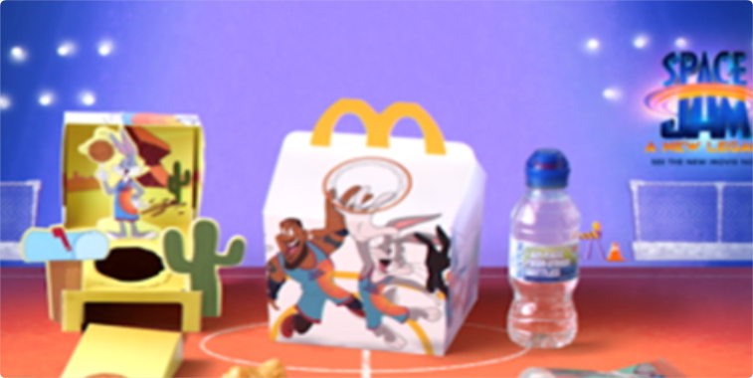
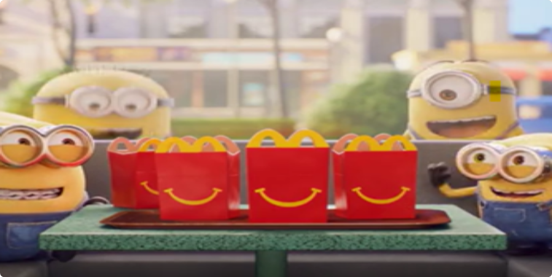

McDonald’s
Media Agency | Target | Buying Route | Copy length
OMD UK | Families | Family AGP Bronze Spot | 30”
Happy Meal
Background
Due to the changing media landscape with declining children’s TV consumption and increased restrictions around HFSS advertising, it was becoming more difficult to talk to Parents and Kids aged 4-7 about Happy Meal.
McDonald’s needed to find a solution that provided them with an environment they could reach dual viewing more effectively, reconnecting with families to drive nostalgia and remind them all the reasons why they love Happy Meal – and ultimately improve ROI.
Plan
DCM and OMD collaborated to create a long-term Bronze spot partnership that gave McDonald’s access to every family film – this would help establish a long-term association in cinema’s premium environment as well as also driving cut through within the ad reel. McDonald’s ran various 30” creatives across the year to reflect the current in-store Happy Meal promotions.
Results
The partnership worked well for McDonald’s, delivering significant reach among its key audience, as well as driving brand KPIs.
Increased Intent To Visit Restaurants
Half of cinemagoers exposed to the ad reported that they had gone on to visit McDonald’s.
Boosting Sales of Happy Meals
61% of those that recalled the Bronze Spot ad went on to purchase a Happy Meal.

