Slide 1

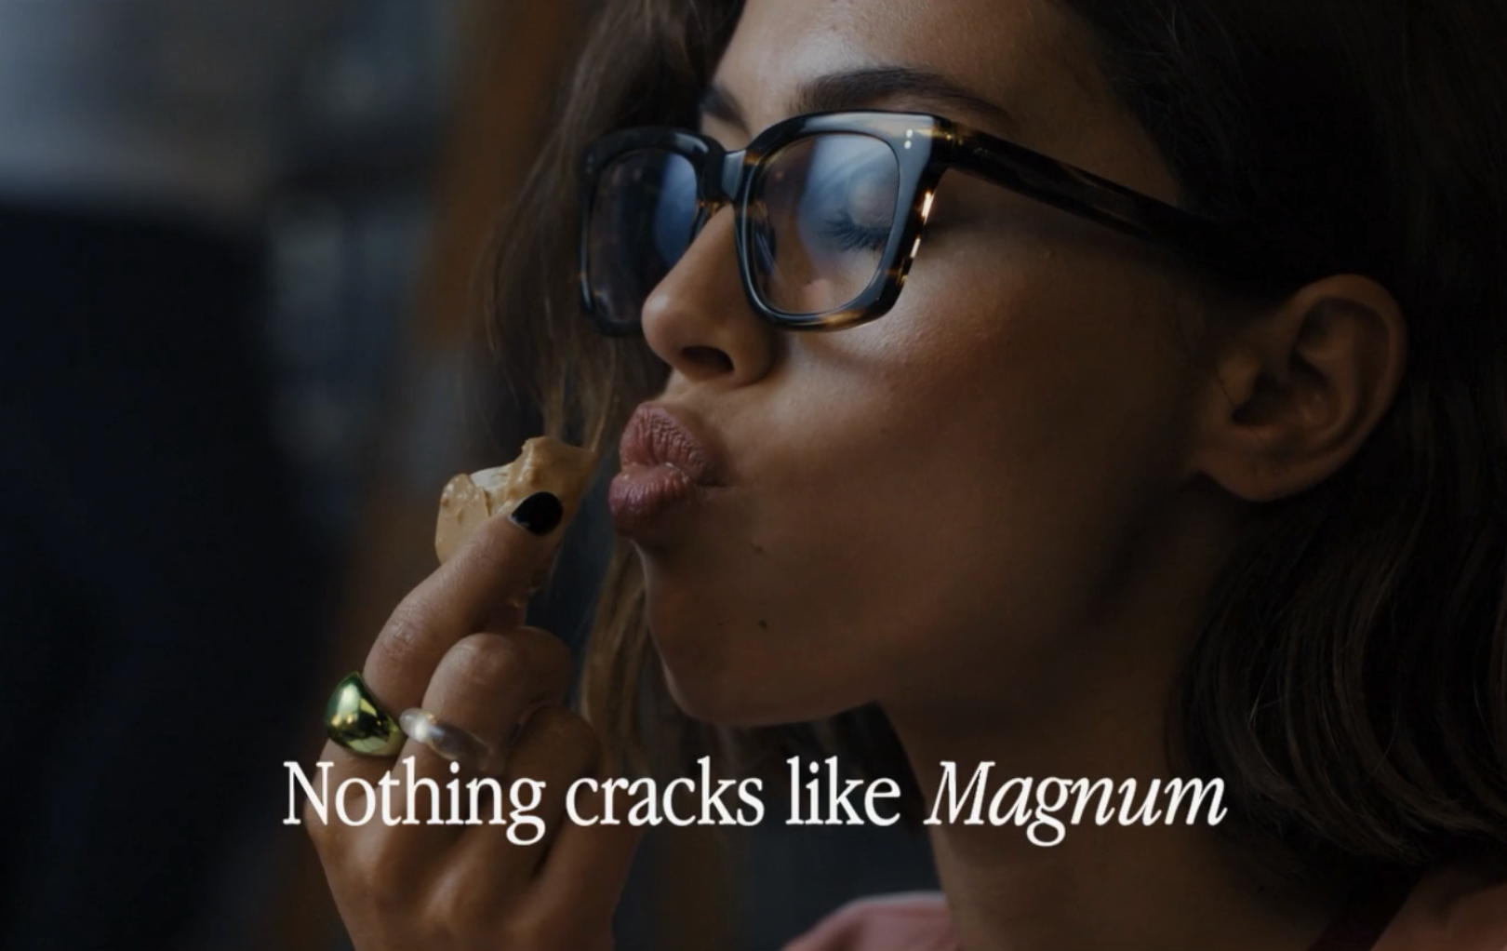

Magnum
Background
Given the upcoming changes to the HFSS regulations across TV, Magnum was keen to include cinema in the media mix to demonstrate how the big screen can boost their core KPIs including message takeout and perceptions surrounding quality and innovation.
Plan
Magnum bought into a Silver Spot in Bridget Jones: Mad About The Boy, showcasing its 60” copy in a premium position, accessing one of the biggest cultural moments of 2025.
Results
Cinema was integral in driving message takeout, seeing a +13% significant uplift in being able to identify ‘Nothing cracks like Magnum’. Additionally, cinema drove positive uplifts across perceptions surrounding ‘innovation’, ‘quality’ and ‘expertise’.
Source: DCM / Magnum. Conducted by: Differentology Feb 2025.
Notes:
Source: DCM / Magnum. Conducted by: Differentology Feb 2025. Results base 18+. Uplifts are test (exposed to ad) vs control (unexposed to ad. Uplifts seen from Control (unexposed to cinema ad) vs Test (exposed to cinema ad)

Slide 2
Magnum
Nothing cracks like Magnum
Media agency | Target | Buying route | Copy length
Mindshare | 28+ Adults | Silver Spot | 60”
Background
Despite already being a highly salient brand, Magnum aimed to convert lapsed buyers and given the upcoming changes to the HFSS regulations across TV & VOD platforms, Magnum was keen to include cinema in the media mix to demonstrate how the big screen can boost core KPIs of quality and innovation.
Plan
Magnum launched its new creative copy that focused on the ‘Magnum crack’, a sonic signifier of the quality of its cracking chocolate. Knowing that cinema can provide a premium audio-visual experience, Magnum wanted to align itself with the quality of the big screen to land its key campaign line, “Nothing cracks like Magnum”.
Magnum bought into a Silver Spot in Bridget Jones: Mad About The Boy, showcasing its 60” copy in a premium position, accessing one of the biggest cultural moments of 2025.
Results
Cinema was integral in driving message takeout, with those exposed to the ad in the cinema delivering a +13% significant uplift in being able to identify ‘Nothing cracks like Magnum’ as the main message of the ad.
Additionally, cinema drove positive uplifts across other metrics including ad awareness (+14%), recall (+15%), improved impressions (+10%), consideration (+4%) and perceptions surrounding ‘innovation’, ‘quality’ and ‘expertise’.
Source: DCM / Magnum. Conducted by: Differentology Feb 2025.
Notes:
Source: DCM / Magnum. Conducted by: Differentology Feb 2025. Results base 18+. Uplifts are test (exposed to ad) vs control (unexposed to ad. Uplifts seen from Control (unexposed to cinema ad) vs Test (exposed to cinema ad)

