Slide 1
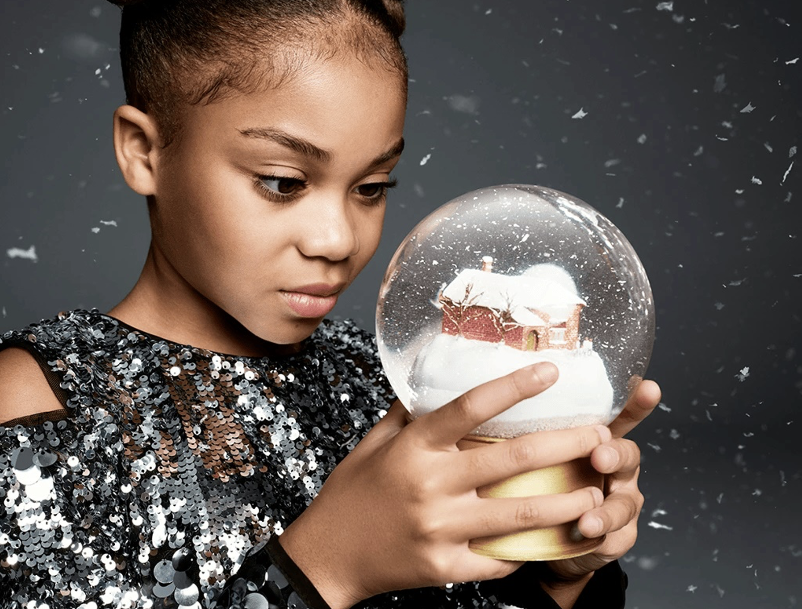
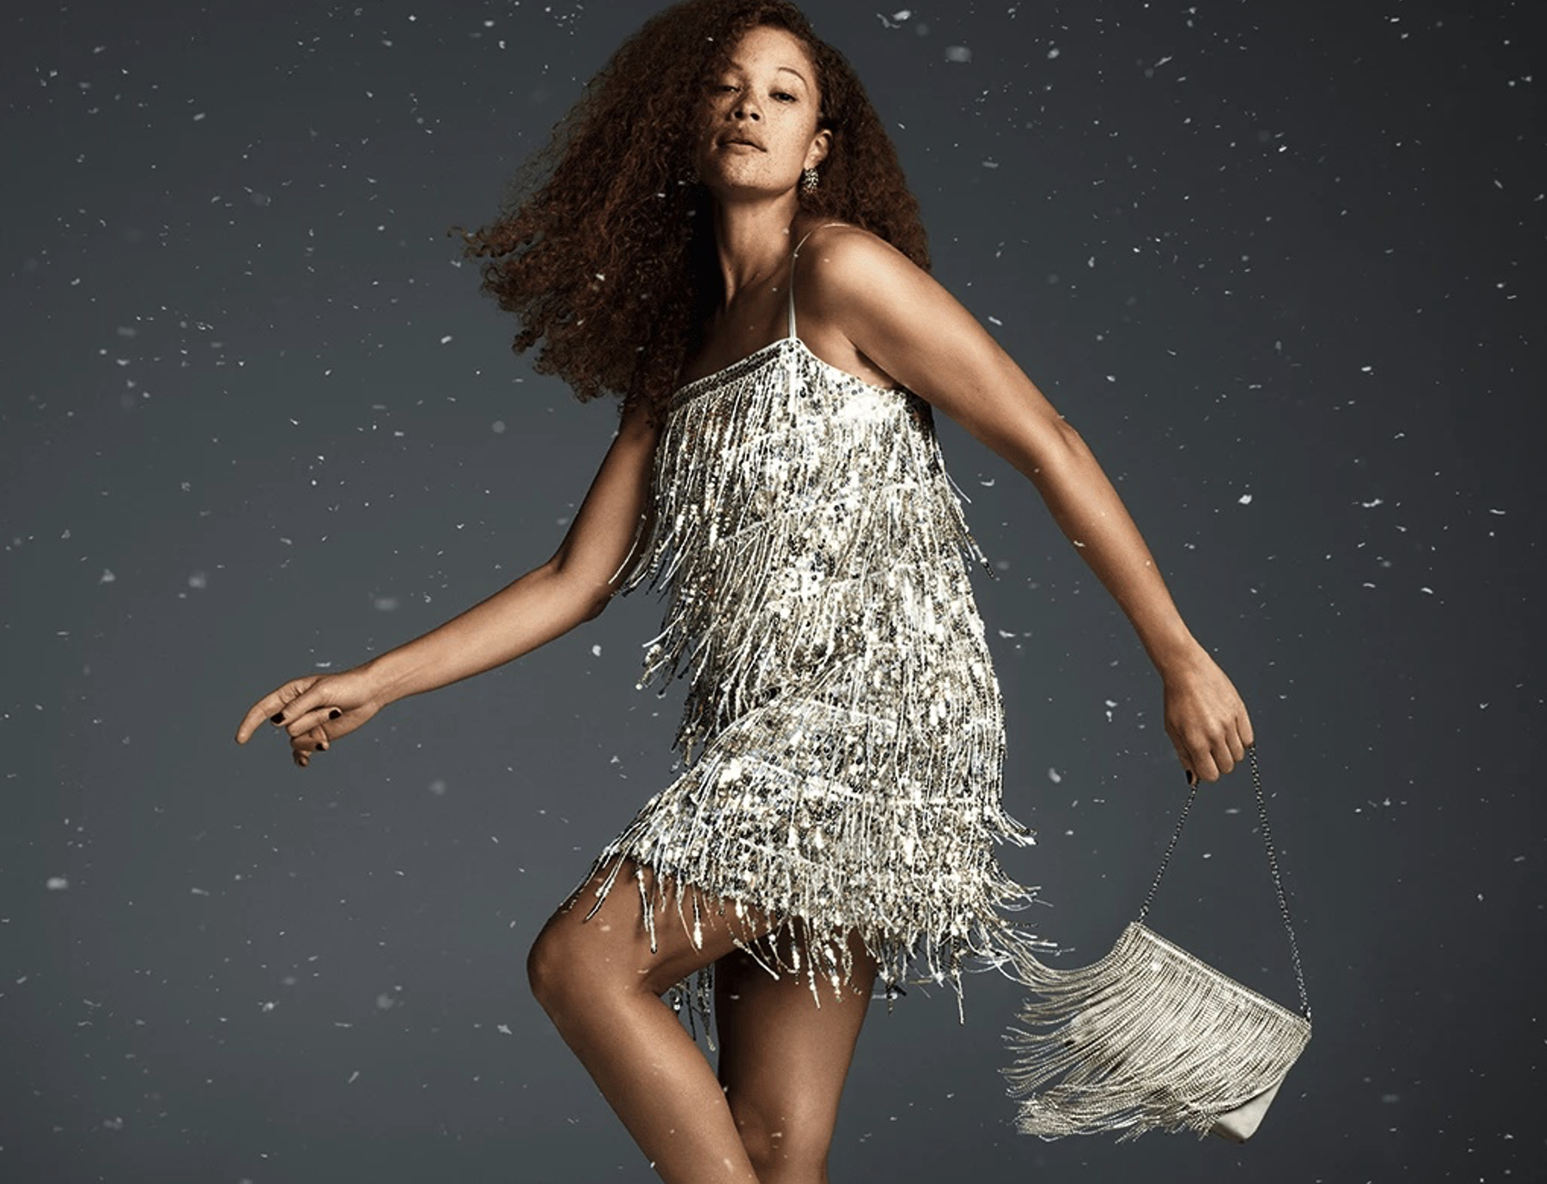

Marks & Spencer
DCM Awards Nominee:
Best Use of Cinema (Small)
Background
In Christmas 2024, Marks & Spencer (M&S) wanted to showcase its quality clothing collections and successfully cut-through the festive noise to create a connection with its core family audience.
Plan
To achieve share of mind at this busy time of year, M&S knew it needed to be an integral part of festive family moments, so the brand launched its 90” copy in Paddington in Peru, a franchise that previously had partnered with M&S in 2017.
Results
M&S were able to drive emotional connection and brand love, seeing its Clothing & Home sales grow by 2% YoY.
Source: DCM / M&S
Notes:
Source: DCM / M&S

Slide 2
Marks & Spencer
DCM Awards Nominee:
Best Use of Cinema (Small)
Background
In Christmas 2024, Marks & Spencer (M&S) aimed to connect with families beyond linear TV, by connecting with audiences during moments of culture & shared experiences. The challenge was to showcase its quality clothing collections and to successfully cut-through the festive noise to create a genuine connection with its core family audience.
Plan
To achieve share of mind at this busy time of year, M&S identified cinema as a key festive family moments and so it launched its 90” copy in Paddington in Peru, a franchise that previously had partnered with M&S in 2017.
Results
Launching the campaign in Paddington in Peru successfully connected with its target audience, proving that the most effective advertising doesn't just interrupt the moment - it becomes part of its very fabric, driving deep emotional connection and brand love.
Media agency | Target | Buying route | Copy length
Mindshare | Families | Film Pack | 90”
Sales uplift YoY
M&S were able to drive emotional connection and brand love, seeing its Clothing & Home sales grow by 2% YoY.
Source: DCM / M&S
Notes:
Source: DCM / M&S

