Slide 1
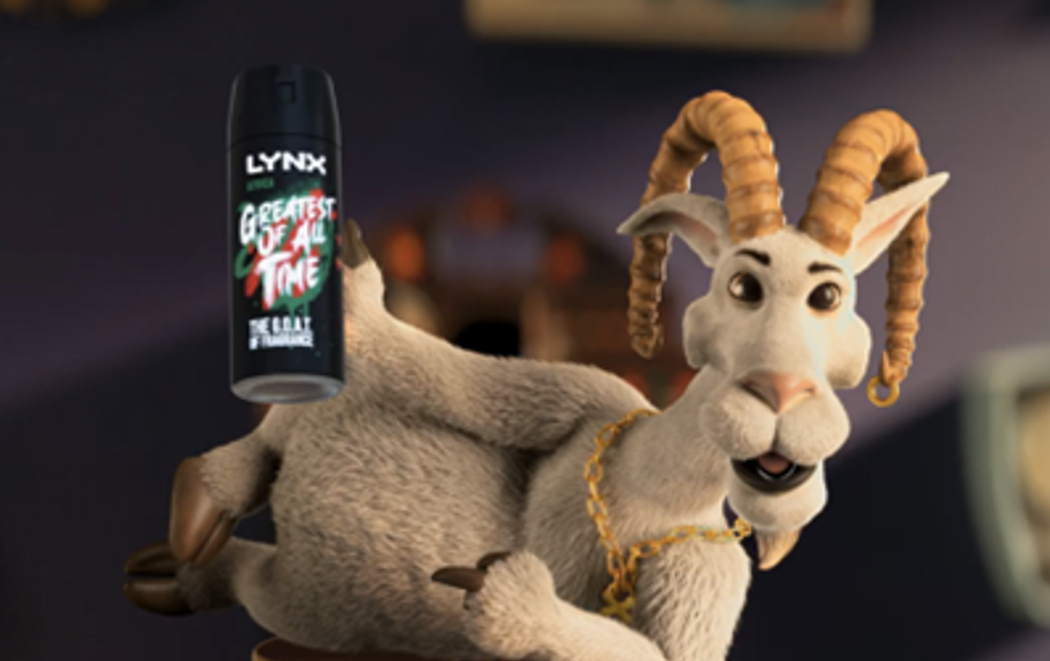


Lynx
Background
Lynx was on a mission to win over a new generation of men and ensure its iconic Africa fragrance remains relevant and appealing. The campaign's central message was Lynx Africa declaring itself 'The GOAT’ (the greatest of all time).
Plan
The campaign ran across key titles for the young male demographic including Mission: Impossible - Dead Reckoning Part One, Oppenheimer and Indiana Jones and the Dial of Destiny.
Results
Over half of those exposed in cinema agreed it had left them with a ‘better impression’ of Lynx, +13% uplift vs. control.
Cinemagoers who had seen the ad were +11% more likely to agree Lynx ‘is known for having the best fragrances’ and +14% more likely to recommend the brand.
Source: DCM / Lynx Conducted by; Differentology, June 2023.
Notes:
Source: DCM / Lynx Conducted by; Differentology, June 2023
Results base: 16-34s. Uplifts are test (exposed to ad in cinema) vs control (not exposed to ad in cinema)

Slide 2
Lynx
The Greatest Of All Time
Media agency | Target | Buying route | Copy length
Mindshare | 16-34s | 16-34 Men AGP + Film Packs | 30”
Background
Lynx was on a mission to win over a new generation of men and ensure its iconic Africa fragrance remains relevant and appealing. The campaign's central message was Lynx Africa declaring itself 'The GOAT' aka ‘the greatest of all time’, and the ad itself took a playful and literal approach to claiming its GOAT status, with an animated goat taking centre stage.
Plan
Lynx knew cinema delivered strongly for its core younger adult audience and would offer both high attention to the ad and premium associations too - ideal for the launch of the GOAT creative.
The campaign ran across key titles for young male demographic including Mission: Impossible - Dead Reckoning Part One, Oppenheimer and Indiana Jones and the Dial of Destiny. Cinema ran as part of a wider campaign that included TV, BVOD, Social, Online and Outdoor.
Results
Launching with cinema as part of the AV mix worked very effectively for Lynx across key campaign KPIs.
Improved impressions
Over half of those exposed in cinema agreed it had left them with a ‘better impression’ of Lynx (+13% uplift vs. control) and they were 10% more likely to agree ‘Lynx is a brand for someone like me’.
Campaign comprehension and recommendation
Cinemagoers who had seen the ad were +11% more likely to agree Lynx ‘is known for having the best fragrances’ and +14% more likely to recommend the brand.
Source: DCM / Lynx Conducted by; Differentology, June 2023.
Notes:
Source: DCM / Lynx Conducted by; Differentology, June 2023
Results base: 16-34s. Uplifts are test (exposed to ad in cinema) vs control (not exposed to ad in cinema)

