Slide 1
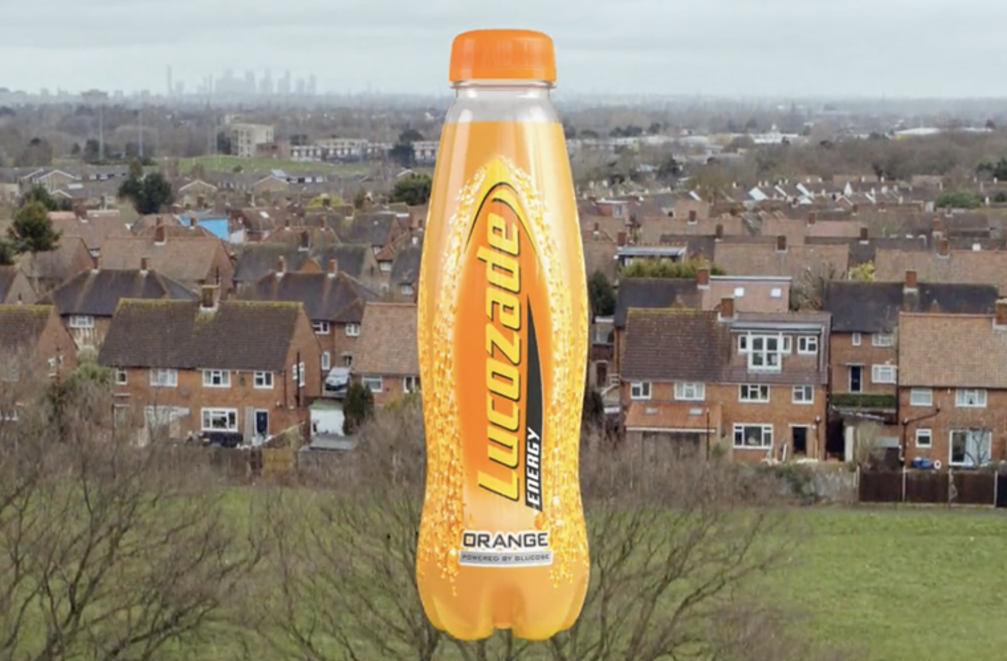
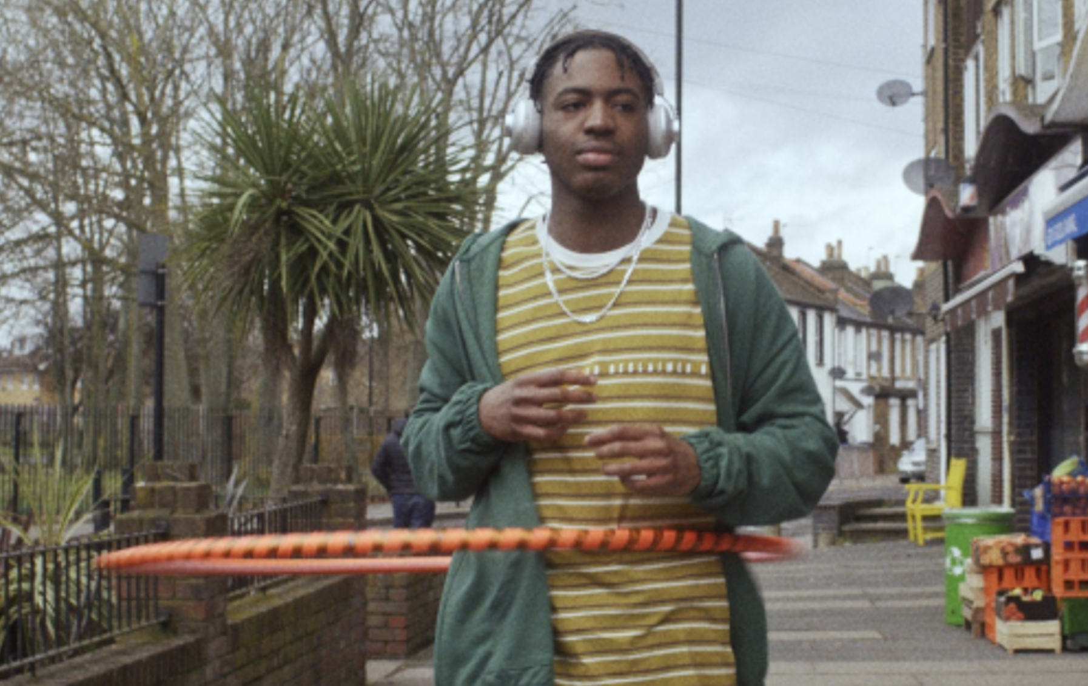

Lucozade
Background
Lucozade wanted to test out the impact of including cinema in its AV mix. Knowing it could help the brand increase reach, particularly amongst younger audiences, Lucozade wanted to see what the high attention environment could deliver in terms of cut through and brand impact.
Plan
As the campaign was predominantly looking to reach a broad adult audience the HFSS AGP was the best option for maximising reach, which gave this campaign access to titles including The Batman & Uncharted.
Results
Uplifts for key brand perceptions; ‘helps me perform at my best’ (+31%) and ‘is a fun brand’ (+30%) amongst those exposed via cinema.
Significant uplift in those claiming to be ‘extremely likely’ (+38%) to consider the brand vs. control group.
Source: DCM / Lucozade. Conducted by; Differentology, April 2022.
Notes:
Source: DCM / Lucozade. Conducted by; Differentology, April 2022.
Results base: All adults 15+. Uplifts are test (exposed to ad in cinema) vs control (not exposed to ad in cinema)

Slide 2
Lucozade
Media agency | Target | Buying route | Copy length
EssenceMediacom | Adults | HFSS AGP | 30”
It’s on
Background
In 2022, Lucozade wanted to test out the impact of including cinema in its AV mix. Knowing it could help the brand increase reach, particularly amongst younger, affluent audiences, Lucozade wanted to see what the high attention environment could deliver in terms of cut through and brand impact.
Plan
As the campaign was predominantly looking to reach a broad adult audience the HFSS AGP was the best option for maximising reach, which gave this campaign access to titles including the batman & uncharted.
Cinema was included on the plan alongside TV & BVOD with all channels running the same 30” creative to drive reach.
Results
Exposure to the Lucozade ad on the big screen helped to improve perceptions of the brand and resultingly increase consideration.
Improve impressions
Uplifts for key brand perceptions; ‘helps me perform at my best’ (+31%) and ‘is a fun brand’ (+30%) amongst those exposed via cinema.
Drive consideration
Significant uplift in those claiming to be ‘extremely likely’ (+38%) to consider the brand vs. control group.
Lasting impact
Those exposed in cinema were +37% more likely to be able to recall the advertisement.
Source: DCM / Lucozade. Conducted by; Differentology, April 2022.
Notes:
Source: DCM / Lucozade. Conducted by; Differentology, April 2022.
Results base: All adults 15+. Uplifts are test (exposed to ad in cinema) vs control (not exposed to ad in cinema)

