Slide 1
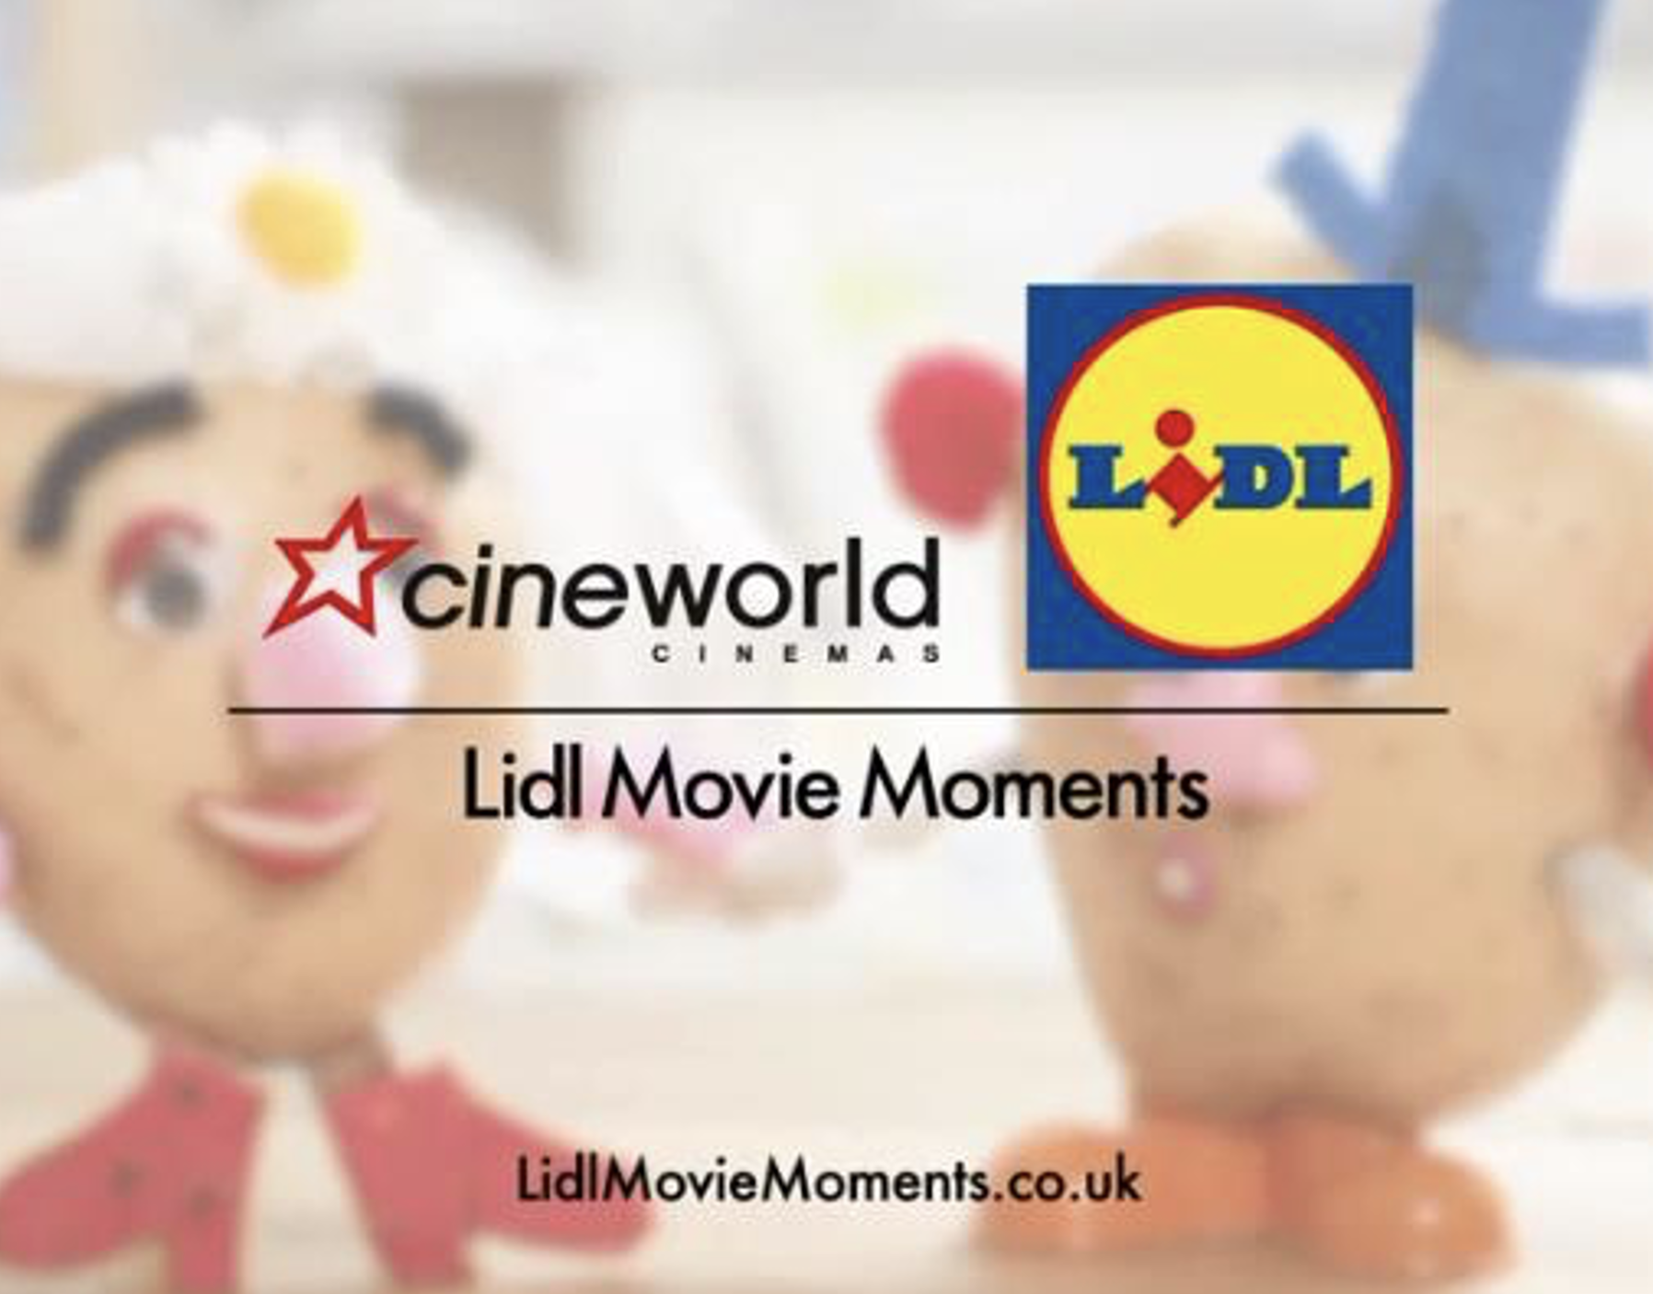
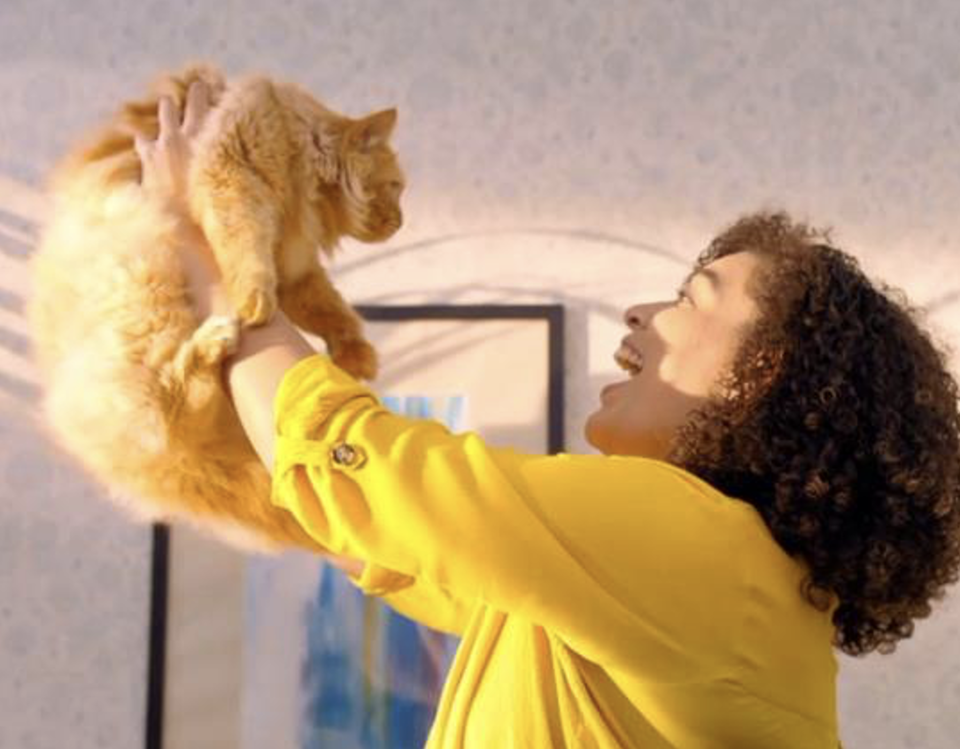

Lidl
DCM Awards Winner
Grand Prix
Background
With previous success using cinema, Lidl had two primary aims with this campaign - increase penetration amongst young families and increase the percentage of Lidl customers spending over £40.
Plan
DCM Studios proposed partnering with Cineworld, across five highly-anticipated family films: Mary Poppins Returns, Dumbo, Toy Story 4, The Lion King and Frozen II. Bespoke ‘Lidl Movie Moments’ idents were created to run after the hero ad in the reel and there was a competition announced where Lidl customers could win Cineworld tickets by spending >£40.
Results
The competition to win Cineworld family tickets received over 11,000 entries – 5x more than the campaign target.
Customers spending >£40 rose by 2.6% which exceeding initial campaign target of 1%.
Notes:
No source on previous presentation

Slide 2
Lidl
DCM Awards Winner
Grand Prix
Media agency | Target | Buying route | Copy length
Starcom | Families | Film Packs + Family AGP | 30-60”
‘Lidl Movie Moments’
Background
Lidl has historically used cinema to good effect by promoting specific product ranges and seasonal activity – proving how it can help drive both short-term ROI for the business as well as longer-term brand awareness. Lidl had two primary aims for this campaign - increase penetration amongst young families and increase the percentage of Lidl customers spending over £40.
Plan
DCM proposed partnering with Cineworld, which has the most cinemas in proximity to Lidl stores, across five highly-anticipated family films – Mary Poppins Returns, Dumbo, Toy Story 4, The Lion King and Frozen II. With an aim to drive action and short-term sales, the partnership with Cineworld incentivised Lidl customers to increase their basket size. Those who spend over £40 in-store were able to upload a photo of their receipt to enter a competition to win Cineworld tickets for the whole family.
Lidl, in partnership with DCM Studios, created bespoke ‘Lidl Movie Moment’ idents that would run after Lidl’s brand ad to further drive engagement with the brand and the online competition.
Results
The ‘Movie Moments’ partnership helped Lidl engage young families and drive action leading to increased commercial success.
Encouraging competition participation
The competition to win Cineworld family tickets received over 11,000 entries – 5x more than the campaign target.
Higher customer value
Customers spending >£40 rose by 2.6% which exceeded the initial campaign target of 1%.
Notes:
No source on previous presentation

