Slide 1
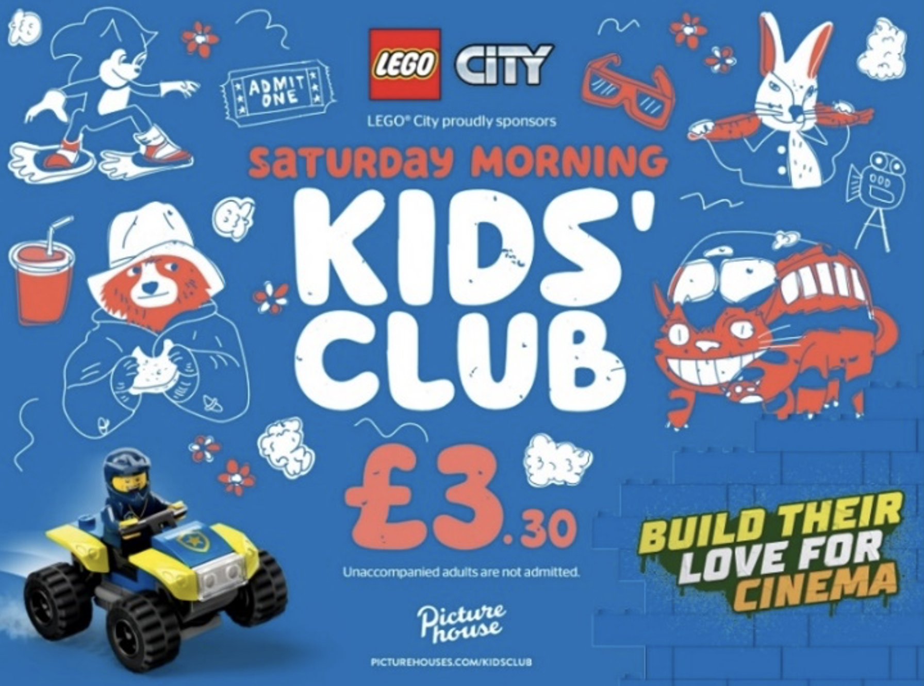
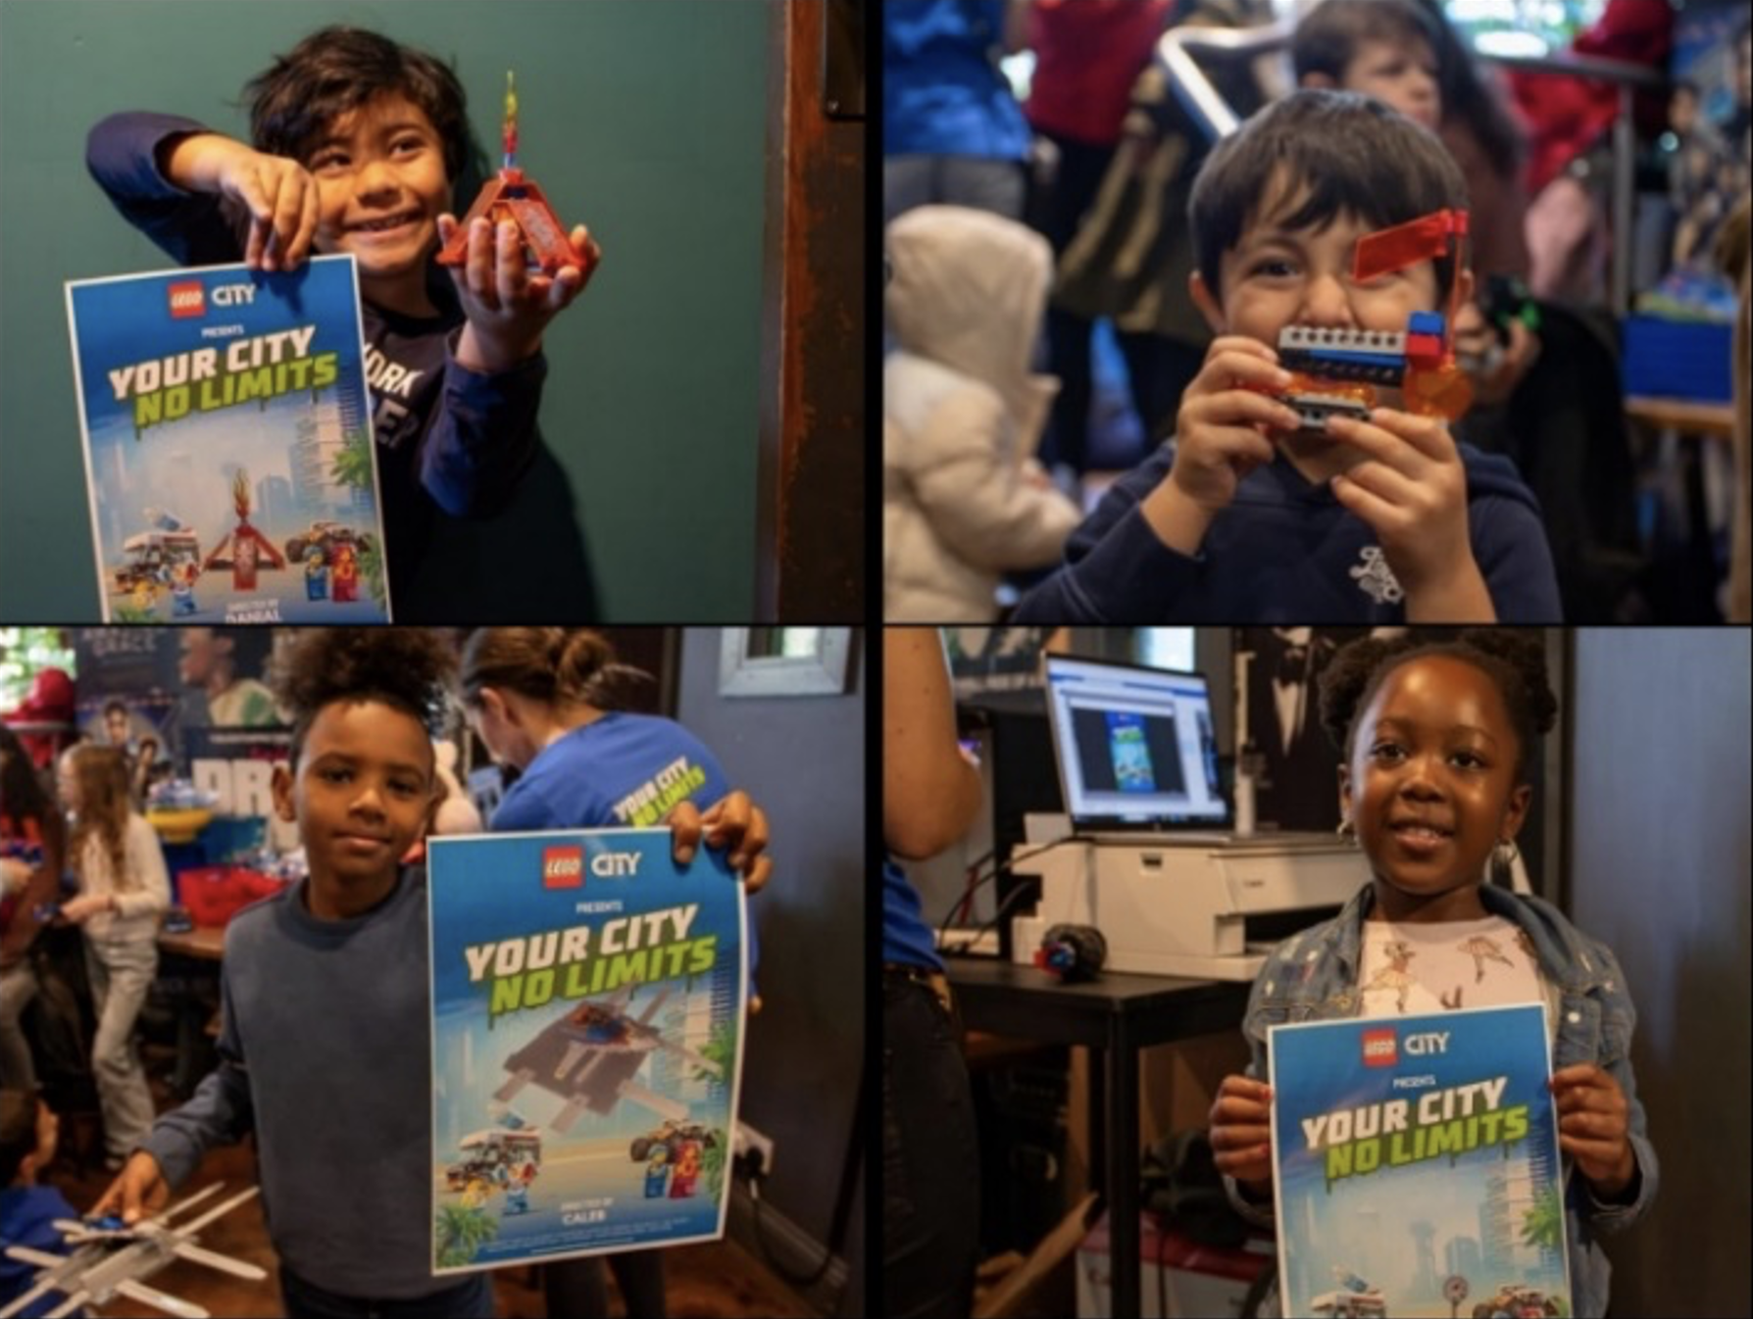

LEGO
DCM Awards Winner:
Best Use of Cinema (Small)
Background
LEGO’s challenge was that interest among young boys had begun to drop, and sales were slowing so the brand needed to re-establish stronger loyalty.
Idea
LEGO partnered with Picturehouse running 30” ad in family titles and 10” Saturday Kids' Club idents. At nine cinemas, LEGO City activations allowed kids to play LEGO for free before the screenings & take samples home.
Results
Awareness exceeded expectations growing +6% YOY to 70%
Product share among boys aged 3-5 grew by +18%, surpassing LEGO’s goal and showcasing the effectiveness of the high impact and hands-on media strategy.
Notes:
No source on previous presentation

Slide 2
LEGO
DCM Awards Winner:
Best Use of Cinema (Small)
LEGO City & Picturehouse Kids’ Club Build Their Love For Cinema
Media agency | Target | Buying route | Copy length
Initiative | Boys 3-5 | Kids Club Partnership | 30”, 10”
Background
LEGO’s challenge was that interest among young boys had begun to drop, and sales were slowing so the brand needed to build awareness, re-establish engagement to ultimately deliver increased sales and stronger loyalty.
Idea
LEGO saw the opportunity that the ‘family cinema trip’ could offer – reaching parents and kids together and being able to harness the immersion of cinema to introduce them to a whole new world of play with LEGO City, coining the ‘"Build Their Love for Cinema” proposition.
Plan
Alongside the activation, LEGO ran a 30” ad in Picturehouse’s Family AGP, in addition to a bespoke 10” Kids Club ident that drove awareness of the partnership. LEGO also had a huge presence across the Picturehouse website boosting awareness of the partnership and local activations. LEGO also ran 8 monthly competitions giving fans the chance to win LEGO City bundles, to further drive product desirability and trial among families.
Results
The "Build Their Love for Cinema" campaign revitalised LEGO City, driving brand love and engagement among kids and their parents.
Awareness
Increased +6% YOY to almost 70%, exceeding expectations.
Increased product share
The active consumer share among boys aged 3-5 grew by +18%, surpassing LEGO’s goal and showcasing the effectiveness of the high impact and hands-on media strategy.
Notes:
No source on previous presentation

