Slide 1
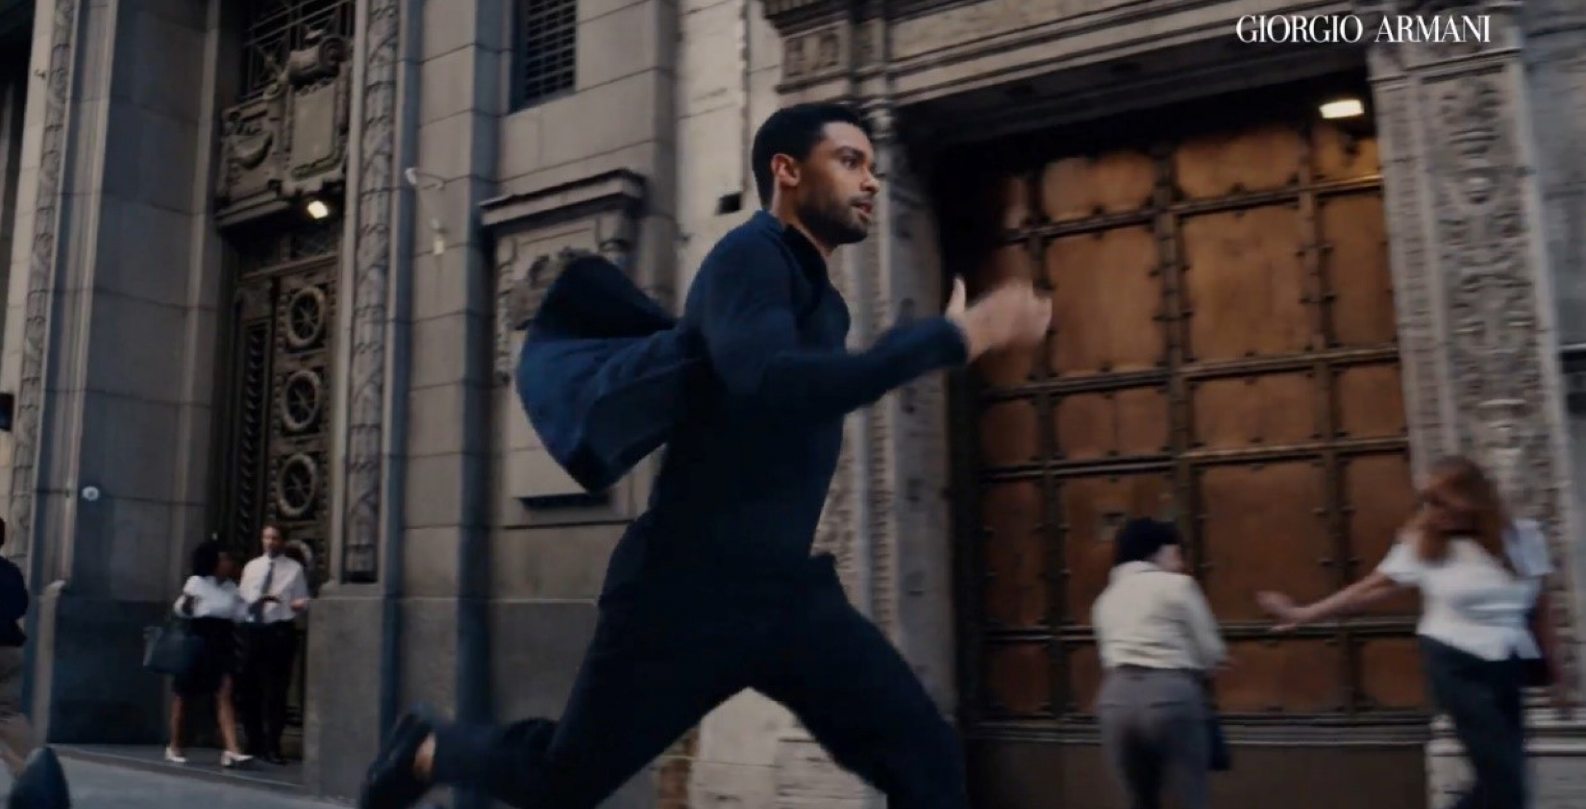
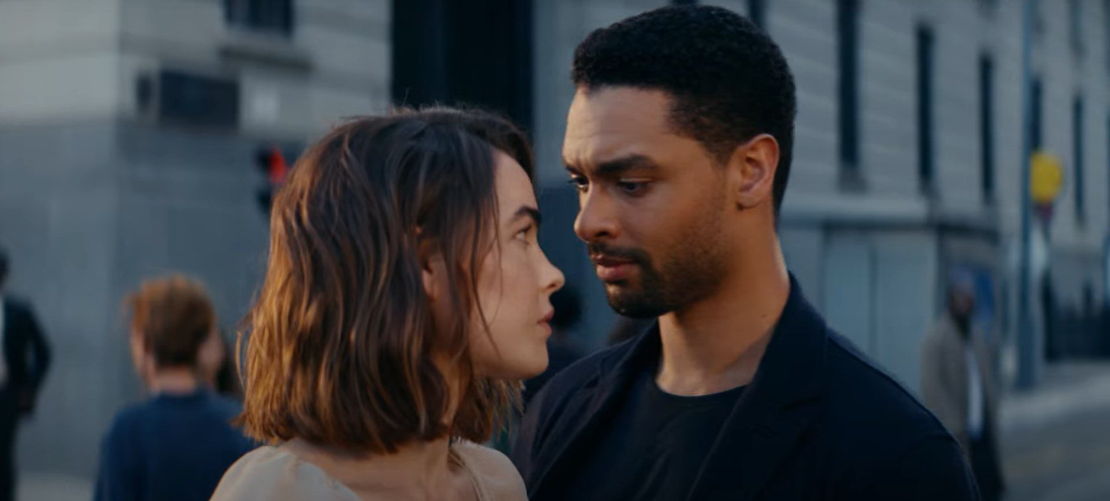

L’Oréal
Background
L'Oréal wanted to reach those who were in the market for a male fragrance, whether for themselves or as a gift. The Armani Code campaign was specifically looking to cut through, excite and engage potential customers.
Plan
L’Oréal ran the ad in the Bronze Spot for Amsterdam and Silver Spot for The Banshees of Inisherin prioritising alignment with premium content that would reach a primarily male audience.
Results
Awareness of the Armani Code fragrance was up +9% vs. control.
Exposure in cinema delivered significant uplifts across key perceptions such as ‘is a fragrance I would wear every day’ (+39%) and ‘is a fragrance I would gift to someone’ (+29%).
Source: DCM / L’Oreal Armani Code. Conducted by; Differentology, October 2022.
Notes:
Source: DCM / L’Oreal Armani Code. Conducted by; Differentology, October 2022.
Results base: All Adults. Uplifts are test (exposed to ad in cinema) vs control (not exposed to ad in cinema)

Slide 2
L’Oréal
Media agency | Target | Buying route | Copy length
EssenceMediacom | Adult men/ female gifters | Bronze and silver spots | 60”
Armani Code
Background
Ahead of the its key festive purchasing season, L'Oréal wanted to reach those who were in the market for a male fragrance, whether for themselves or as a gift. The Armani Code campaign was looking to cut through, excite, and engage existing and potential new customers.
The new brand asset starring Regé-Jean Page ran in cinema as part of a wider AV campaign that included TV, BVOD, Social and Online. Cinema was included on the plan as L'Oréal knew that cinema could deliver a young, affluent-skewing audience in a highly receptive environment where more attention is paid vs. other AV formats.
Plan
Aligning with premium content was key and the Armani Code ad ran across the DCM estate running in the Bronze and Silver Spots of titles that would efficiently deliver against the primary male audience including Amsterdam and The Banshees of Inisherin.
Results
Cinema worked effectively as part of the AV mix driving significant uplifts.
Successful cut-through
Awareness of the Armani Code fragrance was up +9% vs. those not exposed in cinema.
Increased consideration
‘Extremely likely’ to consider Armani Code saw a +38% uplift amongst exposed respondents.
Improving brand perceptions
Exposure in cinema delivered significant uplifts across key perceptions such as ‘is a fragrance I would wear every day’ (+39%) and ‘is a fragrance I would gift to someone’ (+29%).
Source: DCM / L’Oreal Armani Code. Conducted by; Differentology, October 2022.
Notes:
Source: DCM / L’Oreal Armani Code. Conducted by; Differentology, October 2022.
Results base: All Adults. Uplifts are test (exposed to ad in cinema) vs control (not exposed to ad in cinema)

