Slide 1
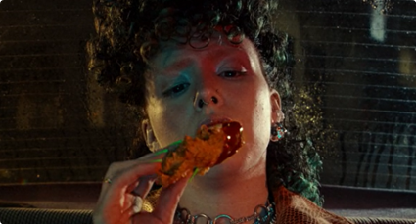


KFC
Background
Whilst KFC is an already established brand, this campaign aimed to drive further brand awareness in addition to boosting consideration of purchasing KFC products.
Plan
KFC bought into an HFSS AGP in addition to several film packs across the summer months giving them access to films such as Mission Impossible Dead Reckoning, Asteroid City, and Oppenheimer.
Results
+60% uplift for those exposed via cinema having a ‘better impression’ of KFC
+159% uplift in ‘extremely likely’ to consider KFC for young adults exposed via cinema.
Source: DCM / KFC. Conducted by; Differentology, June 2023
Results base: All Ads. Uplifts are test (exposed to ad in cinema) vs control (not exposed to ad in cinema)

Slide 2
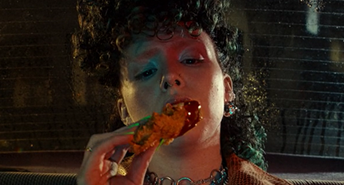
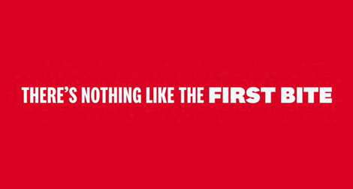

KFC
Media Agency | Target | Buying Route | Copy length
Mindshare | 16-34s | HFSS AGP + Film Packs | 30”
It’s Finger Lickin’ Good
Background
KFC wanted to stand out in the industry against competitors as the number one place to get great tasting chicken and ultimately drive consideration and purchase.
To achieve this, KFC knew cinema would be key for showcasing the new 30” creative in a premium visual environment to drive quality and taste credentials with an engaged young audience.
Plan
KFC bought into an HFSS AGP in addition to several film packs from running from June – September 2023, giving them access to films such as Strays, Mission Impossible Dead Reckoning Part One, The Flash, Asteroid City, Oppenheimer and Indiana Jones and the Dial of Destiny.
Results
Cinema delivered significant uplifts across KFC’s core metrics:
Recall
64% recalled seeing the campaign previously, surpassing benchmarks.
Driving Consideration
+159% uplift in ‘extremely likely’ to consider KFC for young adults exposed via cinema.
Improve Impressions
Uplift for those exposed via cinema for having a ‘improved impressions’ of KFC (+60%) and 11% higher agreement that ‘KFC has the best chicken’.
Source: DCM / KFC. Conducted by; Differentology, June 2023
Results base: All Ads. Uplifts are test (exposed to ad in cinema) vs control (not exposed to ad in cinema)

