Slide 1
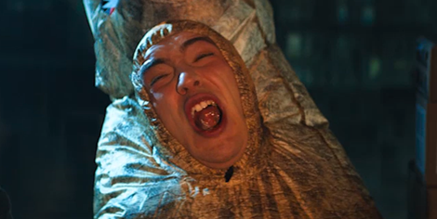
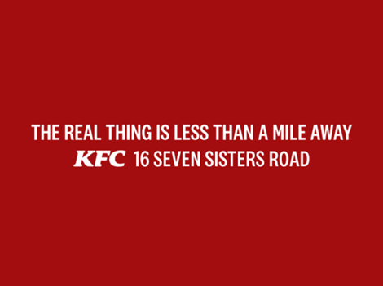

KFC
Background
KFC had launched a new 60” TV ad which was centred on the brand’s many ‘copy-cats’ across the UK. KFC wanted to see what could be done to further engage the target audience in a distinctive way that would drive perceptions of quality and drive consideration.
Plan
DCM Studios developed a series of contextualised bespoke copy (with end frames) that ran alongside the most highly anticipated blockbusters to bring this national campaign to life in the cinema environment and add a touch of local relevance.
Results
Uplifts across perceptions that KFC is a ‘modern’ (+42%) and ‘trustworthy’ (+32%) brand, vs. the control sample.
Consideration of KFC increased +15% amongst those exposed to the ad in cinema.
Source: DCM/Differentology research
Base: 800 ABC1 adults aged 25+ who own a TV

Slide 2
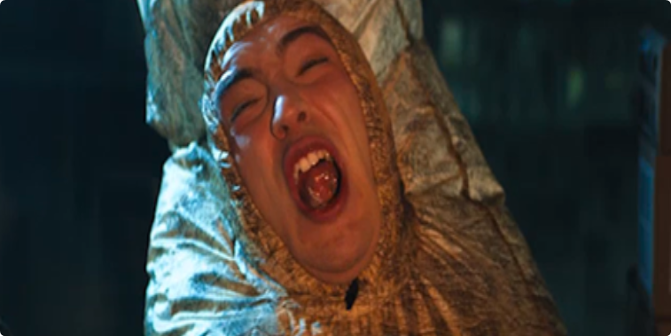
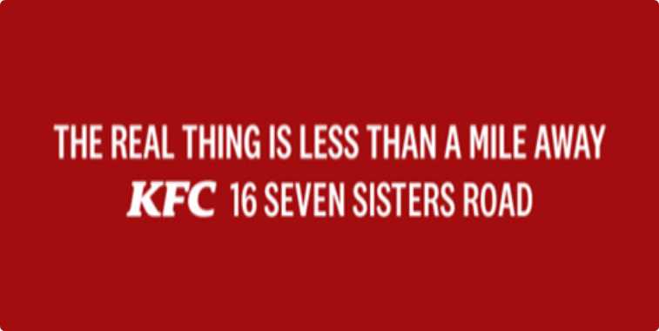

KFC
Media Agency | Target | Buying Route | Copy length
Publicis | 18-44s | Gold & Silver Spots | 40”
Imitators
Background
KFC had launched a new 60” TV ad which was centred on the brand’s many ‘copy-cats’ across the UK. Beyond just using the existing impactful creative, the brand wanted to see what could be done to further engage the target audience in a distinctive way that would help further drive perceptions of quality and drive consideration.
Idea
DCM Studios identified an opportunity for KFC to develop a campaign that contextualized itself to upcoming major releases and help drive customers into restaurants by using DCM’s end-frame technology.
Plan
The content series ran alongside the most highly anticipated films launching in 2019, including Godzilla: King Of The Monsters, Spiderman Far From Home, Once Upon a Time in Hollywood, Joker and Last Christmas. The ad mimicked the look and feel of the upcoming feature, before revealing that it was a tongue-in-cheek imitation, with the core message that the original is always better. Cinemapper, DCM’s cinema proximity & end-frame planning tool to help bring a localised message to this national campaign.
Results
This innovative extension of existing copy worked incredibly well in cinema, landing the key messages and driving key campaign metrics.
Cut Through
Ad awareness increased for those exposed in cinema by 62% vs. control.
Boosting Consideration
Consideration of KFC increased +15% amongst those exposed to the ad in cinema.
Driving positive brand perceptions
Uplifts across perceptions that KFC is a ‘modern’ (+42%) and ‘trustworthy’ (+32%) brand, vs. the control sample.
Source: DCM/Differentology research
Base: 800 ABC1 adults aged 25+ who own a TV

