Slide 1
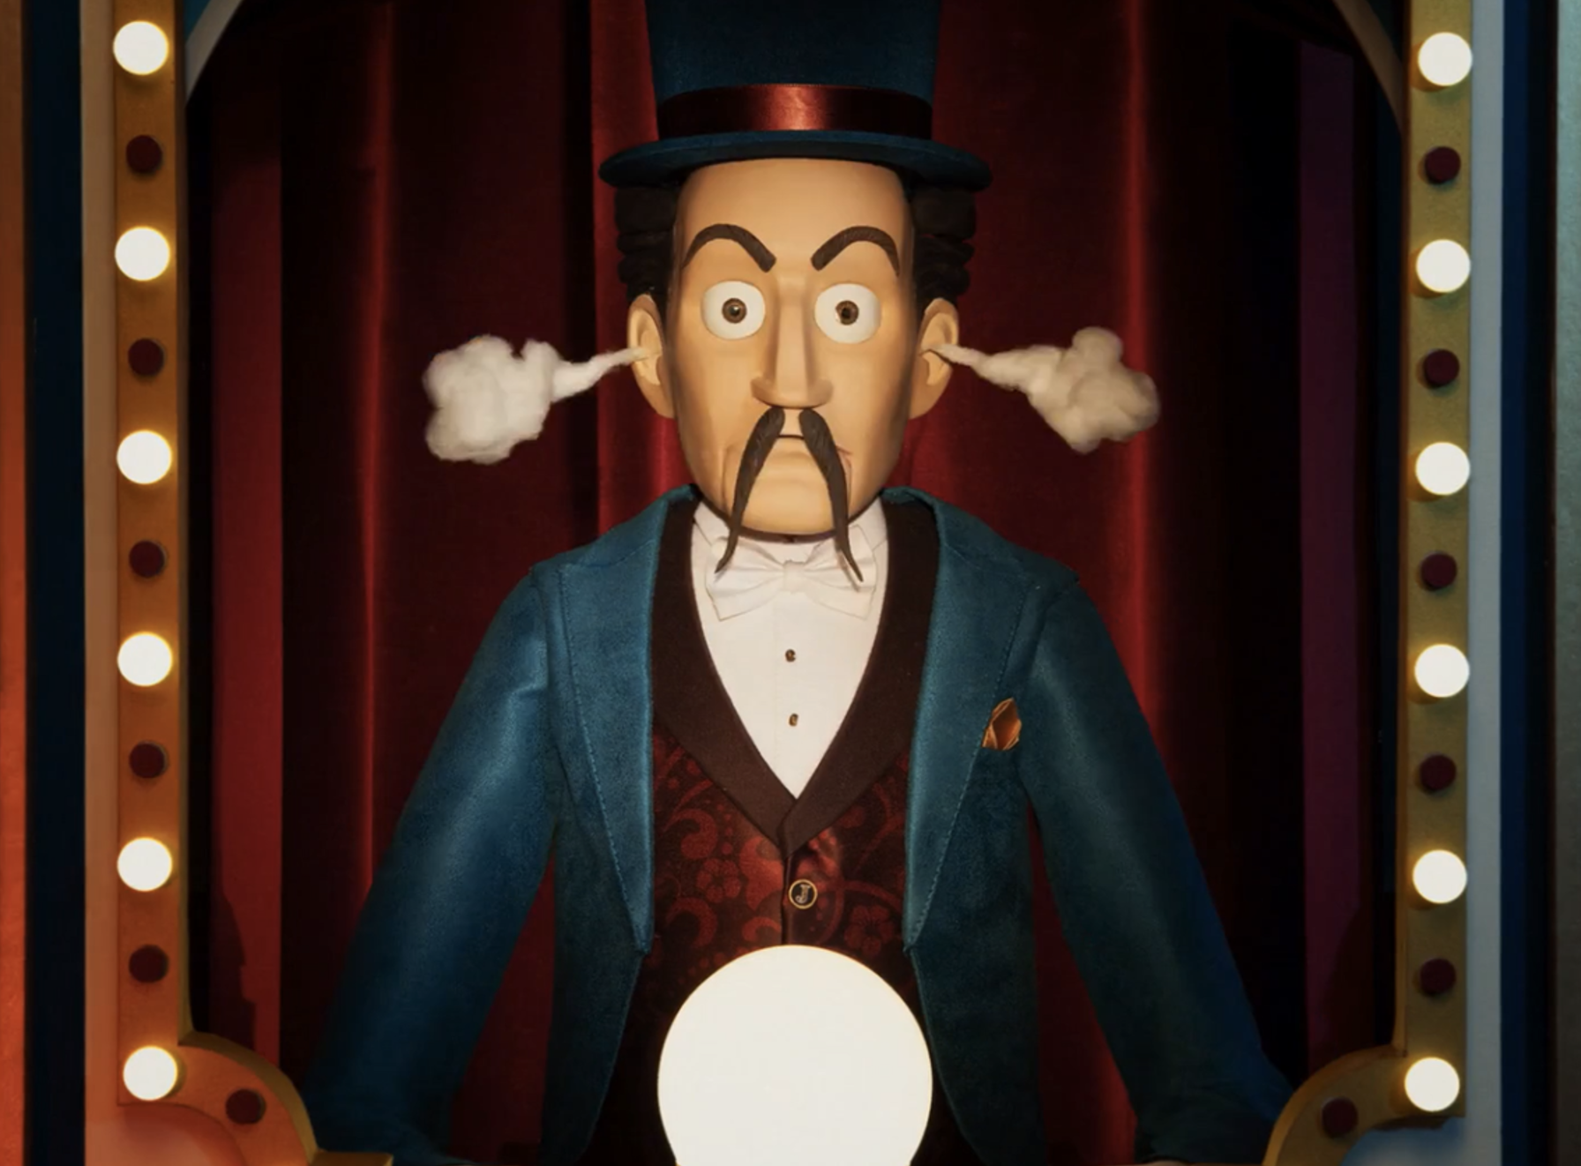
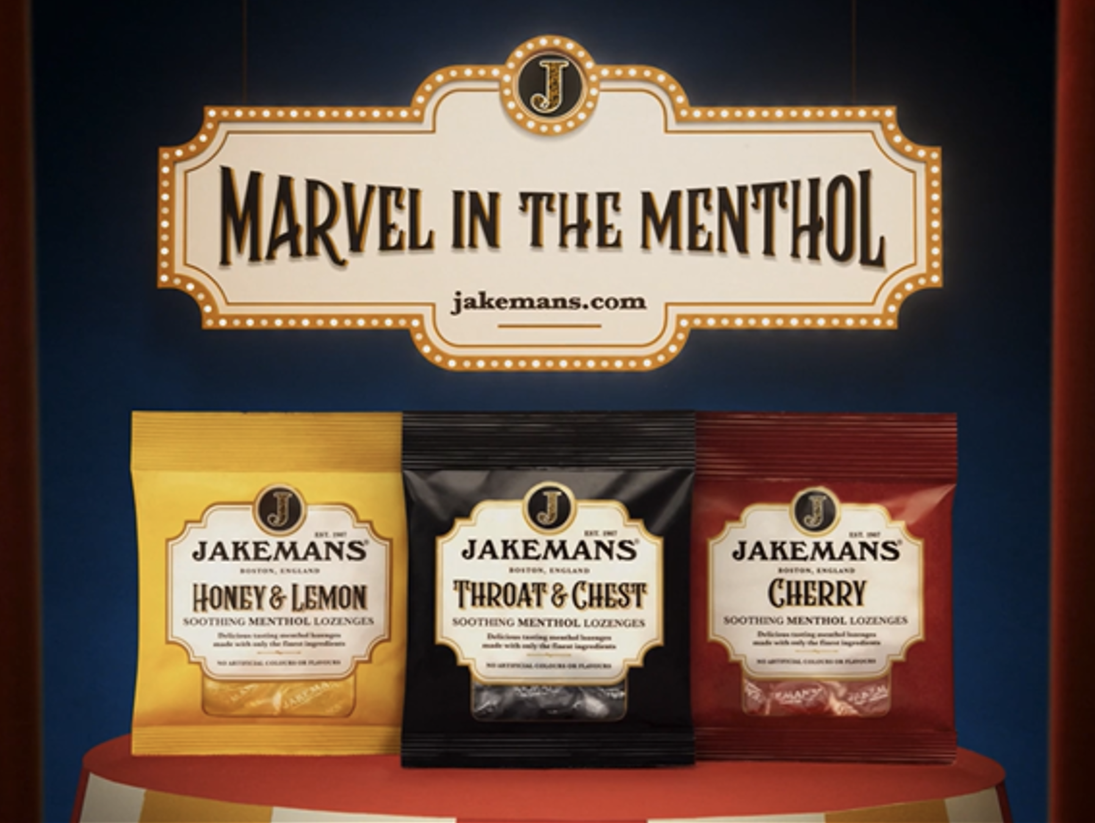

Jakemans
Background
This campaign was the brand’s first-time including cinema in the AV mix, with Jakemans wanting to drive impact amongst film loving consumers with their ‘Marvel in the Menthol’ creative.
Plan
Jakemans bought a film pack in Downtown Abbey: The Grand Finale, which was identified as a good fit, significantly over-indexing for their key target audience of 45+ adults.
Results
Recall of the Jakemans creative in cinema was 72%, significantly higher than the DCM benchmarks.
Significant uplift in those saying they would consider (T2B) Jakemans Throat Lozenges, (+71%) amongst cinemagoers who saw the ad.
Source: DCM / Jakemans. Conducted by; eWorks Sep 2025.
Notes:
Source: DCM / Jakemans. Conducted by; eWorks Sep 2025.
Base: 18+. Uplifts are test (exposed to ad) vs control (unexposed to ad)

Slide 2
Jakemans
Media agency | Target | Buying route | Copy length
Bray Leino | 45+ | Film Pack | 30”
Marvel in the Menthol
Background
Jakemans looked to include cinema on the AV mix for the first time, running its Marvel in the Menthol 30” TV copy on the big screen to see the impact cinema’s unique environment could deliver for their target demographic of 45+ adults.
Plan
Jakemans wanted to access a title that would help them reach a high proportion of their 45+ target audience demographic. Downtown Abbey: The Grand Finale, the highly anticipated final instalment in the much beloved franchise, significantly over-indexed against the key audience and so was the perfect choice for Jakemans.
Results
The big screen was a huge success for Jakemans, with cinema’s attentive environment the ideal location for the unique creative and drive uplifts on KPIs.
Impressive recall
Recall of the Jakemans creative in cinema was 72%, significantly higher than the DCM benchmarks.
Boosting consideration
Significant uplift in those saying they would consider (T2B) Jakemans Throat Lozenges, (+71%) amongst those who were exposed to the ad in cinema.
Source: DCM / Jakemans. Conducted by; eWorks Sep 2025.
Notes:
Source: DCM / Jakemans. Conducted by; eWorks Sep 2025.
Base: 18+. Uplifts are test (exposed to ad) vs control (unexposed to ad)

