Slide 1
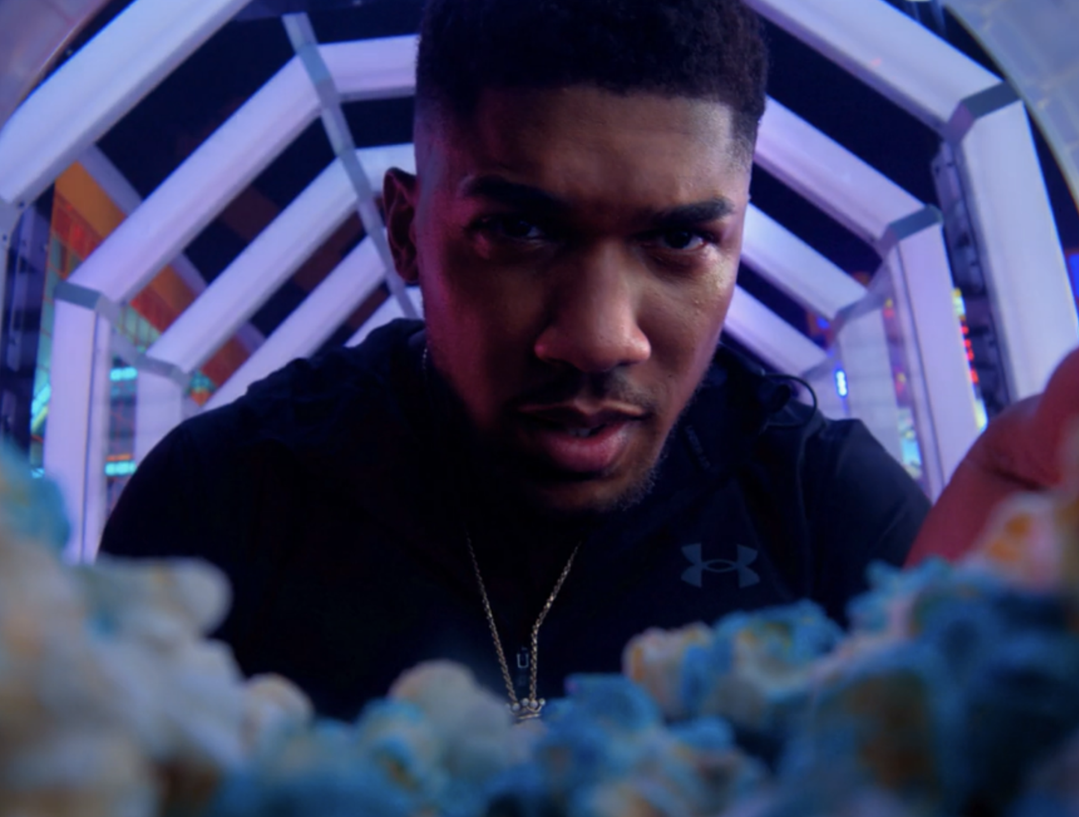
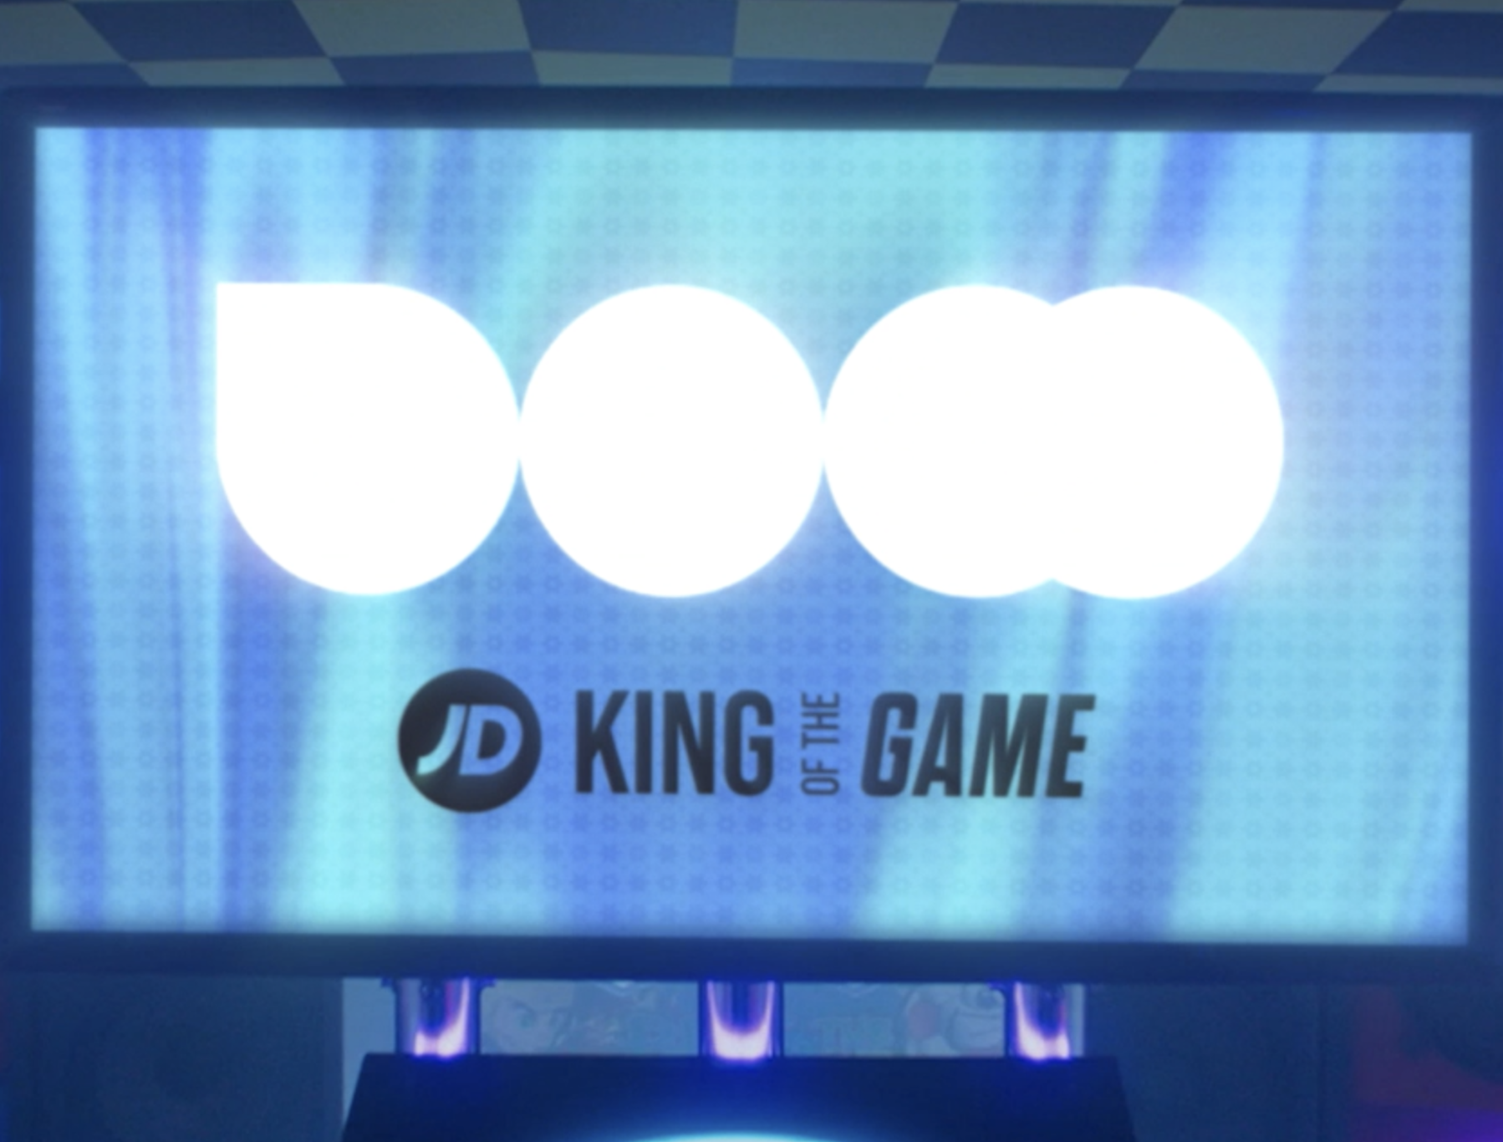

JD Sports
Background
JD Sports wanted to cut through with its young and diverse audience and reach them away from the clutter and distraction of online/social media environments.
Plan
Collaborating with DCM Studios, two branded idents were created using footage from the original brand ad. 30” copy was used throughout the campaign, but JD Sports also used DCM’s proximity planning tool Cinemapper tool, to run 120” copy in cinemas closest to JD Sport’s top-performing stores.
Results
Recall of the ‘King of Games’ ad peaked at 70% for cinemagoers, an uplift of +17% vs. control and well ahead of DCM benchmarks (48%).
Intent to act having been exposed to the ad in cinema was above 80% across all creative routes.
Source: DCM / JD Sports. Conducted by; Differentology, November 2022.
Notes:
Source: DCM / JD Sports. Conducted by; Differentology, November 2022.
Results base: 16-24s. Uplifts are test (exposed to ad in cinema) vs control (not exposed to ad in cinema)

Slide 2
JD Sports
Media agency | Target | Buying route | Copy length
Smart Media | 16-24 | Film Pack | 120”, 30”, Opening & ,Closing Bespoke Idents
King of the Game
Background
JD sports wanted to really cut through with its young and diverse audience and make an impact at Christmas, a key time of year for the business whilst aiming to reach the audience away from the clutter and distraction of online/social media environments.
Plan
JD sports bought into Black Panther: Wakanda Forever, feeling it
was the perfect launch moment for the Christmas campaign with cinema allowing the brand to showcase the ad in the highest quality environment. Collaborating with smart media and the DCM studios team, two branded idents were created to run alongside the main brand ad. The bespoke idents used footage from the original ad starring Antony Joshua, with the aim of ultimately boosting frequency of the JD sports brand and cut through within the reel.
JD sports also decided to run the full hero 120” ad in cinema during the opening week of the film and using DCM’s proximity planning tool Cinemapper tool ran this activity in cinemas closest to JD Sport’s top-performing stores. After the opening week, all cinemas would revert to showing the 30” ad to keep cover building in the run up to Christmas.
Results
The ‘King of the Game’ campaign delivered incredibly positive results for JD Sports within the target 16-24 audience in the run up to Christmas.
Successful cut-through & resonance
Recall of the ‘King of Games’ ad peaked at 70% for cinemagoers, an uplift of +17% vs. control
and well ahead of DCM benchmarks (48%). 75% of cinemagoers exposed to the ad agreed that JD Sports is ‘relevant to me and aligns with my interests in culture, music and sport’.
Driving positive action
Intent to act having been exposed to the ad in cinema was above 80% across all creative routes.
Source: DCM / JD Sports. Conducted by; Differentology, November 2022.
Notes:
Source: DCM / JD Sports. Conducted by; Differentology, November 2022.
Results base: 16-24s. Uplifts are test (exposed to ad in cinema) vs control (not exposed to ad in cinema)

