Slide 1
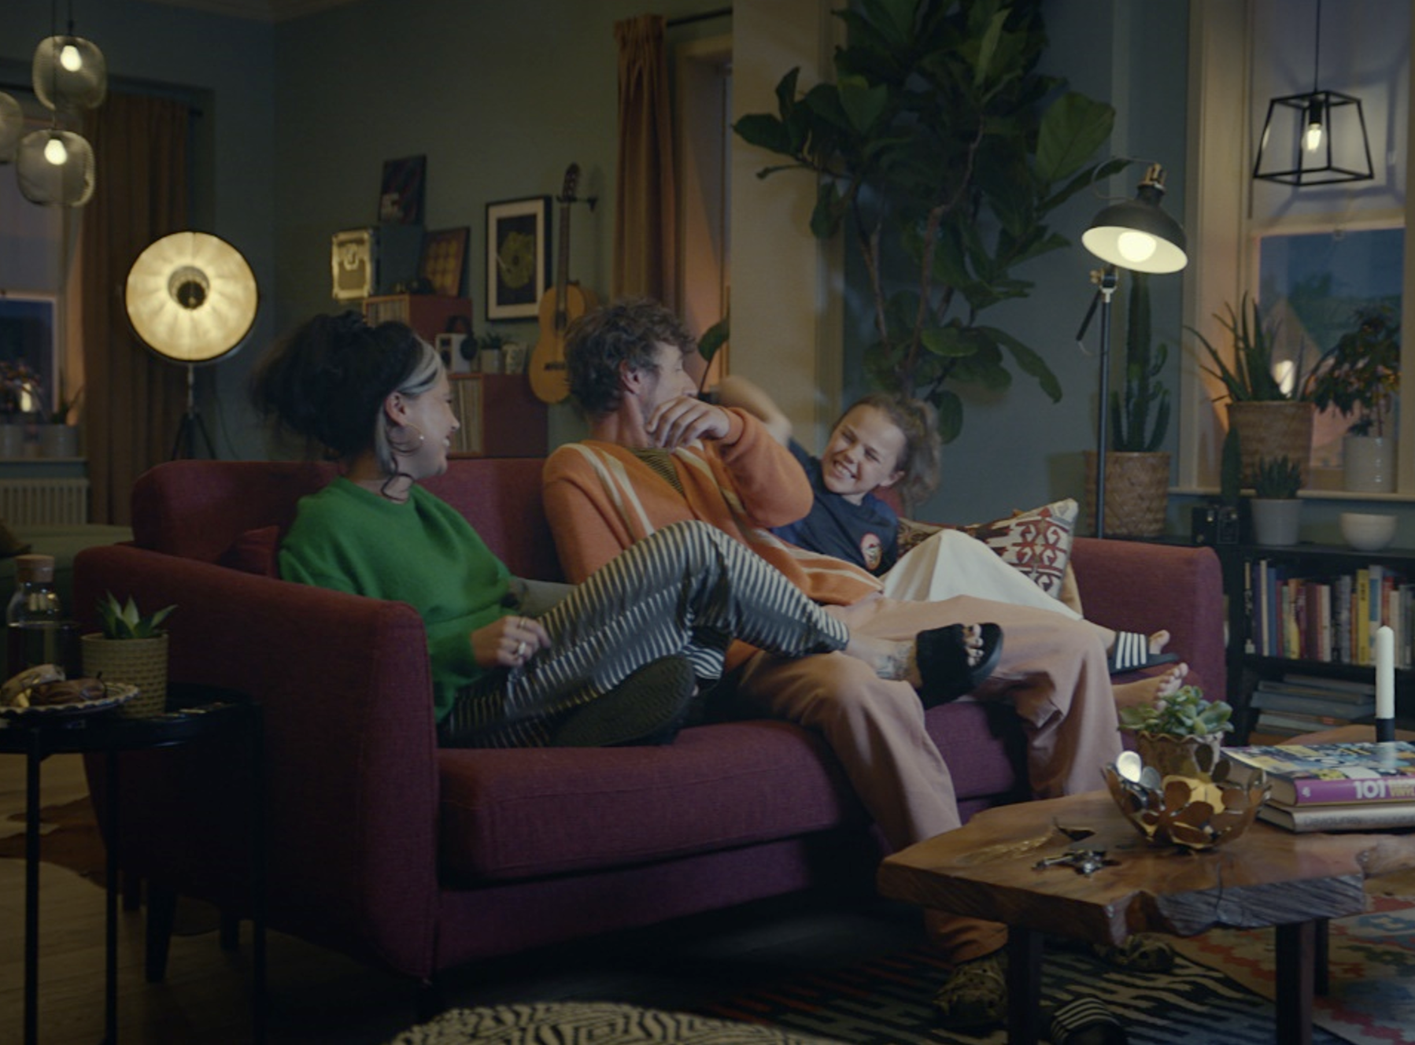
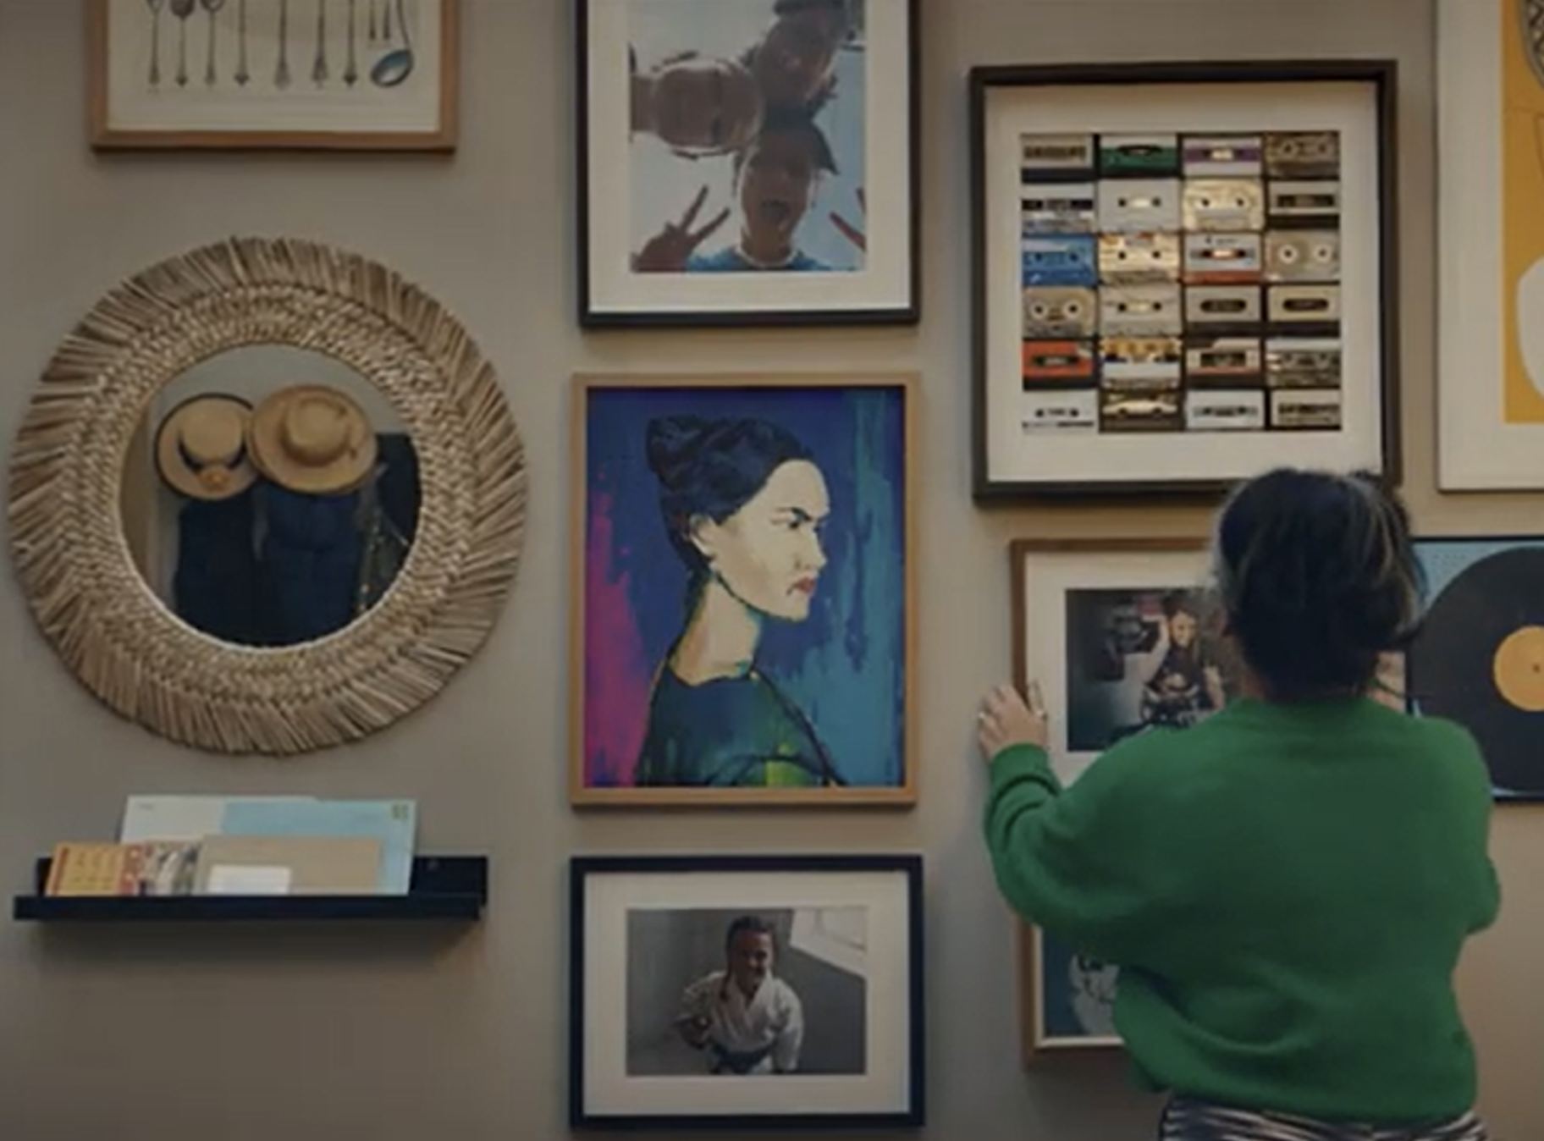

Ikea
DCM Awards Winner
Best Long-Term Use Of Cinema
Background
IKEA needed to bounce back post-Covid 19 and get people back to its stores once they reopened – and to do this successfully, IKEA needed to feel like part of the community.
Idea
A new media strategy was designed to bring IKEA ‘Closer to Home’ – mapping drive times around each store and prioritising ad spend in these regions.
Plan
IKEA bought an AGP running 60” copy across a range of blockbusters and major releases. Bespoke regional end frames were also used, which were adapted to each cinemas’ nearest IKEA store.
Results
The ‘Closer to Home’ strategy worked well for IKEA driving market share by +1.4pp YOY to its highest ever level.
Source: IKEA 2023 DCM Awards Entry
Notes:
Source: IKEA 2023 DCM Awards Entry

Slide 2
Ikea
DCM Awards Winner
Best Long-Term Use Of Cinema
Closer To Home
Media agency | Target | Buying route | Copy length
iProspect | Adults | AGP | 60”
Background
IKEA needed to bounce back post-Covid 19 and get people back to its stores once they reopened – and to do this successfully, IKEA needed to feel like part of the community.
Idea
A new media strategy was designed to bring IKEA ‘Closer to Home’ – mapping drive times around each store and prioritising ad spend in these regions, so the brand was reaching those who are most relevant and likely conversions.
Plan
IKEA bought an AGP running 60” copy across a range of titles in the key areas to maximise reach and emotional connection. To hit the object of increased footfall, bespoke regional end frames were also used, which were adapted to each cinemas’ nearest IKEA store – totalling 20 different executions across the UK.
Results
The ‘Closer to Home’ strategy worked very well for IKEA driving market share by +1.4pp YOY to its highest ever level.
Increased footfall
Footfall increased +31% YOY, with media driving an additional 2m visits and £45m in in-store revenue.
Improved media ROI
Despite fluctuating budgets, this strategy has also delivered IKEA more for less, with Media ROI improving 24% YOY across 2022.
Source: IKEA 2023 DCM Awards Entry
Notes:
Source: IKEA 2023 DCM Awards Entry

